Slide 1
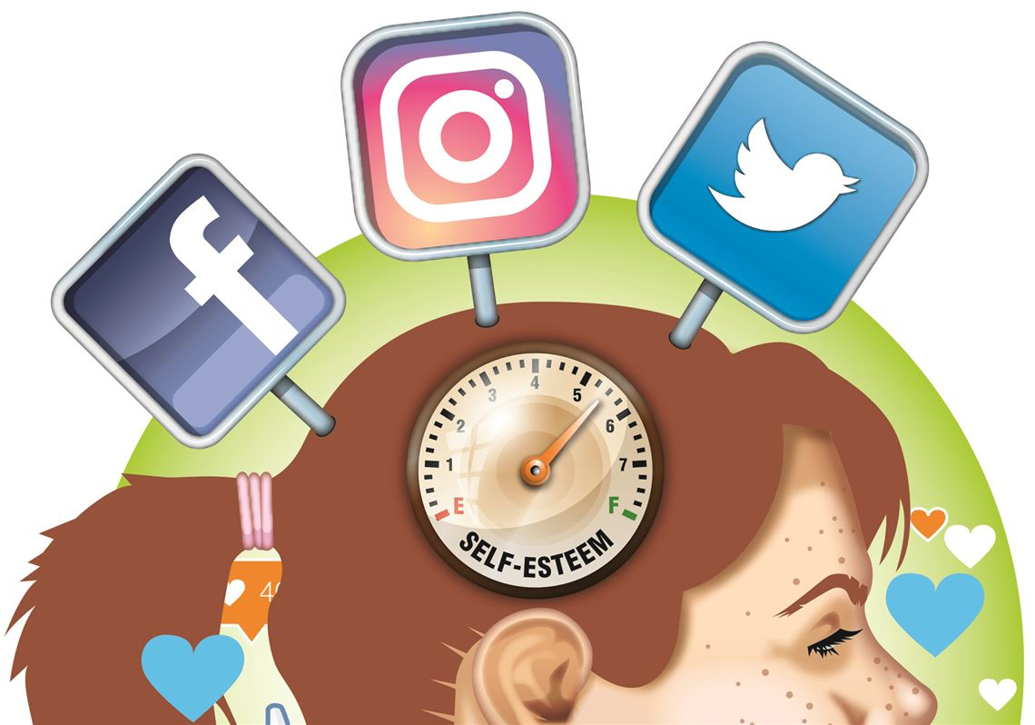
#mentalhealth #wellbeing #mentalhealth
Weekly Reflection
13th July 2020
Keeping Safe Online

Slide 2
Keeping Safe Online
How are you feeling this week?
What does keeping safe online mean to you?

Slide 3
Keeping Safe Online
There are lots of great reasons for using the internet but there are also lots of risks associated with internet use.
What does ‘Don’t talk to strangers’ mean?​
How might this ‘rule’ change, when we communicate with people online?​
What are the key messages from this One Direction Parody Online Safety Song?​

Slide 4
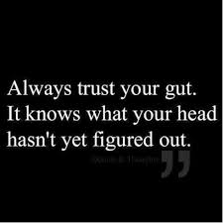
Keeping Safe Online
What is a gut feeling?​
Have you ever had this feeling?​
Your gut feeling could also be seen as your intuition about a situation. ​
It is the feeling you get about whether something is right or wrong and it may be warning you of risks or dangers about to happen.​

Slide 5
Keeping Safe Online
What online situations might you get a “gut feeling” that tells you that you may be at risk? ​
The Internet gives students a wide range of opportunities to connect with or learn from people who may not be in their circle of close friends —
whether ​through games, social network sites, blogs, instant messaging, forums, and so on. ​
While this can be great, connecting with people online occasionally can carry risks ​
What are the risks with connecting with others online?​
How can we reduce these risks?​

Slide 6
Keeping Safe Online
What can you do to keep safe online?
Don’t post any personal information online – like your address, email address or mobile number.
Think carefully before posting pictures or videos of yourself. Once you’ve put a picture of yourself online most people can see it and may be able to download it, it’s not just yours anymore.
Keep your privacy settings as high as possible
Never give out your passwords
Don’t befriend people you don’t know
Don’t meet up with people you’ve met online. Speak to your parent or carer about people suggesting you do
Remember that not everyone online is who they say they are
Think carefully about what you say before you post something online
Respect other people’s views, even if you don’t agree with someone else’s views doesn’t mean you need to be rude
If you see something online that makes you feel uncomfortable, unsafe or worried: leave the website, turn off your computer if you want to and tell a trusted adult immediately.

Slide 7
Further Information on this topic
SPECIFIC FURTHER INFORMATION ON THIS TOPIC CAN BE FOUND HERE:​
https://www.internetmatters.org ​
https://www.ceop.police.uk/safety-centre/ CEOP Report Website ​
https://www.saferinternet.org.uk/advice-centre/young-people/resources-11-19s​
Childline – 0800 1111 www.childline.org.uk - To find support and advice for young people about a range of issues​
Fearless (crime stoppers) – www.fearless.org For advice and a way to anonymously report crime​
https://www.thinkuknow.co.uk Think You ​
Know Internet Safety Website ​

Slide 8
Keeping Safe Online
Some of you may have heard of Sam Tyrer from Change Talks. He has visited us quite a few times and was in the middle of delivering some workshops to some of you.
He along with his colleague Dave have delivered some Mental Health Family Hour live webinar’s
Episode 10 – Your Mental Health Questions answered - https://www.youtube.com/watch?v=SjujcFx93Ok&feature=youtu.be
Episode 9 – Mindfulness and Visualisation techniques - https://www.youtube.com/watch?v=XWdWPNXiGXU
Episode 8 – Resilience, Peer-pressure and bullying - https://www.youtube.com/watch?v=k0Kt5A_xplU
Episode 7 – Beliefs, Self-esteem and confidence - https://www.youtube.com/watch?v=cR64okqz0xI
Episode 6 – Eating Disorders and Body Image - https://www.youtube.com/watch?v=EYFs_FkncqA
Episode 5 - Motivation, depression and suicide - https://youtu.be/em5qprEAYdw
Episode 4 – Stress and coping strategies - https://youtu.be/y9Z5tuqLE4Q
Episode 3 – Social Media and Body Image - https://youtu.be/95OFYS6p4E8
Episode 2 - Communicating about Mental Health – https://www.youtube.com/watch?v=iVQRvSxn6gM
Episode 1 – Anxiety - https://www.youtube.com/watch?v=wZKO4sb9BAk

