Slide 1
Weekly Reflection
Express Yourself
During
Children’s Mental Health Week

Slide 2

‘Express Yourself’
How are you feeling this week?
My thoughts and feelings
Are you confident enough to express who you are?

Slide 3

Children’s Mental Health Week
1st-7th February 2021
Express Yourself

Slide 4


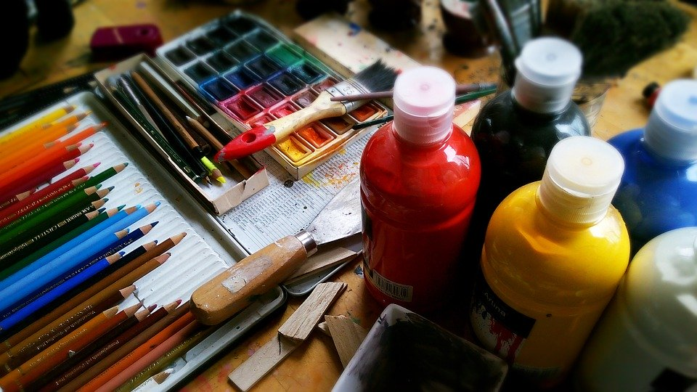

What does express yourself mean?
“Express yourself” is about finding creative ways to share feelings, thoughts, or ideas…
…through things like art, writing, music, dance and
doing things that make you
feel good.

Slide 5
Why does finding healthy ways
to express yourself matter ?
Being creative and expressing yourself can:
help you to relax and de-stress
generate “feel-good” endorphins which can lift your mood, help you feel empowered, and create a sense of identity and achievement
help to boost your self-esteem, connect with others, and give you purpose and meaning
How does society often expect young people to look, think, speak and act? And where do these ideas come from?
Do these expectations stop you from expressing your true self?
How does that make you feel?

Slide 6
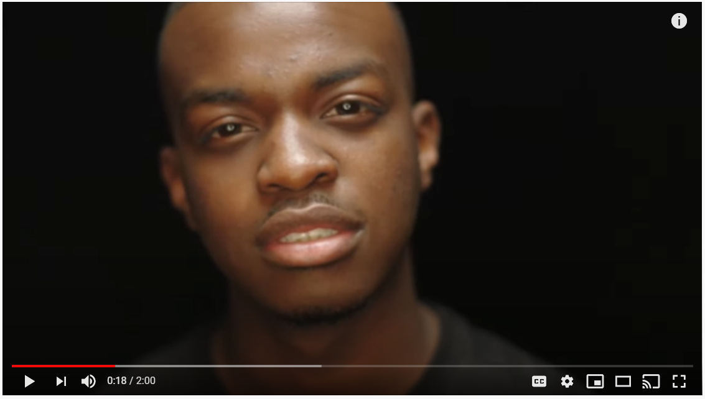
What can creative Self-Expression look like?
Watch this spoken word piece by George the Poet on the theme of possibilities
Discuss the possibilities
for each of us to explore our own creativity this Children’s Mental Health Week.

Slide 7



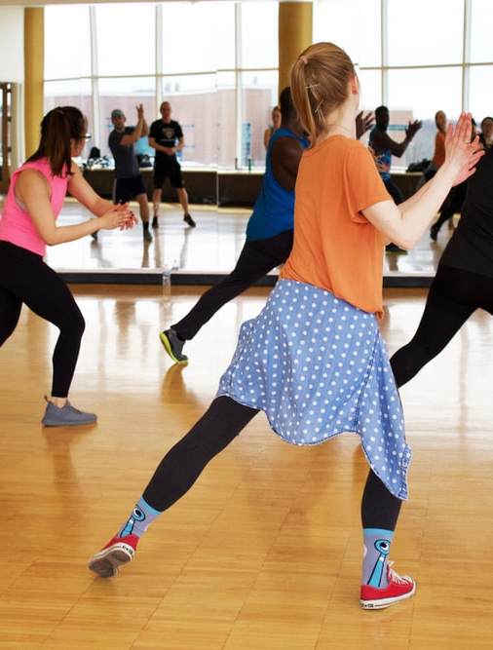
How can we help and support each other to get creative and
express ourselves this Children’s Mental Health Week?

Slide 8
Other ways to support Children’s Mental Health Week
Dress to Express Day
Friday 5th February
Our lives are full of colour and we can use colour to help make sense of how we’re feeling, who we are and the world we live in.
You could wear your favourite colour or choose a range of colours that express
how you’re feeling.
Colour can be very personal and mean different things to different people, so this
is a great opportunity to encourage self-expression
and celebrate a diverse range of emotions.

Slide 9
Express Yourself
Credits
All images in this presentation are royalty free from unsplash.com, pixabay.com and canva.com
George the Poet’s spoken word piece was shared by Random Acts - Channel 4's home for creative short films.

Slide 10

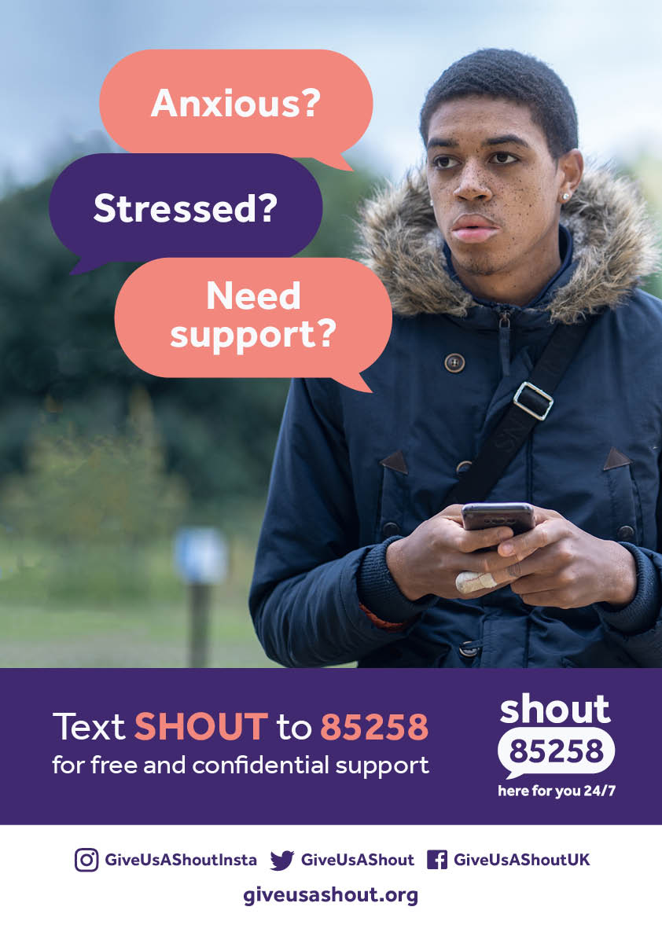







Where to go for support?
Helpline: 0808 801 0677
Studentline: 0808 801 0811
Youthline: 0808 801 0711
0300 330 0630
Open 10:00-22:00 every day

