Slide 1
Why choose GCSE Geography?
The world in which we live is likely to change more in the next 50 years than it has ever done before. Our role in that change is more important than ever. Geography explains the changes and helps to prepare people. It is a subject about now and the future.
Geography gives a balanced viewpoint which is good preparation for the world of work. Employers want people with the following attributes:
Good communication skills
Ability to manage themselves
Ability to work as a team
Numeracy and literacy
Ability to solve problems
Computer literacy
Spatial awareness
Environmental and social awareness

Slide 2
Why choose GCSE Geography?
Geographers can... | Geographers are...
Make a concise report | Good communicators
Handle data | Spatially aware
Ask questions and find answers | Problem solvers
Make decisions about an issue | Good team players
Analyse material | Computer literate
Organise themselves | Well rounded, flexible thinkers
Think creatively and independently | Socially, economically and environmentally aware
You may be planning to go to university or the world of work, whichever option you choose, the study of Geography will equip you with invaluable skills for the future. A Geography qualification is extremely useful for a very wide range of careers and further courses of study. Nationally, geography has one of the best graduate employment records in the country.

Slide 3
Possible Geographical careers
Planning and development surveyor | Water conservation officers
Environmental manager/consultant | Commercial/residential surveyor
Exploration geologist | Logistics and distribution manager
Geographical Information Systems manager | International aid/development worker
Landscape architect | Political risk analyst
Nature conservation officer | Cartographer
Town and country planner | Police/crime analyst
Transportation planner | Epidemiologist – specialist in how diseases/viruses spread.
Ps – shhh you could even be a teacher

Slide 4
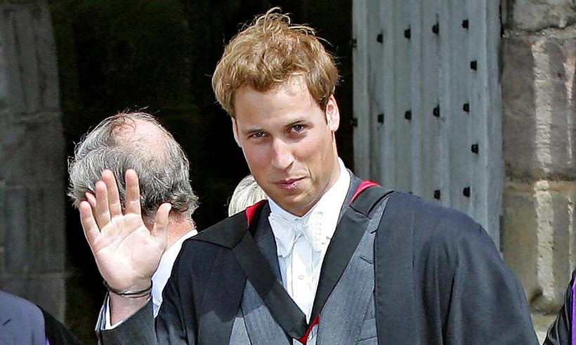
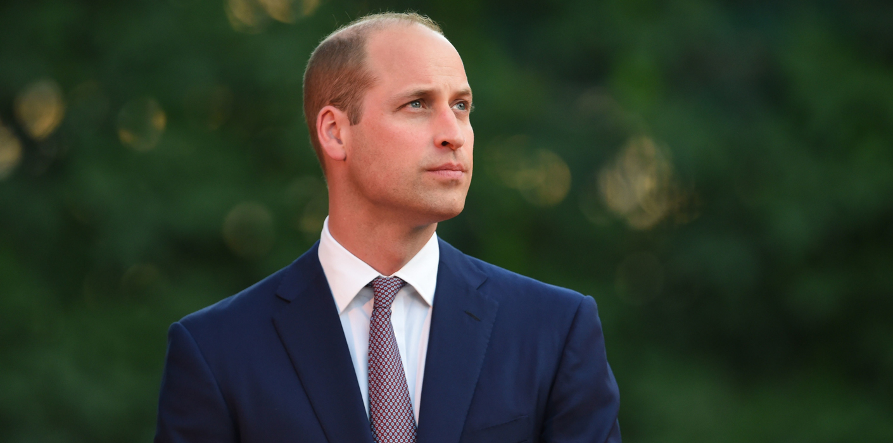
Has anyone important ever chosen geography?
Prince William studied Geography at St. Andrews
Only our future king to name just one

