Slide 1

WALTON-LE-DALE
WELCOME TO YEAR 10:
GUIDE TO EXAM COURSES AND WORK EXPERIENCE
“We are aspirational for ourselves and others”

Slide 2
Everything you need to
know about KS4 so that your children can be successful &
help you in
your old age!

Slide 3
KS4 Courses
All students take English Language, English Literature, Maths, Science, ‘ICT’
AND THREE OPTIONS
English, Maths and most options are GCSEs and worth one award
Science: Some students take triple Science (Bi, Ch, Phy); others take dual award
ICT, Health & Social Care, Enterprise, Performance, Sport…
are vocational courses – Technical Awards
These are the equivalent of 1 GCSE
Careers, PSE are done in addition – for example on Enrichment Days
The above are referred to as LEVEL 1 & LEVEL 2 courses

Slide 4
Qualification Levels
Level 4
University
Level 3
A Levels
BTEC Level 3
Level 2
GCSE grades 5-9,
BTEC Diplomas; NVQs
Level 1
GCSE grades 1 to 4

Slide 5

Recent changes to GCSEs
GCSE courses to be assessed by exams at the end of Y11
More exams at the end of the 2 years
Coursework to be reduced in importance
English – no marks for ‘Speaking & Listening’, no coursework
Maths – more problem solving and worded questions
Exams made more difficult
Exams – more factual
Exam questions - language makes understanding more difficult
Only 60% or so will achieve grade 4 or above
- more of the marks are for spelling, grammar

Slide 6

Grades
GCSEs - Grades are from 1 to 9, with 9 being the highest
This is a change from grades G to A*, with the idea from Government that students should achieve more.
BTEC & Technical Award
Grades are Distinction*, Distinction (equivalent to a Grade 7), Merit, Pass (equivalent to a Grade 4), then Level 1 Pass

Slide 7
College courses 2020
96% attendance
‘every hour of classroom tuition is matched with an hour of personal study’
A Levels: at least grade 5 in five separate National Curriculum subjects at GCSE level, INCLUDING English & Maths (Cardinal Newman tends to look at GCSEs first)
Level 3 Vocational: 5 X GRADE 4s at GCSE including Eng & Maths
Apprenticeship (Level 2): 5 x grade 4s, including E & M
If you do not get a 4 in En & Ma - REPEAT

Slide 8
The Challenge
and our support

Slide 9
MEMORISING
You forget 80% of what you learn
80%
60%
40%
20%
1 week
TIME
1 hour
1 day

Slide 10
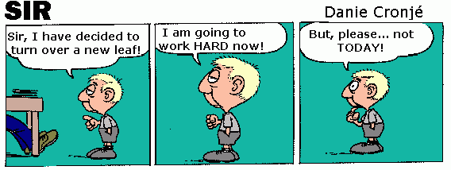
If you think you can or think you can’t, You’re Right

Slide 11


Slide 12
Expectations
We expect every student to aim for the highest possible grades
We will not set a target grade – we expect the best from everyone
The reports will show
  Progress – expected, good, exceptional, less than expected
  Current grade - estimated
  Attitude to Learning – broken down into homework, assessments, classwork, effort, behaviour – so you can see where any issues are
Independence & Resilience
After-school support
Additional intervention / support if below expectations

Slide 13
Attendance
High Attendance = High Achievement

Slide 14
Attitude to Learning
Good attitude to learning = High Achievement

Slide 15

Coursework
Some subjects have a coursework element (Controlled Assessment) – for example Art, the vocational subjects, Technology….
Coursework is usually worth 20-30% - sometimes more for vocational subjects.
Students are given a deadline for each piece of coursework or part of a coursework.
Please check that your child is meeting these deadlines and that it is of the right standard.

Slide 16


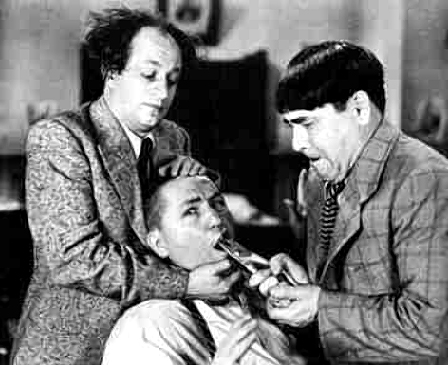
If it is not right…..
Home contact
Small group support / One to one tuition
Task is repeated / re-done
After school Study Support – additional lessons
Mentor support

Slide 17
Final Exams
All GCSEs have a final exam (or 2 or 3)
NOTES – Students need to keep up to date with work, organise their work
and keep it (usually in exercise books) so they can revise from
these notes. EXERCISE BOOKS NEED TO BE NEAT etc.
REVISION – Will need to start early – March in Y11 – but will also need to be
done for Y10 exams, Y11 mocks. Revision guides
WHY ? Because it helps in real exams. Retrieval practice
EXAM LANGUAGE & QUESTIONS – Increased emphasis on understanding
what an exam question means
EXTENDED WRITING
NEED TO PRACTICE EXAM QUESTIONS / PAPERS
HOMEWORK- NOT GOT ANY ??!!!! REVISE

Slide 18
MENTORING
YEAR 10 - For students who may be:
  falling short of their target grades
  experiencing difficulties that are leading to underachievement in a number of subjects
YEAR 11 - For all students
The mentor will work with the student and parents to make sure the
student is working hard, on target and up to date in all subjects.
The mentor will intervene if the student falls behind and work with
students & subject teachers to manage ‘catch-up’.

Slide 19
PARENTS - WHAT YOU CAN DO TO HELP AND KEEP YOUR SANITY UNTIL GCSEs ARE FINISHED!

Slide 20
Jobs for Parents
  “What work do you need to do?”
  “Show me the work that you have done….”
  Is there somewhere to study?
  Xbox & Snapchat are not the same as work.
  Contact school, in particular your child’s
  Head of Section to check on progress AND
  attitude

Slide 21
‘LASTMINUTE.COM MAN’ ?
Who thinks they can pull it out of a hat at the last minute.

Slide 22
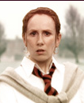
Am I bothered ?
Am I bothered ?
EXAM WORRIES ?
Am I bothered ?
Am I bothered ?
Am I bothered ?
Am I really bothered ?
Am I bothered ?
Do I look bothered ?
Tell me, am I bothered
Look at my face; do I look bothered
Even if they say not,
they usually are

Slide 23
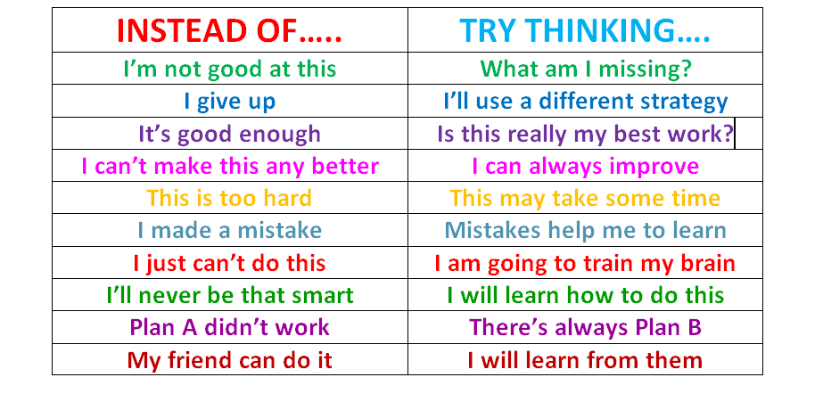

Slide 24
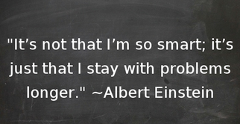

Slide 25
“The fight is won or lost far away from witnesses - behind the lines, in the gym, and out there on the road, long before I dance under those lights”
Muhammad Ali

