Slide 1
TEAMS
How to access Teams

Slide 2
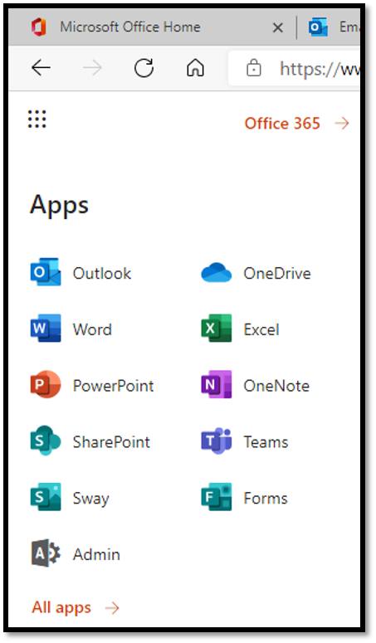
LOG on to OFFICE 365 TOP LEFT HAND CORNER – click the dots

Slide 3
OUTLOOK IS YOUR EMAIL ACCOUNT
Your teacher will email you with an outline of the work every day. This email will contain a link to the resources for the lesson and a link to 'live lesson' if there is one.
It’s important you read your email carefully each morning.
If you can’t find the email, you can search the teacher's name.

Slide 4
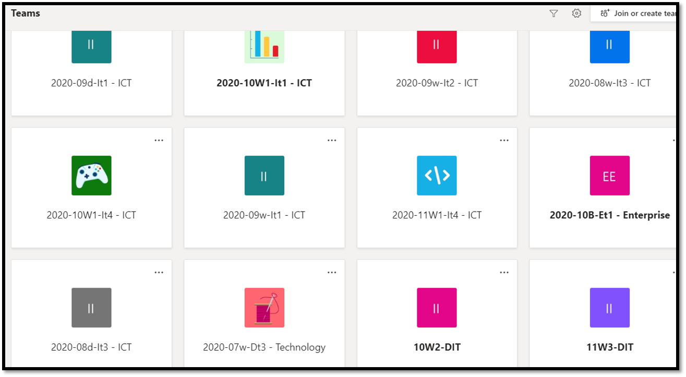
TEAMS IS WHERE ALL OF YOUR RESOURCES AND ASSIGNMENTS ARE STORED.
SELECT YOUR CLASS

Slide 5
TEAMS IS WHERE ALL OF YOUR RESOURCES AND ASSIGNMENTS ARE STORED.
POSTS – THIS IS WHERE A TEACHER MAY ASK A QUESTION TO THE CLASS OR ANSWER ANY QUESTIONS ABOUT THE WORK. IT’S IMPORTANT THAT YOU CHECK HERE FOR ANY POSTS.
ASSIGNMENTS – THIS IS WHERE YOUR TEACHER WILL HAVE SAVED THE RESOURCES FOR EACH LESSON. THIS IS WHERE YOU WILL UPLOAD YOUR WORK.
FILES – THE TEACHER WILL HAVE PUT RESOURCES IN 'FILES' SECTION > CLASS MATERIALS.
(ALWAYS READ THE MESSAGE FROM THE TEACHER CAREFULLY TO SEE EXACTLY WHERE THE RESOURCES ARE)

Slide 6
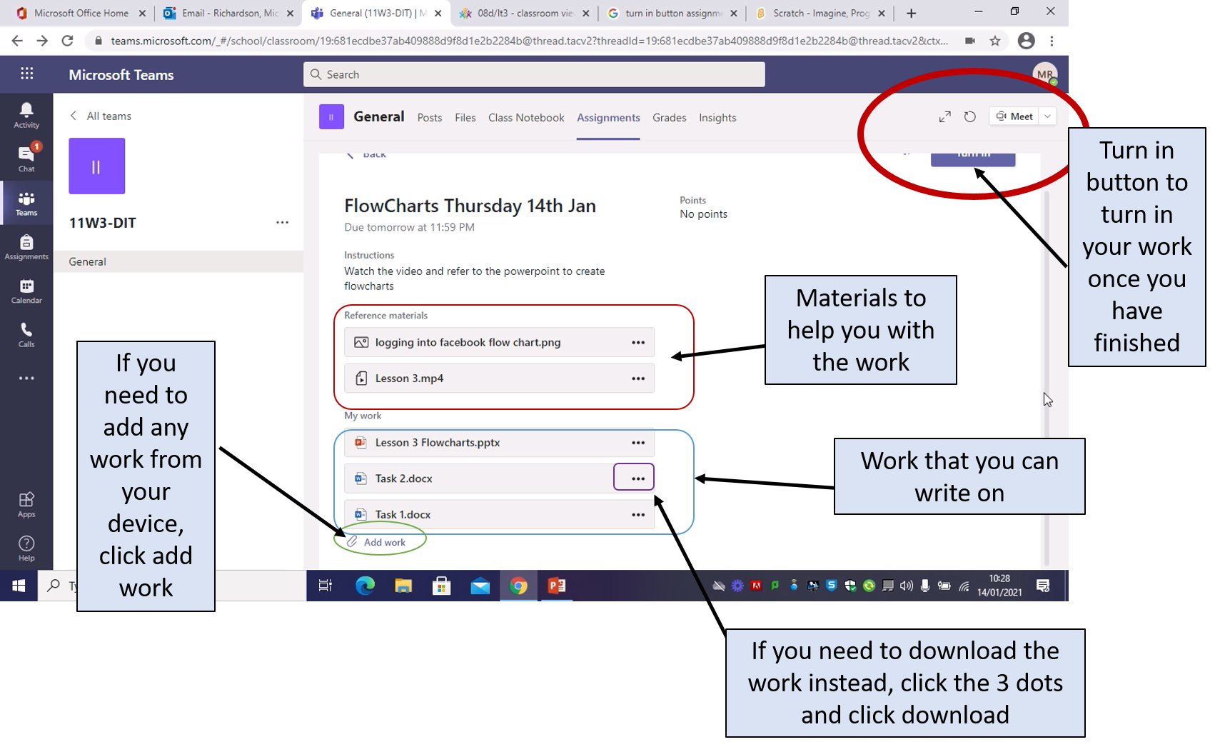
Assignments

Slide 7
CHAT FUNCTION.
IF YOU ARE STRUGGLING WITH THE WORK, YOU CAN MESSAGE THE TEACHER DIRECTLY THROUGH THE CHAT FUNCTION.
OR
REPLY TO THE EMAIL THEY SENT YOU.

Slide 8
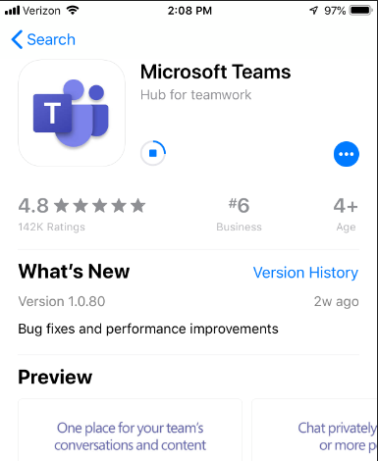
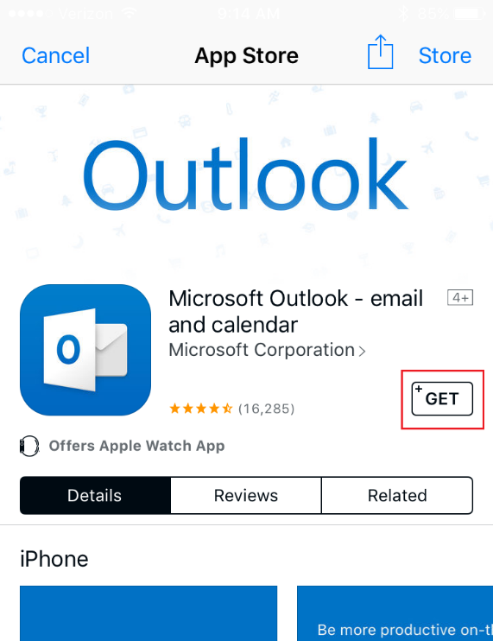
IF YOU ARE USING A MOBILE PHONE DEVICE OR TABLET… You can download the outlook (email) and teams app

