Slide 1
KP

Slide 2
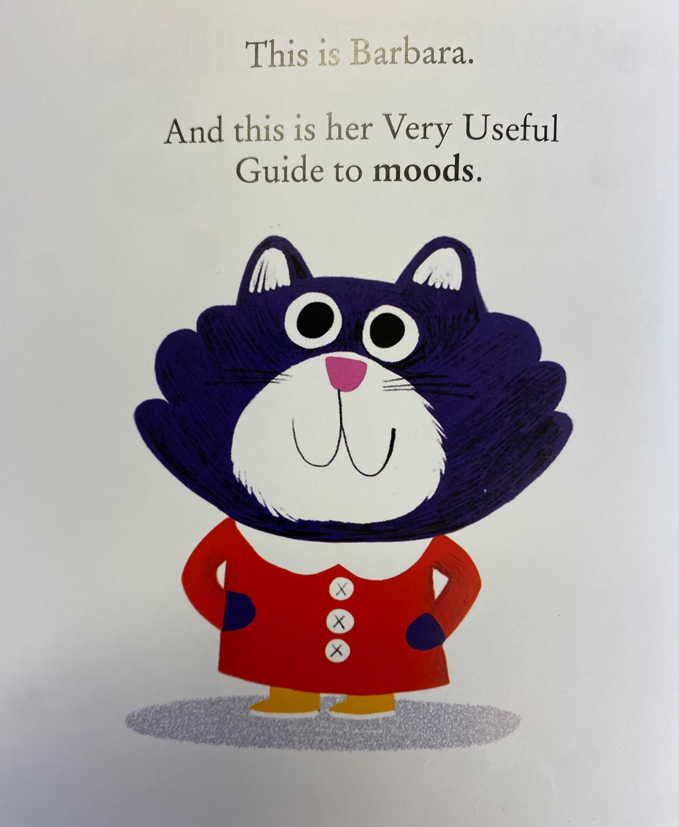
NP

Slide 3
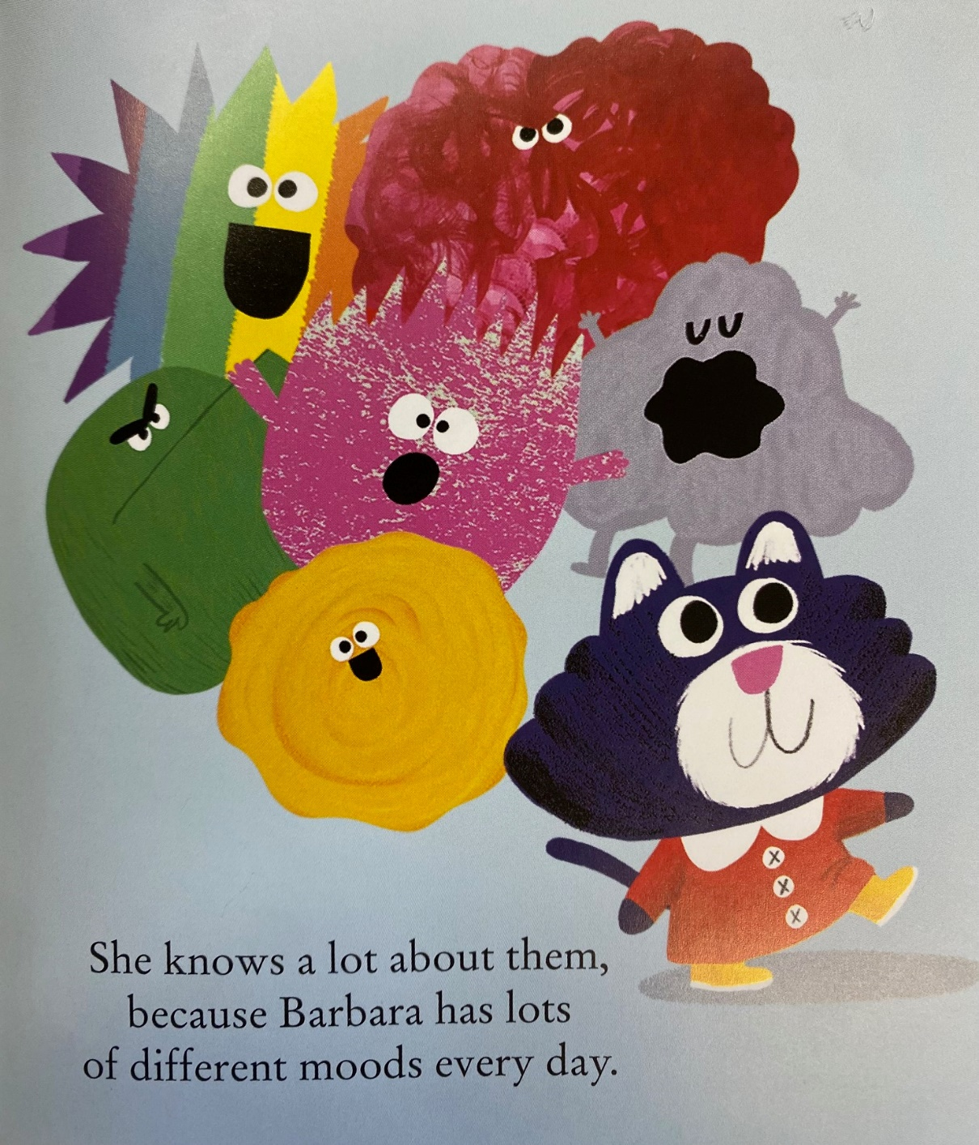
KJ

Slide 4
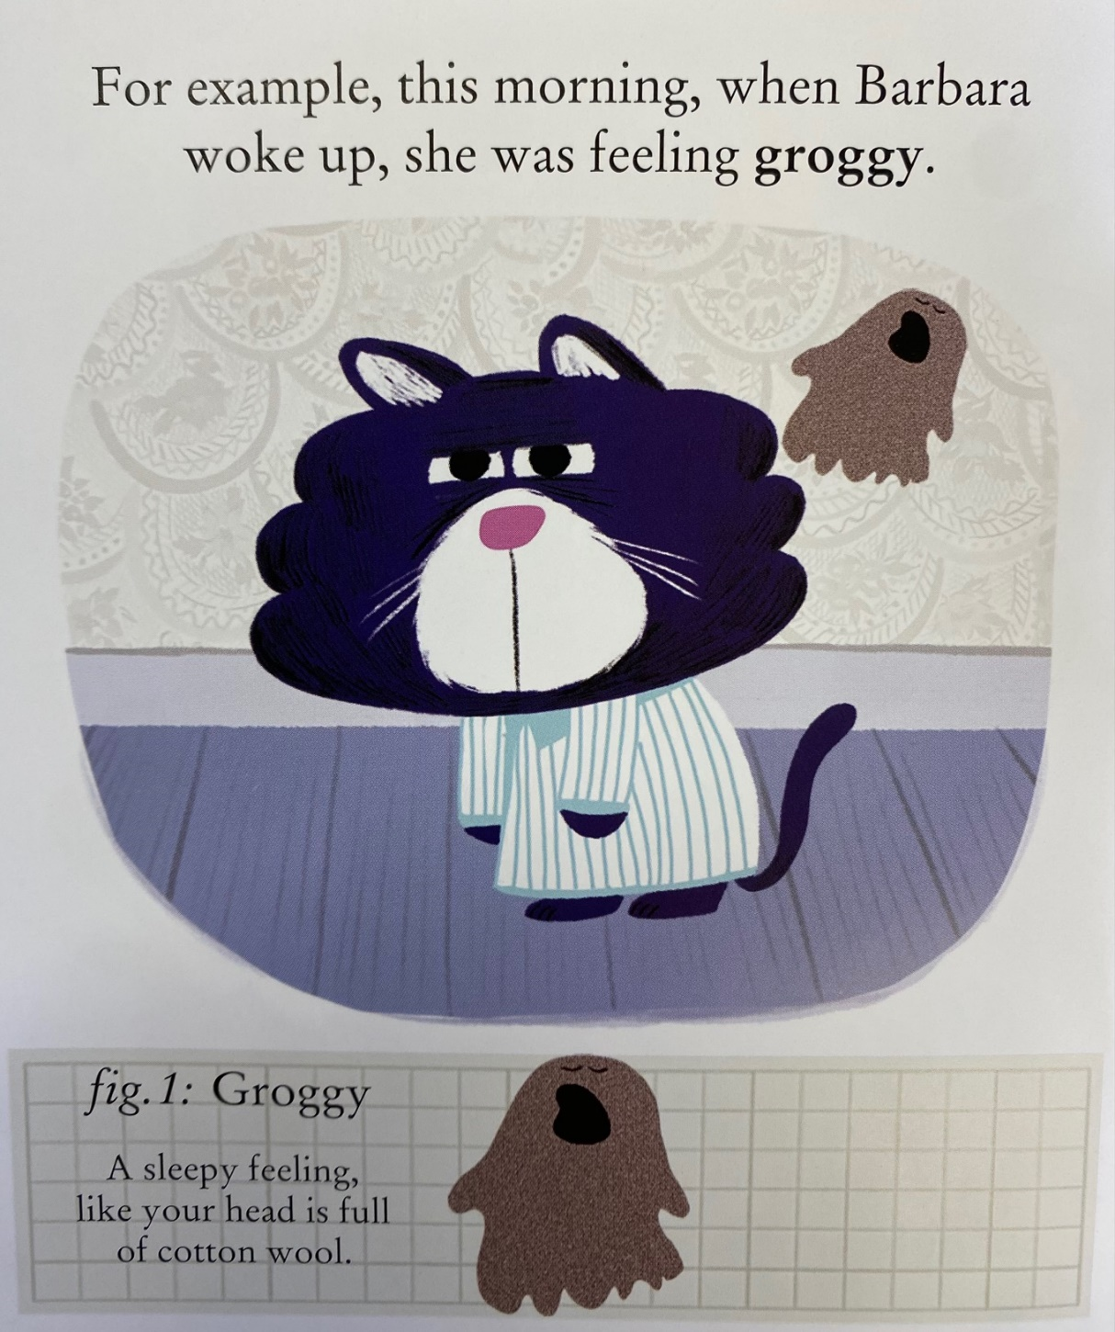
DLE
GK

Slide 5
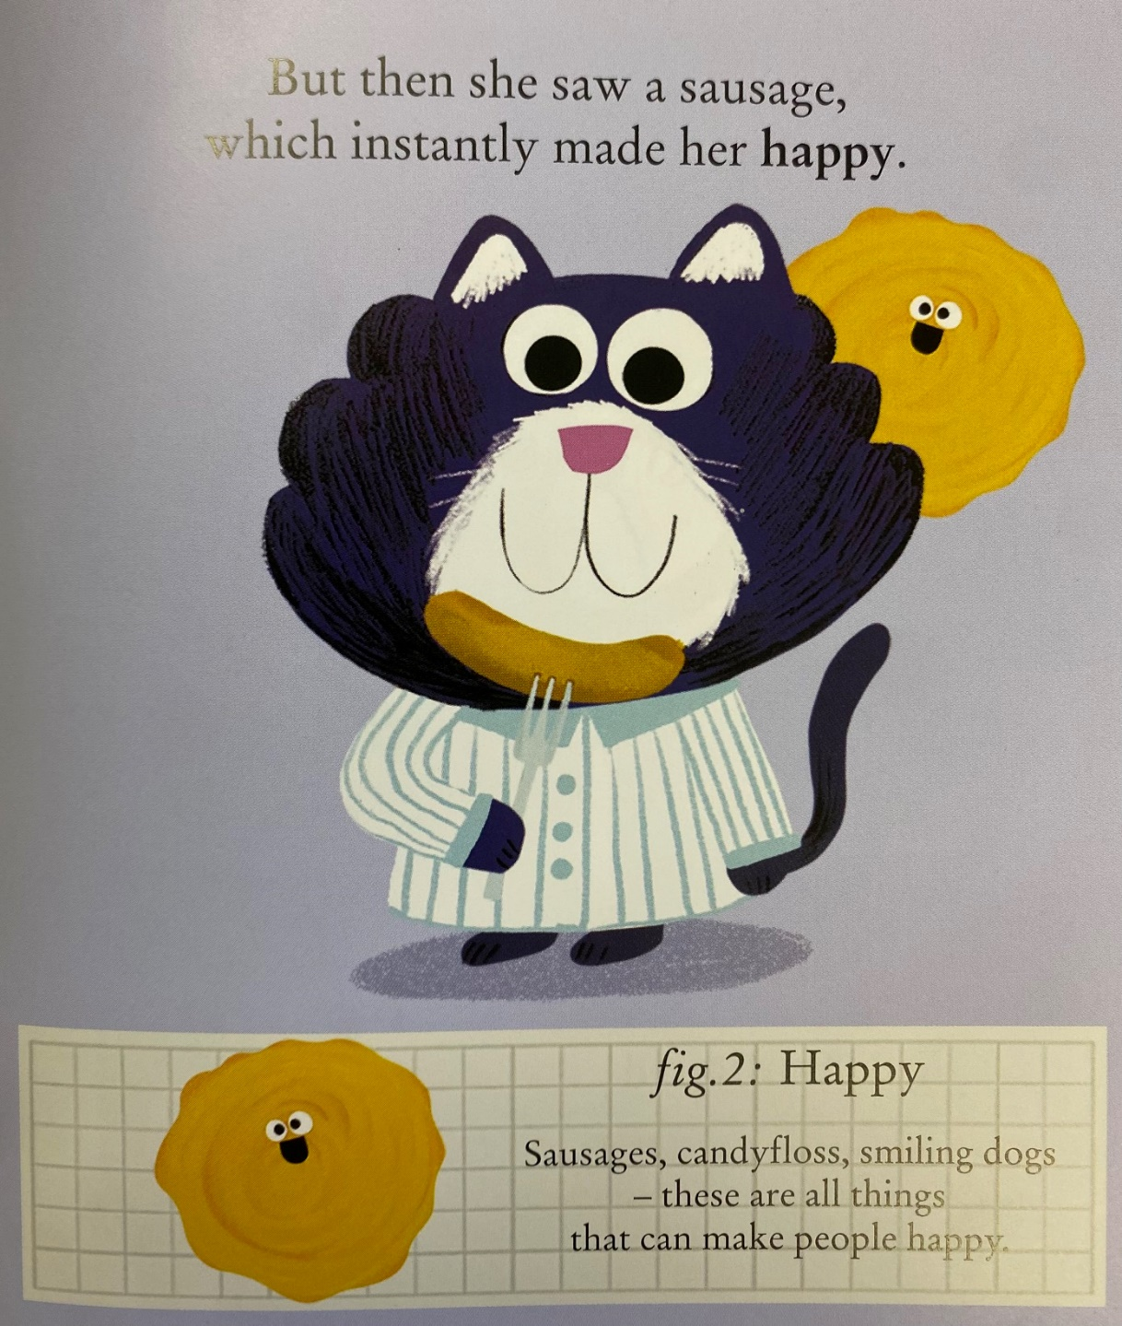
LH
CF

Slide 6
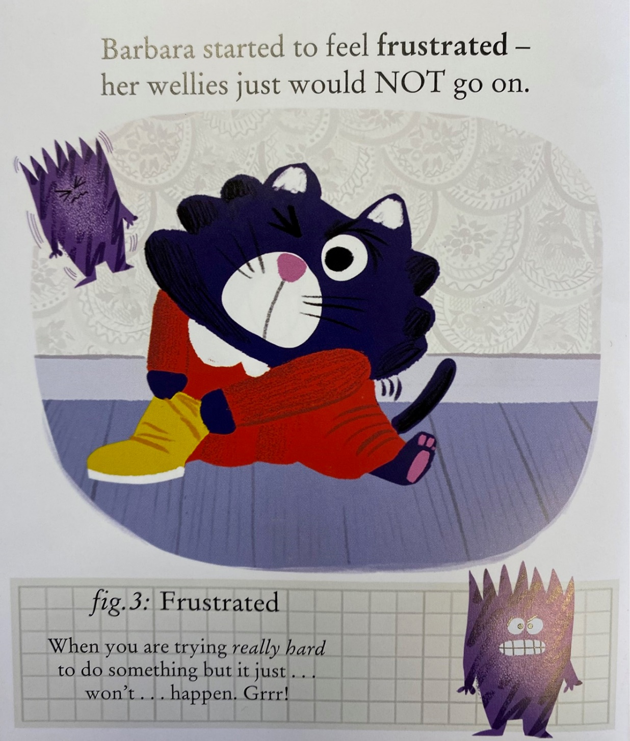
RC
Damien

Slide 7
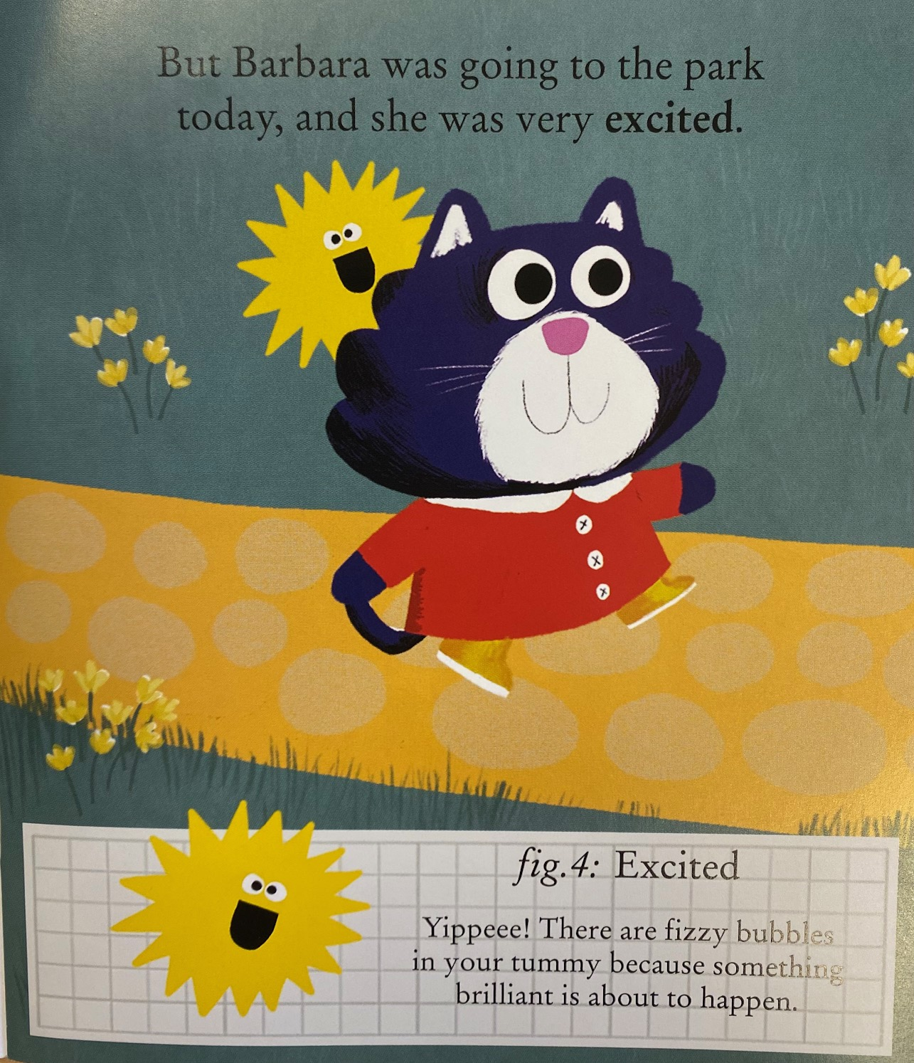
Oliver S
GW

Slide 8
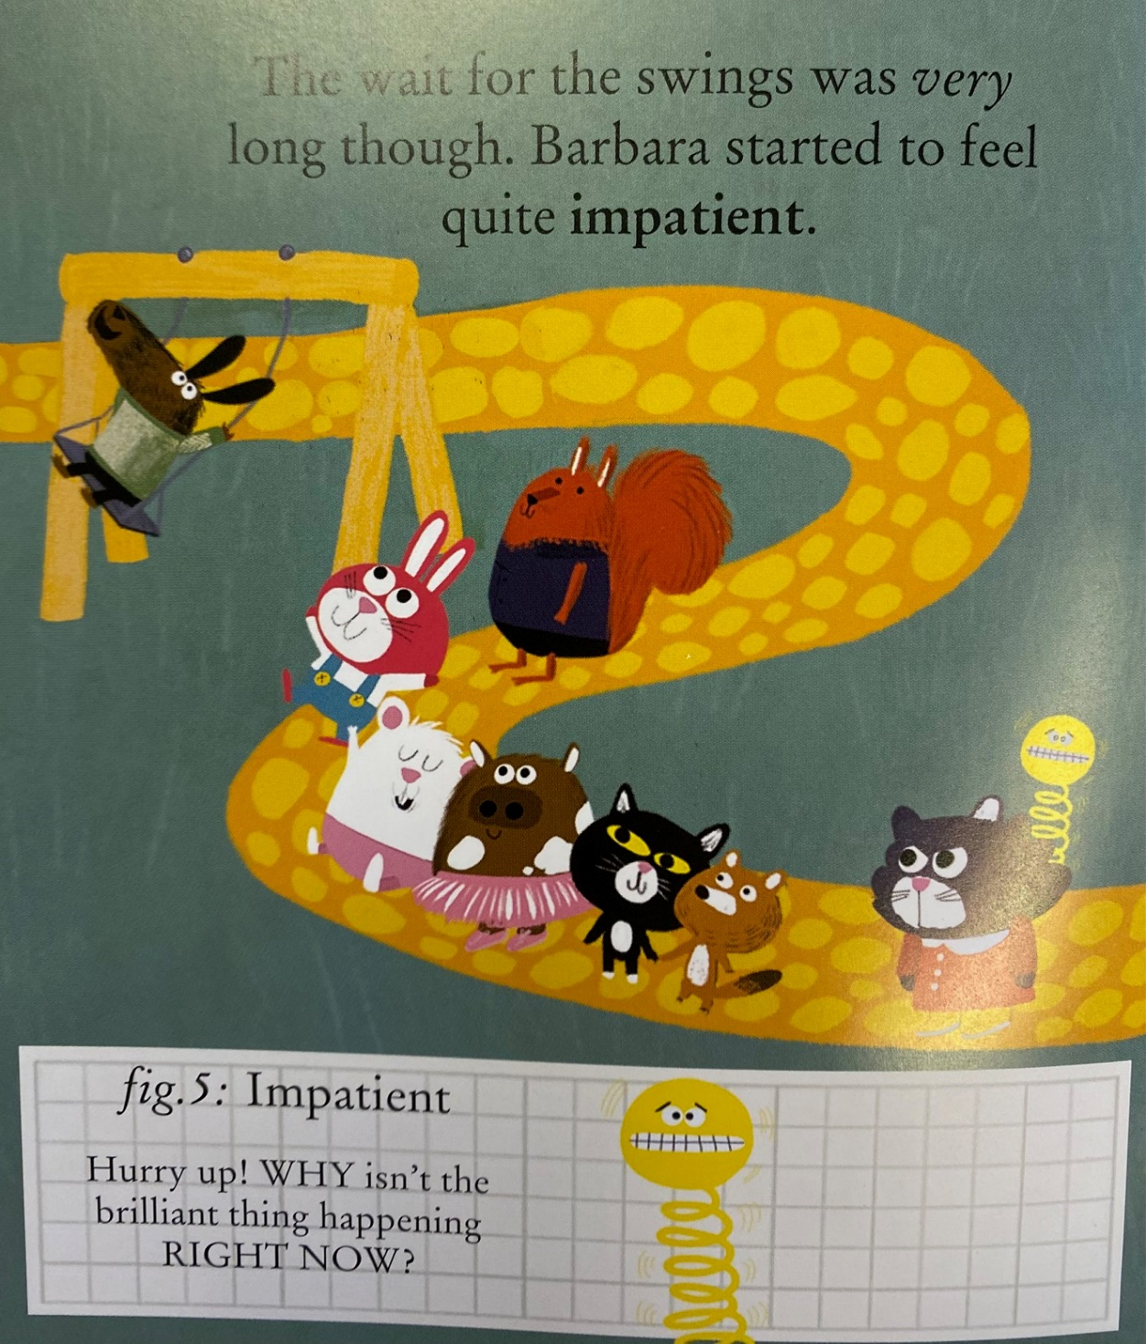
AK
SS

Slide 9
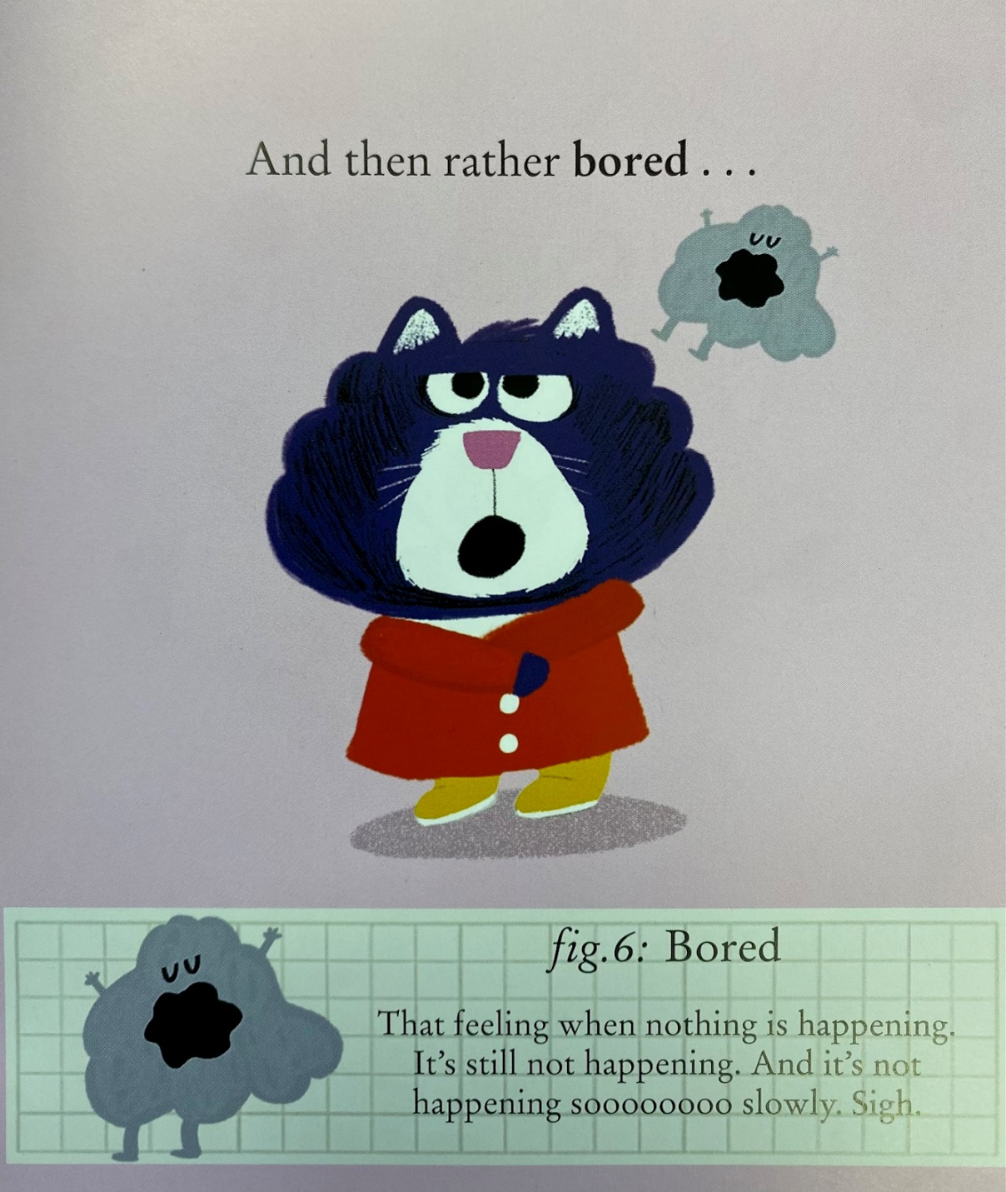
Loki
KB

Slide 10
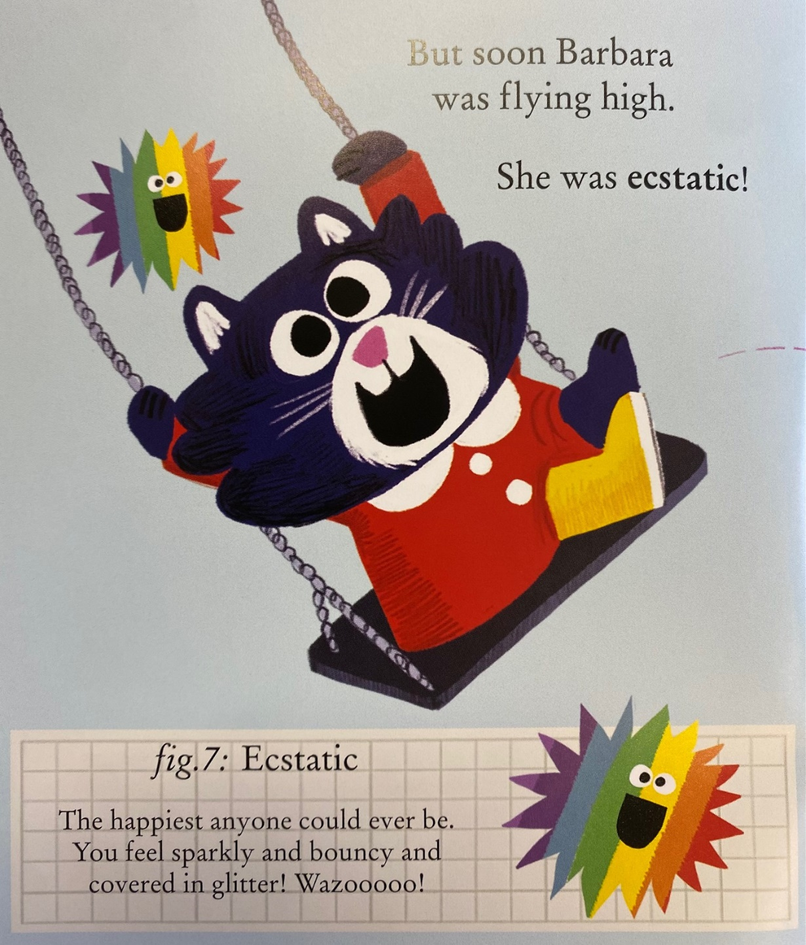
Emma (Lunch)
CMT

Slide 11
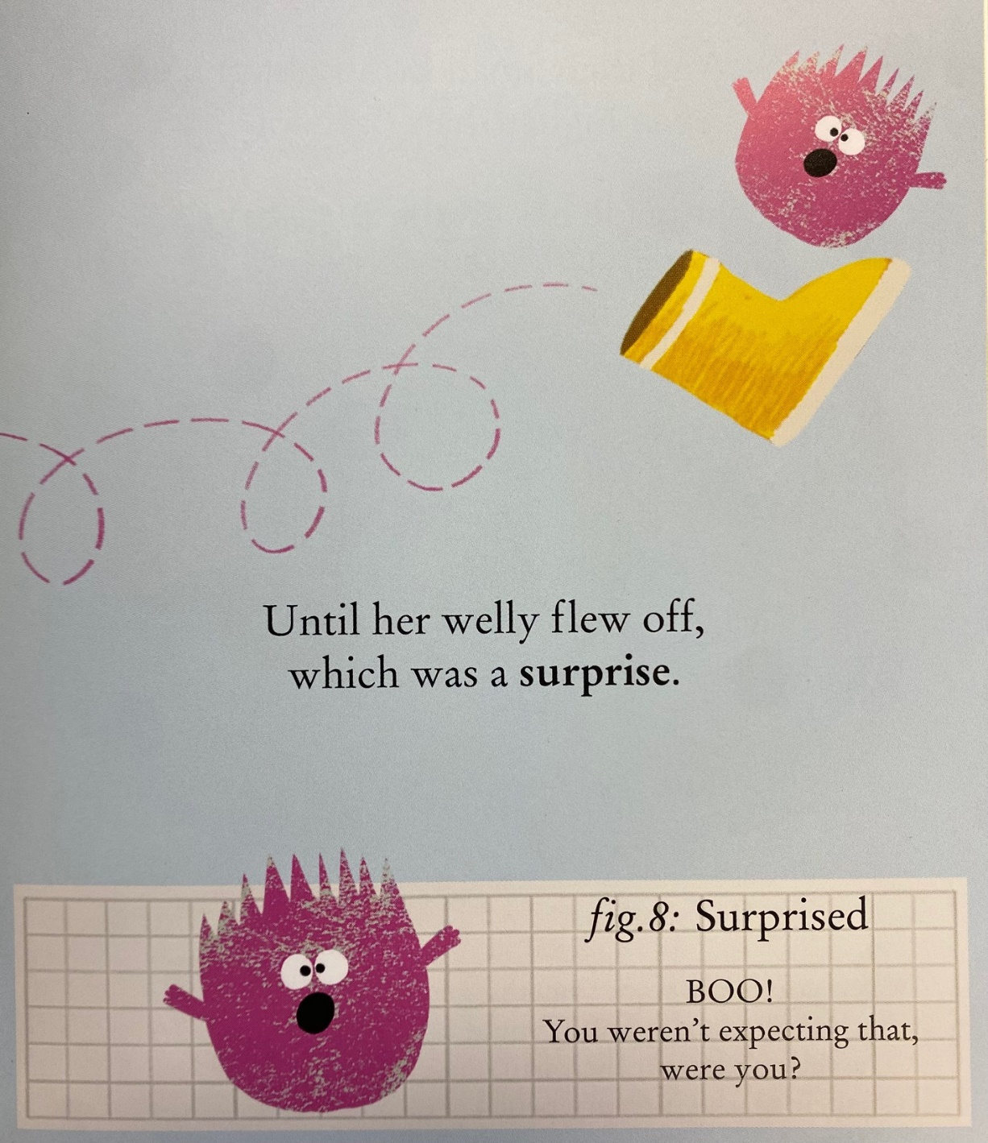
Tyler A
Riley C

Slide 12
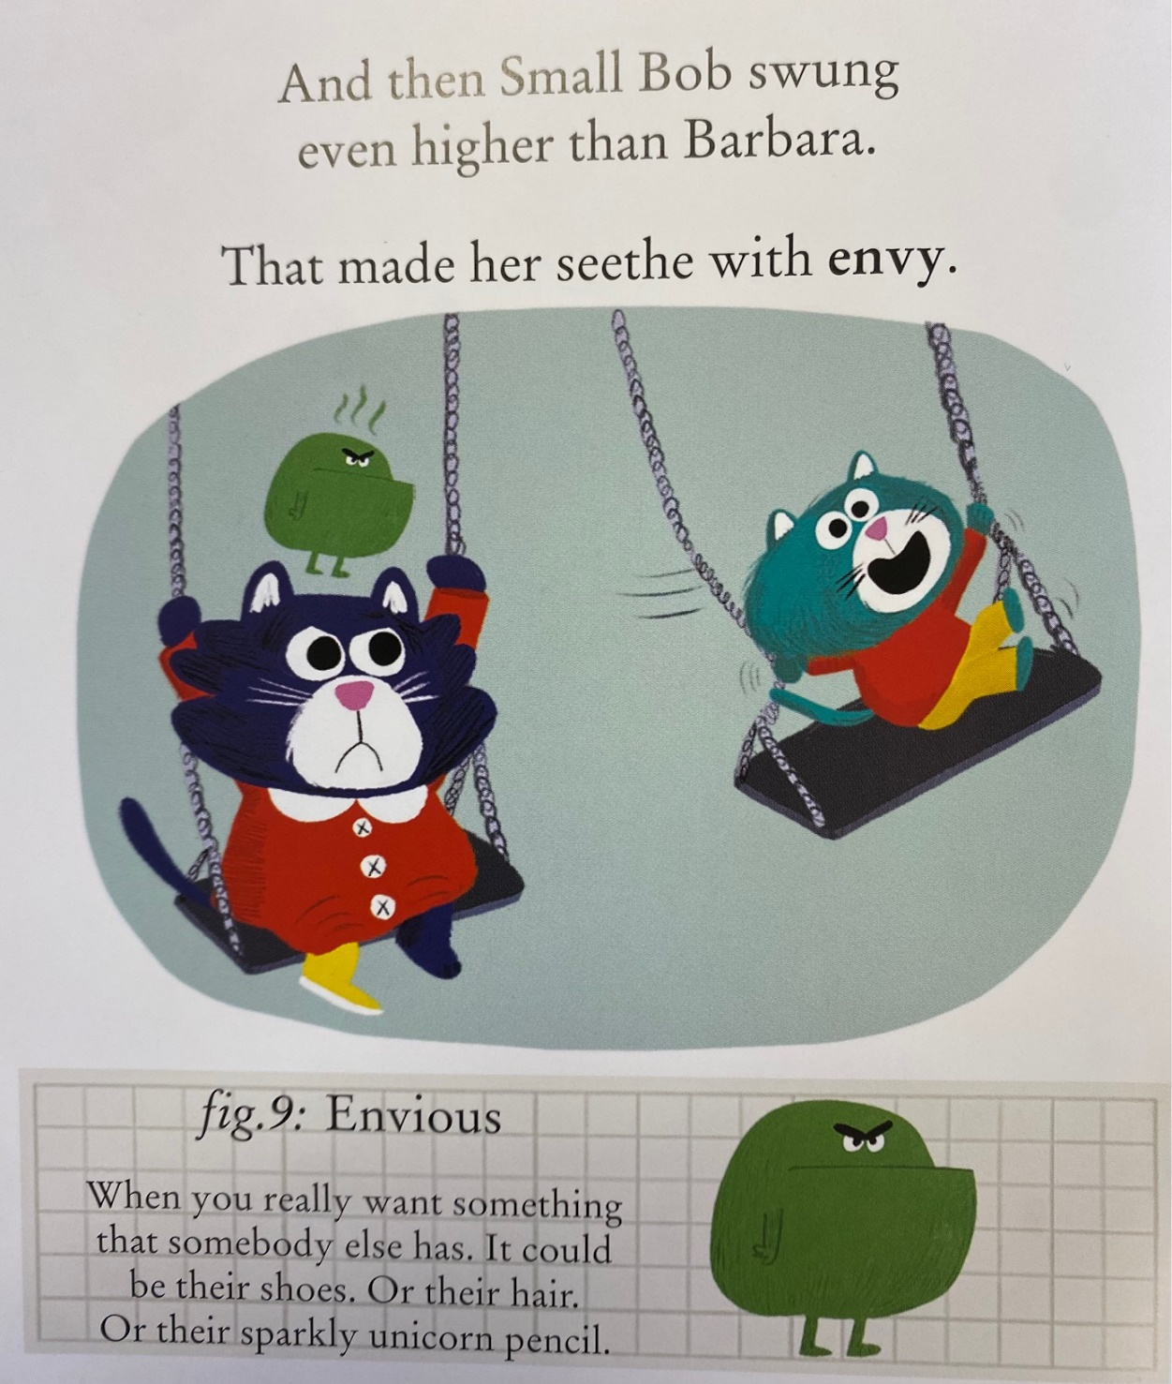
LC
Mickey

Slide 13
Shiloh
AS

Slide 14
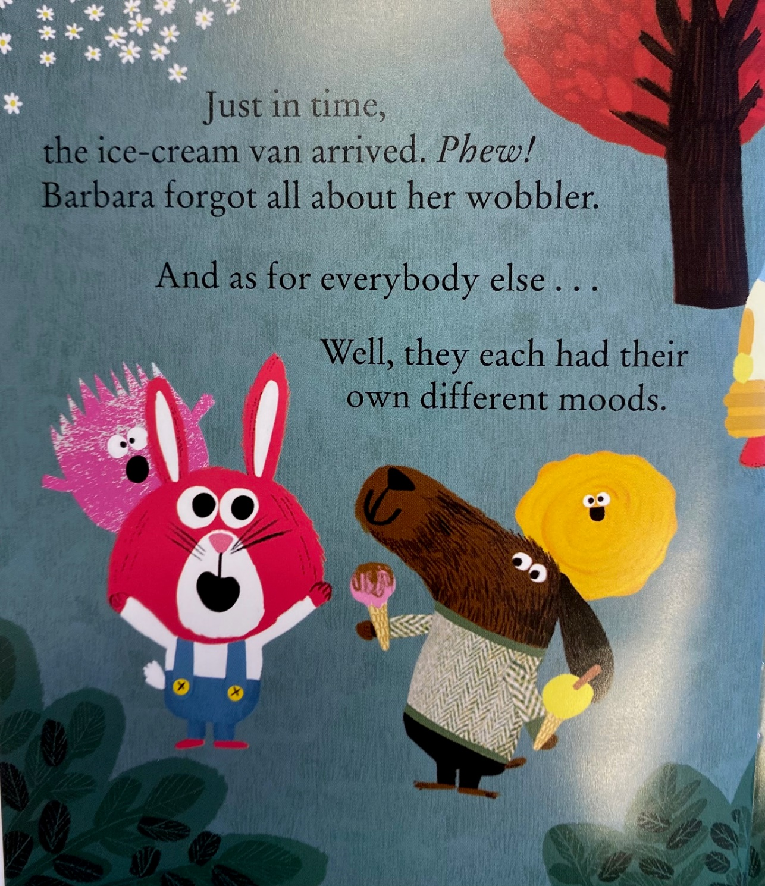
EM
AC
DO

Slide 15
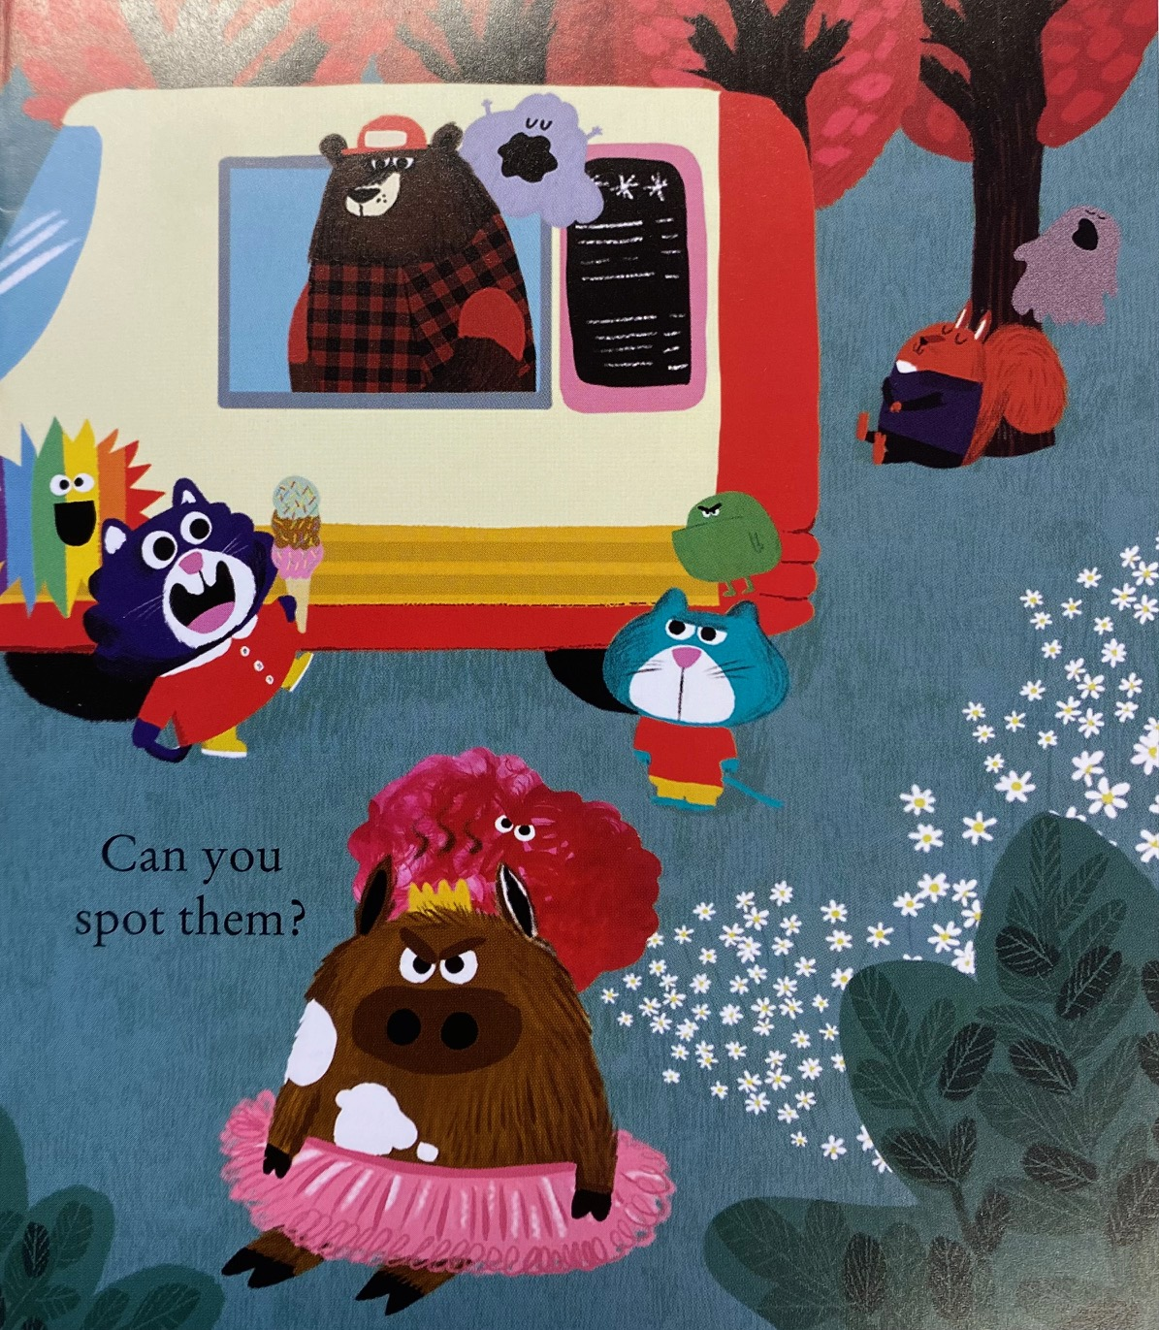
AF

