Slide 1
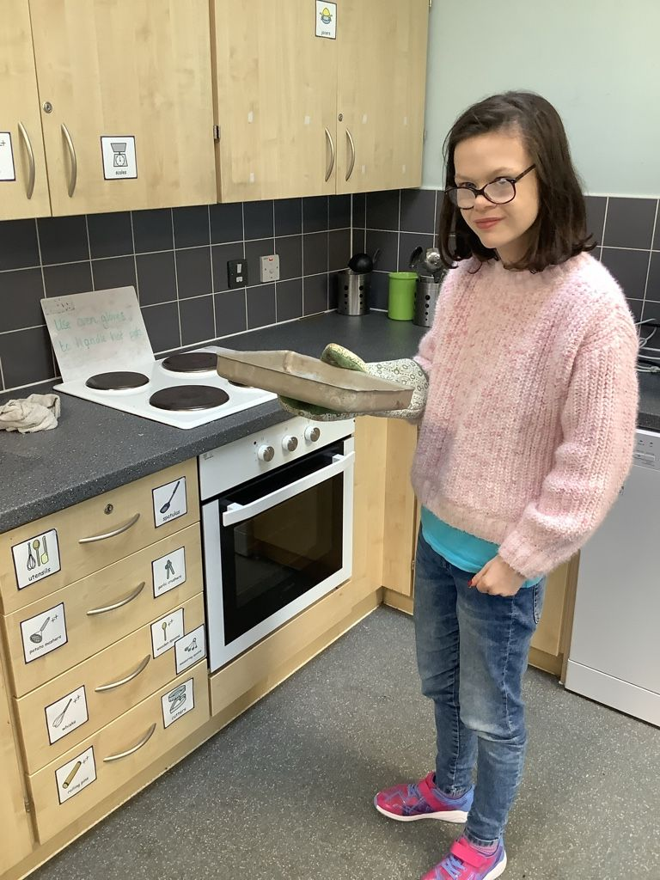
Maisie - College
Maisie is always friendly, respectful and helpful to others inside and outside of her class. She consistently acts as a positive ambassador for our school and college.
Maisie is always eager to learn and has excellent participation in class. She is very responsible and always completes her duties of keeping the Hive and College kitchen clean and tidy.

