Slide 1
Lead Inclusion School Role and PE overview, 2021- 2022
Peter Clayton
Warmley Park School and College

Slide 2
Lead Inclusion School Role. Intent 2021- 2022.
“The role and aim of the program, the way you interpreted the brief and set out the aspirations”
Youth Sport Trust: Lead School Prospectus
Project Goal; Create a national movement of schools that drive individual and whole school improvement through the differenr specialist areas of : Inclusion, Health and Wellbeing, that ARE WELL ALIGNED TO THE Youth Sport Trust and positioned to support our mission. Project Ambitions: Through the infrastructure of specialist lead schools, we aim to create a strategic approach to innovation, concept development and delivery. We have 4 clear ambitions.: Demonstrate the value of Health and Wellbeing, PE, Sport, Inclusion and Achievement within the whole school and /or community concepts. Advocate the impact o fht specialist areas on young people’s wellbeing, leadership and achievement. Pioneer school centred innovation, based on action research to influence national strategies and practice. Develop, test and deliver specialist interventions and learning that create transformational change in schools and communities. Youth Sport Trust Offer: Opportunities to work nationally with leading experts in PE, school sport and physical activity to enhance the health, wellbeing and achievements of students. National recognition as a pioneering network of schools driving the specialist area forward in England Direct investment in to schools through training, resources, equipment and engagement with positive role models. Networking opportunities to share best practice, inspire learning and maximise impact.

Slide 3
Lead Inclusion School Role. Intent 2021- 2022.
“The role and aim of the program, the way you interpreted the brief and set out the aspirations”
Youth Sport Trust: Lead School Prospectus
Expectations of Lead Inclusion School: To hold YST membership for academic year To commit to being the Lead Inclusion School for the academic year. To submit all monitoring and evaluation reports on time, and keep to all agreed and pre-set deadlines. Funding will only be released on receipt of adequate data reporting in November and February in the academic year. You must attend Regional networking events for Lead Schools To access a minimum of 1 development Coach session through academic year. As a lead Inclusion School you must be a brand ambassador for YST and our ethos. Your role is to be: An Advocate for Inclusion and expert advisor on high quality inclusive practice for young people with additional support needs in PE, School Sport and School Games, working to enable SGO’s, schools and other organisations across a county area Vision: We pioneer new ways of using sport to improve children’s wellbeing and give them a brighter future. Ensuring that it is: Inspiring, Accessible and Meaningful. Core Delivery: Training, Advice and Guidance: (Sportability, All About Autism, FA Girls project) Inclusive Competition and Pathways (SGO’ advice, promote events across WESPORT) Young People Leading the Way (Step Into Sport Courses, Promote opportunities to put training into practice) Raising Aspirations and developing Inclusive School Sports Clubs (Support schools in setting up Inclusive clubs) Support Schools directly with Inclusion development areas highlighted from the 20/21 Inclusion summary document (eg Inclusive health check, intra and inter events, Sportsability training, Autism training, Step into Sport access, Inclusive sports clubs, access to local SGO programme)

Slide 4
Lead Inclusion School Role. Implementation: 2021- 2022
“What has happened, who has been involved, how has it been delivered, inclusion opportunities”
Main Focus Areas | Outcomes
1. Step Into Sport | 2 annual courses delivered (Bath Uni and UWE, 90 students including SEND attended from across WESPORT region -BANES, N.Somerset, S.Glos and Bristol. Promotion of follow up events
2. Leadership Opportunities | SiS courses, Table Cricket leaders award pilot in Special School completed, lunchtime leaders project (CSET aiding), Active lunchtime project, Internal leadership events. Promotion with SGOs regarding SEND students as young leaders
3. Inclusion Events | SGO advice, support with events, Promotion of SGO events to all special schools and SEND in mainstream, promotion of Panathlon events, Bristol Bears and Glos CCC events. Working closely with local SGO from CSET partnership. WPS attends local Inclusion events.
4. Staff Training | 3 Courses delivered at WPS, future courses planned, audit conducted on training needs and skills
5. SGO advice and support | SGO meetings attended (with WESPORT region and CSET area), Contribution to WESPORT Inclusion Podcast, attending Lead Inclusion Schools conference in Worcester (Oct 2021) Attendace at YST National Conference in Coventry (March 2022) cancelled due to Covid
6. Football FA project | Training attended, pilot scheme set up with current delivery (summer 2022)
7. School/College based projects | Curriculum development, Inclusion Checklist, School Games Mark Bronze award application, balanced calendar of events to attend (transport, parent letters, risk assessments), CSET meetings and training courses attended and information promotion.

Slide 5
WESPORT: Criteria for PE and School Sport Development
Criteria | Warmley Park School and College
1. Engagement: The engagement of all pupils in regular physical activity. (Chief Medical Officer guidelines recommend that primary school aged children undertake at least 30 minutes of physical activity a day in school. | Promotion with teaching colleagues about importance of PE in the curriculum. Ideas and Schemes of work provided to teachers termly. Active lunchtimes promoted and encouraged. Young leaders and CSET coach provided to Secondry/Primary playground once weekly
2. Profile: The profile of PE and sport being raised across the school as a tool for whole school improvement. | The profile of PE at Warmley is quite high. WPS makes a point of attending as many off school events and comps as practical. WPS uses many local community facilities (pool, Warmley Wheelers etc and also offers DofE and access to the annual Jubilee Challenge (part of Ten Tors event)
3. Standards: Increased confidence, knowledge and skills of all staff in teaching PE and Sport. | In service training in PE is offered through the school to teachers, TAs, Care Assistants and mid day supervisors. Specific CSET PE courses are also promoted for staff to attend. PE lead attends national conference.
4. Experiences: Broader experience of a range of sports and activities offered to all pupils. | WPS prides itself on offering new, alternative and diverse PE activities. However we could always offer more
5. Competition: Increased participation in competitive sport | WPS attends as many off site events as practical. Leading attending school at special school events in the area. WPS also has opportunity for intra class competition through the academic year

Slide 6
Inter school competitions, off site PE provision and external coaching.
PE Lead Teacher continues to be in close communication with colleagues in Bristol in order to access the range of inter school sports events on offer. PC has tried where possible to enter as many classes and pupils into relevant sports festivals and events.
PE Lead Teacher has continued to communicate with WESPORT which funds the annual PANATHLON events (2 multi sports, 2 ten pin bowling and an annual swimming gala comp). They also provide Inclusive SEND opportunities at large scale games events that WPS try to attend and qualify for.
PE Lead Teacher has maintained close links with the SGO at the CSET Sports Partnership (Inclusive events, training projects, advice, meetings, using CSET coaches for WPS sessions)
Warmley Park has continued to work closely with the local Warmley Wheelers Cycle project (now overseen by the Milestones Trust) to ensure WPS involvement in this fantastic community project. Head of Secondary Department has set up a module of delivery on site at WPS with Warmley Wheelers which was planned as an intervention for a number of our students.
PE Lead Teacher has continued links with Gloucestershire County Cricket who provide annual modules of coaching plus competitions (Table Cricket and Inclusive SEND Cricket festivals)

Slide 7
Inter school competitions, off site PE provision and external coaching.
Warmley Park continues to deliver Forest School sessions at the local and extensive woodland area (Warmley Forest Park). Post 16 groups have had access to Forest School activities through a Sport and Fitness Pathway during 2021-2022. Activities have included problem solving, trail finding, orienteering and woodland skills. This really is a fantastic alternative learning environment for all our pupils. Other classes in WPS also offer on site Forest School activities.
Bristol Bears community coaches are now a regulars at Warmley Park and over the last 6 years has delivered multi skills, rugby coaching plus a range of sports activities which have been very popular with students. Post 16 Students also have opportunity for work experience with Bristol Bears coaches in support.
PE Lead Teacher has worked with colleagues to plan and spend part of the annual Primary pupils PE premium.
Head of Post 16 has once again provided access for students at attend the Annual Jubilee Challenge walk on Dartmoor (This is a fantastic achievement)
Duke of Edinburgh. 2 teachers taking responsibility with one accredited as DofE leader
Swimming at KS 3/4/5 have taken place in community pools
Swimming at KS1 and 2 takes place in our school pool along with all age Hydrotherapy sessions. Swimming is a life skill and a very important therapy for many of our students and we will continue to offer it to KS1, 2, 3, 4 and Post 16 where possible.

Slide 8
Inter school competitions, off site PE provision and external coaching.
Main Benefits of inter school and off site events:
Social Inclusion with mainstream pupils and other SEND peers
Appropriate behaviour in community settings
Appropriate behaviour when working with external staff/coaches
Extending the school boundaries beyond what is “familiar and safe”
Developing skills for life

Slide 9
Warmley Park School PE Festivals/Events and Competitions. (Includes: Intra class, inter school, county, regional) sheet 1
Date | Event Description | Student information
Mon 4th Oct 2021 | Ten Pin Bowling KS2, Panathlon, Avon Meads | KS2/3 attended, 10 total 1st and 3rd position.
Wed 6th Oct 2021 | Ten Pin Bowling KS3/4, Panathlon, Avon Meads | KS3/4 attended, 10 total. 4th position.
Fri 15th Oct 2021 | Dodgeball Festival, Ashton Gate, Bristol Bears | KS4, 10 total.
Tues 16th Nov 2021 | Panathlon multi sports comp, Primary, UWE | KS2, 10 total. 2nd position.
Tues 23rd Nov 2021 | Panathlon multi sports comp, Secondary, UWE | KS3/4, 16 total. 3rd and 4th position.

Slide 10
Warmley Park School PE Festivals/Events and Competitions. (Includes: Intra class, inter school, county, regional) sheet 2
Date | Event Description | Student information
Fri 10th Dec 2021 | Dance Festival Online, Bristol Bears | Several classes booked on line.
Thu 13th Jan 2022 Fri 21st Jan 2022 | Step Into Sport Inclusive Leadership Course 1, UWE Step Into Sport Inclusive Leadership Course 2, Bath | Post 16, 8 students total. (88 mainstream students attended)
Thu 20th Jan 2022 | Inclusive Boccia and NAK Comp, CSET, Mangotsfield | KS2, 5 students total. DNA due to Covid
Fri 18th Feb 2022 | Target Games Festival, Ashton Gate, Bristol Bears | KS3, 6 students total. DNA Storm school closed. DNA rearranged date (18th Mar 22)
Thu 10th Mar 2022 | KS2 Intra class multi sports festival, CSET support | KS2 all classes. DNA due to Covid

Slide 11
Warmley Park School PE Festivals/Events and Competitions. (Includes: Intra class, inter school, county, regional) sheet 3
Date | Event Description | Student information
Fri 25th Mar 2022 | Table Cricket, County Event, UWE, Glos CCC | Post 16, 8 students total 2nd position.
Fri 8th April 2022 | Tennis Festival, Ashton Gate, Bristol Bears | KS2/3, 10 students total.
Sat 7th May 2022 | Jubilee Challenge 1 and 3, Ten Tors Event, Dartmoor (note weekly training sessions from Jan to May) | Post 16, 16 students total.
Thu 12th May 2022 | KS2/3 Obstacle Course Circuits, CSET supported Intra class event | All KS2 classes involved on rota.
Fri 13th May | All Move Project, Festival at WPS | College students

Slide 12
Warmley Park School PE Festivals/Events and Competitions. (Includes: Intra class, inter school, county, regional) sheet 4
Date | Event Description | Student information
Mon 23rd May 22 | SEND Cricket Festival, Frenchay, Glos CCC. Secondary age groups | KS4, 10 students total. 2nd position
Fri 27th May 2022 | Netball Festival, UWE, Bristol Bears. | Post 16, 6 students total.
Thu 9th June 2022 | Queens Commonwealth Baton Relay Event | Varied classes taking part. (7 classes, 70 students) plus leadership for 9 Post 16)
Fri 10th June 2022 | SEND Cricket Festival, Chipping Sodbury, Glos CCC. Primary age groups | KS2/3, 10 students total.
Mon 20th June 22 | CSET Commonwealth Sensory Games, UWE | KS1/2/3/4/5 tbc

Slide 13
Warmley Park School PE Festivals/Events and Competitions. (Includes: Intra class, inter school, county, regional) sheet 5
Date | Event Description | Student information
Tue 21st June 2022 | CSET Commonwealth Inclusion Festival, Pomphrey Hill Playing Fields, CSET/Mangotsfield School | KS2/3, 17 students total. Post 16, 8 student leaders total.
Fri 24th June 2022 | CSET Commonwealth Parallel Games, Dings RFC | KS3/4, 14 students total.
Week 20th -24th June, 2022 | National Sports Week, Target Games, Intra Class Competition | All classes taking part.
Thu 30th June and Fri 1st July | Duke of Edinburgh Expedition | Post 16 D of E pathway group.
Thu 7th July 2022 | Intra Class, Forest Skills and problem solving challenge day. CSET supported. | KS2/3/4/5 classes taking part.

Slide 14
Warmley Park School PE Festivals/Events and Competitions. (On site external coaching) sheet 7
Date | Description | Student information
Terms 1,2,3,4,5,6 Year 2021- 2022 | Bristol Bears, Mondays in Post 16. Rota of sports throughout academic year linked to their Festival rollout. | All Post 16 weekly
Terms 1,2,3,4,5,6 | CSET Coach, Playground leaders project, Lunctime club project and FA/YST Football Pilot project. Thursdays Lunch period | Varied classes and Key Stages
Term 2, (4 week module) | Table Cricket, Skills and Leadership Course, Jeanette Tate, Glos CCC | Post 16
Term 4 | Super 1’s Cricket. Jeanette Tate, Glos CCC | Post 16
Terms 1,2,3,4,5,6 | Community Engagement projects. Range of sports coaches on site delivery. (Refer to Kris T for details) | Varied

Slide 15
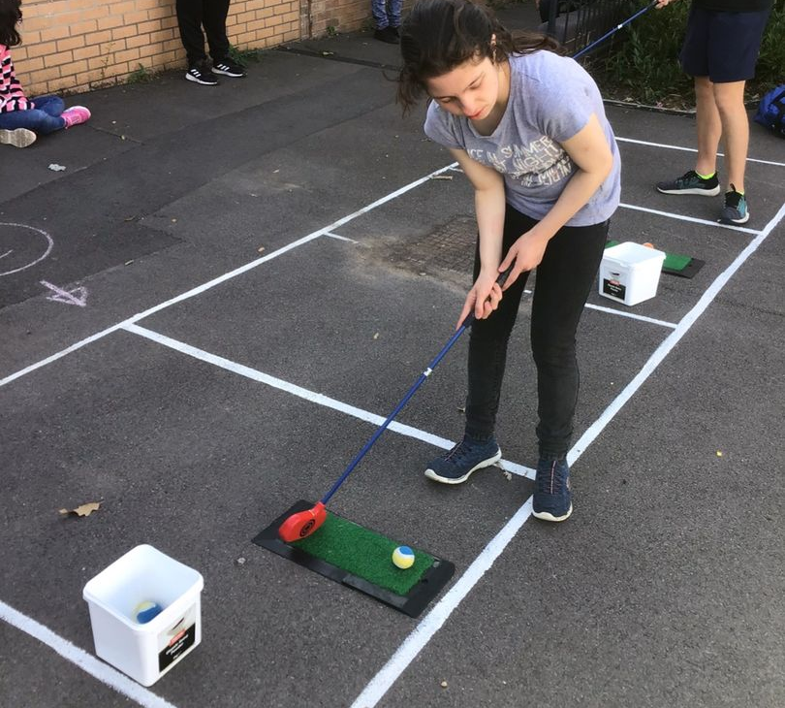
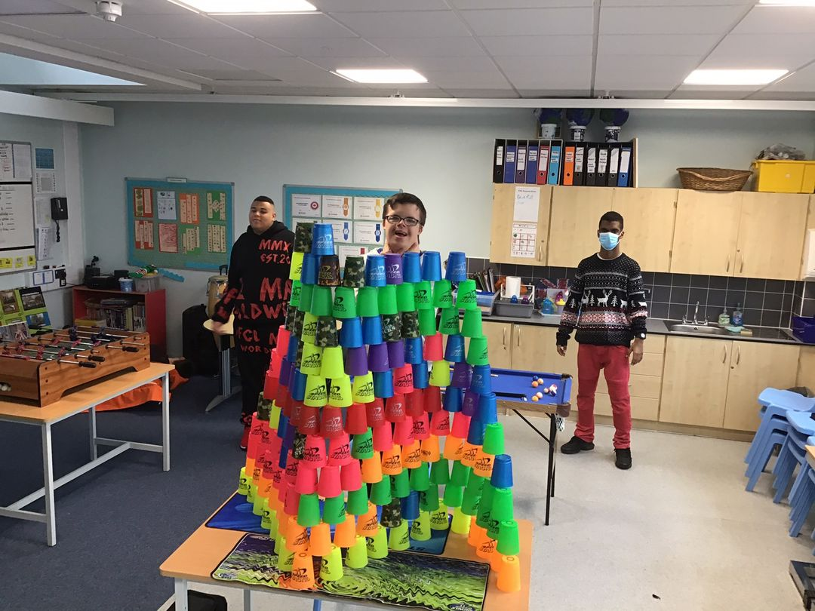
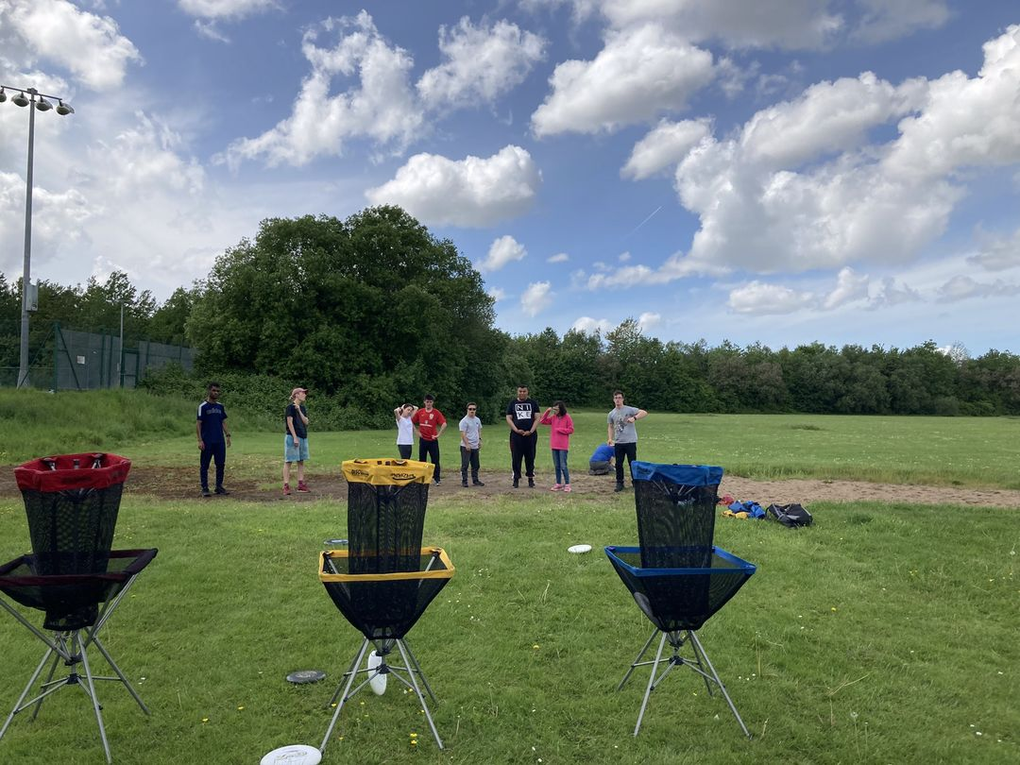
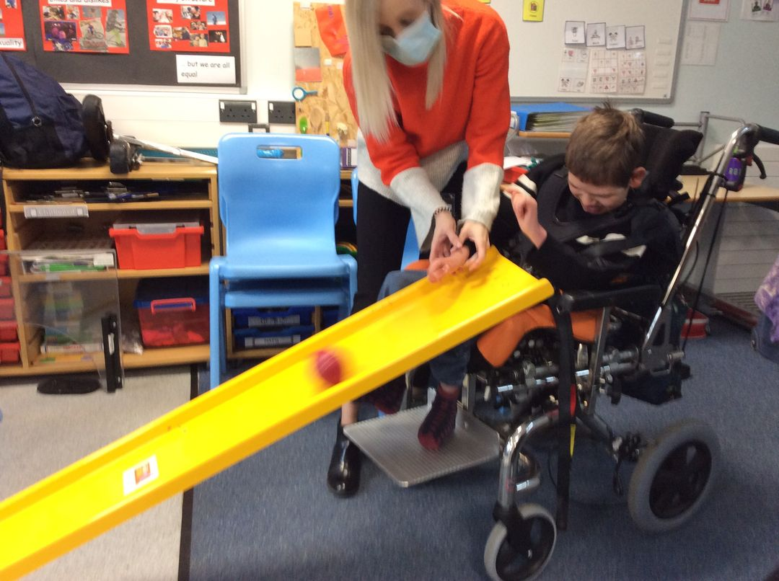
Examples at WPS of a wide range of inclusive PE and Sports activity delivered as part of a balanced curriculum.
2021 -2022.

Slide 16
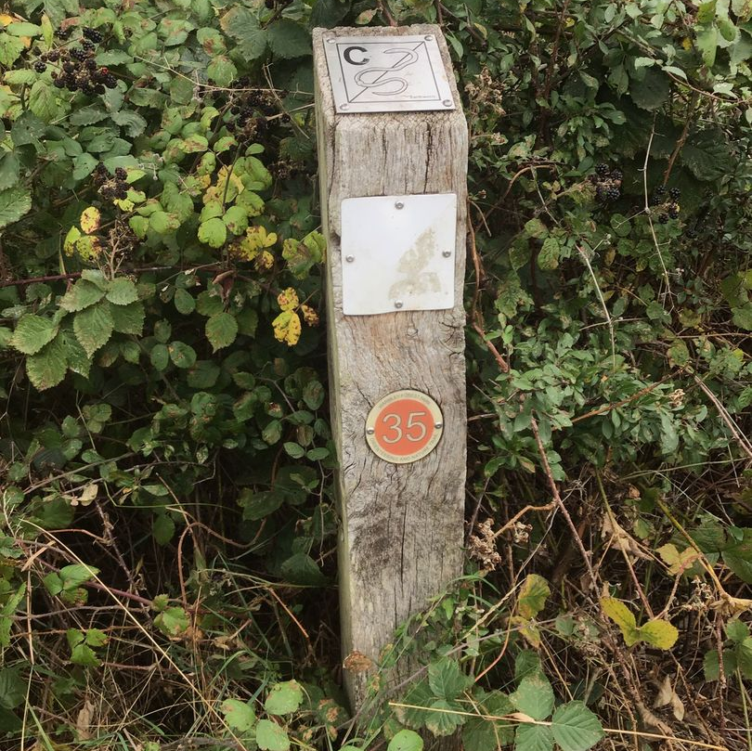
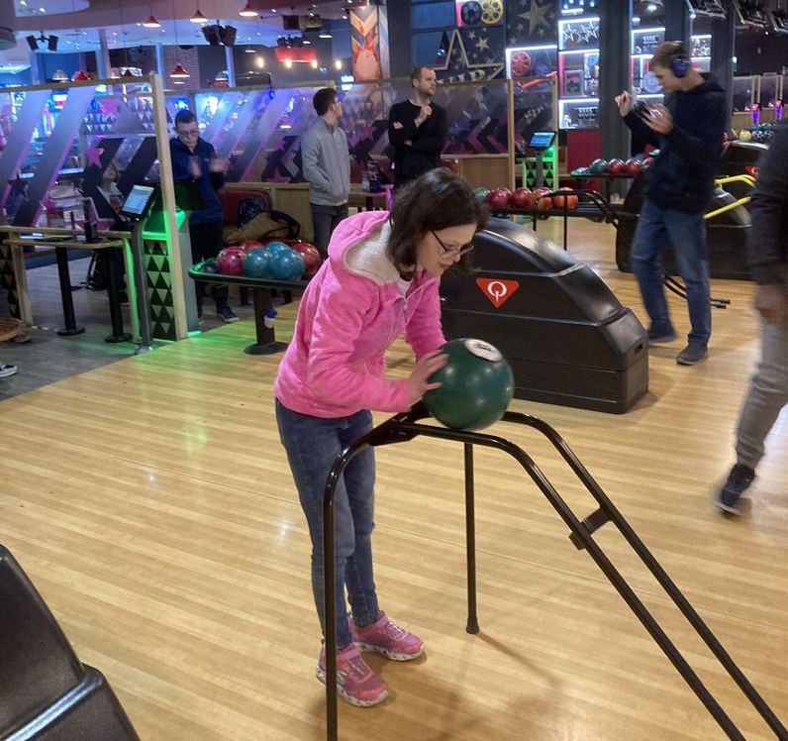
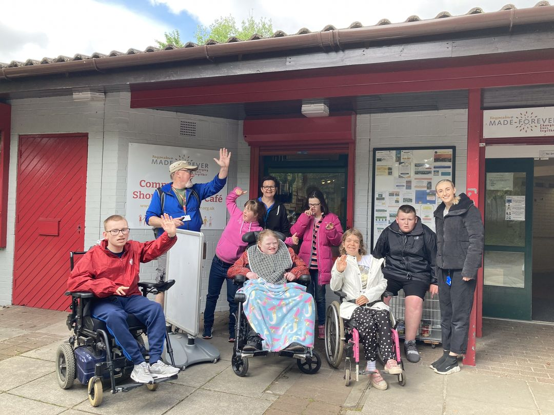
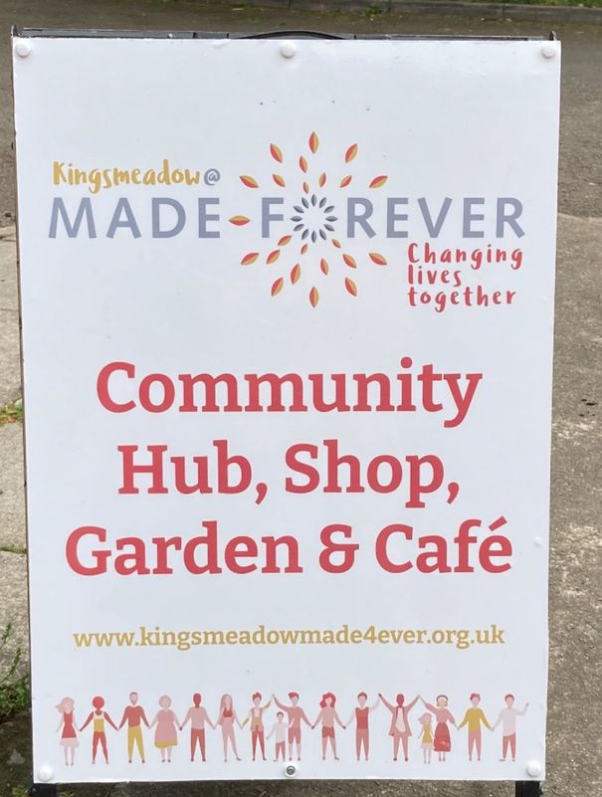
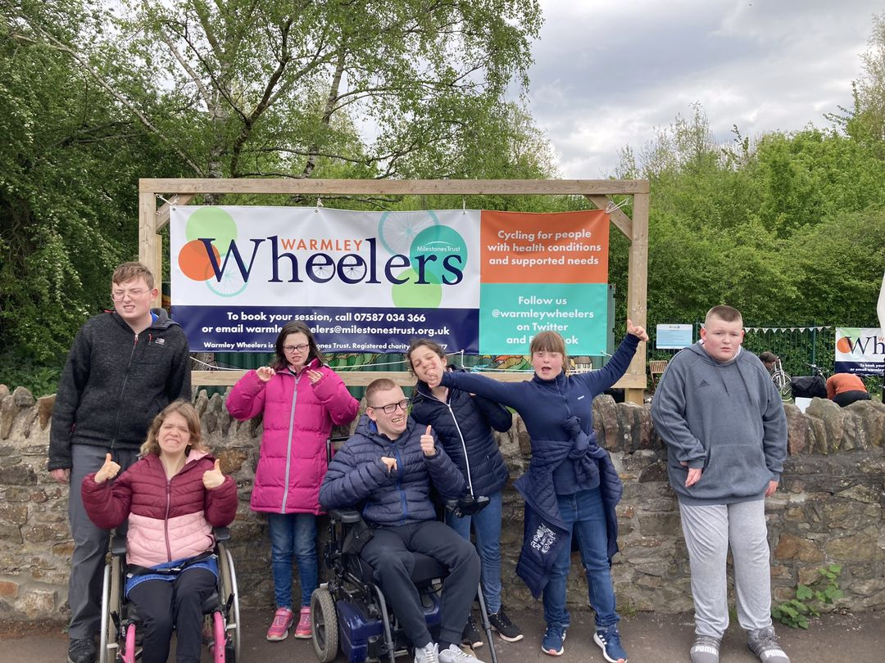
Examples of community facility use for the PE curriculum
2021-2022

Slide 17
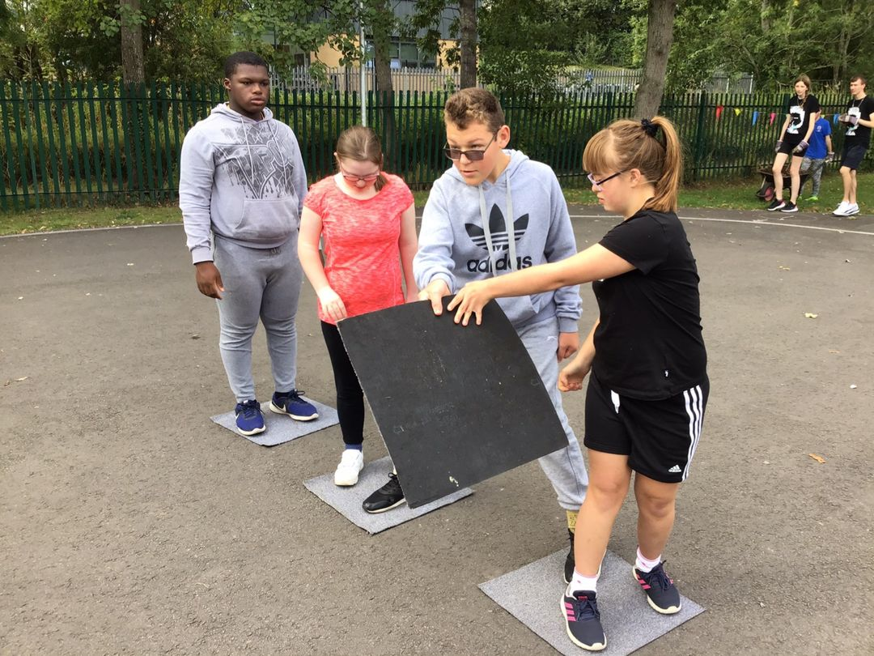
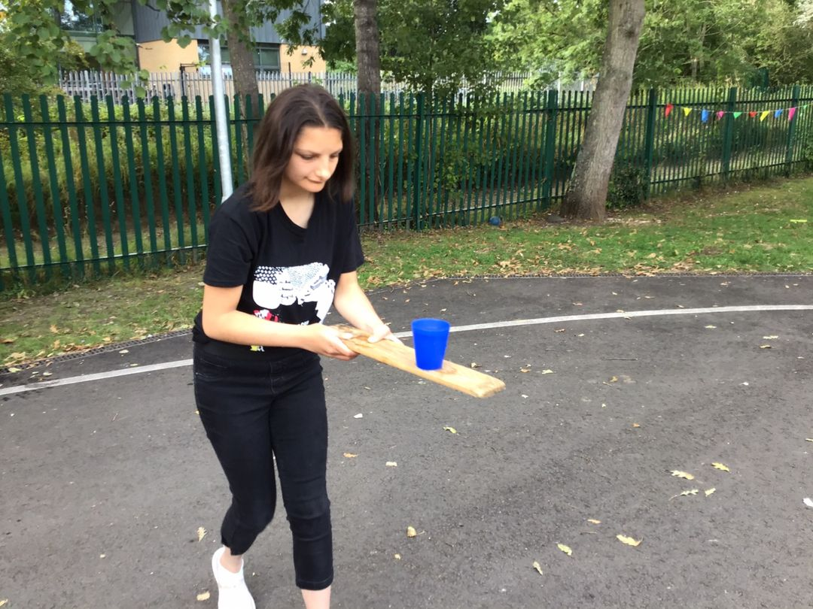
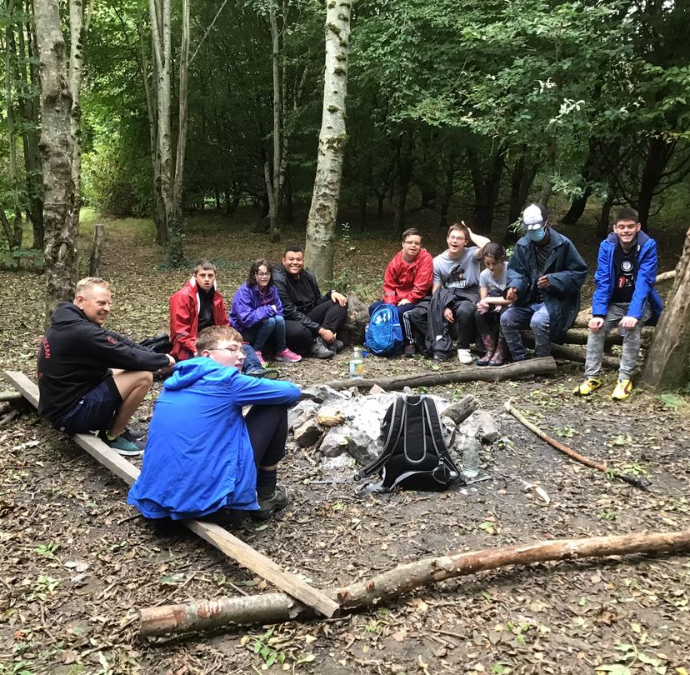
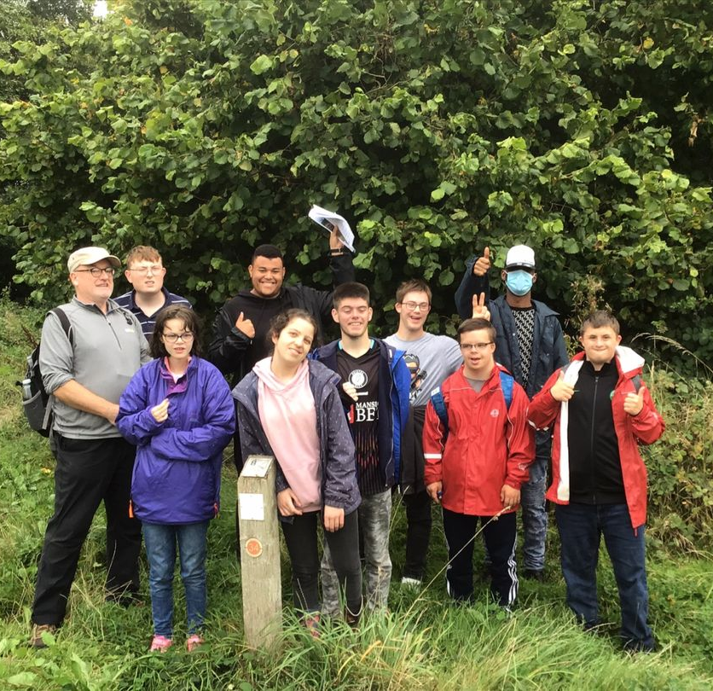
These images show examples of the use of Forest School/Skills at all ages at WPS. It is extremely popular with students.
2021-2022

Slide 18
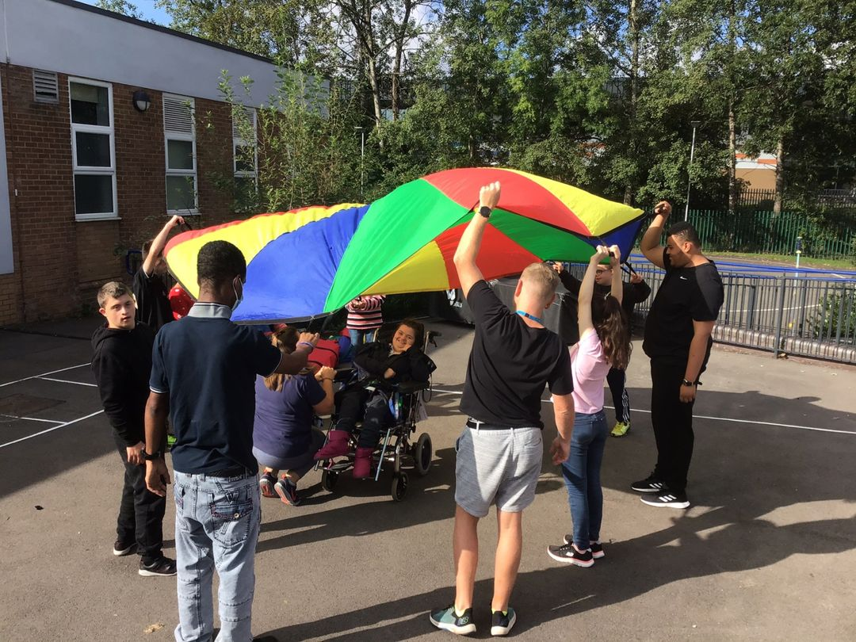
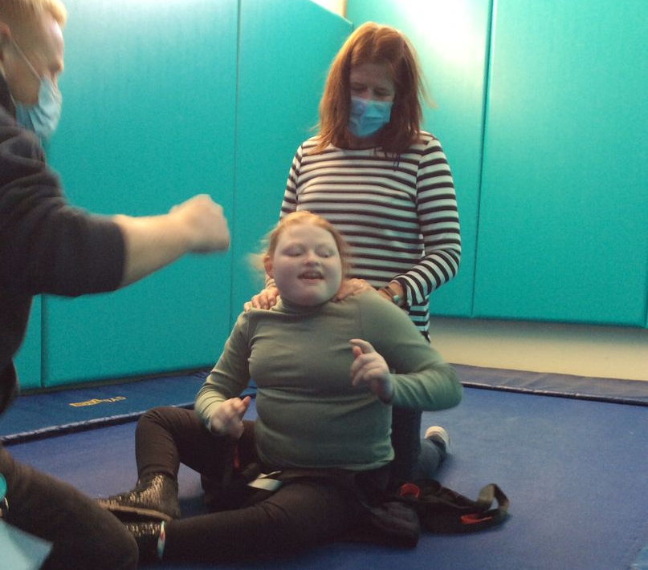
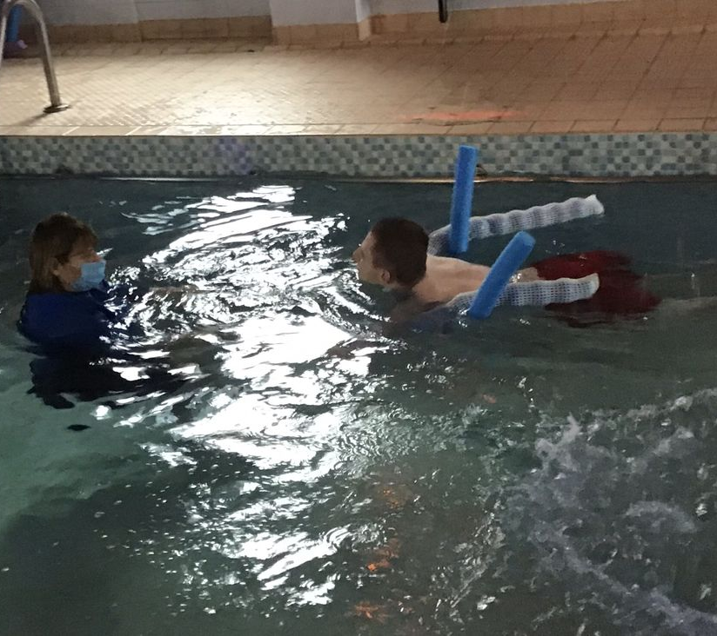
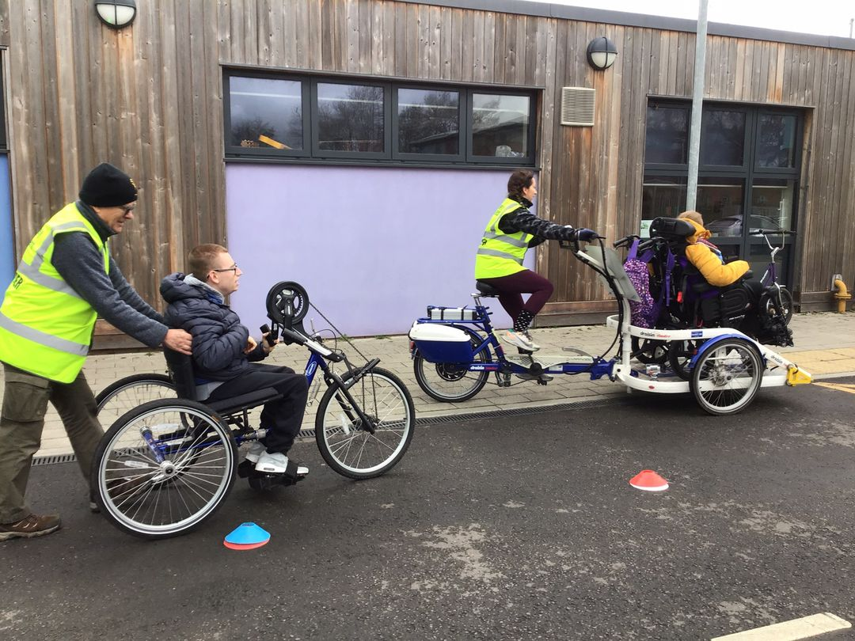
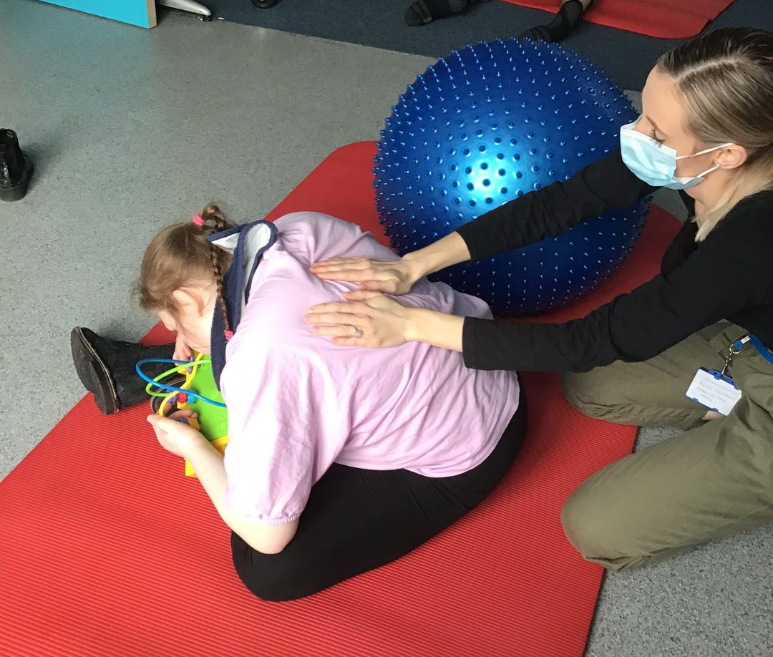
Examples of Sensory and Therapeutic PE activities with students.
2021-2022

Slide 19
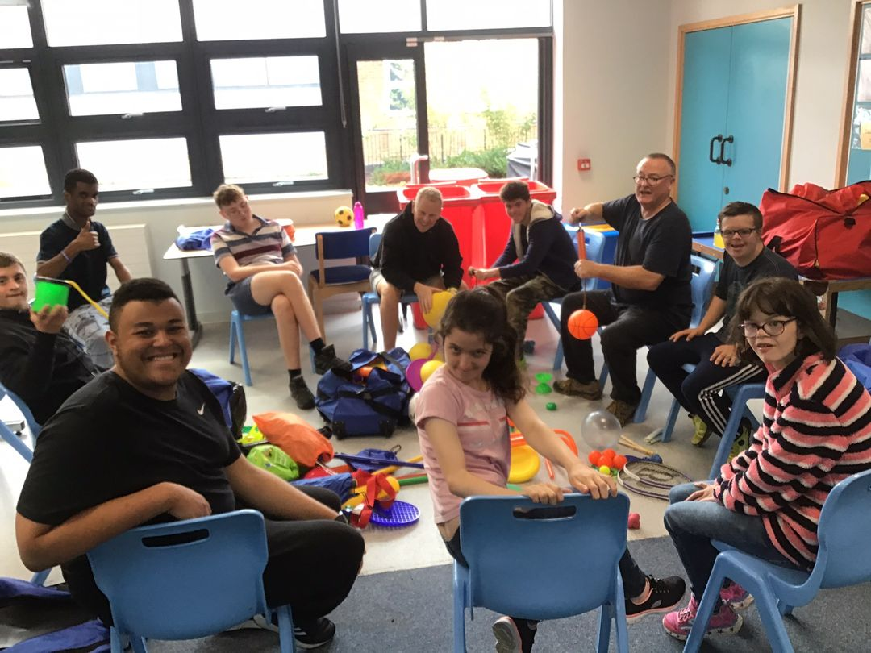
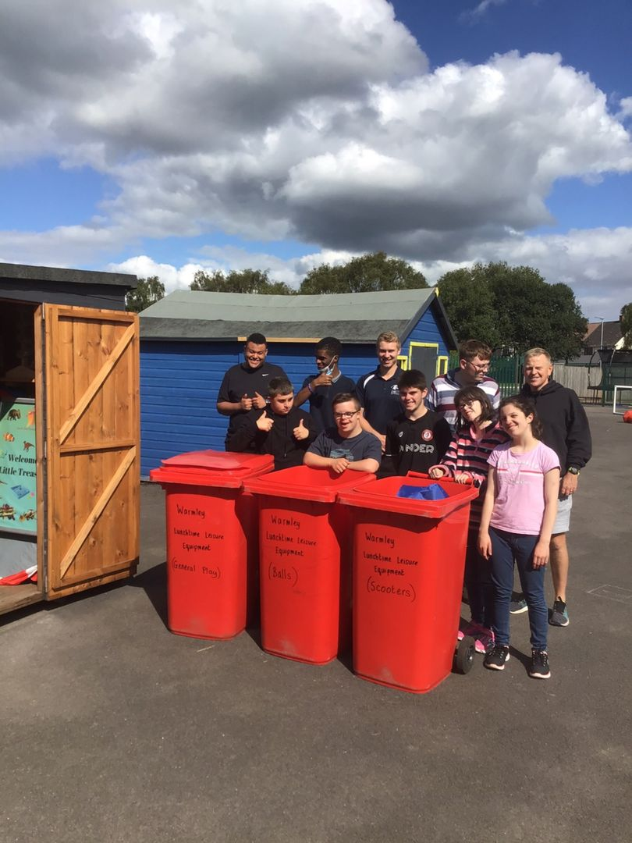
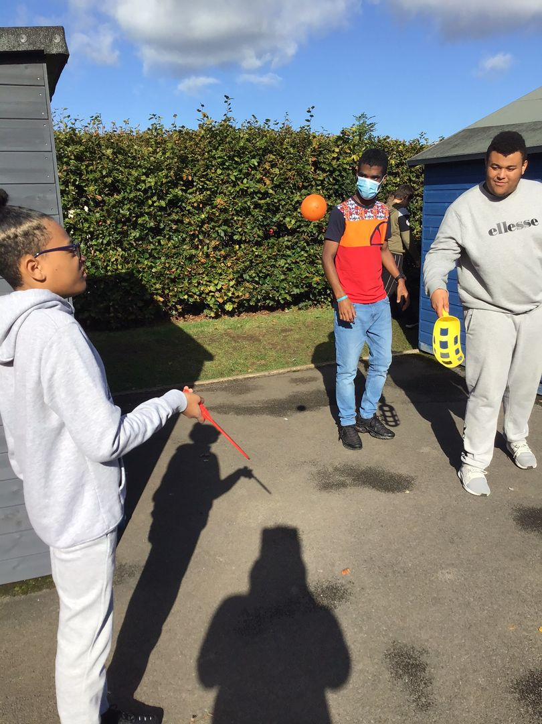
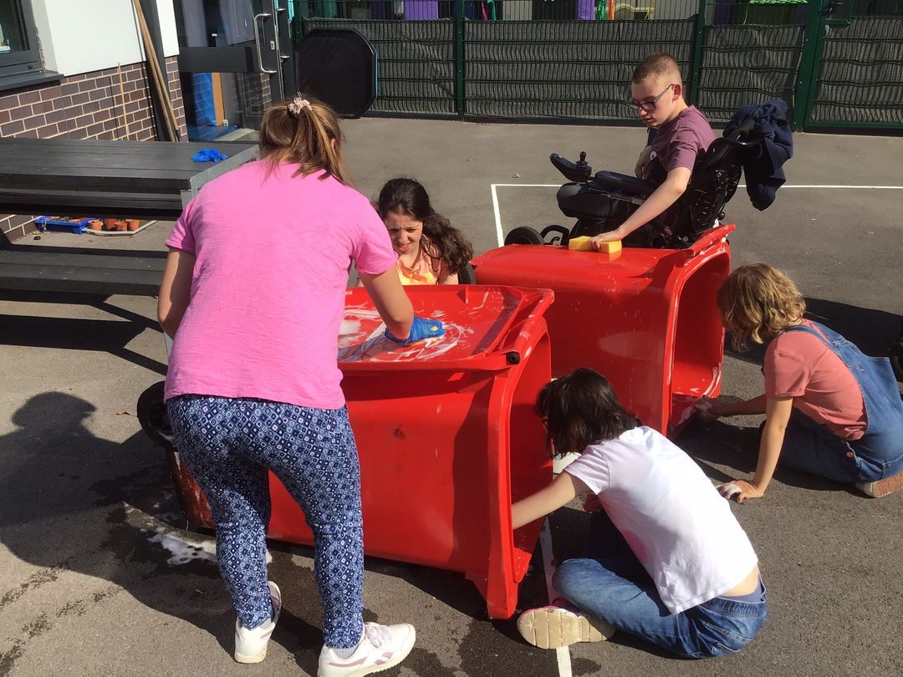
Young Leaders project at Lunchtimes in Secondary playground. CSET coach has aided delivery on weekly basis.
2021-2022

Slide 20
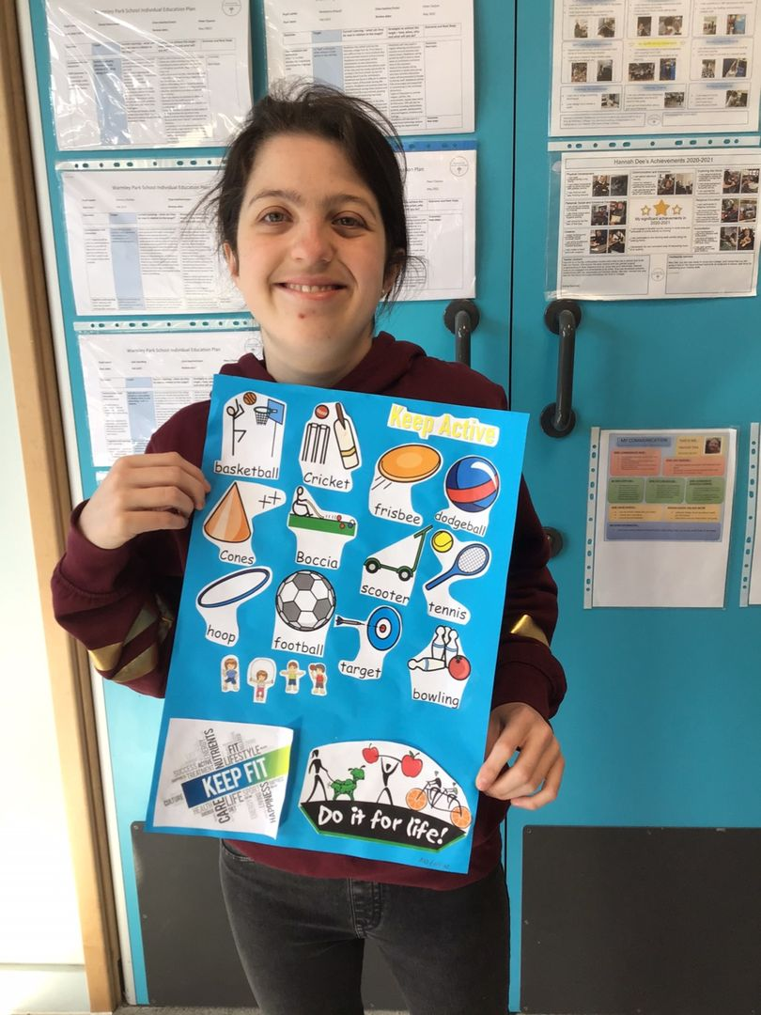
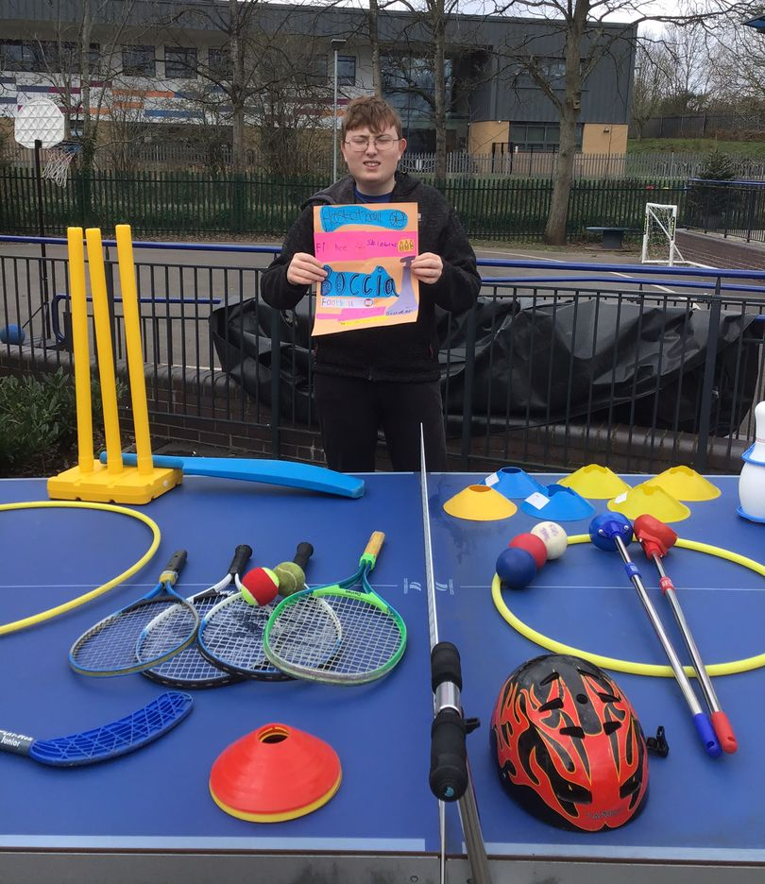
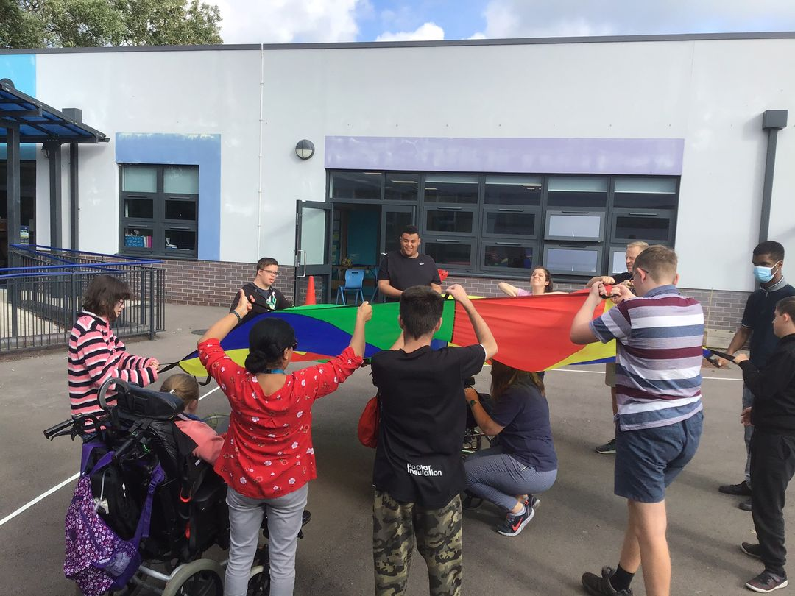
Active Lunchtimes project in post 16. Part of an ASDAN module.
2021-2022

Slide 21
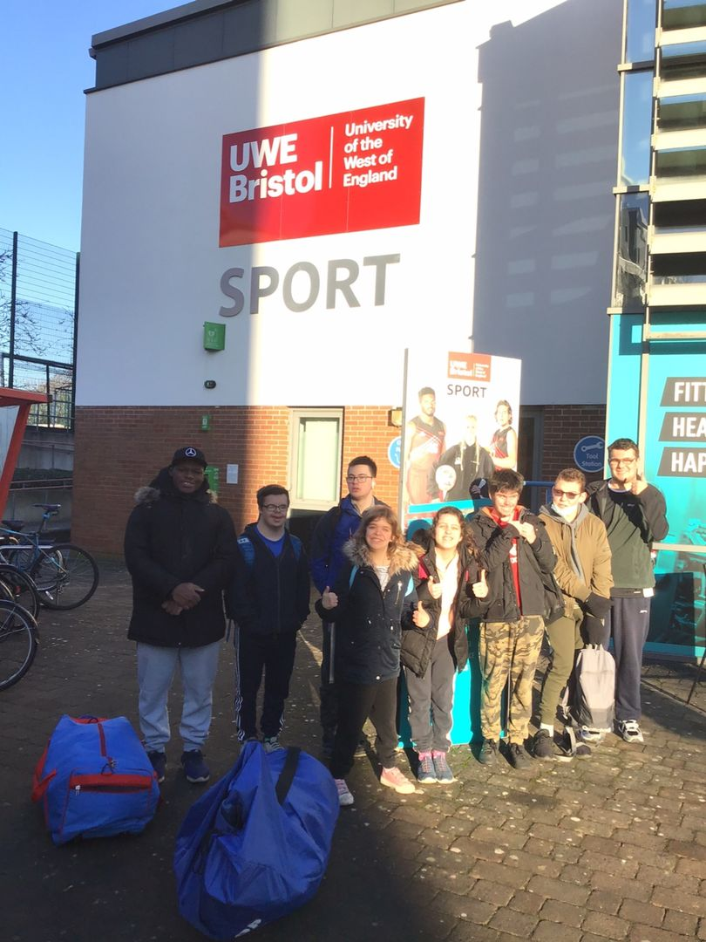
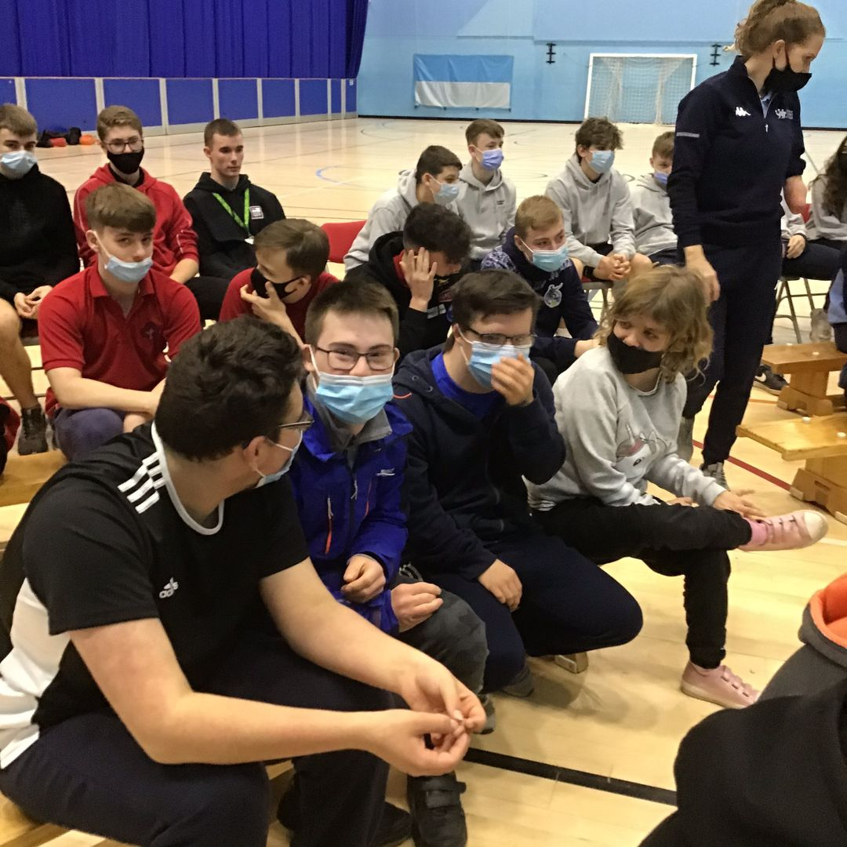
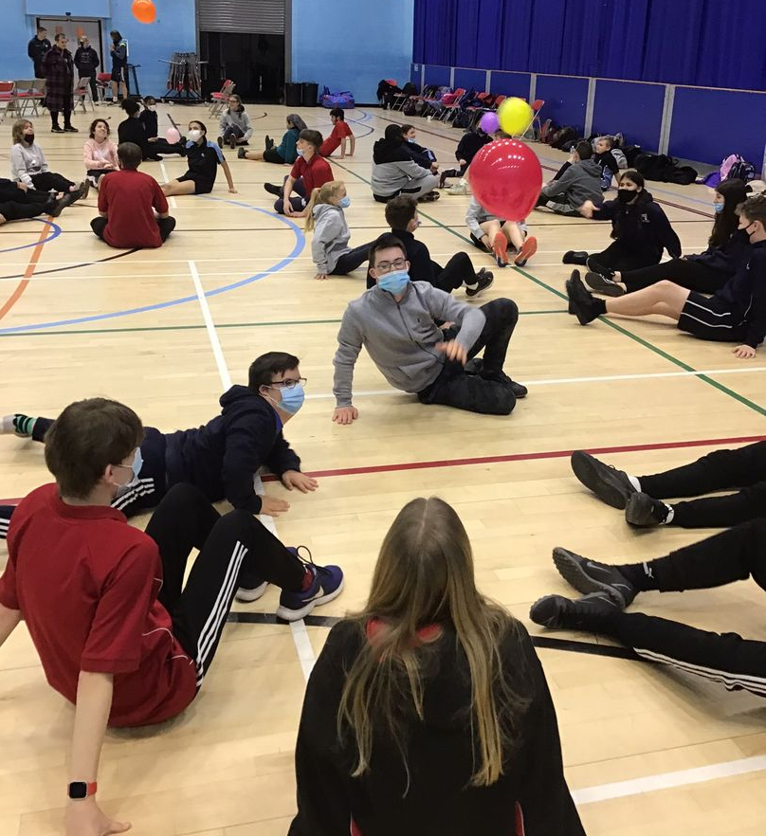
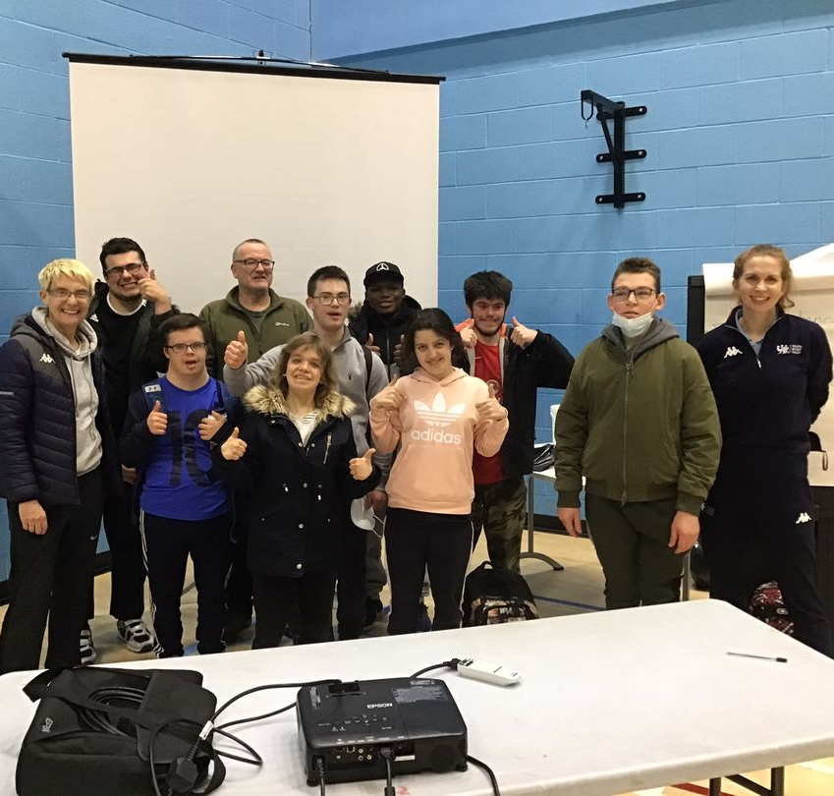
Step Into Sport training with mainstream peers. Over 90 students attended the 2 courses at UWE and Bath Uni.
Jan 2022

Slide 22
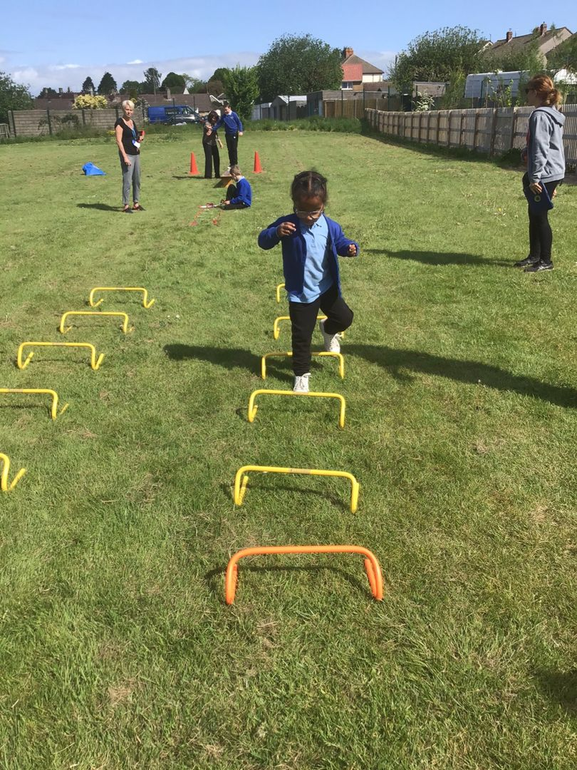
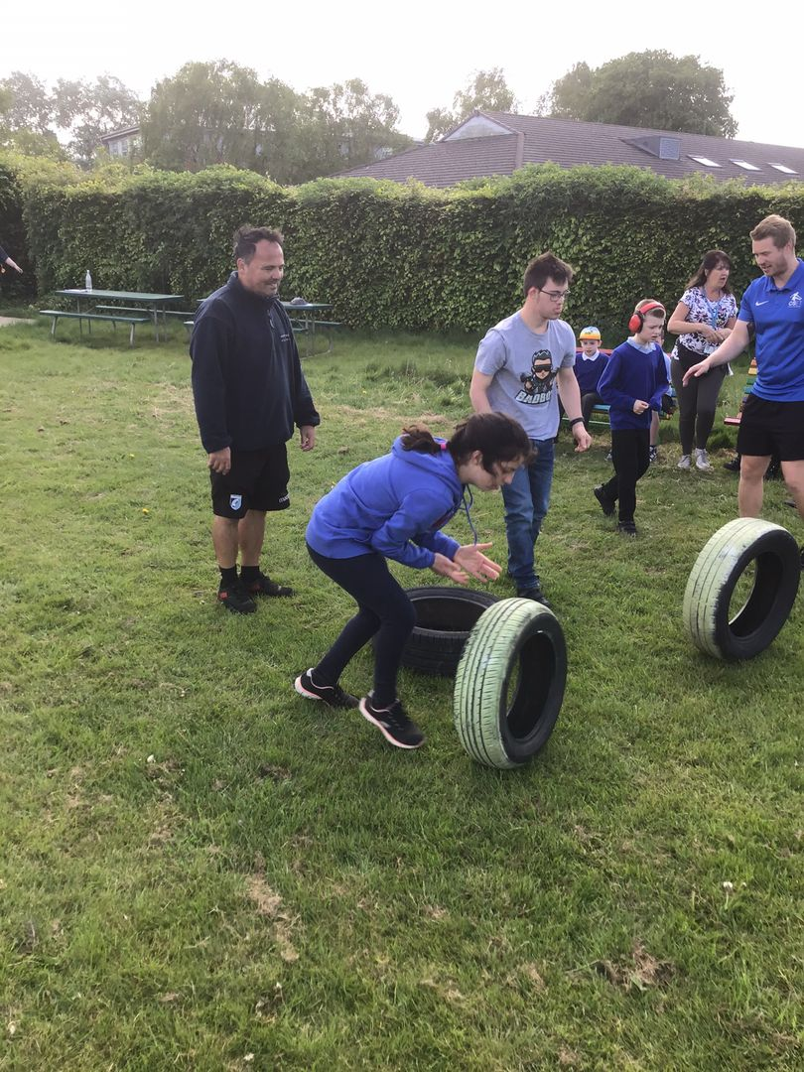
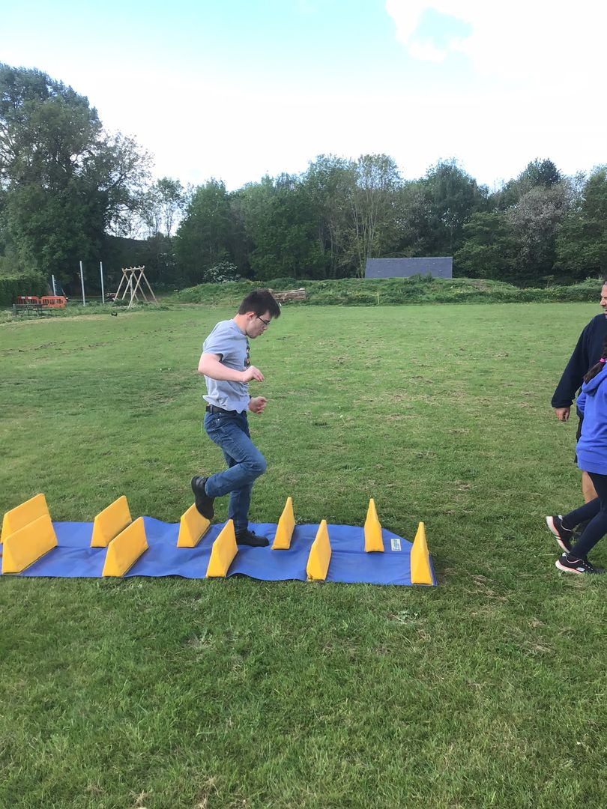
As a result of the Step Into Sport training, post 16 students are beginning to lead at intra class events, such as the KS2 obstacle course. May 2022.

Slide 23
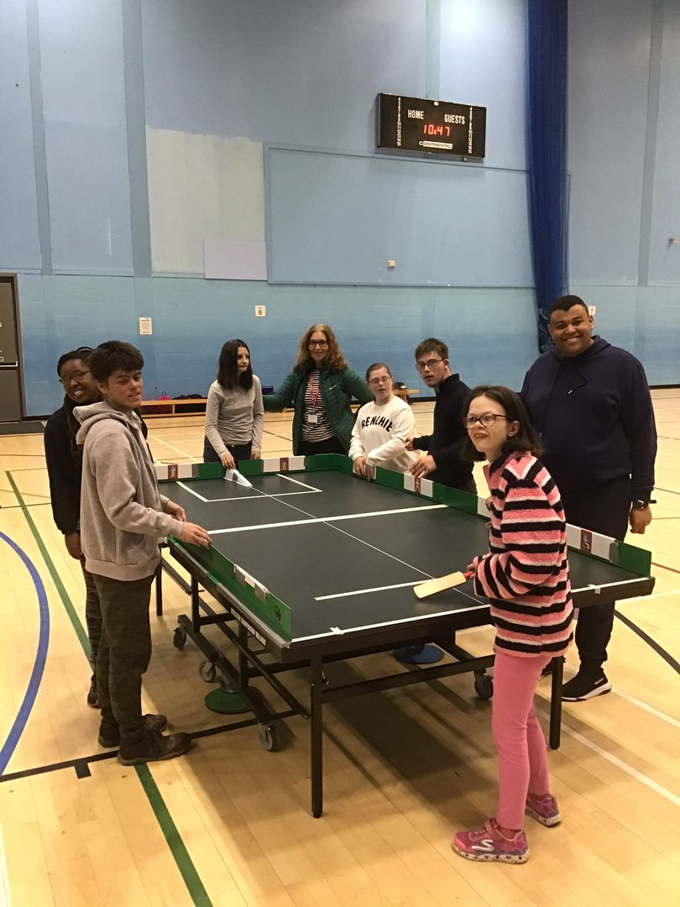
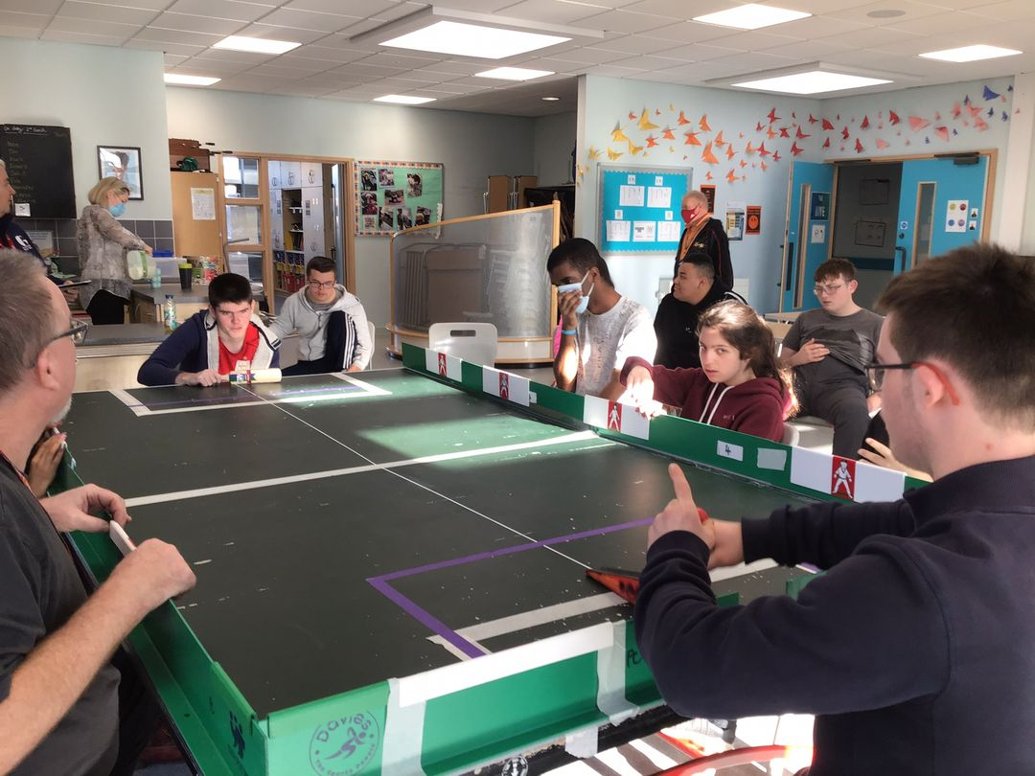
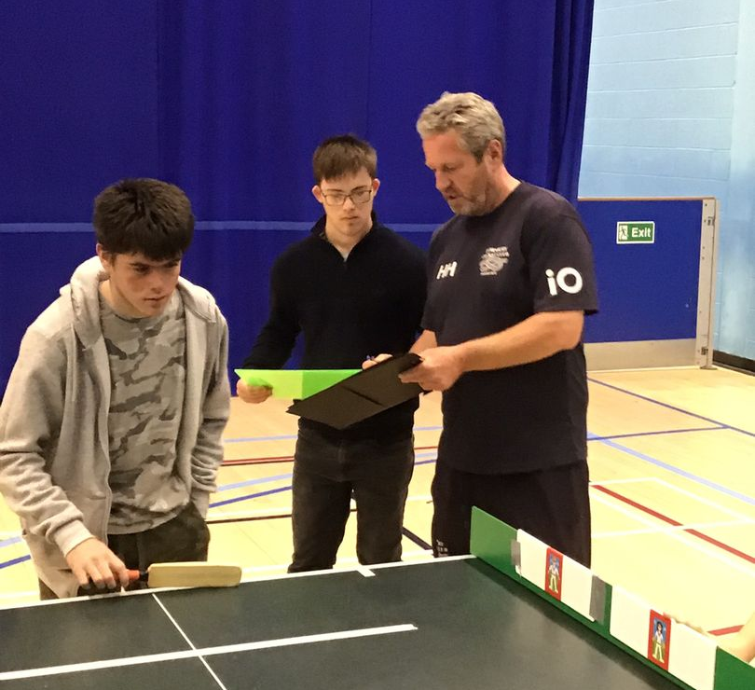
Students in Post 16 have been training as Table Cricket Leaders. As well as playing the game, some have also been officiating at the County Table Cricket competition. March 2022.

Slide 24
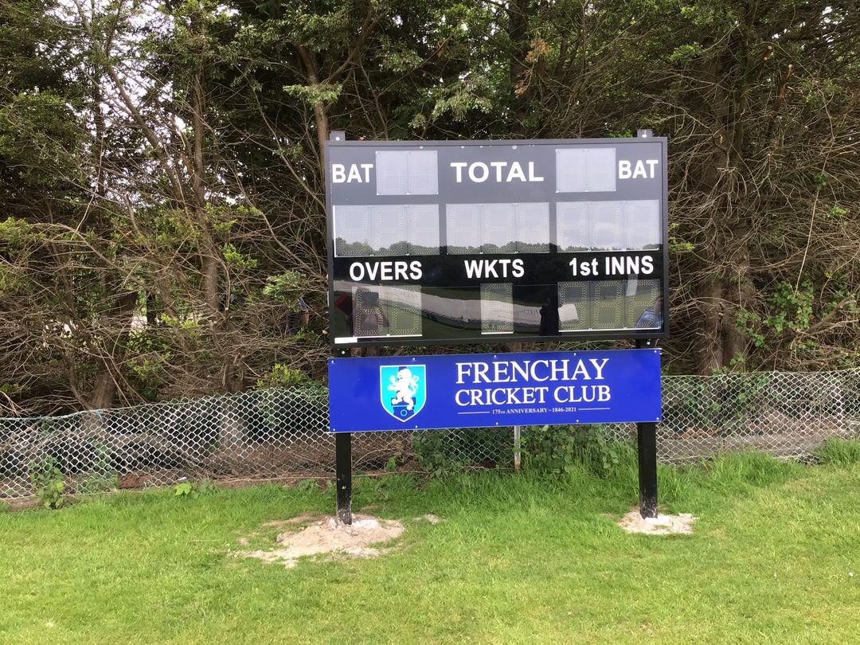
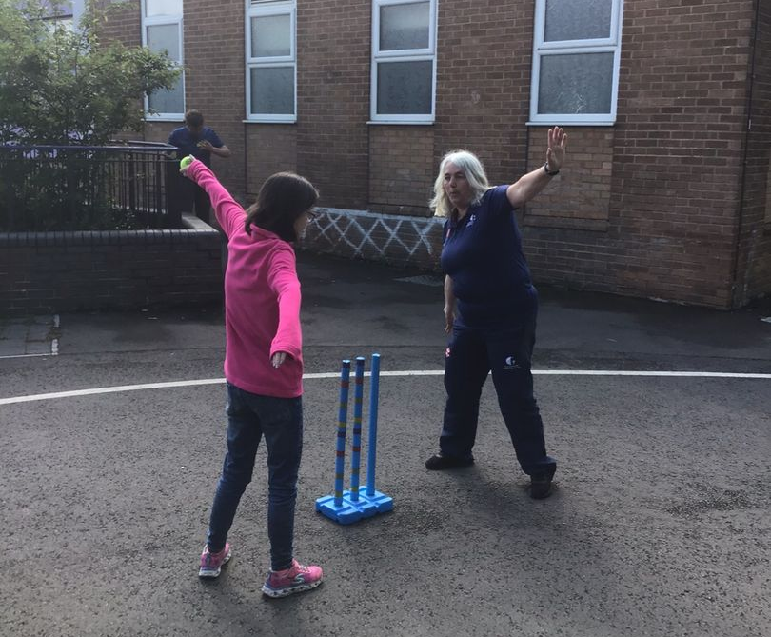
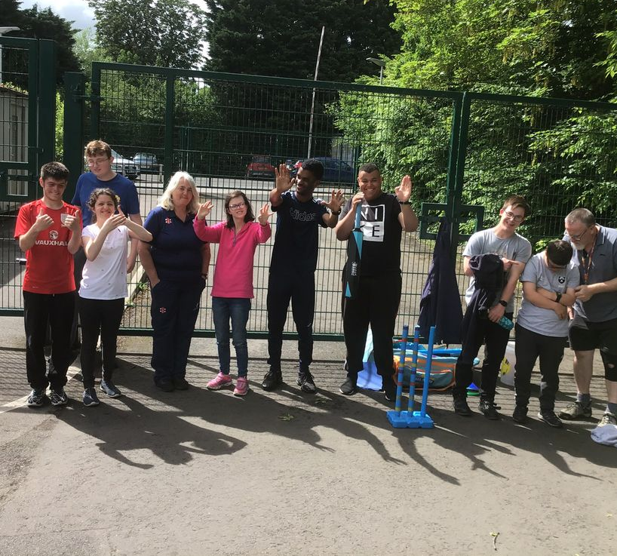
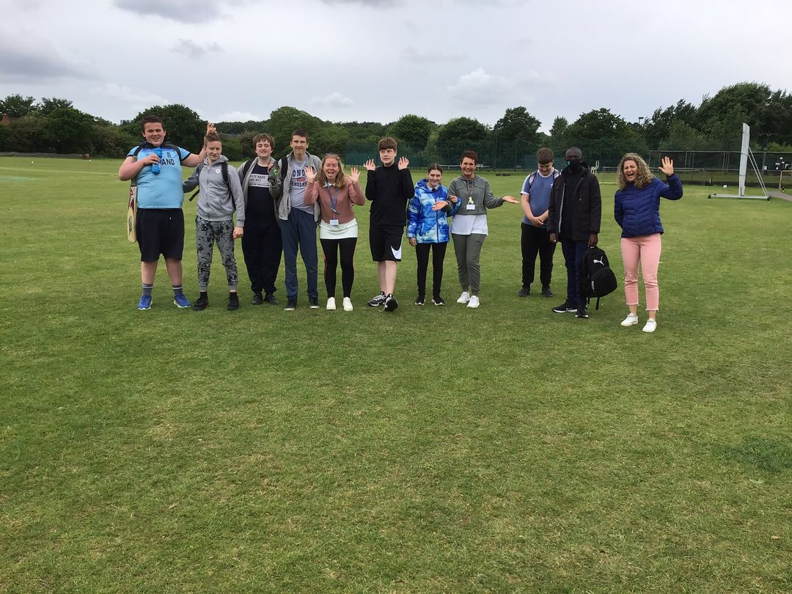
An example of one of the many events that WPS attend throughout the academic year. This is the secondary SEND County Kwik Cricket event held at Frenchay, May 2022

Slide 25
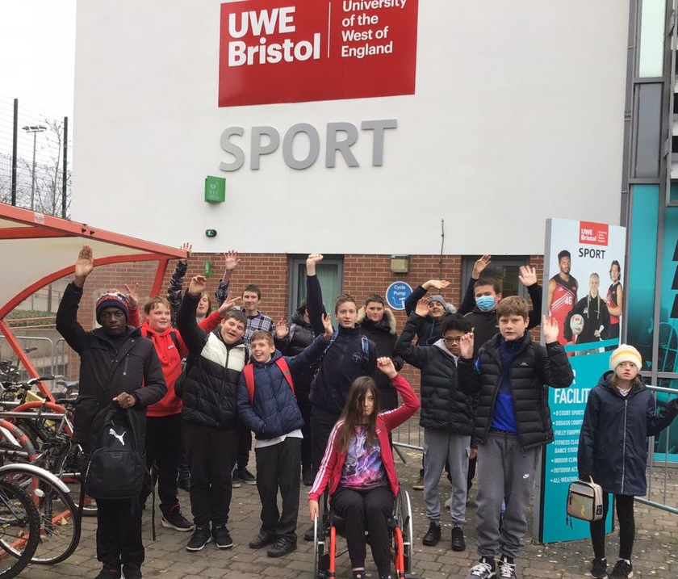
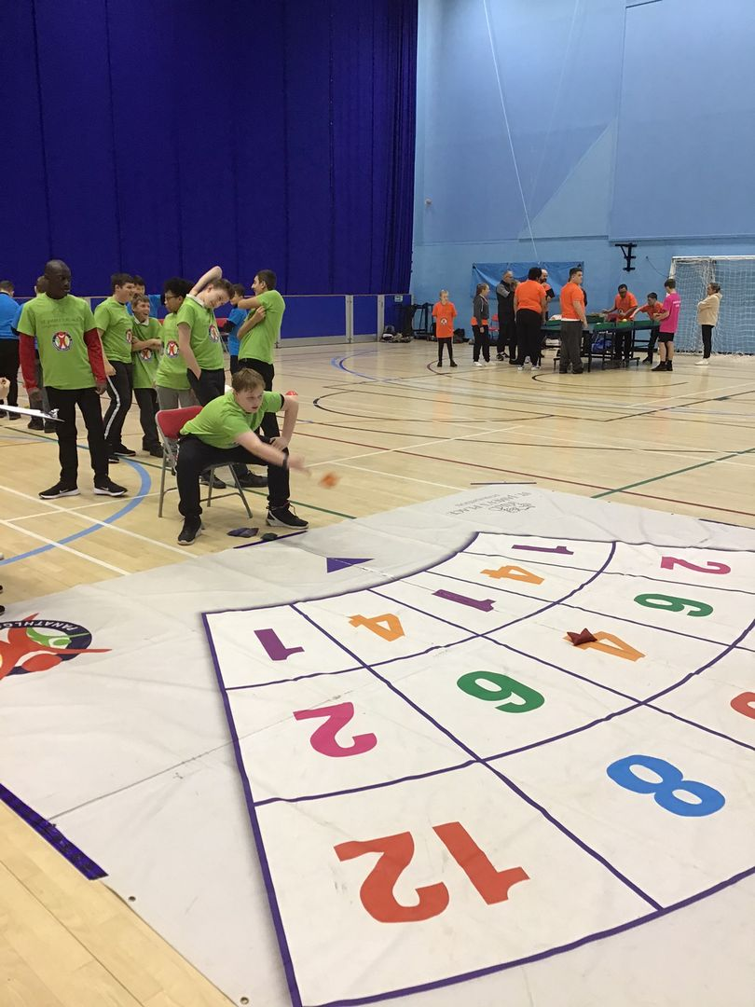
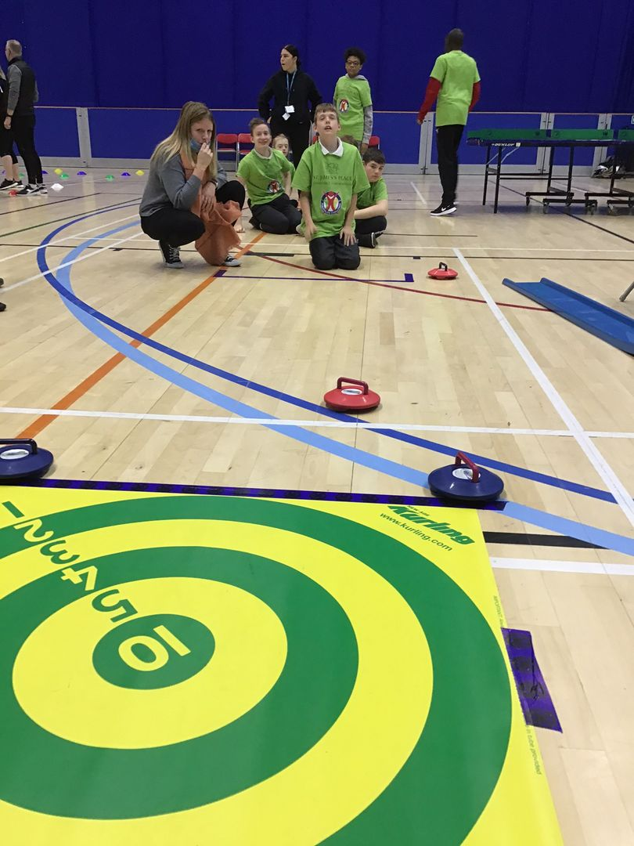
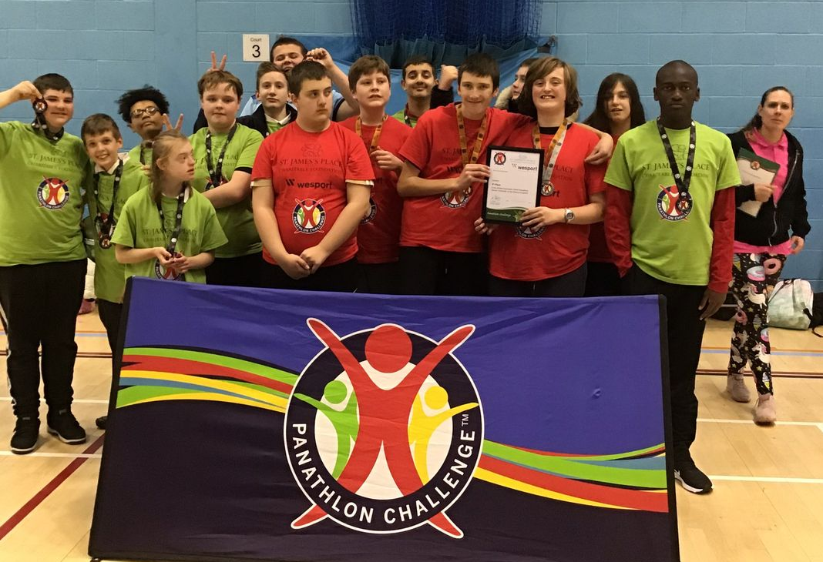
The flagship inter schools SEND event. This is funded by WESPORT and run by the Panathlon organisation on an annual basis. WPS attend each year. Secondary age group at UWE.
Nov 2021.

Slide 26
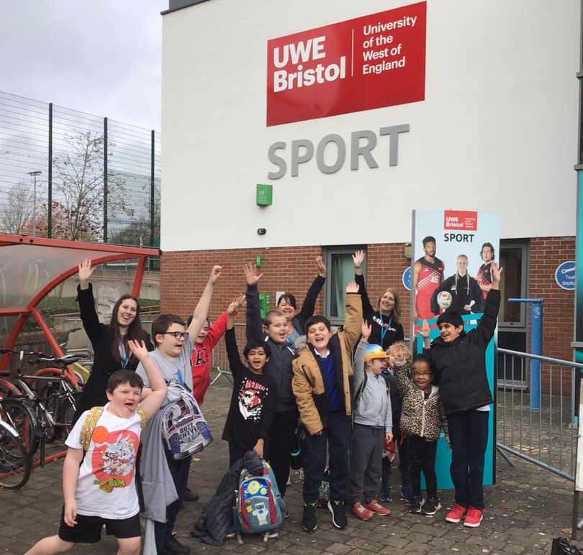
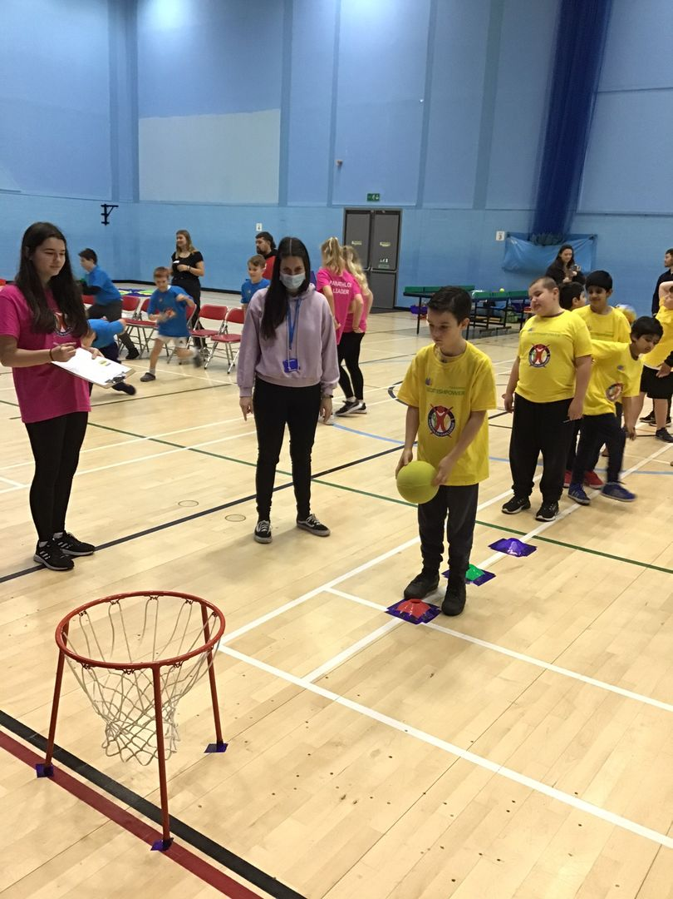
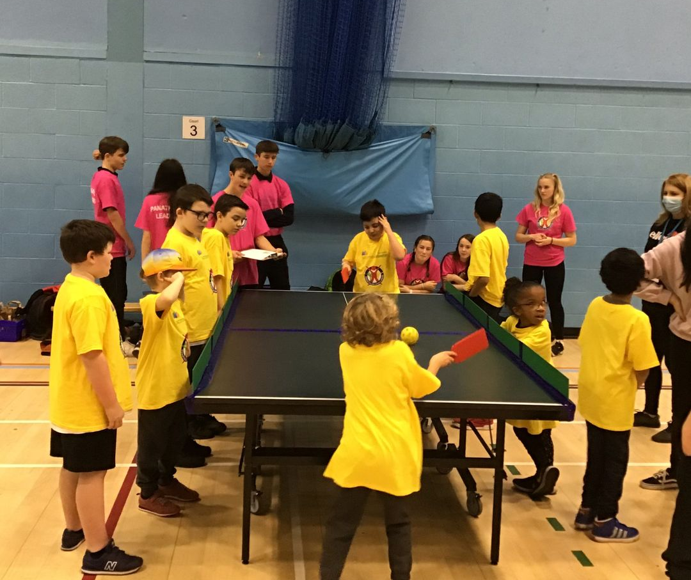
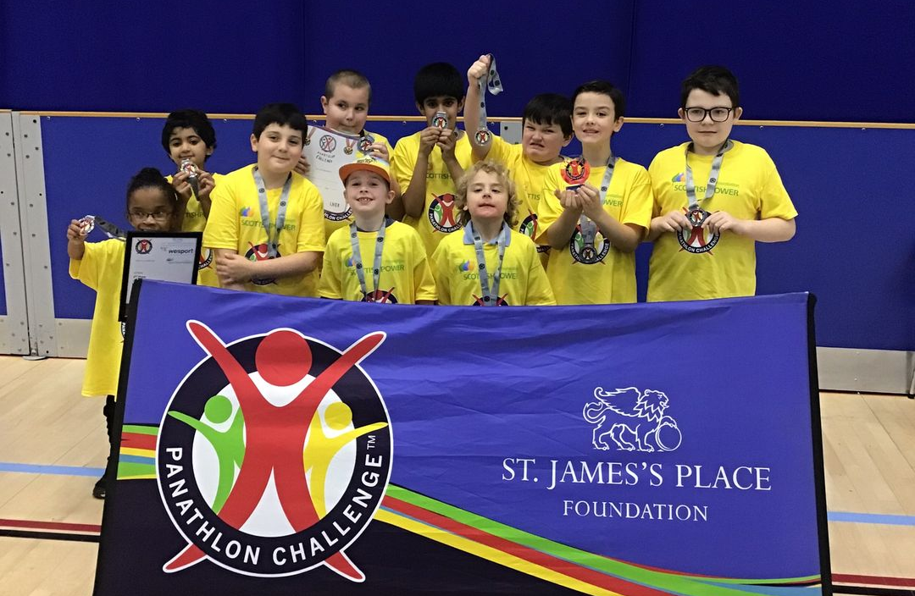
The flagship inter schools SEND event. This is funded by WESPORT and run by the Panathlon organisation on an annual basis. WPS attend each year. Primary age group at UWE,
Nov 2021.

Slide 27
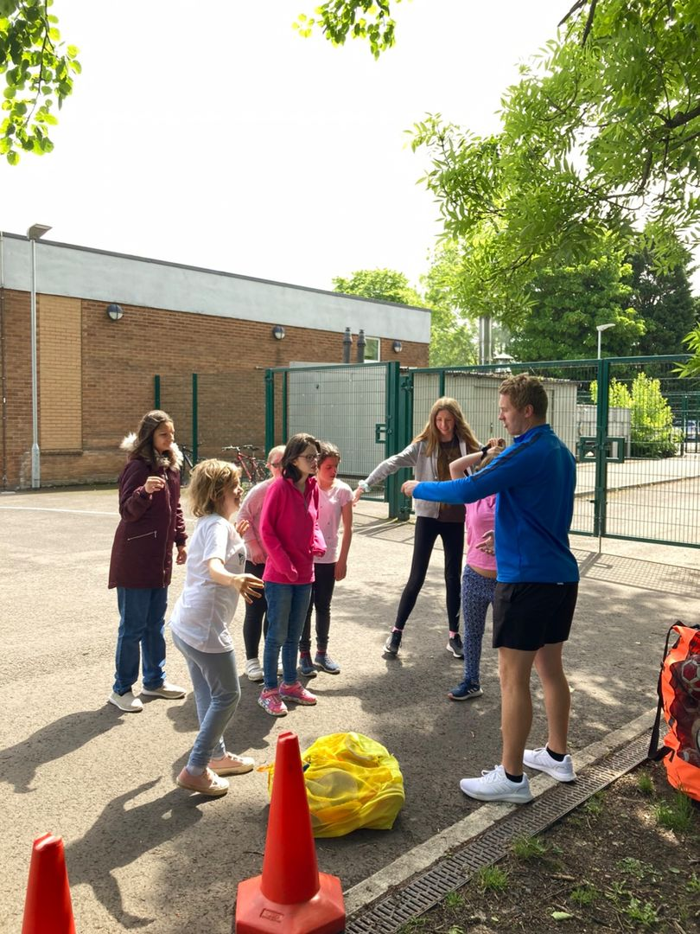
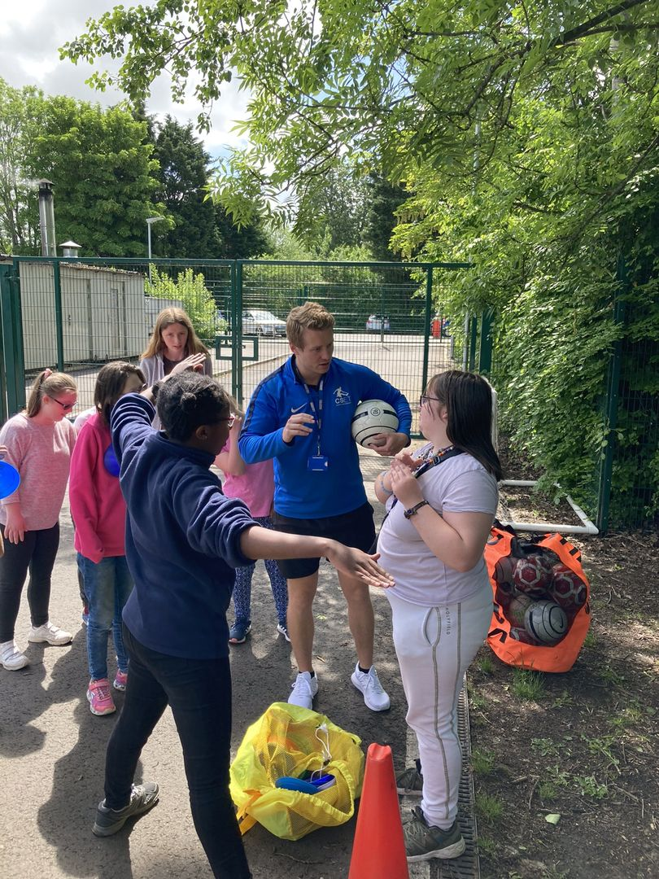
CSET coach, Alex, is currently working with WPS to deliver a pilot project on Girls Football. This is a resource developed by the Youth Sport Trust and the FA. Summer term 2022.

Slide 28
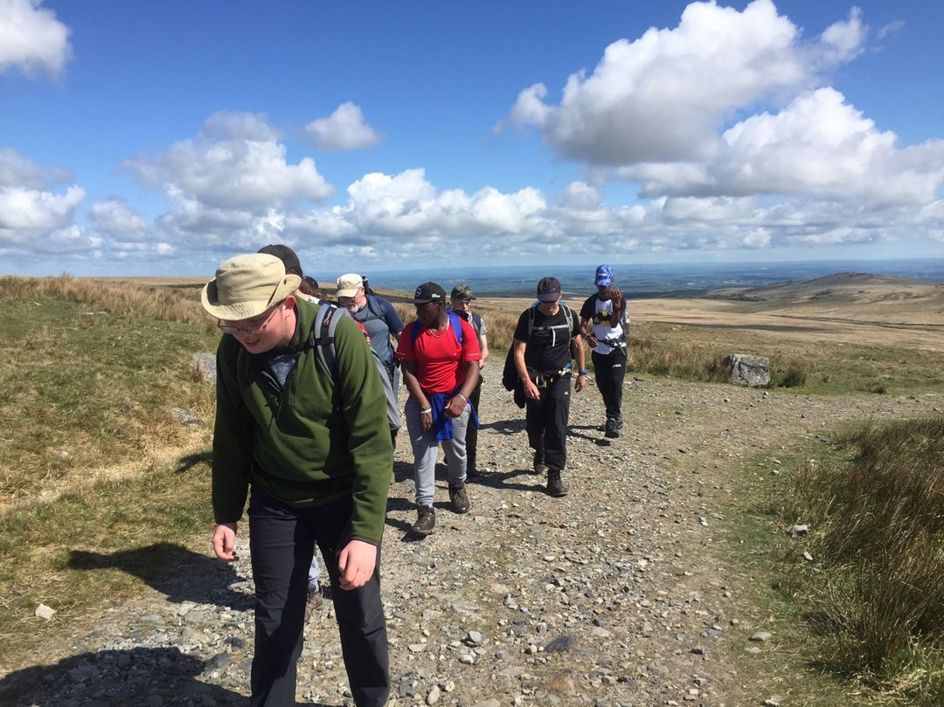
For many years, Marian, Mike and Russell at Warmley Park School and College have given the opportunity for students from WPS to take part in the Jubilee Challenge at the Ten Tors event on Dartmoor. In addition WPS delivers the Duke of Edinburgh award and some fantastic Outdoor (OAA) activities such as sailing and canoeing with the “All Aboard” organisation.
Images from Jan and May 2022.

Slide 29
PE and Sport Premium funding 2021-22
‘The premium must be used to fund additional and sustainable improvements to the provision of PE and sport, for the benefit of primary-aged pupils, in the 2021 to 2022 academic year, to encourage the development of healthy, active lifestyles.’
https://www.gov.uk/government/publications/pe-and-sport-premium-conditions-of-grant-2021-to-2022/pe-and-sport-premium-conditions-of-grant-2021-to-2022-maintained-schools
At Warmley Park we are using our PE and Sports Premium funding to support primary pupils but alongside this we have allocated funding from the school budget to enable all pupils to promote quality PE for all pupils. Our funding for 2021-22 was £16810
1. We identified a group of 16 pupils who were struggling with their readiness to learn due to sensory regulation behaviours. To support these pupils we used the PESP to pay for weekly cycling lessons at 2 different venues which were evaluated at the end of the year as being highly effective with pupils with 100% engagement. This in turn, along with Forest School and swimming has led to better levels on engagement during subject specific teaching time. For next year we will build on this to include more pupils in a whole school cycling initiative.
2. 12 Primary pupils have received Rebound Therapy funded by the PESP (this is in addition to those who have it on their EHCP). Assessment shows an increase in core strength and stability which is improving posture, and increased sensory regulation which is improving readiness to learn. One day per week of HLTA
3. Targeted support for pupils who do not have access to green areas (ie garden) at home or for whom going to shared play areas such as parks with their families is difficult. Forest School sessions with 1:1 support to enable pupils to explore freely. Evaluation demonstrated increased physical skills such as climbing and walking with more stamina.
Focus | Activity | Numbers of pupils | Cost | Assessment
1 | Cycling | 16 | £6,460 | Highly effective
2 | Rebound | 12 | £5,250 | Highly effective
3 | Forest School | 4 | £5,100 | Highly effective

