Slide 1
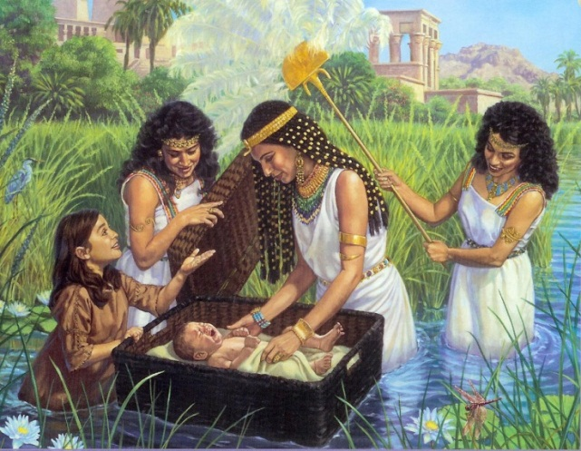
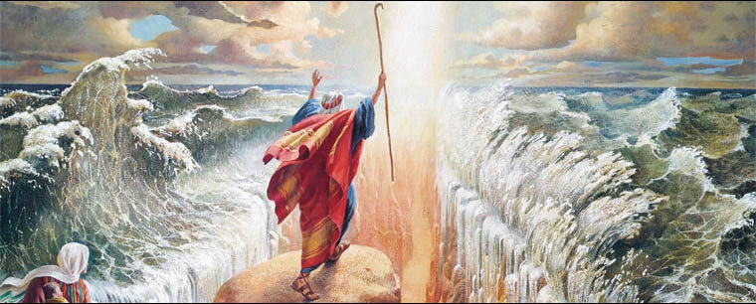
Moses and the Exodus
LO: To understand why the Exodus was such a significant event in Jewish and Christian history.

Slide 2
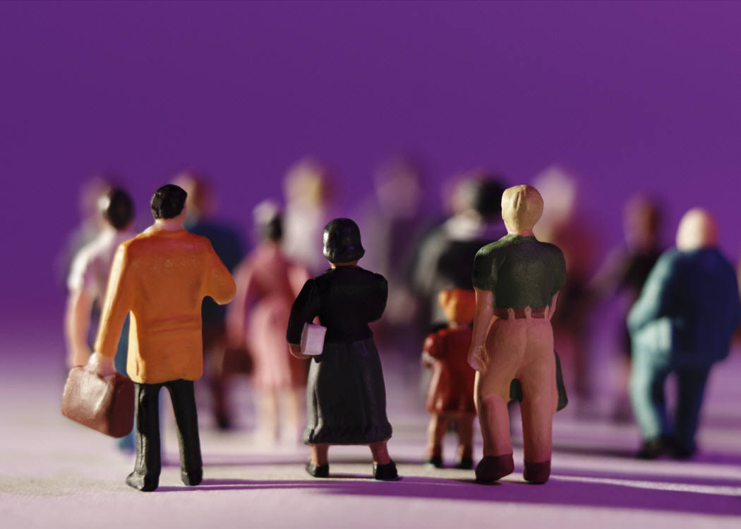
The Exodus
What does it mean?
Are there any words that sound similar?
Does anybody know what it refers to?
Notes:
Think, pair, share

Slide 3
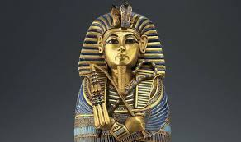
Why do you think Pharaoh refused to let the Jewish people go?

Slide 4
The plagues of Egypt
The Plagues of Egypt
Which plague would have convinced you to let the Israelites go and why?
The ten plagues were: river of blood, frogs, mosquitos, flies, death of animals, boils, hail, locusts, darkness and the death of the eldest son.
Notes:
Students to try and get as many plagues as they can- then read the information sheet and for each one they got from watching the video, give themselves a point

Slide 5
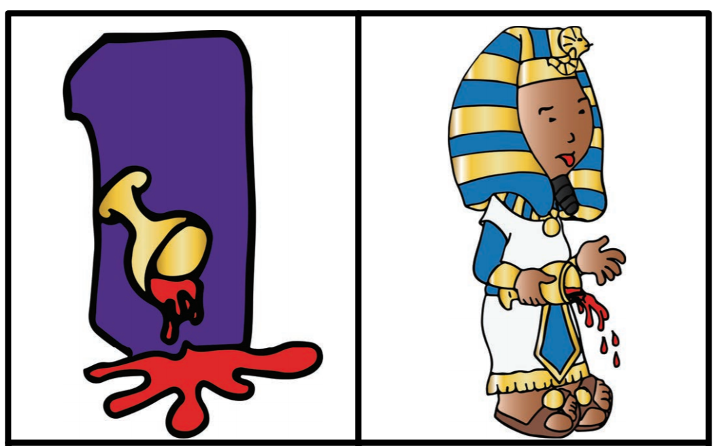

Slide 6
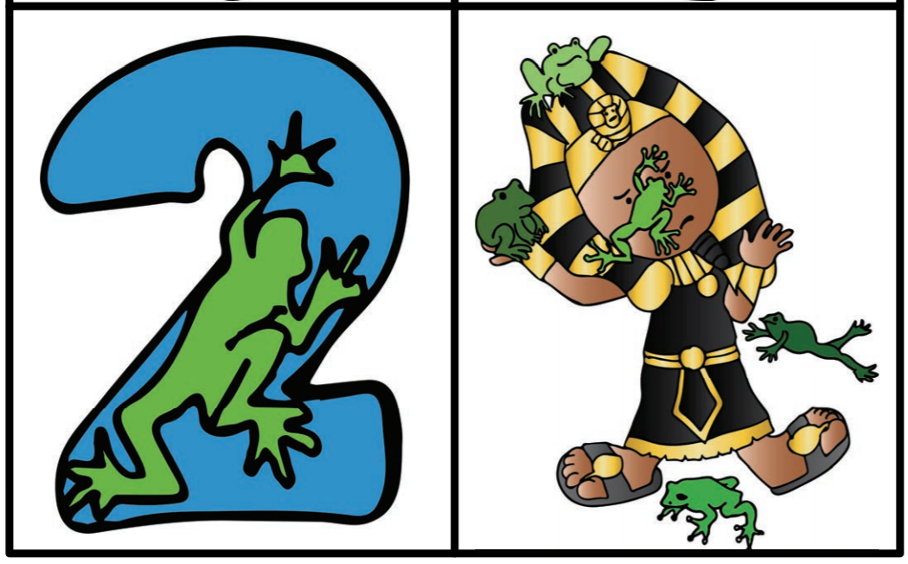

Slide 7
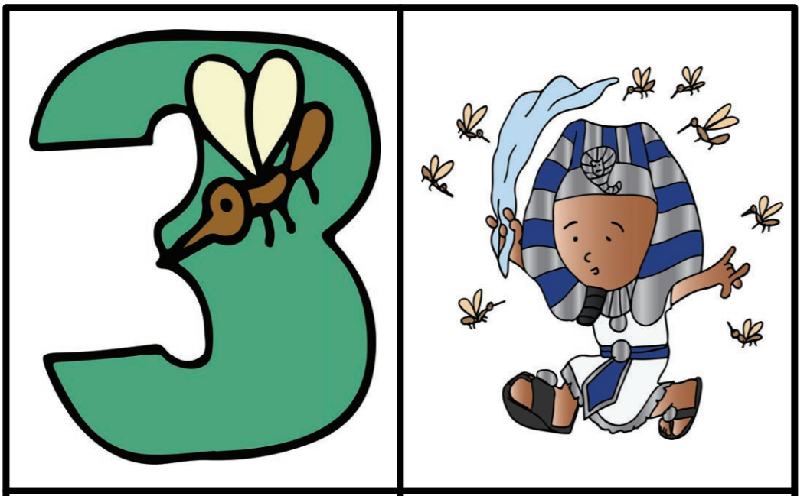

Slide 8
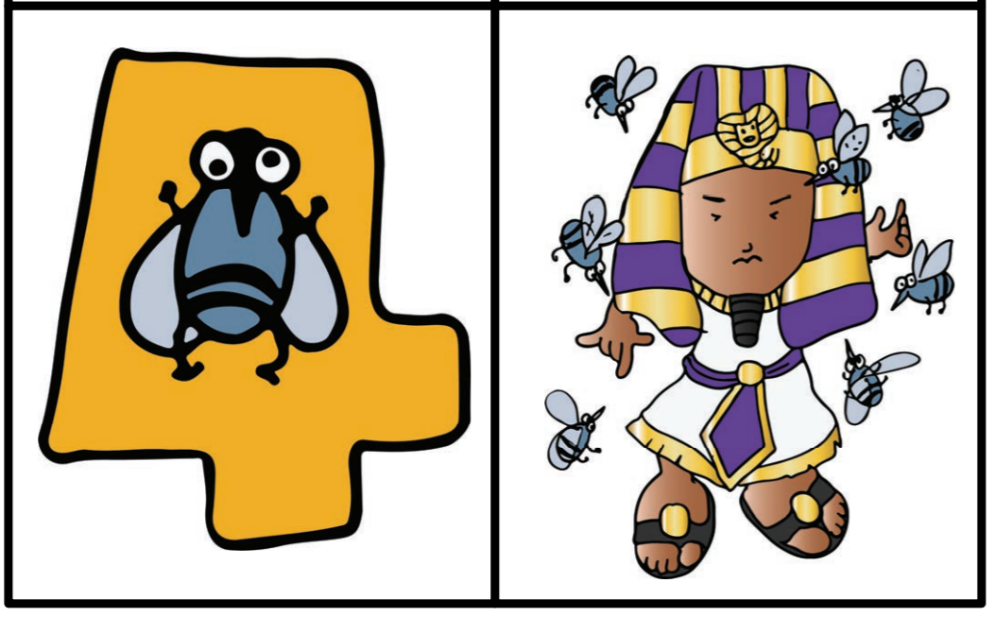

Slide 9
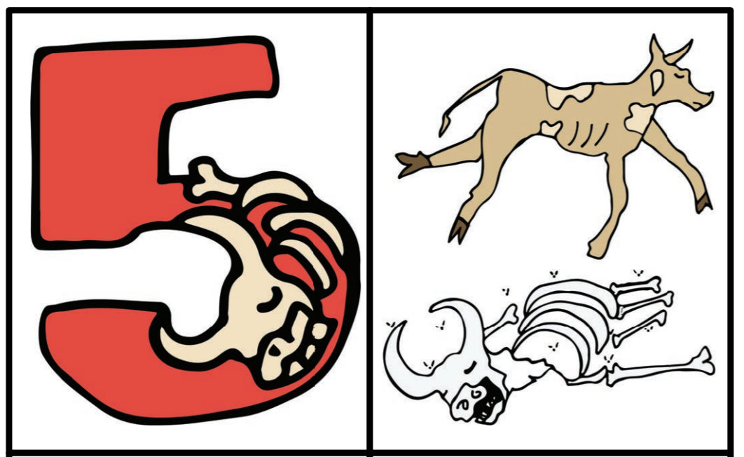

Slide 10
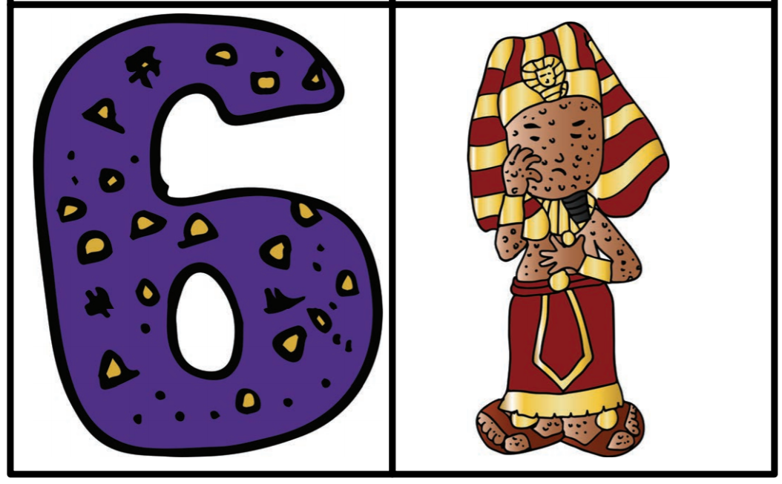

Slide 11
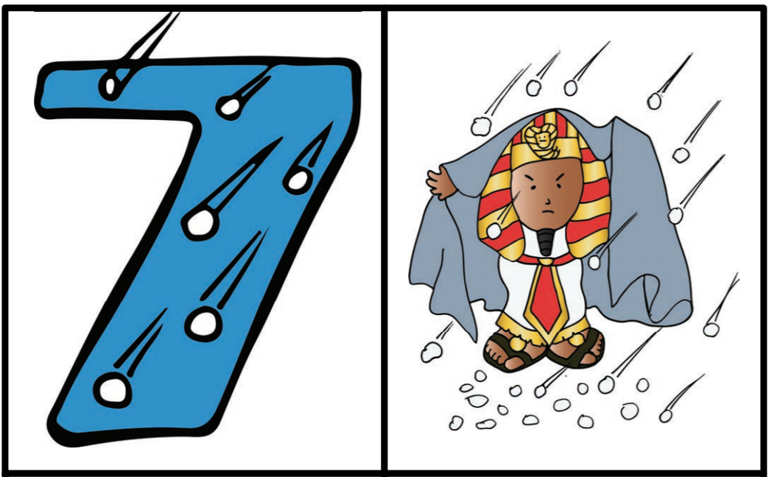

Slide 12
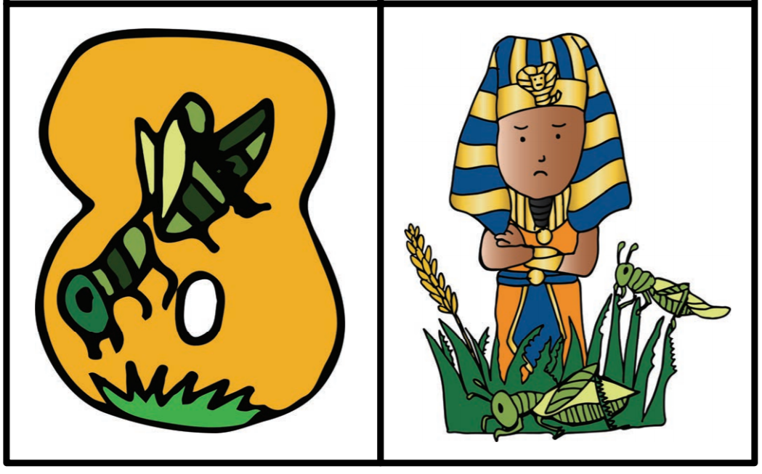

Slide 13


Slide 14
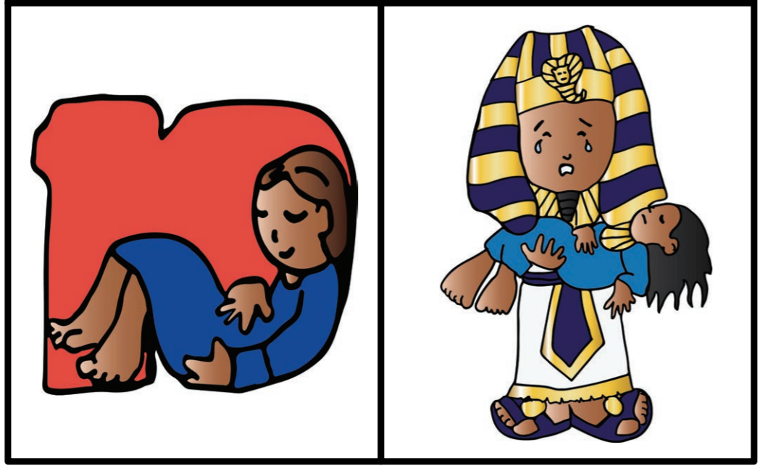

Slide 15
Mild task
Draw your own images for the 10 plagues and label them.

Slide 16
Spicy Task
Write a newspaper report about the plagues of Egypt.
How many were there?
How did it impact their lives?

Slide 17
Newsflash!
Thursday 1st April
Pharaoh refuses to let the Israelites go; God is angry.
He promises ten plagues on the Egyptians.

Slide 18
Newsflash!
Tuesday 13th April
The river Nile turns to blood.
All fish are dead.
It’s the first plague.

Slide 19
Newsflash!
Tuesday 20th April
It’s raining frogs!
Frogs cover the land.

Slide 20
Newsflash!
Saturday 24th April
Dust around the town turns to gnats.
It’s the third plague.
Pharaoh still does not give in.

Slide 21
Newsflash!
Wednesday 4th May
Big flies swarm houses of Egyptians.

Slide 22
Newsflash!
Sunday 15th May
Egyptians lose cattle, sheep and goats as mystery fifth plague strikes the animals.

Slide 23
Newsflash!
Thursday 19th May
Ash in the air covers the Egyptians in boils and sore spots.
Doctors fear another plague.

Slide 24
Newsflash!
Monday 23rd May
Worst storm in Egyptian history as hail and snow pound on the land.
“Don’t leave your home,” the weatherman says.
Pharaoh still won’t let Israelites go.

Slide 25
Newsflash!
Saturday 28th May
Swarm of locusts eat everything in sight.
Pharaoh still says ‘no’ to Moses.

Slide 26
Newsflash!
Monday 30th May
“This is the longest night we’ve ever had,” cries an Egyptian as three days of darkness fall.
Israelites have normal daylight.
“I wish Pharaoh would give in,” cries an Egyptian child.

Slide 27
Newsflash!
Wednesday 2nd June
Moses announces that God will kill the oldest child in each Egyptian family.
The tenth plague has arrived.
Israelites are spared the suffering.

Slide 28
Newsflash!
Thursday 10th May
Pharaoh gives in.
Israelites are free to leave in the morning.

