Slide 1

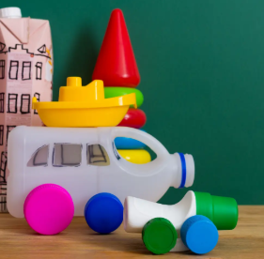
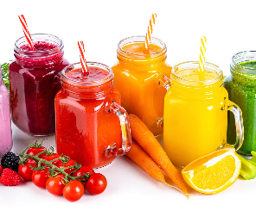
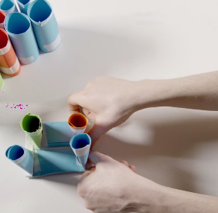
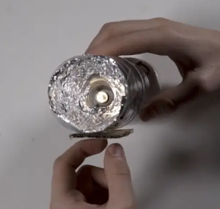
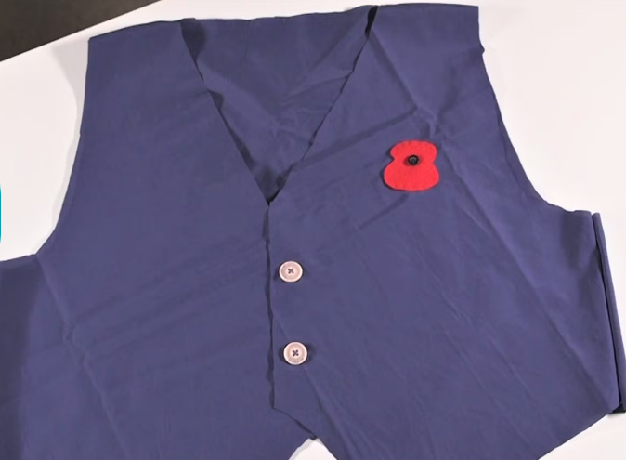
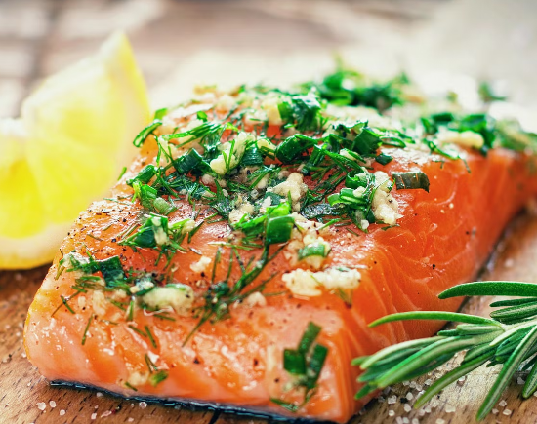
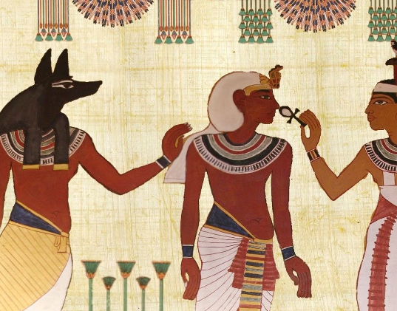
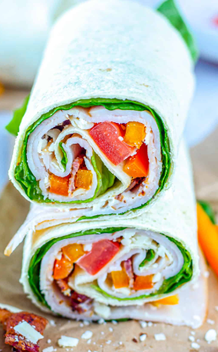
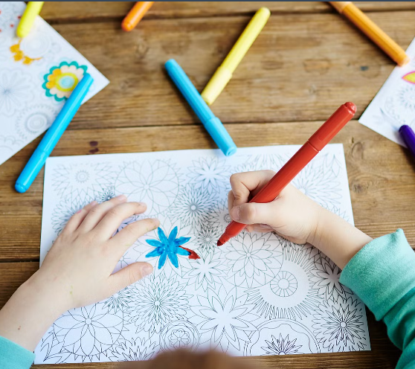
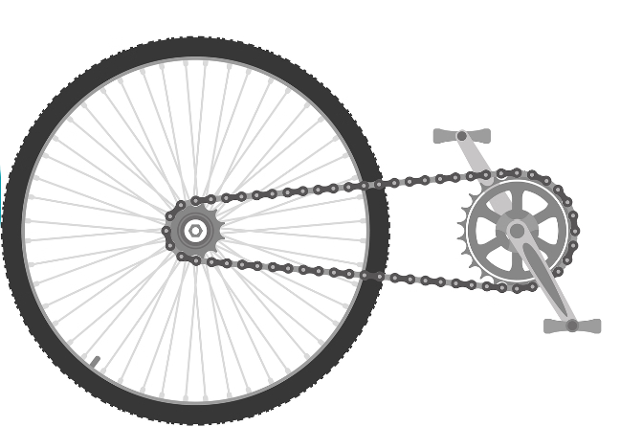
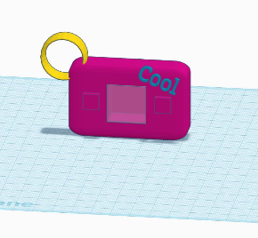
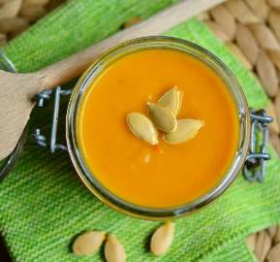
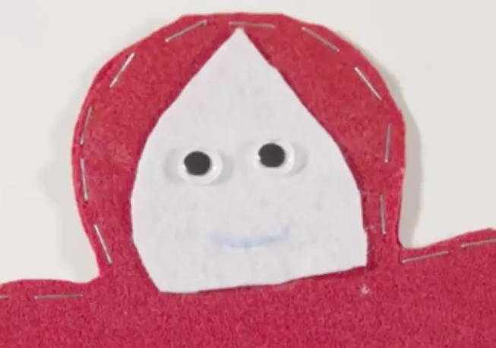
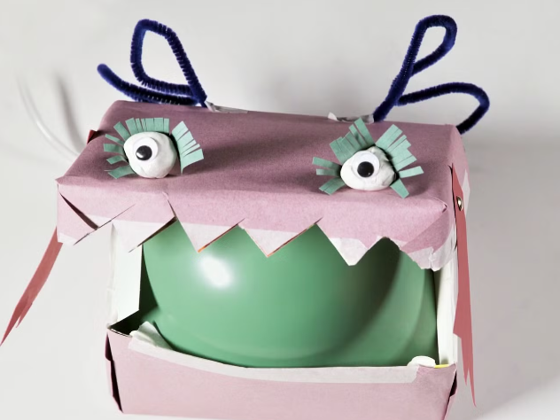
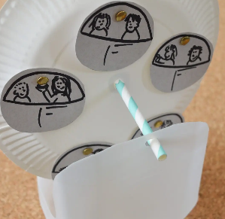
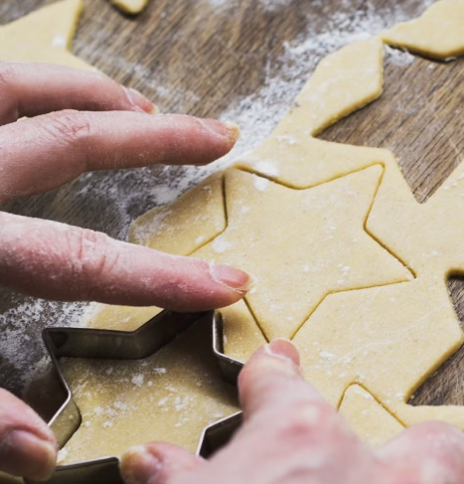
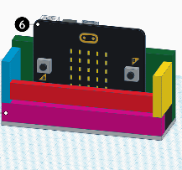
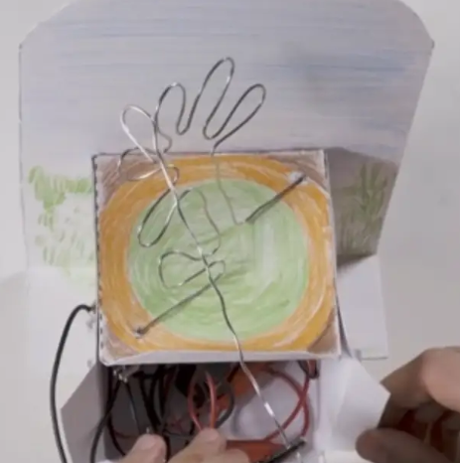
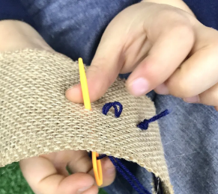
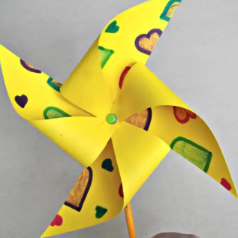
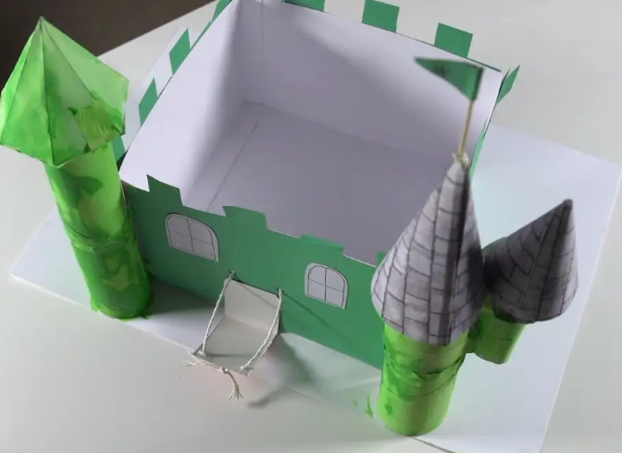
Academic Year 2024-2025
Curriculum Overview
DT
 | Reception | Year 1 | Year 2 | Year 3 | Year 4 | Year 5 | Year 6
Autumn 1
Spring
Summer
Cooking
and nutrition: Smoothies
Cooking
and nutrition:
Come dine
with me
Structures: Baby bear's chair
Electrical
systems:
Torches
Textiles:
Waistcoats
Structures: Junk Modelling
Textiles:
Egyptian collars
Mechanical systems:
Gears and pulleys
Digital
world:
Navigating the
world
Cooking and nutrition: Soup
Cooking
and nutrition: healthy wrap
Mechanical systems:
Pneumatic toys
Digital
world: Mindful moments timer
Textiles:
Puppets
Mechanisms: Fairground
wheels
Cooking
and nutrition:
Adapting a
recipe
Digital
world:
Monitoring
devices
Electrical
systems:
Steady hand game
Textiles
Bookmarks
Structures: Constructing a windmill
Structures: Constructing
castles

