Slide 1
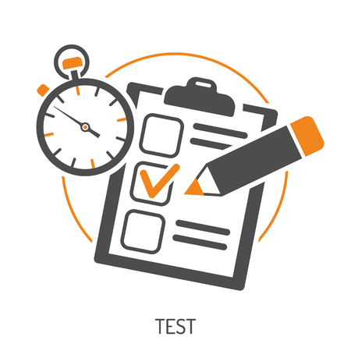
Practice Exams November 2022

Slide 2
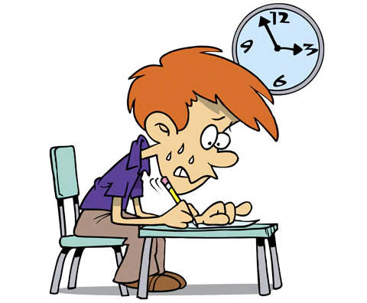
Practice Exams
Your Practice Examinations begin on Monday 28th November 2022.
Your GCSE examinations begin on Monday 15th May 2023.
That’s 168 days from the start of the practice examinations to the real ones! (it’s about 19 school weeks or 95 school days)

Slide 3
Why?
The whole point of the practice exams is to have a run through of the exam experience.
It will give you an experience of juggling revision and preparation for multiple exams over a short period of time.
You will experience the demands of the different examinations within the strict conditions and time constraints that you will face over the summer.

Slide 4
Where?
You will all receive a personalised timetable.
Your timetable shows:
which exams you will be taking
where you will be sitting your exam and the seat number you have been given
You will be allocated a different seat for each of the exams that you take.
We will also have a seating plan in the old gym in the area where you leave your bags.
A small number of you will be taking your exams in other rooms (conference room, A2/3 etc).

Slide 5
9 8 7 6 5 4 3 2 1
A
B
C
D
E
F
G
H
A8
A
B
C
D
E
F
G
H
C2
Front
G6
Break and Lunch seating area where you leave your bags (and phones)
Way in
Way in

Slide 6
When?
For each exam: You should form assembly lines up as soon as possible:
For lesson 1 meet at 8.50am – for a 9.00am start
For lesson 3 meet at 11.20am – for a 11.30am start
Exam conditions: begin on entry to the exam room.
Make sure you leave your switched off phone in your bag in the lunch seating area. Take out your clear pencil case/equipment. Any water bottles must also be clear and not have labels on.
Finding your seat: use the seating plan to go to your allocated seat.
Toilet use: unless it is an emergency you will not be allowed to go to the toilet during exams – please go beforehand.
Invigilation: the exams will be invigilated by external staff and SLT.
After The Exam: you will collect your bag and return to your timetabled lesson.

Slide 7
Exam Readiness
Equipment:
​
Black pen – always bring a spare.
Pencils, rubbers, ruler and pencil sharpener.
Highlighters
Tippex MUST NOT be used​
Pencil cases must be transparent or bring your equipment in a see-through polythene bag
Calculator and mathematical equipment – for Maths, Science and Geography.
Illness: ​
If you are ill on the date of one of your exams you must let the school know immediately.
As it is a practice exam, alternative arrangements will be made to sit the exam at a later date.​

Slide 8
Exam Conduct
The examinations will be conducted according to the JCQ regulations from the Examination Boards.
When you enter the examination room you should go immediately to your place and sit quietly to await the start of the examination.
There must be NO communication with any other candidate during the exam. This means that you will NOT talk or attempt to communicate in any other way with another candidate.
Should you be unwise as to do this in a GCSE exam you will be reported to the examination board. They may disqualify you from that exam and any others that you have taken.

Slide 9
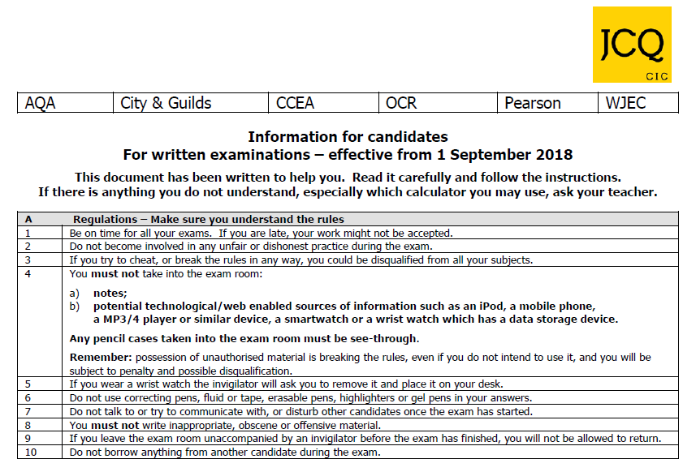
JCQ exam regulations

Slide 10
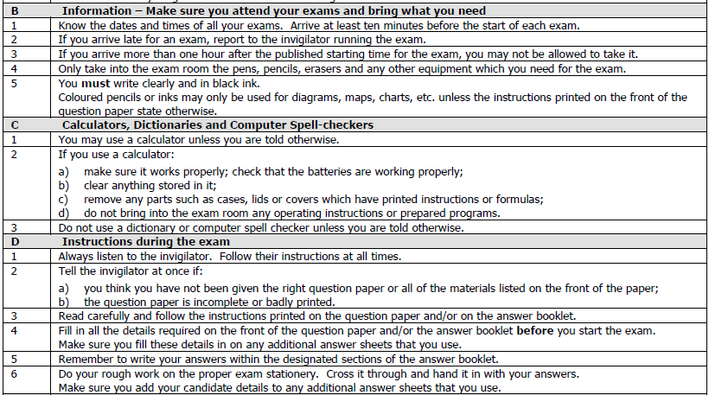
JCQ exam regulations

Slide 11
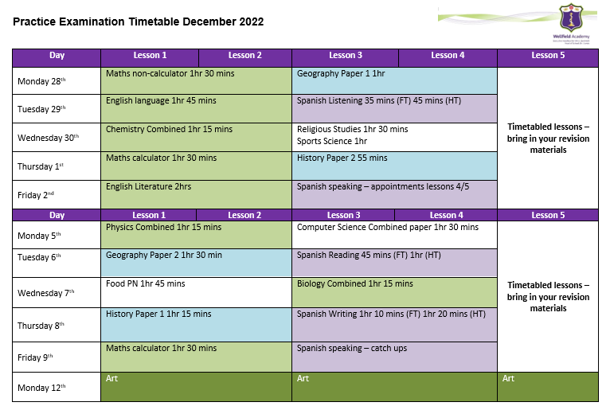
Exam Timetable

