Slide 1
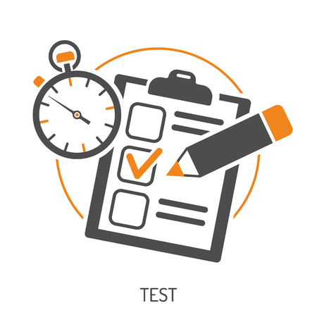
Practice Exams March 2022

Slide 2
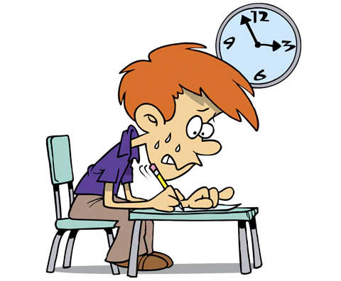
Practice Exams
Your Practice/Mock Examinations begin on Monday 14th March 2022.
63 days before the real thing.
Including the exams, that’s 28 school days left.
Your final examinations begin on Monday 16th May 2022.

Slide 3
Awarding Grades
On February the 7th the Department for Education released the final guidance relating to the awarding of GCSE grades this year.
For summer 2022
Changes to coursework
More generous grading
Changes to content
Provision of support materials
Advance Information

Slide 4
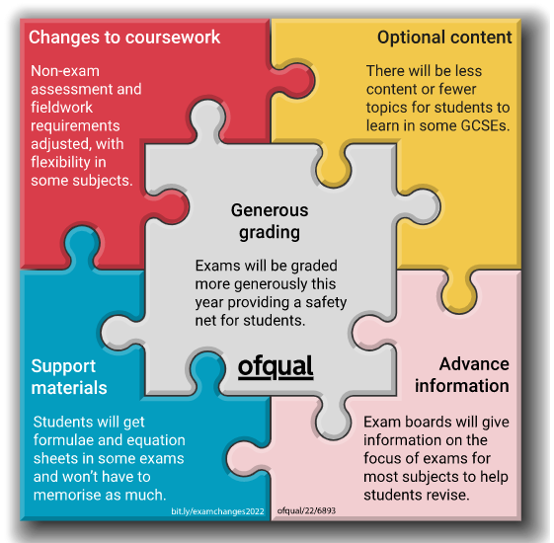

Slide 5
Is it the same as last time?
You will all receive a personalised timetable.
Your timetable shows:
which exams you will be taking
where you will be sitting your exam and the seat number you have been given.
You will be allocated a different seat for each of the exams that you take.
We will also have a seating plan in the old gym in the area where you leave your bags.
A small number of you will be taking your exams in Ambleside building in rooms A1, A2 or A6.

Slide 6
9 8 7 6 5 4 3 2 1
A
B
C
D
E
F
G
H
A8
A
B
C
D
E
F
G
H
C2
Front
G6
Break and Lunch area where you leave your bags
Way in
Way in

Slide 7
What Happens?
For each exam: You should form assembly lines as soon as possible:
For lesson 1 assemble at 8.55am
For lesson 3 assemble at 11.25pm
Entering the old gym: make your way into the old gym, leave your phone in your bag in the lunch seating area (make sure it is switched off). Take out your clear pencil case/equipment. Any water bottles must also be clear and not have labels on.
Finding your seat: you will then be asked to use the plan to go to your allocated seat.
Toilet use: unless it is an emergency you will not be allowed to go to the toilet during exams – please go beforehand.

Slide 8
What Happens?
Exam conditions: begin once you enter the old gym
Invigilation: the exams will be invigilated by external staff (as they will be in the public exams).
After The Exam: collect your bag and return to your timetabled lesson.

Slide 9
Exam Conduct
The examinations will be conducted according to the JCQ regulations from the Examination Boards.
When you enter the examination room you should go immediately to your place and sit quietly to await the start of the examination.
There must be NO communication with any other candidate during the exam. This means that you will NOT talk or attempt to communicate in any other way with another candidate. Should you be unwise as to do this in a GCSE exam you will be reported to the examination board. They may disqualify you from that exam and any others that you have taken.

Slide 10
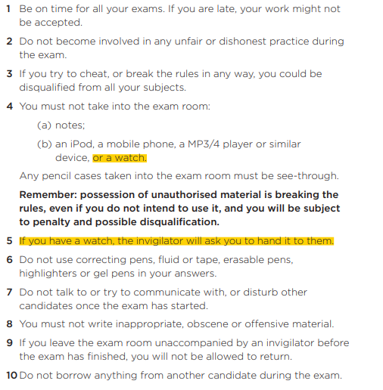

Slide 11
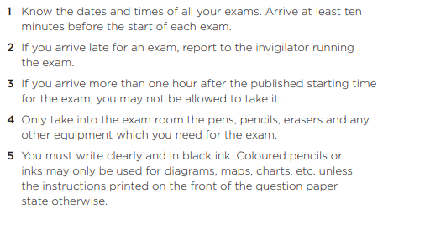

Slide 12
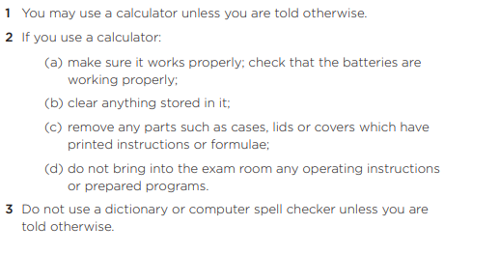

Slide 13
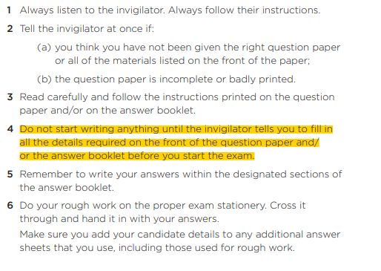

Slide 14
Exam Conduct
UNIFORM:
You must attend each examination in full school uniform
EQUIPMENT: ​
Black pen – always bring a spare.​
Pencils, eraser, ruler and pencil sharpener.​
Tippex MUST NOT be used​
Pencil cases must be transparent or bring your equipment in a see-through polythene bag. ​
Coloured pencils for maps and diagrams etc and Design Technology.​
Calculator and mathematical equipment – for Maths and Science.​
ILLNESS: ​
If you are ill on the date of one of your exams, you must let the school know immediately. As it is a practice exam, alternative arrangements will be made to sit the exam at a later date.​
This includes if you are self-isolating.​

Slide 15
