Slide 1
ENGLISH

Slide 2
GCSE
GCSE English Language
GCSE English Literature
2 GCSEs
Skills taught throughout KS3 and KS4
100% exam
Assessed through final exams at the end of Year 11.

Slide 3
CURRICULUM
What will your child study in English?

Slide 4
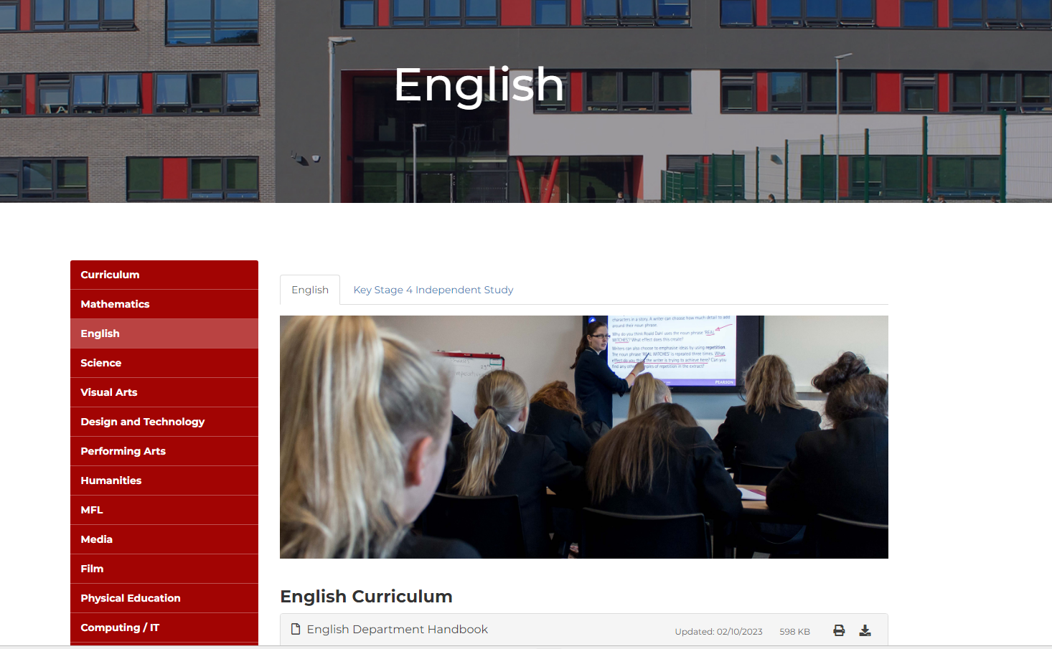
CURRICULUM
What will your child study in English?
See our website for more information!

Slide 5
LIBRARY
Each class has one lesson in the library per fortnight.
In this lesson they will be provided with a booklet focused around a certain topic.
There will be both fiction and non-fiction texts, and our aim is for students to enjoy reading.
They will also get the chance to choose and read their own book.

Slide 6
HOMEWORK
Educake quizzes:
Linked to lessons.
Great opportunity for children to test knowledge at home.
Reviewed by class teachers.
Your child can take their test more than once and they can also create their own quizzes to revise topics they feel less confident in.
If you need any help (i.e. with usernames or passwords) please contact your child’s English teacher in the first instance

Slide 7
TOE BY TOE
Dedicated Literacy Mentor delivers various interventions.
Phonics-based reading programme
Delivered during the first 20 minutes of each English lesson.
Delivers immediate improvement in your child’s reading confidence.

Slide 8
LEXONIK
A unique, research-based programme to help improve your child’s reading ability and confidence.
Delivered in six one-hour, teacher-led sessions on a 1:4 teaching ratio.

Slide 9
READING
Additional Reading Support
Super Readables project
High level reading groups
Offers students a chance to discuss their reading, develop vocabulary and build reading confidence.

Slide 10
Any
questions?
emma.warren@wernethschool.com
dominic.liffen@wernethschool.com

