Slide 1
Welcome to Werneth School

Slide 2
Year 7 –
The start of a 5 year learning journey
Mrs Hannah Massey
Head of Year 7 / Associate Senior Leader
Email: hannah.massey@wernethschool.com
Ambition
Respect
Resilience

Slide 3
What does this journey look like?
Year 7 and 8 students will follow a curriculum of:
English, Maths, Science, Computing, MFL, Technology, Humanities, Expressive Arts, PE, Music, Life Learning.
Studying 25 lessons a week, 5 lessons a day.
Ambition
Respect
Resilience

Slide 4
What does this journey look like?
All students will have:
A broad and balanced curriculum
An opportunity to begin developing the knowledge and skills for the foundations of academic success.
Ambition
Respect
Resilience

Slide 5
What does this journey look like?
Towards the end of Year 8 students will have some choice about subjects they take in Year 9, within specific curriculum.
Year 9 will also give students an opportunity to try some new subjects within an enrichment strand.
Students pick their GCSE subjects at the end of Year 9, ready to start GCSE courses in Year 10.
Ambition
Respect
Resilience

Slide 6
Changes in Education
Changes in education over recent has years has seen GCSE grades changed from letters to numbers.
Your child will be sitting GCSEs graded 1-9 or BTEC / vocational courses.
We offer a wide range of subjects to suit different skill sets.
Ambition
Respect
Resilience

Slide 7
Tracking Progress
You will receive a progress report in February and July to inform you of your child’s progress in all subjects.
Ambition
Respect
Resilience

Slide 8
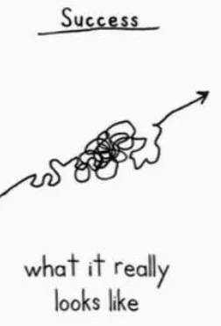
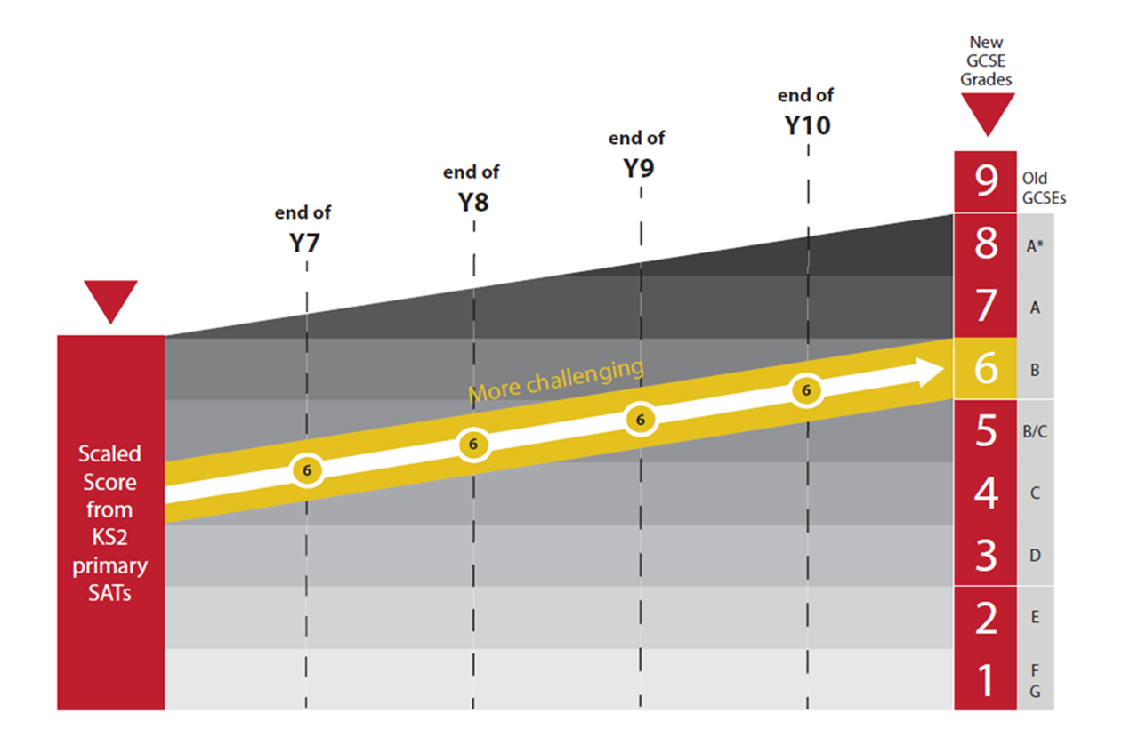
What does this journey look like?
In reality it may look more like this:
What progress should look like.
It is our job to track progress and support when things are not going to plan!
Ambition
Respect
Resilience

Slide 9
Reporting Progress
We are changing how we report in years 7, 8 and 9
We will report on your child’s progress in a similar way to primary schools, using the language ‘Working Towards’ (expected Standard), working at ‘Expected Standard’ and working at ‘Greater Depth’. The Expected Standards are the age relevant expectations for a year 7 student and can be found on the website.
Ambition
Respect
Resilience

Slide 10
Reporting Progress
Almost all students arrive to secondary education with a standardised score from their SATs which gives us as educators an idea of their academic ability.
Each subject will report what ‘Working Towards’, ‘Expected Standard’ or ‘Greater Depth’ for their subject.
We can use these two bits of information to identify if students are achieving well.
Ambition
Respect
Resilience

Slide 11
Reporting Progress
Parents can see what skills and knowledge will be covered in each subject by referring to each subject's Progression Grids. Parents, teachers and students can use these to see what they need to do to improve. Below is an example of the Y7 maths Progression Grids:
Ambition
Respect
Resilience

Slide 12
Reporting Progress
Ambition
Respect
Resilience

Slide 13
Working together to support your child's progress
There are other aspects to coming to school that lead to success. These include:
Maintaining positive relationships and good communication
Excellent attendance and punctuality
Encouraging your child to work hard and have a positive attitude towards their learning and school
Being prepared and ready to learn
Ambition
Respect
Resilience

Slide 14
Working Together to support your child's progress
Please don’t hesitate to get in touch if you have any questions: gillian.kennedy@wernethschool.com
Alternatively the year 7 team are always here to help you:
year7.enquiries@wernethschool.com
Year Achievement Lead and SLT lead – Mrs Hannah Massey
Year Inclusion Manager – Mrs Tracy Taylor
Ambition
Respect
Resilience

