Slide 1
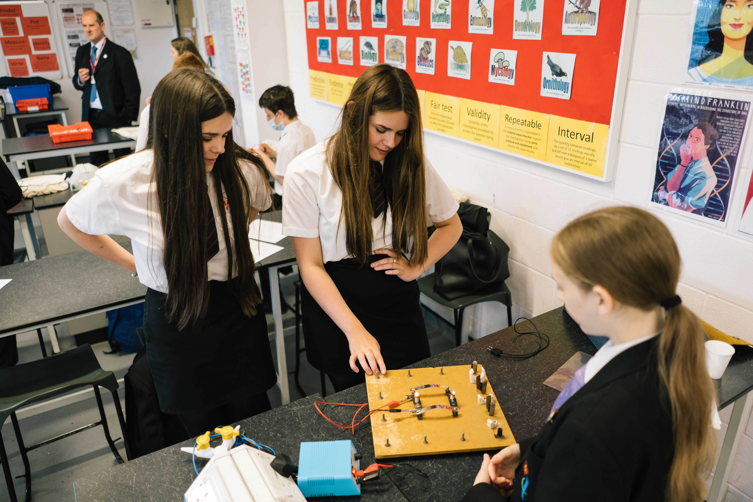
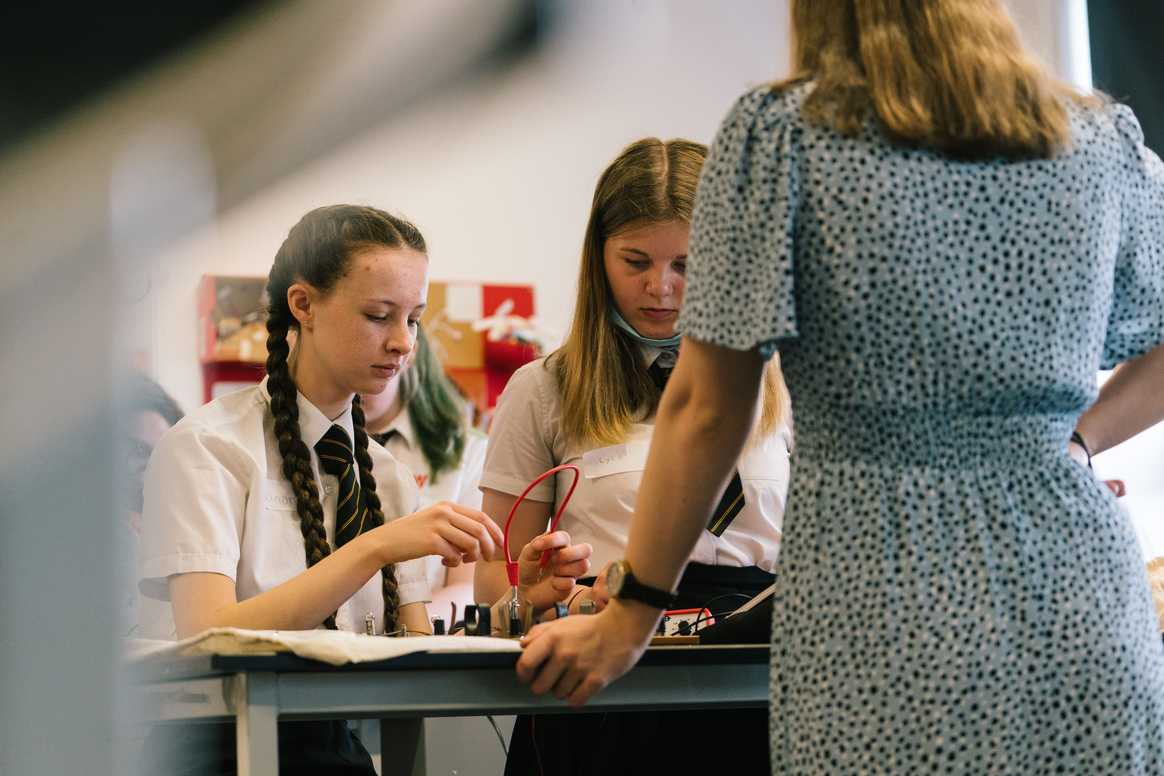
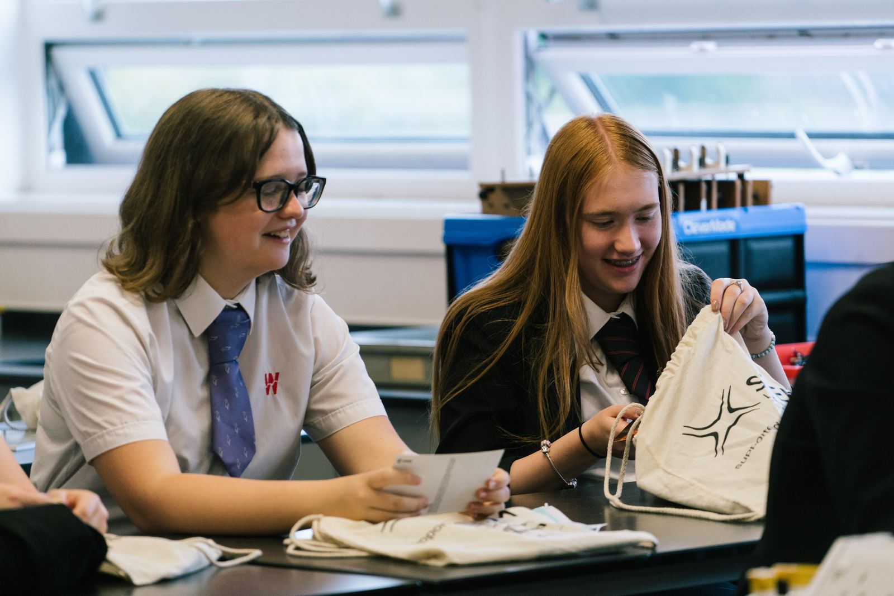

Welcome
to Science
Resilience
Respect
Ambition

Slide 2
Science 2023/24
Mrs. McLaughlin (Head of Science)
Dr. Burrows (Second in Science)

Slide 3
Expectations of students in EVERY lesson:
Pen, pencil, rubber, ruler, sharpener – and spares! Ready to use EVERY lesson
Correct Uniform must be worn at all times
Sit in allocated seat
Register conducted in silence, answered ‘Yes/Here Miss/Sir’
No mobile phones (ensure students have a proper scientific calculator)
No eating EVER, or drinking without permission
Orderly dismissal (standing behind seats)
Non-Negotiable

Slide 4
Moving around school
Students must follow the one way system
Year 11: HART staircase
Year 10: front stair case near the student entrance
Year 8 & 9: middle back staircase
Years 7: back corner staircase

Slide 5
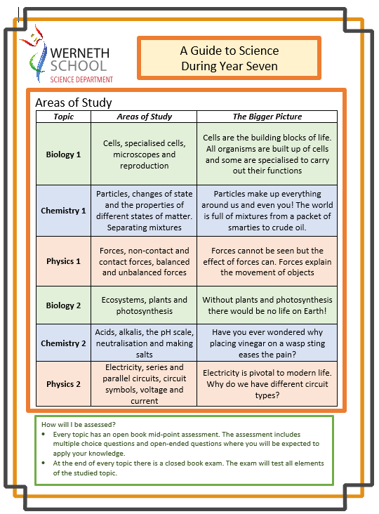
Learning Guide
Students are issued with learning guides at the start of the year to tell them about:
What topics will be studied this year
Why students are studying the selected topics
How students will be assessed?
Notes:
Please instruct students to glue in the relevant learning guide. Please discuss it with your pupils. They can be found in the prep room.

Slide 6
What will students study?
YEAR 7
Biology | Chemistry | Physics
Cells and Reproduction | Particles & Matter | Forces
Ecosystems and Plants | Acids and Alkalis | Electricity
Scientific Skills
YEAR 8
Biology | Chemistry | Physics
Microbes and Disease | Elements | Energy
Organ Systems | Chemical Reactions | Space and Waves
Scientific Skills

Slide 7
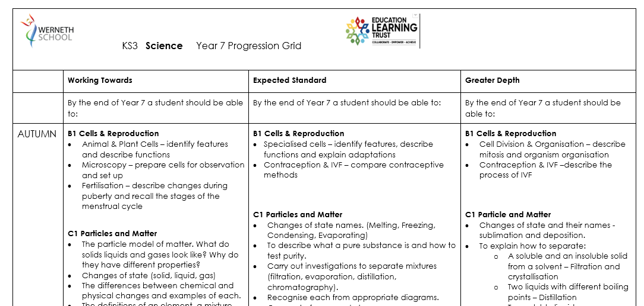
Progression Grids

Slide 8
What will students study?
Example learning journey for a topic studied:
States of Matter
Changes of State
  BP/MP Practical
Chemical vs. Physical Changes
Mid Topic Assessment
Elements, Compounds & Mixtures
  Pure/Impure Practical
Separation Techniques
  Filtration Practical
  Evaporation Practical
  Distillation Practical
  Chromatography Practical
Revision
End of Unit Assessment
Every unit of work at KS3 generally consists of approx. 10 lessons
This will include content lessons (theory and practical based), a revision lesson and 2 assessment lessons
The mid topic assessment is completed in exam conditions, but students may use their books to help
The end of unit assessment is a traditional style test, also completed in exam conditions
Following an assessment, students will be provided with an opportunity to reflect on and improve their work using teacher feedback

Slide 9
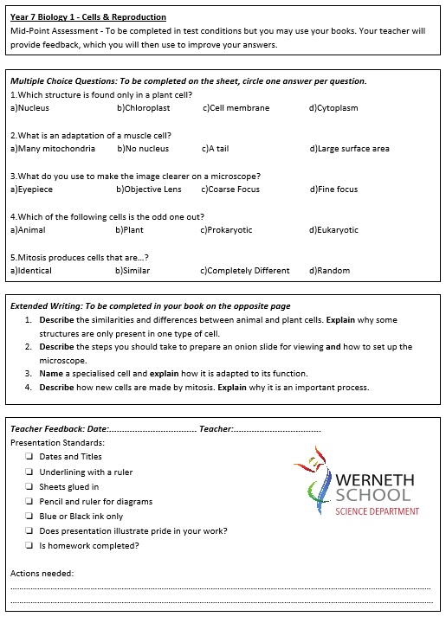
How will students be assessed?
Mid Unit assessments are made up of 5 multiple choice questions, and 4 extended writing tasks

Slide 10
Presentation of work
All students are expected to show pride in the way they present their classwork
Dates and titles should be clear and underlined to show the learning journey
Worksheets should be glued in
Mistakes should be carefully erased/crossed out
There should be no graffiti on classwork or homework

Slide 11
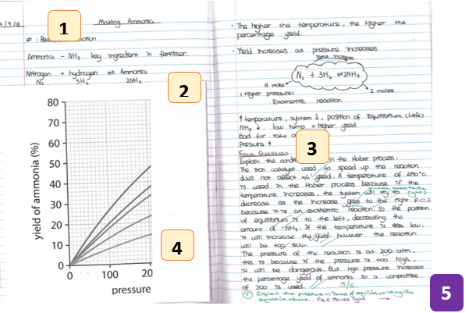
Presentation of Work
Dates and titles written and underlined
Worksheets complete and glued in
Subheadings used where appropriate
Notes in blue/black ink and diagrams in pencil
Student improvements based on teacher marking
Notes:
Please discuss with students

Slide 12

Homework
Students are expected to complete their Seneca units each term. Teachers may set additional tasks if appropriate. Tasks should be set on google classroom.
Each topic studied also has a standard departmental revision task to be completed at home before the final assessment.
Seneca ACCOUNTS WILL BE SET UP SHORTLY FOR ALL YEAR 7 STUDENTS

Slide 13

SENECA is an intelligent learning program (app AND website) that helps students achieve outstanding results.
SENECA uses multiple choice style and extended communication quizzes to build knowledge, boost confidence and reduce exam stress.
Notes:
Please show students the video on the homepage.

Slide 14




Rewards
KS3 unit certificates
Scientist of the week
Praise postcards
Positive phone calls
Rewards events
  Cake @ break
  School trips
Notes:
KS3 unit certificates – will be monitored by LWI (class teacher to update SIMS following end of unit tests – students who achieve/exceed their FFT will receive certificate)
SOTW – teacher nominated each week, LWI to write certificates and distribute prizes
Postcards – at teachers discretion, unlikely to actually be posted home, please hand to student
Cake events hopefully half termly (budget dependent), teacher nominated
School trips e.g. big bang trip, museum trip (TBC)

Slide 15
How do students get rewarded?
All nominations will be made by the class teacher… they will be looking for;
An excellent attitude to learning
Well presented class and homework
Good effort and progress
A willingness to go the ‘extra mile’
Regularly achieve Tassomai goals and complete all homework

Slide 16
Pathways
Students will begin studying for their GCSE’s in year 9
Science is a core subject
Triple Science is offered as an option for students who;
Show a good attitude to learning throughout KS3
Wish to pursue a career in Science and or Technology
Wish to study Science at A-Level
Students who study core Science receive two GCSE’s (but still study Biology, Chemistry and Physics - usually with two teachers)
Triple Science students receive three GCSE’s (Biol, Chem , Phys) and are taught by individual subject specialists in years 10 and 11

Slide 17

Revision Guides
CGP Key Stage 3 combined
revision and work book
Revision of all key topic areas
Practice exam questions
Order through parent
pay or main office

Slide 18
Please don’t hesitate to contact us if you still have any questions:
Joanne.mcLaughlin@wernethschool.com
Judith.burrows@wernethschool.com

