Slide 1
Adjectives

Slide 2
What is an adjective?
An adjective is a word which describes something.
It can tell you what it
Looks like
Feels like
Smells like
Tastes like
Sounds like

Slide 3
Why do we use adjectives?
We can imagine it better.
It makes our sentences more interesting.

Slide 5
The big yellow bus went down the road.

Slide 6
There was a happy, green bug on the leaf.

Slide 7
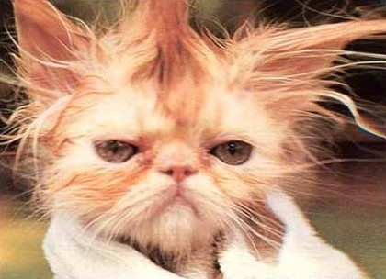
The little cat had a warm bath.

Slide 8
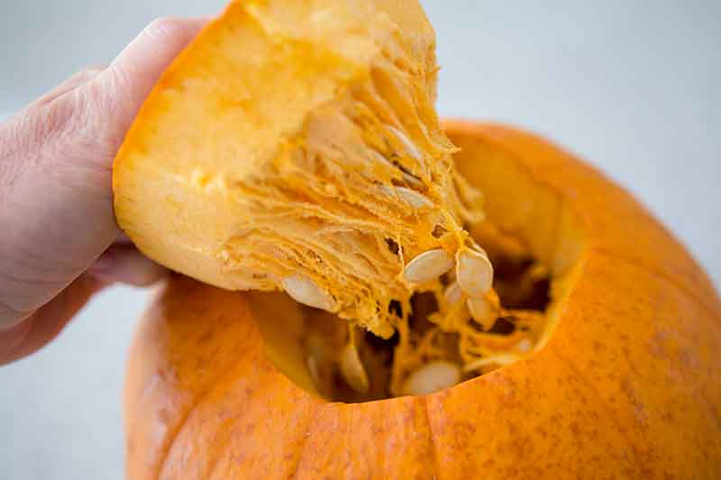
I can feel the _______ pumpkin.
Slimy
Wet
Slippery
Sticky

Slide 9
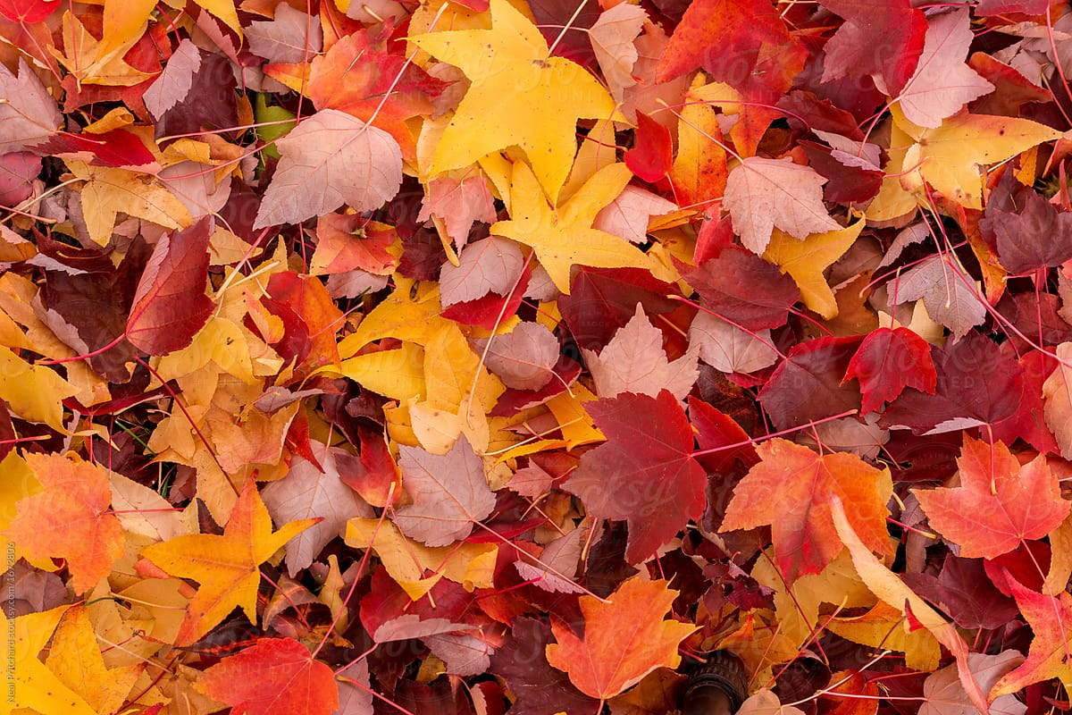
I can see the _______ leaves.
Colourful
Orange
Brown
Red

