Slide 1
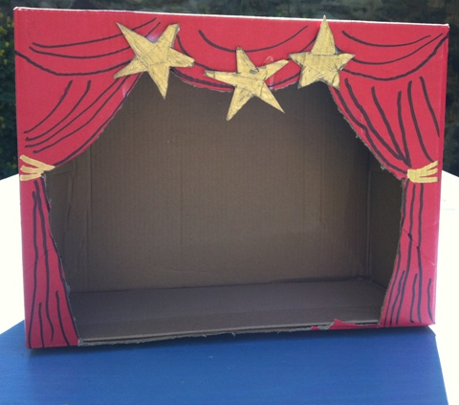
Create your own home theatre

Slide 2
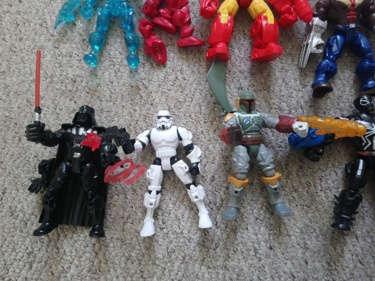
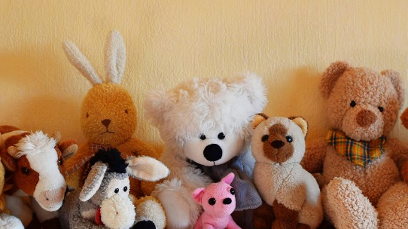
You will need:
A large cardboard box
Scissors
Felt-tips, paints or crayons
Any toys i.e. action figures, teddies etc.

Slide 3
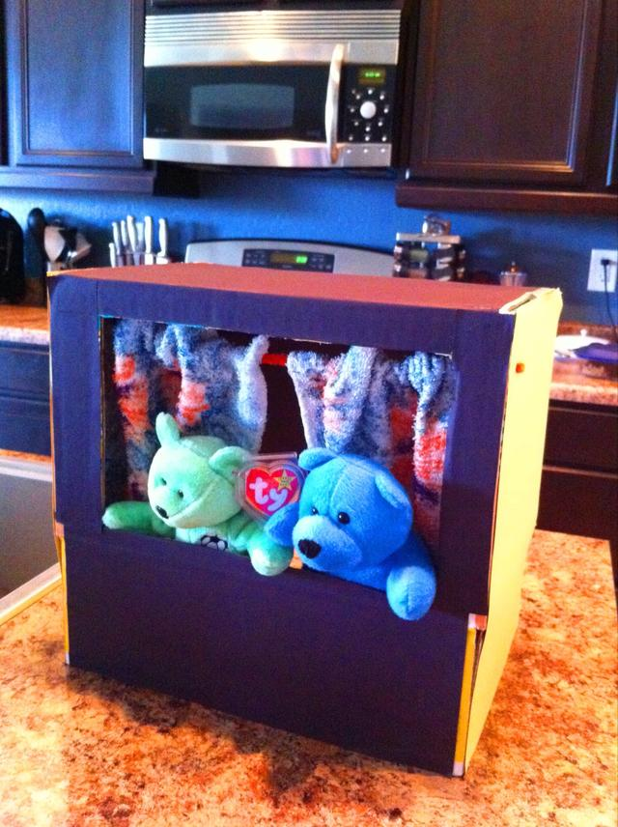
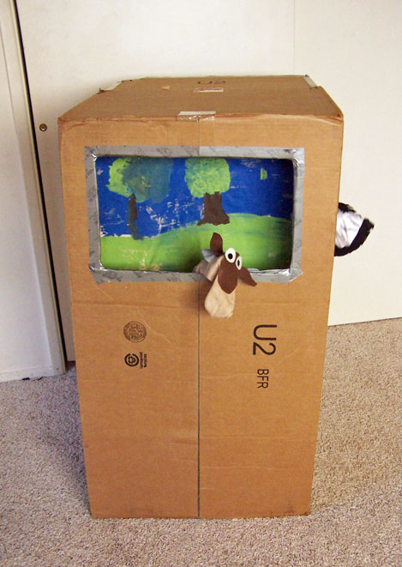
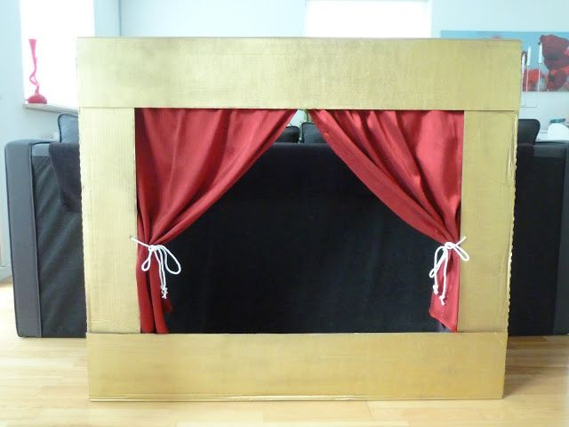
Cut out the front of your stage and decorate it!
Don’t forget to cut out the back of your stage so that you can control your toys

Slide 4
Choose your favourite story

Slide 5
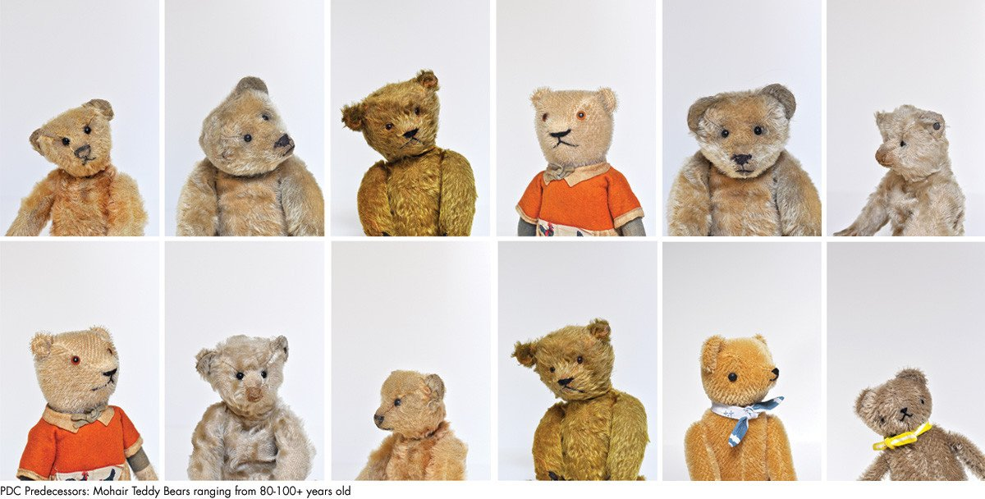
Decide which toys will play each character from your story

Slide 6
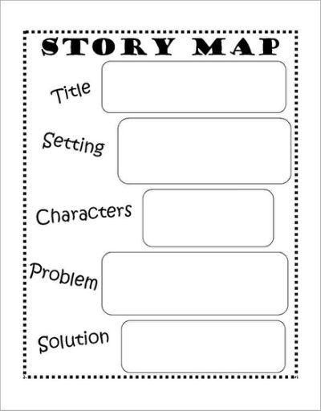
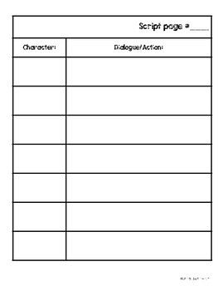
Rewrite your favourite story and write a short script

Slide 7
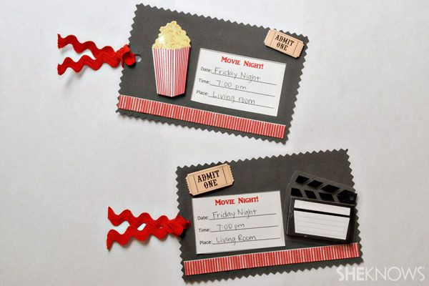
Invite your family to watch the play and make some tickets for them

Slide 8
Have fun!
Please send any photos to:
homeschool@westlancs.lancs.sch.uk

