Slide 1
Lesson 1: Welcome to the computing
Save a copy
KS4- Impact of Technology – Collaborating online respectfully
Notes:
Last updated: 01-07-20
This resource is available online at ncce.io/cres-1-s. Resources are updated regularly — please check that you are using the latest version.
This resource is licensed under the Open Government Licence, version 3. For more information on this licence, see ncce.io/ogl.

Slide 2
Passwords are like underpants
Starter activity
Question: What advice can you give me about passwords?
Think, write, pair, share
Notes:
*‘Think, write, pair, share’ is a teaching and learning strategy that is used to give all learners the chance to provide answers to questions and get involved. The ‘think’ element gives all learners time to read the question and think of their response. They normally write this down. They then talk to the person next to them about their idea (‘pair’). This gives them time to check their understanding and extend their ideas. Finally, the learners ‘share’ their response with the rest of the class or the other pairs, to promote a discussion.
Image source: original image created for NCCE

Slide 3
Lesson 1: Welcome to the computing
Objectives
In this lesson, you will:
Create a memorable and secure password for an account on the school network
Remember the rules of the computing room

Slide 4
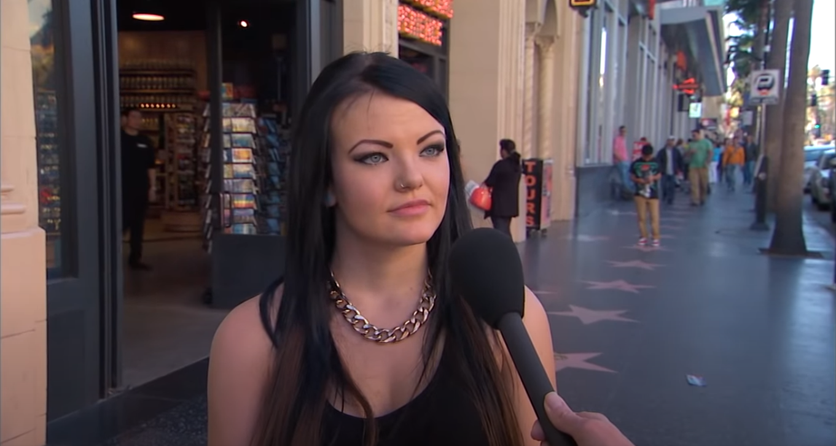
What is happening in this video?
Activity 1
Notes:
Note: This video has been set to automatically start at 0:20 and end at 2:36. If you edit this slide deck, the settings may change.

Slide 5
Use three random words
9fishcloudroad23
Activity 2
Notes:
Advice source: www.cyberaware.gov.uk/passwords
The latest advice from the government is to use three random words in a password. This is because it makes it more difficult for hackers to guess your password, as it is unlikely that the combination of words will be in their list of ‘known passwords’. Your school network may already have certain password requirements, such as capital letters, symbols, numbers, and a minimum number of characters. Let students know what these are. You could add them to the slide above.

Slide 6
howsecureismypassword.net
Activity 2
Test the strength of these passwords to prove that three random words are best. Password Strength Test & Strong Password Generator Tool (comparitech.com)
Password 1 qwerty
Password 2 p@ssw0rd
Password 3 Frog1234
Password 4 9FishCloudRoad23

Slide 7
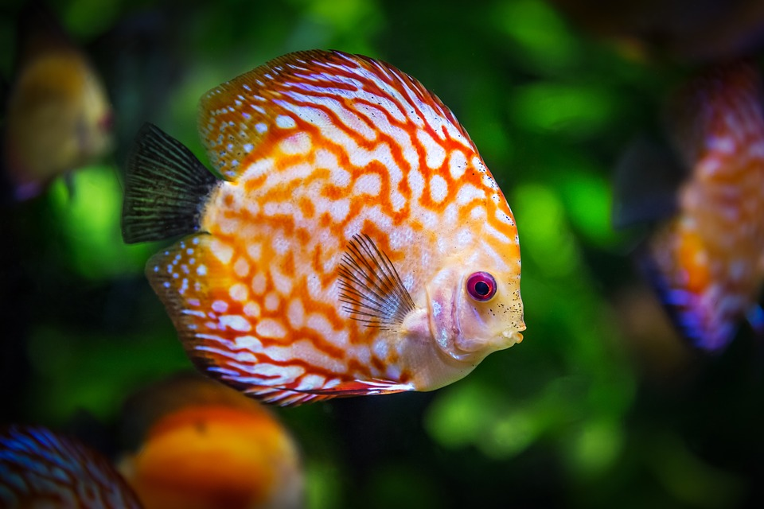
How will you remember your password?
Activity 2
Make it into a story!
My 9-year-old fish saw a cloud from road 23.
Notes:
Image source: https://pixabay.com/photos/discus-fish-fish-fauna-1943755/
Image source: https://pixabay.com/photos/sky-clouds-atmosphere-air-oxygen-1441936/
Image source: https://pixabay.com/photos/road-asphalt-sky-clouds-fall-220058/

Slide 8
Change your password
Activity 2
Notes:
Remind learners that it should be very hard to guess the password from the hint that they write down.

Slide 9
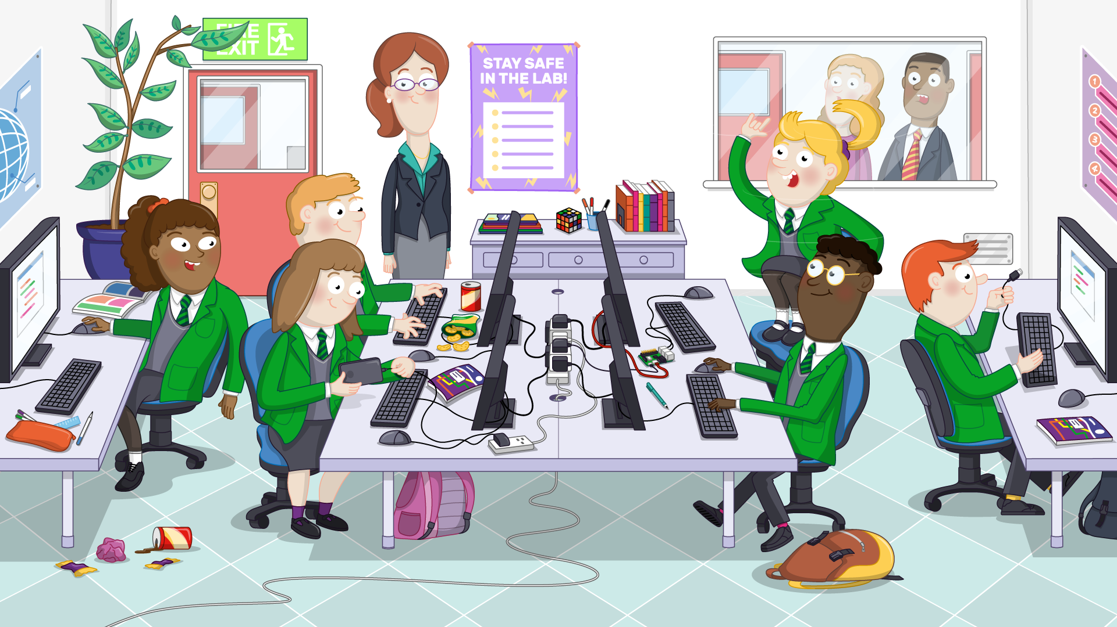
Can you spot all 9 hazards?
Activity 3

Slide 10
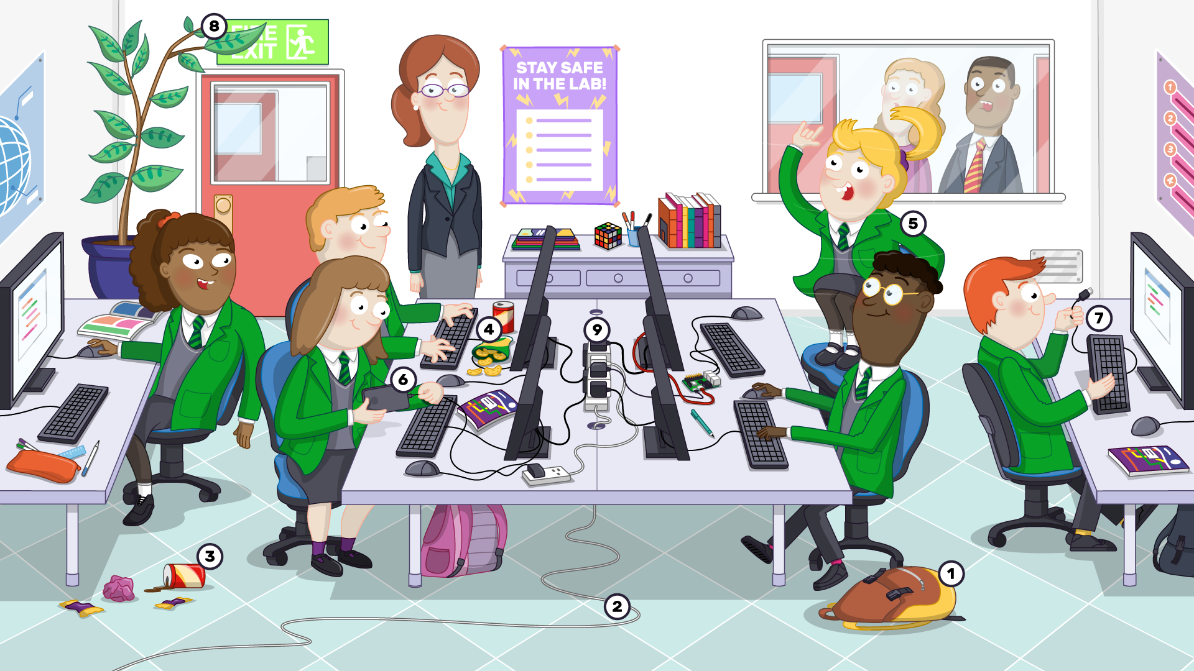
Why are they hazards?
Activity 3

Slide 11
What rules should we have for the computing lab?
Activity 4

Slide 12
Lesson 1: Welcome to computing
Plenary
Which of these is the strongest password?
Secure1
2MyStudioCardboard9
Password1234
P@ssword123
enter
Verbal exit ticket:
Tell me a rule for the computing lab
Notes:
Strongest password answer: 2
Verbal exit ticket: Learners line up sensibly to leave the classroom. As they leave, they tell you one rule for the computing lab. Alternatively, you could give them a slip of paper or a sticky note and tell them to write it down before they line up.

Slide 13
Next lesson
Summary
In this lesson, you...
Created a memorable and secure password
Listed the rules for the computing room
Next lesson, you will…
Learn about your workstation and how to send emails

