Slide 1
Key stage 3 celebration
Friday 24th September 2021

Slide 2
A week in key stage 3
Let’s look back at our week.

Slide 3
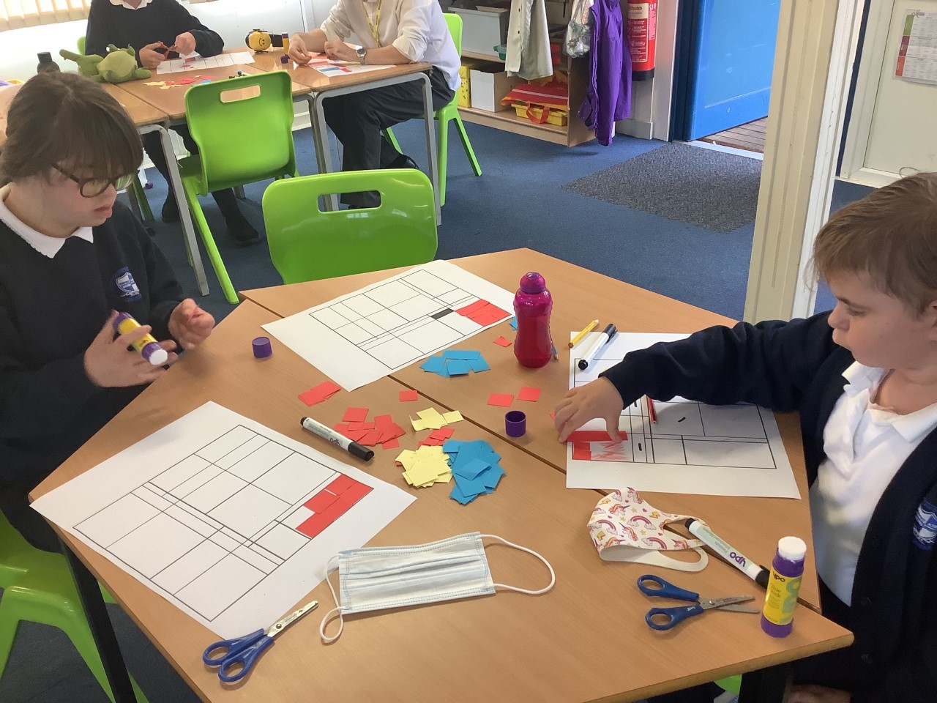
Personal Progress KS3W have been studying the work of Mondrian. Here Grace and Isabelle are working hard together to create a masterpiece. SUCCESS and ACHIEVE

Slide 4
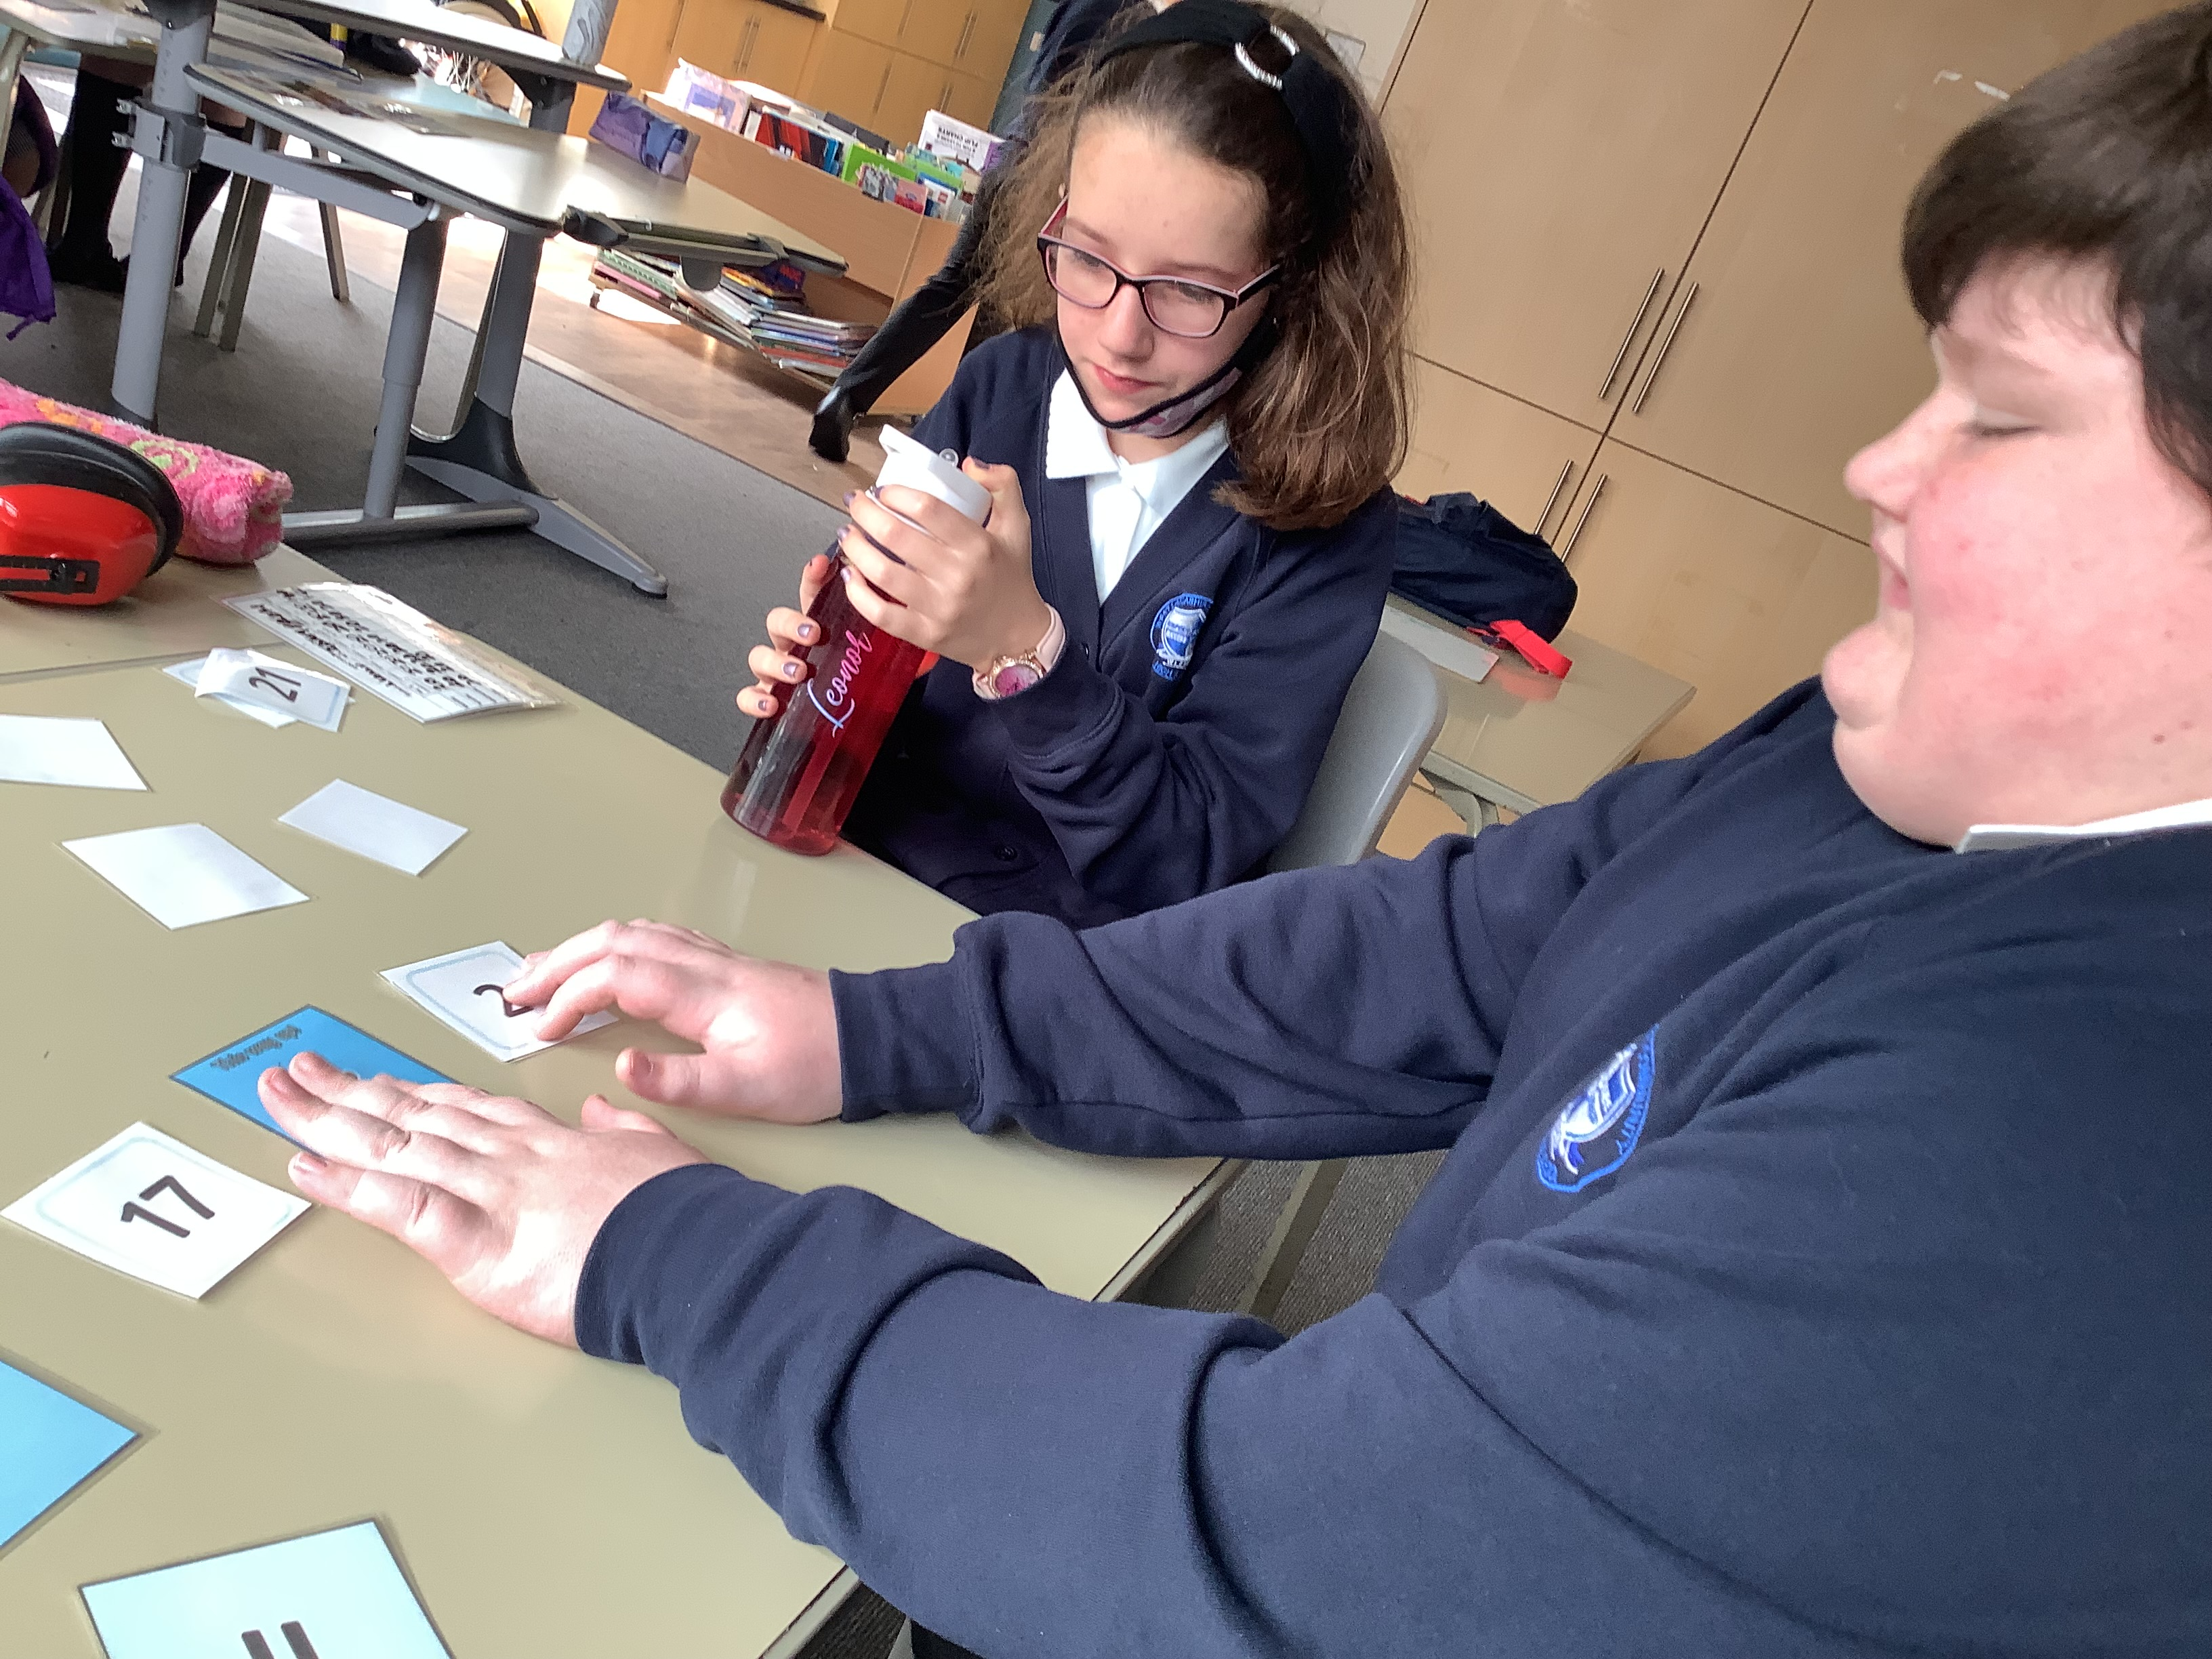
Personal progress
Nathaniel and Leanor are working together to compare numbers using < and > symbols. ACHIEVE and FRIENDSHIP

Slide 5
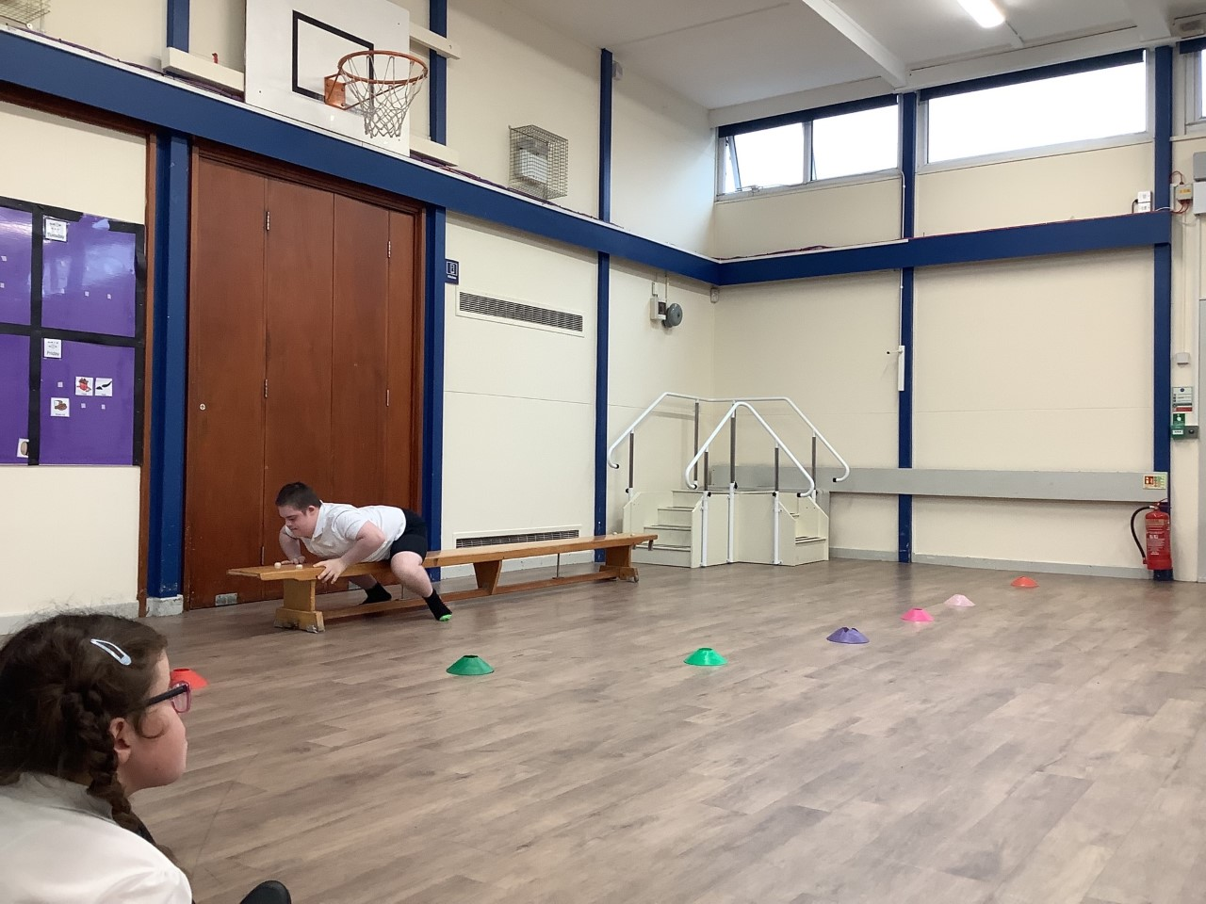
Personal Progress Deacon is working very hard on his MAPT circuit and completing it independently. ACHIEVE

Slide 6
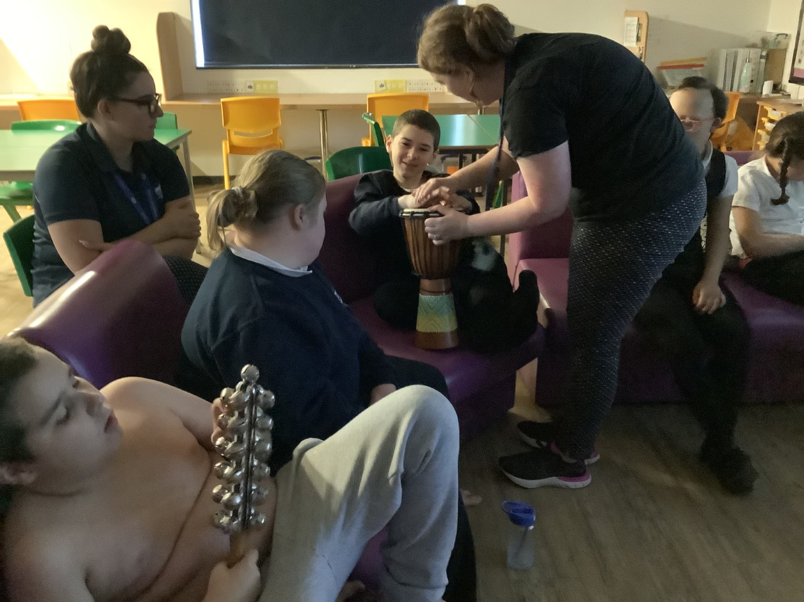
Personal Progress Blake is taking part in his music session with Miss Scott. He seems to be really enjoying himself. SUCCESS

Slide 7
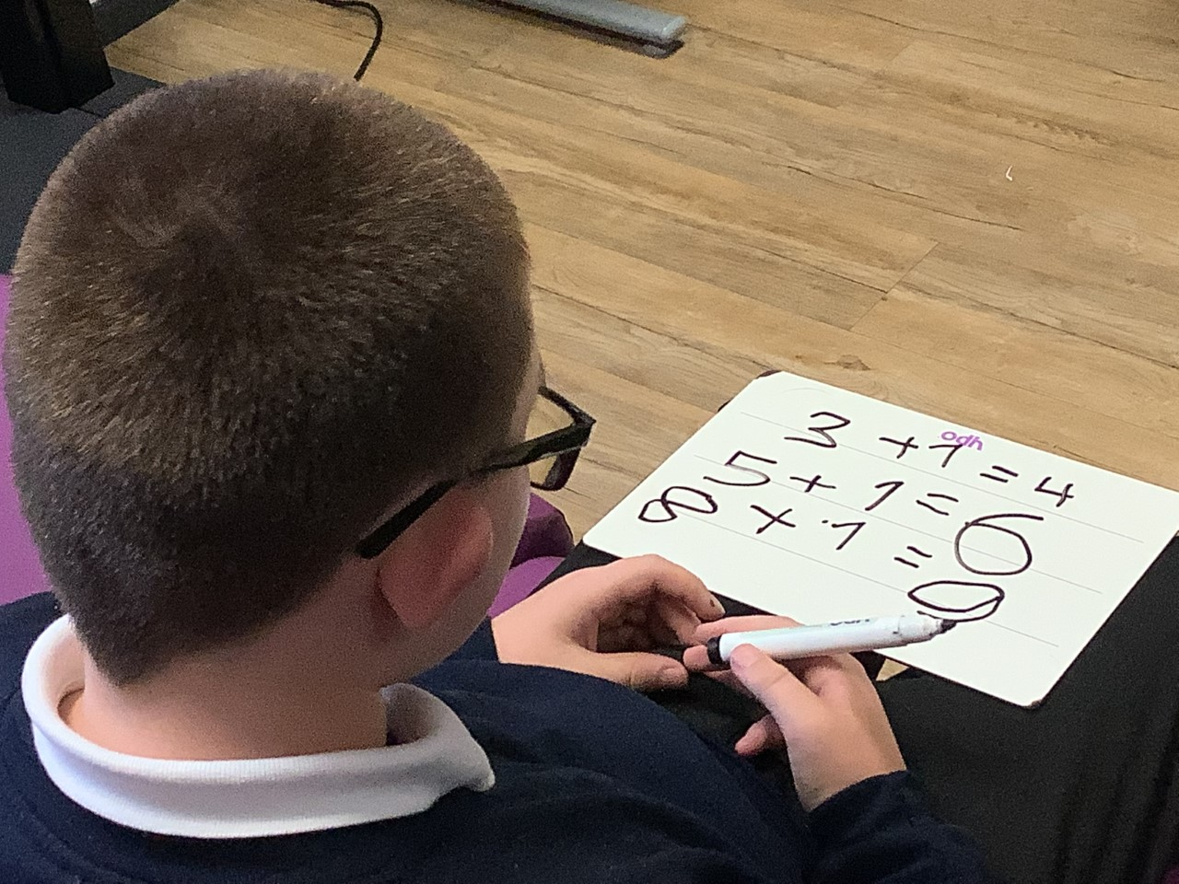
Personal progress Jack has been working hard on his addition number sentences in Maths. SUCCESS and ACHIEVE

Slide 8
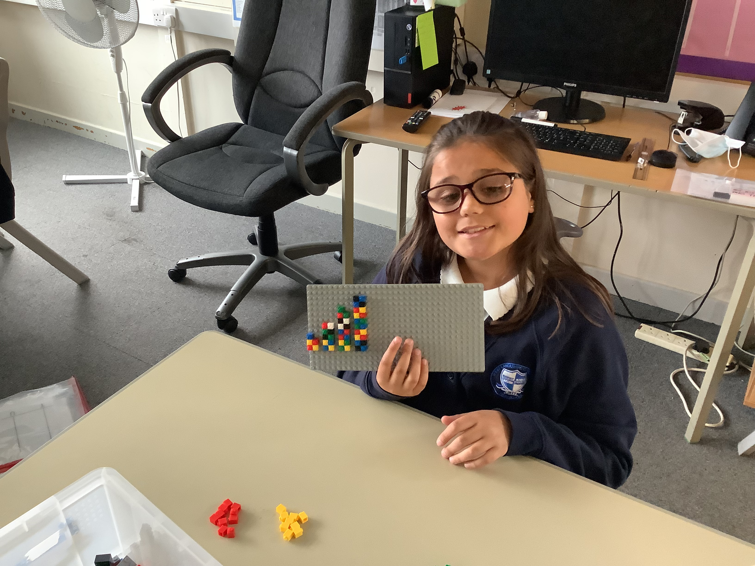
Personal progress Casey has been using Lego to help her understand counting in 5’s. Casey completed these tasks independently. SUCCESS and ACHIEVE

Slide 9
awards
Let’s celebrate our achievements

Slide 10
attendance
Key Stage 3 100% attendance certificates

Slide 11
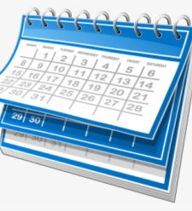
Dates to remember
Our timetable has changed a little.
Try to remember our swimming and PE kits.
Testing on Monday

Slide 12
Dates to remember
Strictly Come Dancing starts on BBC1

Slide 13
final thoughts
Respect each other.
Try to be good friends and kind to people.
Always try your best.
Have a safe weekend.

