Slide 1
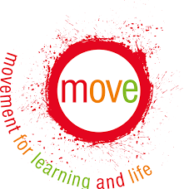
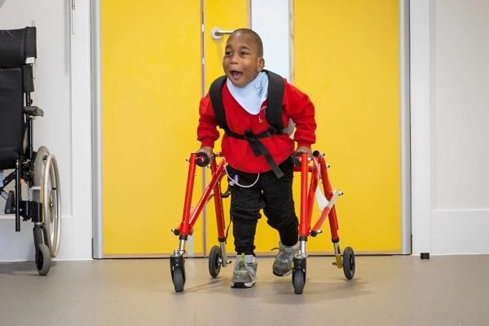
The MOVE Approach Integrated support for daily life
MOVE is not just an exercise program, it is an approach that helps children and young people develop physical skills through meaningful, everyday activities in school.
It works alongside physiotherapy to assess a child's needs and set realistic goals that are embedded into classroom activities, transitions, and social times. This consistent practice helps skills develop more effectively over time.
Student-Centred
Focused on individual needs and aspirations.
Collaborative
Staff, families and therapists working as one.
"Even small improvements make a big difference to comfort and independence."

Slide 2
How MOVE helps your child The MOVE programme aims to transform lives by focusing on five core areas of development and participation.
Improve Independence - Empowering children to navigate their environment with increasing independence and reduced reliance on assistance.
Increase Participation - Ensuring children can take a more active role in school life, lessons and social activities alongside their peers.
Build Confidence - Success in movement leads to a greater sense of achievement and self-belief in all areas of learning.
Support Wellbeing - Promoting physical health and emotional wellbeing through active engagement and regular physical movement.
Functional Skills - Developing practical sitting, standing and walking skills that translate directly to everyday comfort and communication.

Slide 3
Our implementation strategy We ensure the MOVE framework is delivered safely and effectively through professional assessment and specialist support.
Embedded Daily Practice
Unlike isolated therapy sessions, MOVE skills are practiced throughout the entire school day during natural transitions and routines.
Classroom activities
Transitions between lessons
Play and social times
Personal care routines
Collaborative Assessment
A team-around-the-child approach involving education staff, medical professionals, and family members.
School MOVE Lead assessment
Physiotherapist consultation
Parental input and goal setting
Equipment monitoring and safety checks
Tailored Equipment
Strategic use of specialist equipment to facilitate movement and maintain safety while promoting independence.
Standing frames
Walking aids
Supportive seating systems
Regular safety reviews

Slide 4
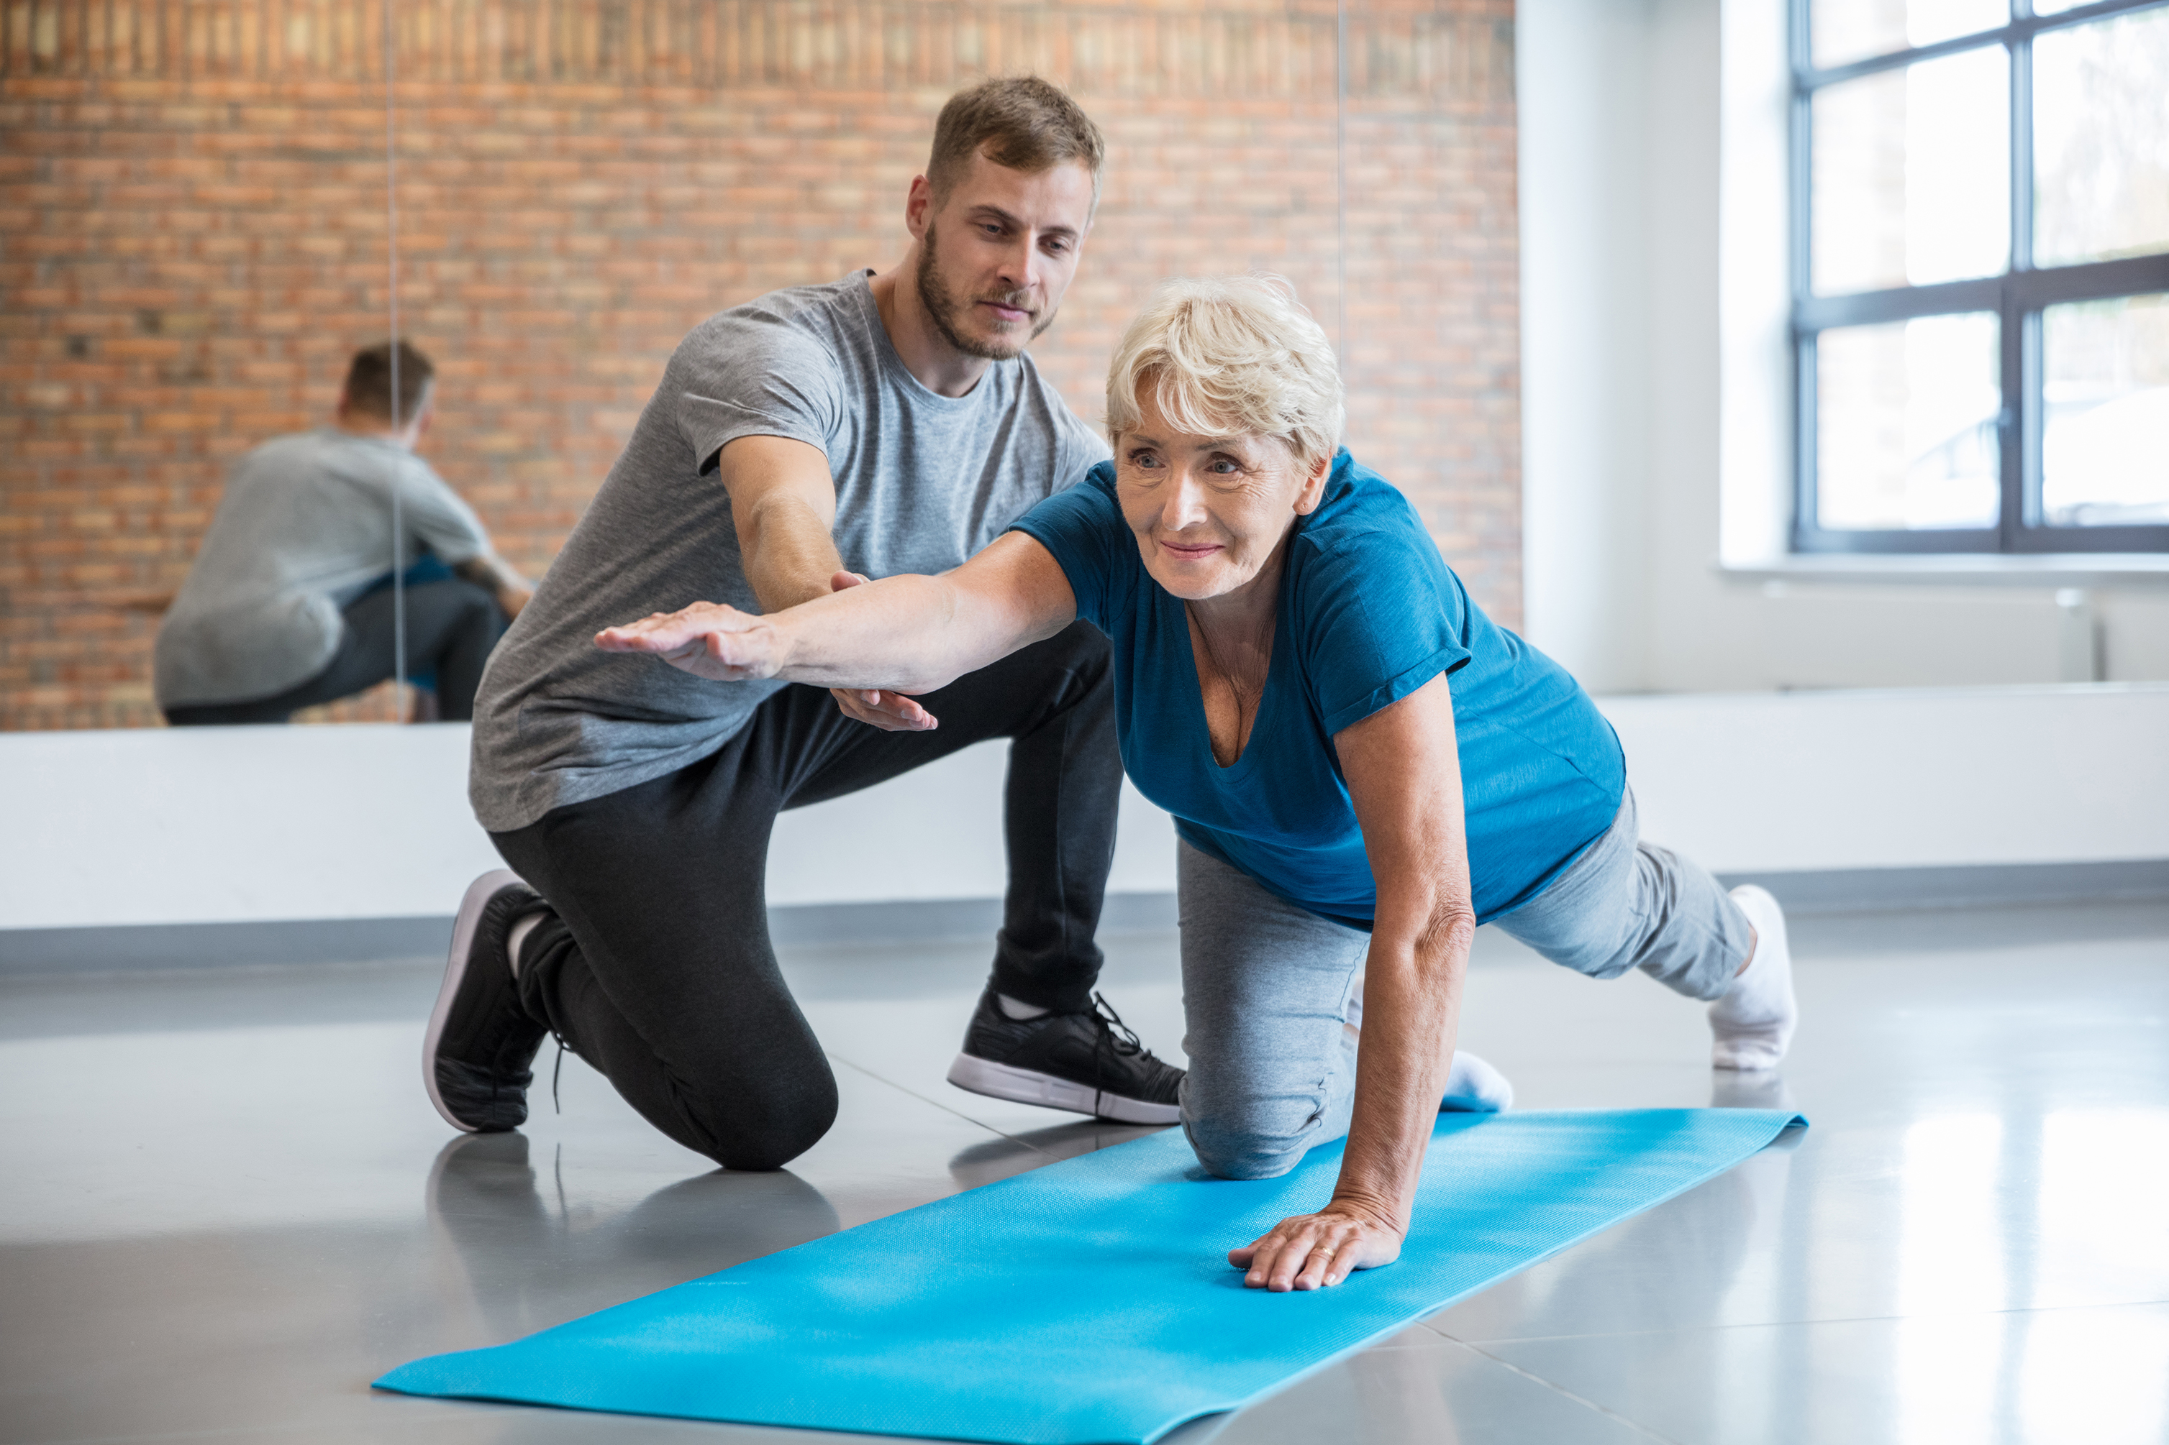
What MOVE looks like in school
Carousel of photos from MOVE sessions

Slide 5
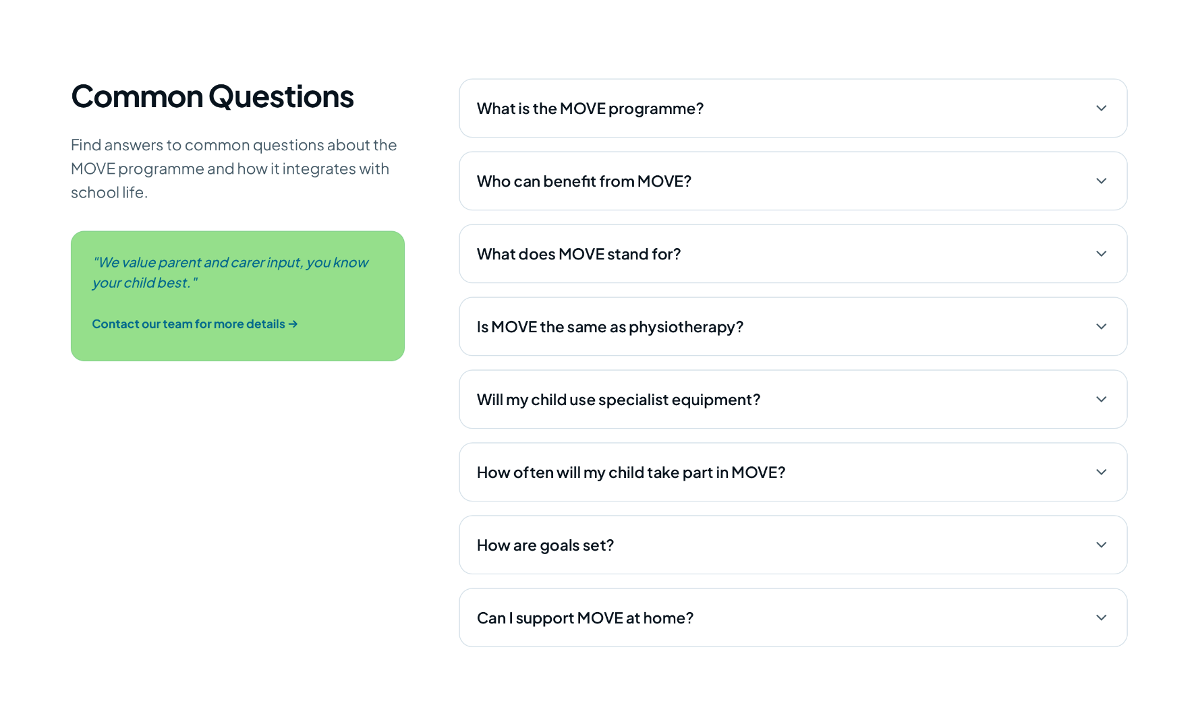
You will be able to click on the ”contact our team for more details” and it could lead to a page with emails of the MOVE practitioners and when you click the arrows next to the question it will drop down and answer the question.

Slide 6
1. What is the MOVE programme?
A child-centred, collaborative framework that enables disabled children and young people to fain independent movement.
2. Who can benefit from MOVE?
Anyone who has not developed the skills of sitting, standing and walking.
3. What does MOVE stand for?
MOVE stands for Movement Opportunities Via Education. It is an approach that helps children and young people develop sitting, standing and walking skills through meaningful, everyday activities in school.
4. Is MOVE the same as physiotherapy?
No. MOVE is not a replacement for physiotherapy. Instead, it works alongside physiotherapy.
The schools MOVE lead with help to assess your child’s physical needs alongside a physiotherapist to set appropriate movement goals and advises on equipment. School staff then embed these goals into daily routines so your child can practise skills regularly in a functional and supportive way.
5. How will MOVE help my child?
MOVE aims to:
Improve independence
Increase participation in school life
Build confidence
Support physical health and wellbeing
Develop functional sitting, standing and walking skills
Even small improvements can make a big difference to comfort, communication, social interaction and independence.

Slide 7
6. Will my child use specialist equipment?
Some children may use equipment such as standing frames, walkers or supportive seating. Equipment is carefully assessed and monitored by the schools MOVE lead and school’s physiotherapist to ensure it is safe and appropriate.
The aim is always to support independence at the right level for your child.
7. How often will my child take part in MOVE?
MOVE is embedded into the school day rather than being a one-off session, however there are MOVE interventions that are ran once a week. Your child may practise movement skills during:
Classroom activities
Transitions between lessons
Play or social times
Personal care routines
This consistent practice helps skills develop more effectively over time.
8. How are goals set?
Goals are individualised and based on what is meaningful for your child. School staff, the physiotherapist and families work together to agree realistic and achievable targets.
We value parent and carer input, you know your child best.
9. Can I support MOVE at home?
Yes. If appropriate, we can provide guidance on simple strategies or positioning advice to help reinforce your child’s goals at home.
Consistency between school and home can make a real difference.

Slide 8
Links to add in
https://moveeurope.org.uk/wp-content/uploads/2022/08/MOVE-at-Home-Activity-Pack.pdf
https://moveeurope.org.uk/wp-content/uploads/2022/08/MOVE-Information-Leaflet.pdf

