Slide 2
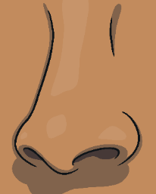
I use my five senses in the winter.

Slide 3
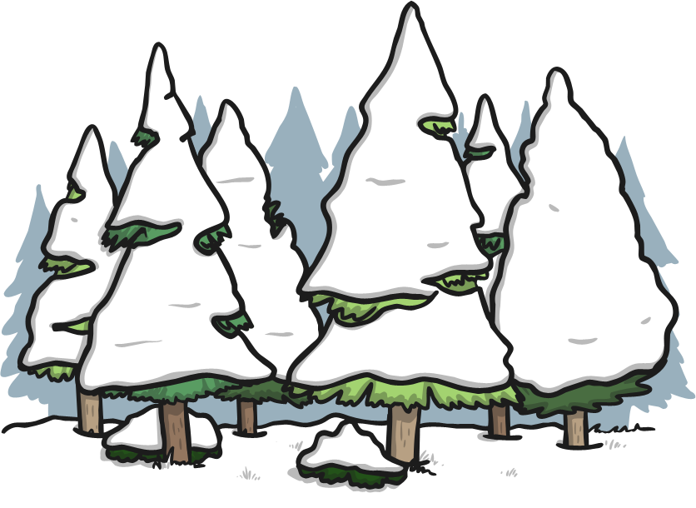
I hear the snow crunching under my feet.

Slide 4
I see the steam from my breath in the air.

Slide 5
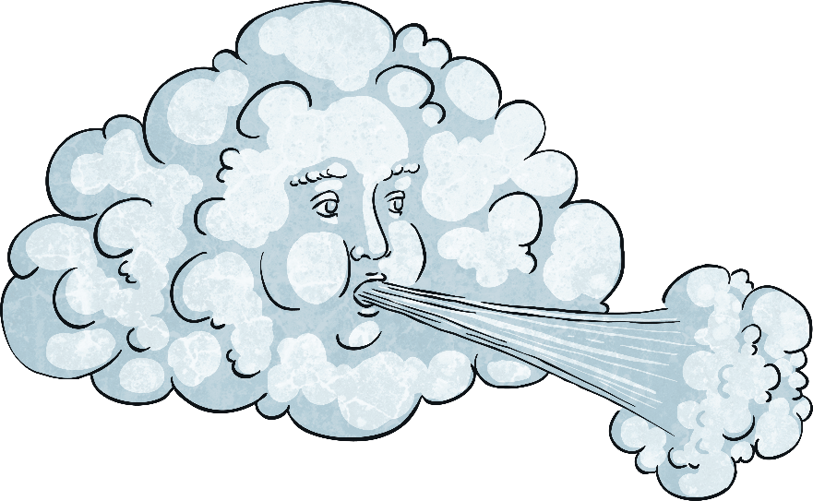
I feel the cold wind on my face.

Slide 6
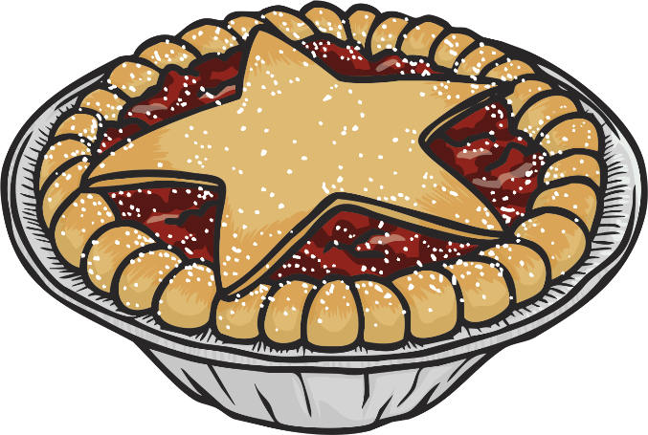
I smell warm mince pies.

Slide 7
I taste a snowflake on my tongue.

Slide 8
I can taste, touch, smell, hear and see winter.

