Slide 1
KS4 Transition Information
Mr P Evans
Head of Year 10
evans@westhillschool.co.uk
West Hill School
Aiming High since 1927

Slide 2
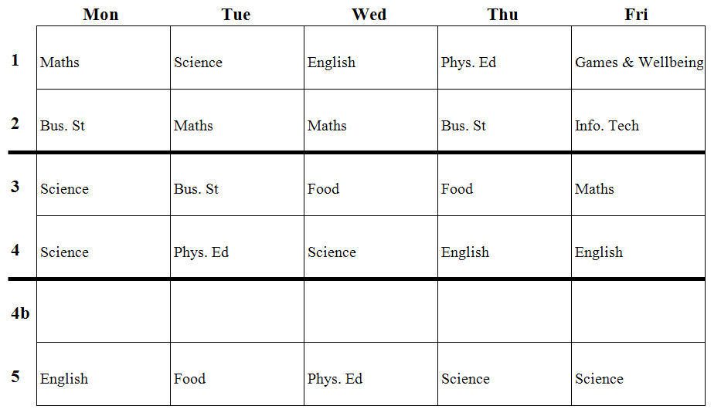
Typical timetable

Slide 3
Daily form time

Slide 4
Independent Learning
Key revision skills and techniques.
Boys should put these into practice at home.
Revision for GCSEs should be continuous.
Get into good habits early on.
Try a variety of methods.

Slide 5
Independent study
Y10:
8- 8.40AM in IT5
Break and lunch in S34.
Dedicated quiet space at home.

Slide 6
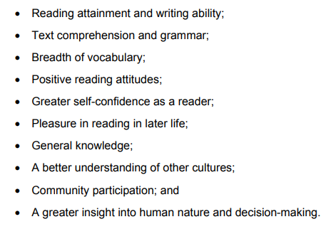
Reading
Research shows a direct link between students who read for pleasure and better academic outcomes across subjects
Department for Education
Research evidence on reading for pleasure

Slide 7
Contact
Form Tutors
Subject Teachers
admin@westhillschool.co.uk
Mr P Evans
Head of Year 10
evans@westhillschool.co.uk

