Slide 1
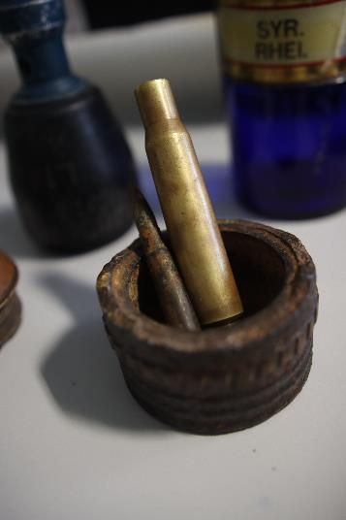
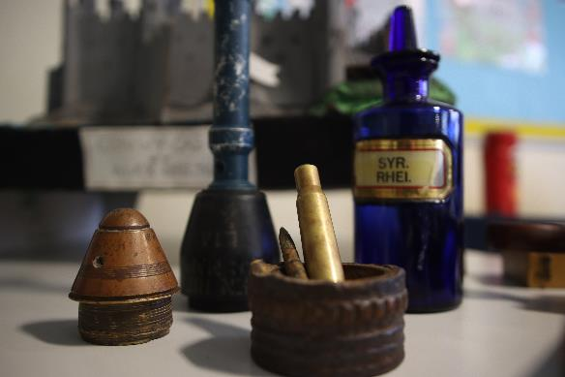
Welcome to GCSE History

Slide 2
Specification Information
Students will sit four exam papers at the end of year 11:
Paper 1 : Medicine 1250-present day, including WW1. 1 hour 15 minutes
A study of the changes in the beliefs about the causes disease and illness over time. You will learn how events, people and institutions have encouraged or held back progress. You will also carry out a case study about the impact World War One had on medicine and surgery.
Paper 2a: Superpower relations and the Cold War 1945-91. 55 minutes
A study of the main developments that unfolded between the USA an the USSR during the period known as the ‘Cold War’.
Paper 2b: Elizabethan England 1558-88. 55 minutes
A study of the social, economic, political, religious and military changes that took place under Elizabeth I.
Paper 3: Germany 1919-39. 1 hour 45 minutes
A study of the social, economic, political, religious and military changes that took place in Weimar and Nazi Germany 1918-39. You will also learn to analyse and evaluate a range of contemporary sources.
There is no longer a coursework module.

Slide 3
What your son will learn
Students learn how significant events, people and decisions have shaped the world we live in. Key questions include…
Why was there a Catholic conspiracy to kill the Queen?
What were the consequences of the Cuban Missile Crisis on Cold War relations?
How does war improve medicine?
How did Hitler become the Chancellor of Germany in 1933?
Was vaccination the most important medical breakthrough 1700-1900?

Slide 4
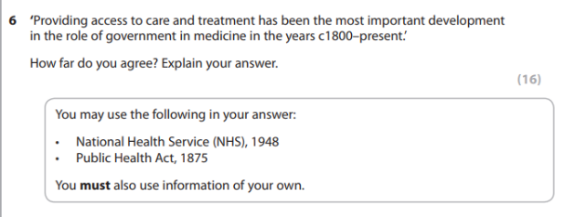
Question types
Here are some examples of the exam questions students will prepare for.

Slide 5
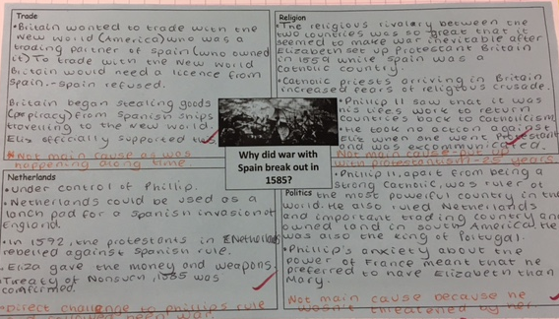
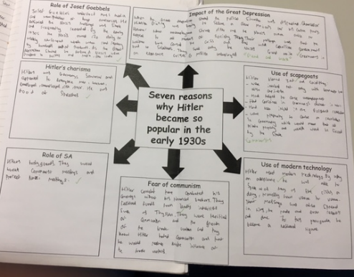
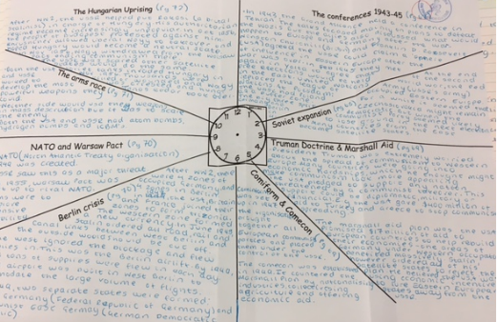
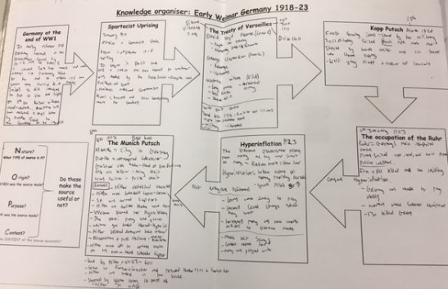
Examples of work

Slide 6
Skills developed
Students will:
Develop their skills of analysis and evaluation through gathering, investigating and assessing material.
Develop their abilities to reason and argue their point of view clearly.
Learn to base conclusions on research.
Learn to put together a logical argument.
Become much more critical of what they read and hear in the news
Develop transferable skills such as independent learning, literacy, open mindedness and developing a clear argument. History is more than learning about names and dates!

Slide 7
Careers/next steps
History is a subject that develops skills of analysis and evaluation. Therefore it can prepare students for:
‘A’ Level in subjects such as History, English, Sociology, Law, Government and Politics.
Work in sectors such as education, journalism, law, civil service, cultural services such as libraries and museums.
Many employers view History as a desirable subject because of the transferable skills developed, particularly keeping an open mind.

Slide 8
Where can you find more information?
Follow our updates on Twitter @WH_Hist
https://www.westhillschool.co.uk/curriculum/subject-areas/history
The History department in school.

