Slide 1

Year 4 Residential 2026
Parent information meeting – 27th November 2025

Slide 2
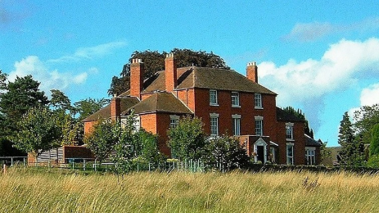
Edgmond hall: Monday 16th March to Wednesday 18th March
Edgmond Hall Centre for Outdoor Learning (link to website)

Slide 3
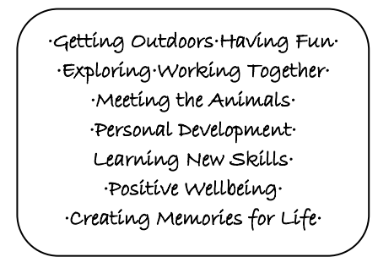
Aims of the visit:

Slide 4
About Edgmond hall
Edgmond Hall is in Shropshire. It sits on the edge of the historic village of Edgmond. It was originally a Georgian Farm House and still reflects this in the Grade II listed main house and outbuildings. It is set in 45 acres of grounds; including woodland, meadow, orchard and old marshland habitats as well as having playing fields and more traditional gardens.

Slide 5
Timings
The children will come to school at a normal time on the Monday. We will complete the register and be ready to leave at around 9.30. Exact coach times will be shared with you nearer the time if you wish to stay to wave your child off.
On Wednesday, we will return to school for the end of school day as normal. The children will come back into classrooms so that we can then safely complete our end of day routine as normal.

Slide 6
Who will be supporting the visit?
There will be a number of school staff who are supporting the visit – some of them will stay for the duration and others will do part of the trip. This is a guided list but there may be changes to this due to staffing within school.
Mrs Lowe – Year 4 Teacher
Miss Shaw – Year 4 Teacher
Mrs Lewis – Senco & Year 3 Teacher
Miss Camm
Mrs Moses
Miss Grimson Mrs Davenport
Mrs Haughton

Slide 7
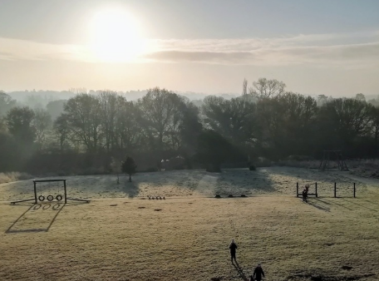
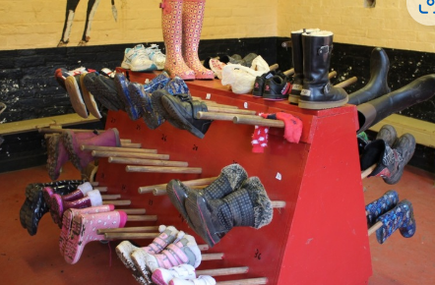
Facilities
• Large playing field with adventure playground
• Boot room and locker room for keeping belongings to use outside
• Dining room, cloakroom and toilets in the main house
• Indoor classroom spaces, including the large classroom in the old barn
• Indoor games room
• Toilets and handwashing in the courtyard for easy access outdoors
• Gift Shop – containing souvenirs.
• The old Billiard room, with tv, quiet games, blackboards and drawing materials

Slide 8
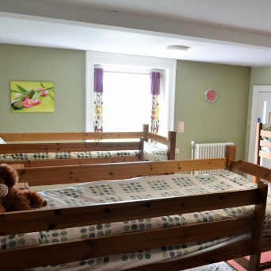
Accomodation
Dormitory style bedrooms with bunkbeds (boys and girls separate)
Shared toilets and showers located one each floor next to the bedrooms
Staff bedrooms are located near to dormitories to enable good supervision

Slide 9
Accomodation The Cottage
Small cottage available for specific children with additional needs/disabilities.
2 bedrooms – 4 children in each room
2 staff bedrooms available
Supervised at all times.
You will be contacted directly for a meeting if we feel your child would benefit from this accommodation.

Slide 10
Meals
The centre aims to provide food that the children will enjoy and that is broadly balanced. They encourage healthy eating by having fresh fruit and vegetables as part of the meals each day. There is a fixed menu, whilst also catering for those with specific dietary requirements using robust procedures.
Day 1: Take own packed lunch, cooked evening meal and snack before bed.
Day 2: Cooked breakfast, provided packed lunch and cooked evening meal. Snack before bed.
Day 3: Cooked breakfast and provided packed lunch before leaving to return to school.
Children are well fed and don’t need to bring their own snacks! They will be taken off the children, as food it not allowed in the bedrooms.

Slide 11
Menu
Day 1 Evening Meal: Fish Fingers with Chips, option of baked beans or peas..
Day 2 Evening Meal: Pasta Bolognaise with Garlic Bread.
.
Lunches will be selected at breakfast time, from a tick list style menu.
Options:
Ham Sandwich
Cheese Sandwich
Tuna Sandwich
*All dietary needs will be catered for. If your child has specific dietary needs, please let us know on the medical form and we will speak with the catering team.

Slide 12
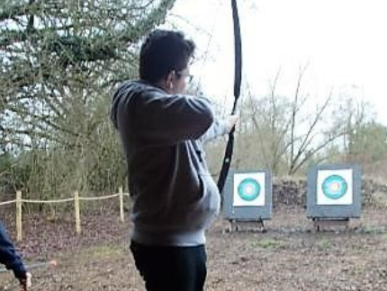
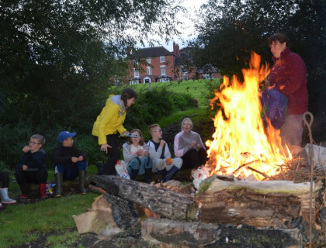
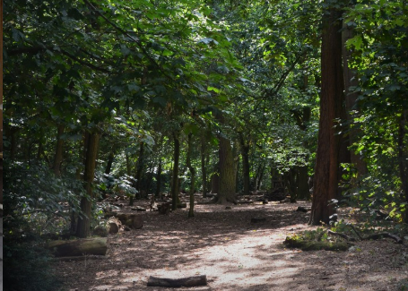
Activities (TBC as it is weather dependent)
Below are possible activities that may be included within the visit – still to be confirmed.
Shelter building
Woodland adventure
Archery
Pond dipping
Outdoor games/campfire
Animal care
Orienteering
*All of the risk assessments are completed by Sandwell Residential education service, who will be in charge of all the activities whilst at Edgmond Hall.
*We are fully insured for the residential through the RPA, which is covered by the Department for Education.

Slide 13
What to bring? Kit List
A backpack with day-to-day items:
Coat/waterproof jacket & trousers
Thick socks
Hat/scarf or suncream and cap – weather dependent!
Re-usable water bottle
Small torch
Packed lunch for Day 1
Maximum £5 for the gift shop

Slide 14
What to bring? Kit List
A small suitcase or bag (coach has limited space):
Wash kit (shower gel, toothpaste, toothbrush)
Pyjamas
Underwear and socks (plenty of socks!)
Slippers/teddy for bedroom use
3 x t-shirts/long sleeved t-shirts
2/3 x jumpers/warm long sleeved tops (required for activities)
2/3 x long trousers (required for activities)
1 x old trainers
1 x trainers to keep clean
Plastic bag for dirty clothing NAME EVERYTHING!
Towel
Book/card game

Slide 15
What not to bring!
Snacks/drinks – children are given plenty of food!!
Electronics (mobile phones, tablets, trackers)
Jewellery
New clothes that you don’t want to get muddy!
Toys

Slide 16
Behaviour
WHEELOCK BEHAVIOURS - Aspire, Respect, Responsibility
On arrival at Edgmond Hall all children will be given a health and safety talk, by Sandwell Staff and reminded of how to behave whilst on the residential.
All children will be shown around the grounds, so they know where everything is including the toilets, handwashing facilities, lockers, bedrooms, dining room, boot room.
Children will be told the rules, where to keep their belongings and how to treat others. This must be adhered to at all times..

Slide 17
Behaviour
WHEELOCK BEHAVIOURS - Aspire, Respect, Responsibility
Whilst away on our visit we will uphold our school values and behaviours at all times.
If a child is deemed to be misbehaving and causing a danger to others, then they will be spoken to by a member of Wheelock School Staff.
If the behaviour continues and they and making the activity unsafe, they will be removed by a member of Wheelock School Staff from the activity and given time to regulate, before rejoining the group.
If the behaviour continues, they will have to sit out for the remainder of the activity. This will be escalated to a member of SLT, who will call school and staff will make the decision as to whether or not parents need to be called and children collected.
ALL CHILDREN MUST BE KEPT SAFE at all times. If this is put at risk then your child will have to go home, and you will be asked to collect them.

Slide 18
cost
Total cost of the trip = £202.69
Deposit to be paid via Arbour of £46.69 by 12th December 2025.
Final Balance to be paid by 9th March 2026.
All monies paid are non-refundable.
You are welcome to pay in instalments between now and March.
If you are eligible for Free School Meals or Pupil Premium, you may be able get funding towards the trip.
Please contact the school office or Business Support Manager.

Slide 19
Any questions? This powerpoint will be available on the school website

