Slide 1

Year 2 residential
Tattenhall
16th-17th June

Slide 2
Monday16th June 2025- Tuesday 17th June 2025
Leave school around 9.30 to arrive around 10.30
Children will need a packed lunch for the first day.

Slide 3
aims
At the Conway Centres, our residential visits offer children and young people diverse and high-quality experiences to enhance their classroom learning and develop life skills to help them reach their full potential.
Our Primary School residentials aim to encourage pupils’ physical and emotional health and wellbeing, having a positive effect on self-esteem, confidence and their ability to interact successfully with others, whilst offering a unique opportunity for them to claim their independence, make their own decisions and build new friendships. They will take away so much more than just fantastic memories!

Slide 4
Arrival
On arrival at the centre, children will be given a safety talk and shown around the centre. They will be shown their beds and have time to unpack.
Activities will begin

Slide 5

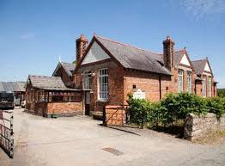
Facilities
Outdoors: Large playing field, adventure playground and bouldering wall.
Indoors: Art studio, drama/dance hall
Other facilities: Dining and chill-out areas
Security: The centre site is fully secure with boundary fencing and coded accommodation access.

Slide 6
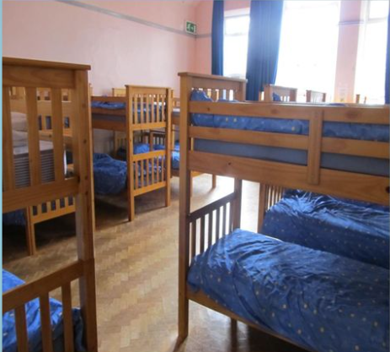
accommodation
We will have the centre exclusively as we have 56 children in Year 2.
There will be 4 dormitories. 2 with bunk beds and two with single beds.
Toilets are close by.
Teacher rooms are right outside the dorms.
Doors are kept open at night. We are the only school there. Lights kept on in the hall so that children can find the toilet if needed.
Children will be shown the teacher’s rooms in case they need them in the night.

Slide 7
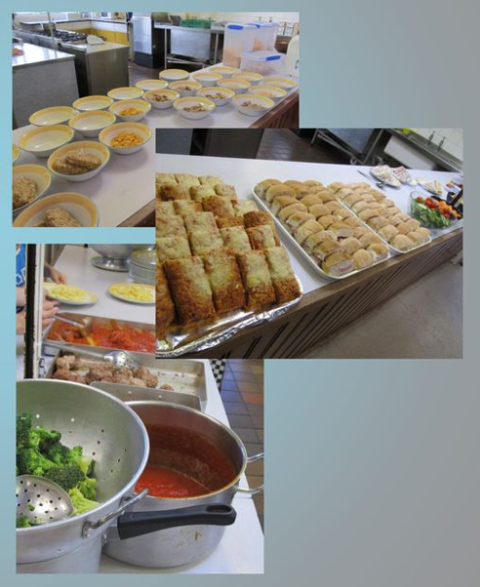
Food glorious food
Breakfast- wide variety including cereals, toast and a cooked breakfast.
Lunch- packed lunch on the first day then provided on the second.
Tea- Lots on offer including fish fingers, lasagne, curry and pizza.
Juice and biscuits provided throughout the day.
The centre will be sent any dietary requirements before the visit so that they can cater to all children’s needs.

Slide 8
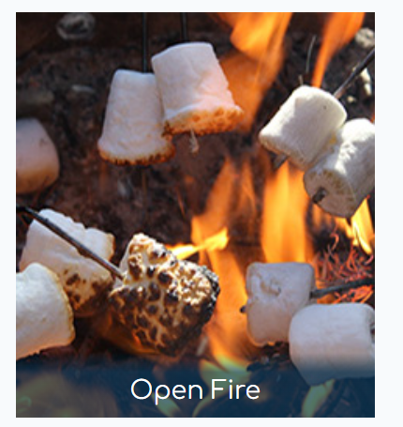


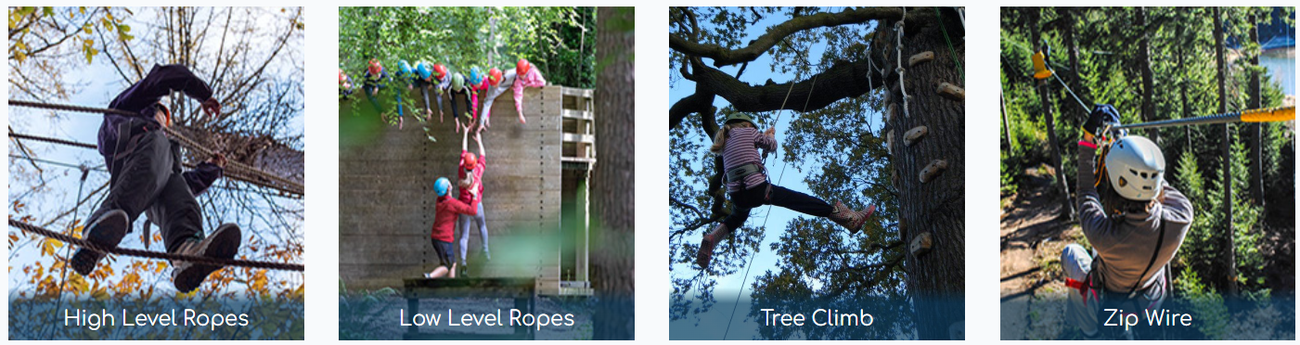
Activities for the trip

Slide 9
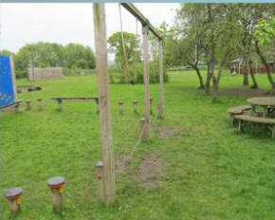
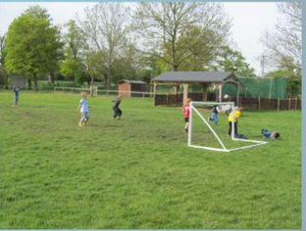
Outside and downtime
There is a large outdoor space for the children during downtime.
Climbing frame
Football area
Seating area
Sofa areas inside

Slide 10
Kit list
The children will spend a lot of time outside so they will need:
Trainers, wellies and slippers for inside.
Pyjamas
Towel
Clothing suitable for outdoor
Coat/ waterproof
Appropriate toiletries
Hat and gloves- weather permitting
Spare clothes if get dirty
No money needed
No snacks needed
Water bottle
Packed for the first day
I will send a further/more detailed kit list closer to the time.

Slide 11
Cost of the trip is £123.86 per child.
Non refundable deposit of £23.86 by 12 March 2025 to confirm and hold place.
Payment options can be set up if required.
We will then send home medical/dietary forms to complete and send back.

Slide 12
Any questions?

