Slide 1
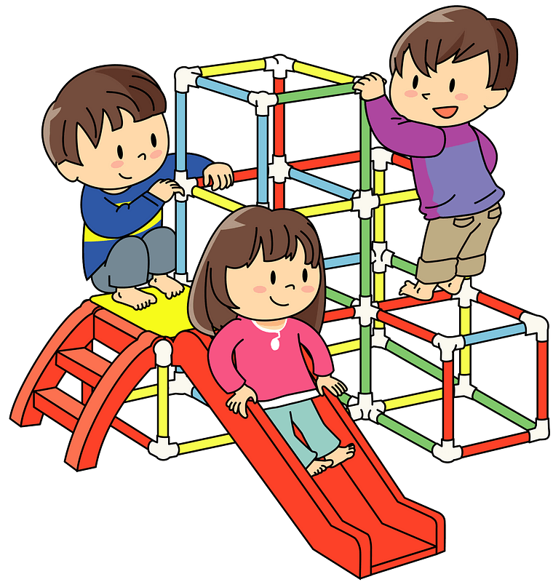
TRANSITION TO SCHOOL
Supporting every child in their transition to school journey
May 2025
Welcome to Wheelock Primary letters sent to all new starters – this includes Tapestry consent and school registration forms.
JUNE 16th 2025 5:00pm- 6:00pm
Welcome meeting
The EYFS team will welcome parents and deliver a presentation to share an overview of our EYFS and any key messages.
Any forms that are outstanding will be completed with parents during this evening. Friends of Wheelock and Badged will be available to introduce themselves and take orders.
JUNE/JULY 2025
Visits/Calls to pre-schools
A member of the EYFS team will call or visit children in their Pre-School settings
We will endeavor to visit children in local pre-schools.
If this is not possible, we will arrange a meeting via phone call to chat to children's key worker.
JUNE & JULY 2024
Visits to school
VISIT 1 Tuesday 24th June 9:30-10:30am or 1:15pm – 2:15pm Stay and play
(Parents will sign up to morning or afternoon session)
VISIT 2 Wednesday 25th June 9.30 -10:30am or 1:15pm – 2:15pm Stay and play
(Parents will sign up to morning or afternoon session)
Families are invited into school for their first stay and play sessions. The EYFS team will welcome families in the main school hall and children will then come and play in their new classrooms. They will be exploring the classroom and getting to know their new teachers.
JULY 2025 – let’s get to know each other!
New starter families will be given access to Tapestry - our online learning & communication journal.
1st-5th SEPTEMBER 2025
Welcome to Wheelock!
Monday – Inset day
Tuesday -10:00am - 11:45am
Wednesday – 10:00am- 12:00pm
Thursday - 8:35- 12:15pm (lunch provided)
Friday- 8:35am – 1:30pm (parents invited in for a picnic lunch @12:30pm)
EYFS staff will be available to chat to parents for 30 minutes after the sessions. Any questions are answered, concerns eased, and every effort is made to ensure both child and parent are confident and happy to start school full time the following week.
Every child’s induction will be personalised to meet their individual needs. Where additional transition activities are required, these will be discussed with the child’s parents.

