Slide 1


Year 4 Information Evening
Monday 8th September 2025

Slide 2
Year 4 Team
Miss Wilkins – Lower Key Stage Lead
Miss Shaw – class teacher of Kingfishers
Miss Lowe – class teacher of Lapwings
Mrs Goode – support
Mrs Capewell – support
Mrs Moses – support
Miss Camm – support
Miss Wood – support

Slide 3

Our Vision and Values
Children at Wheelock are taught to believe in themselves.
Children at Wheelock belong to an inclusive community where all are treated fairly.
Being kind is central to everything that we do at Wheelock.
Believe Belong Be kind

Slide 4
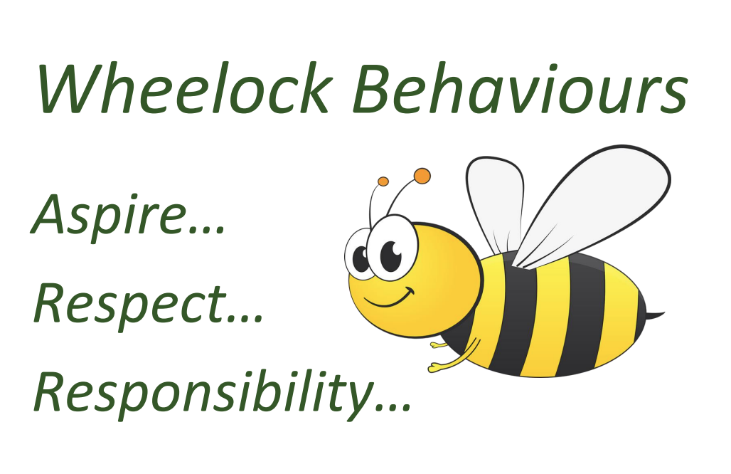
Learning behaviours

Slide 5
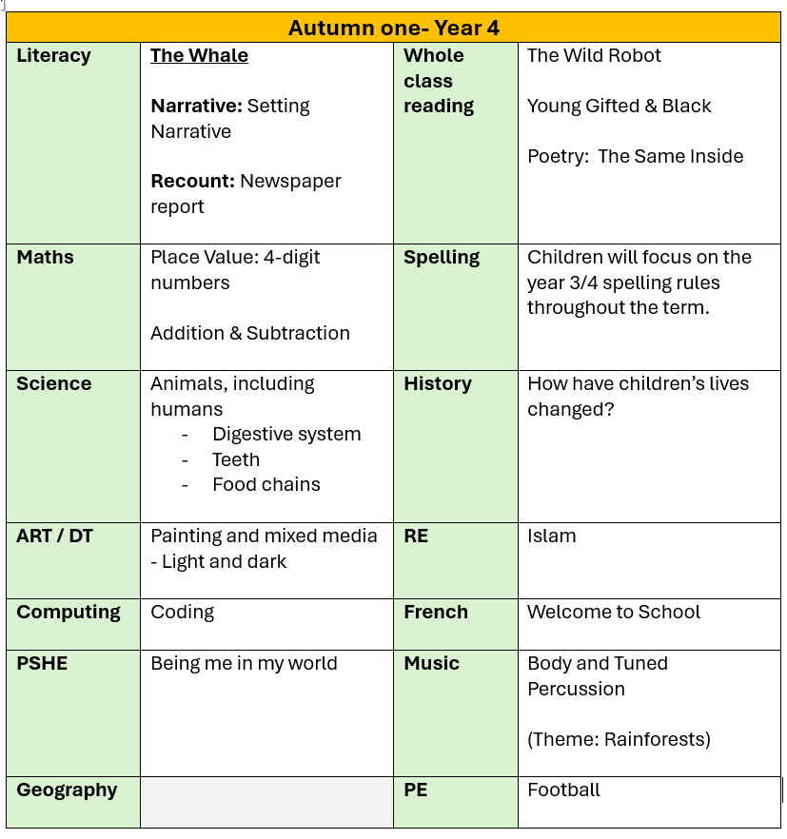
Curriculum coverage

Slide 6
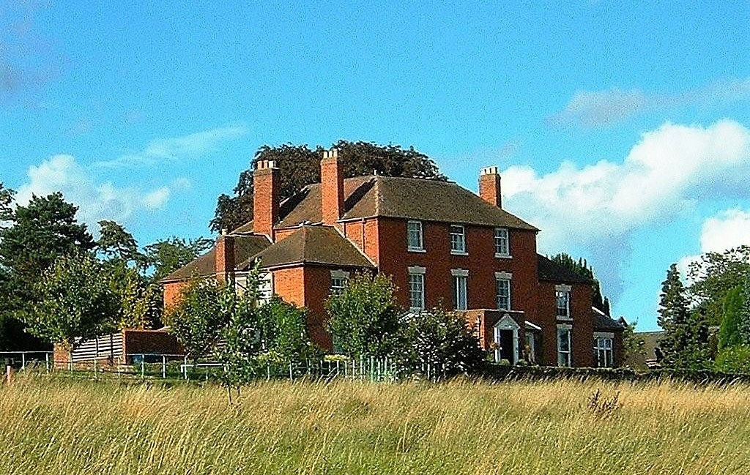
Residential & other visits
Edgmond Hall
16th – 18th March 2025
(there will be an additional information evening about this during later in the year)

Slide 7

Swimming
Year 4 will have swimming sessions in June/July.
Pool on site as it was last year.
Details will be sent nearer the time.

Slide 8
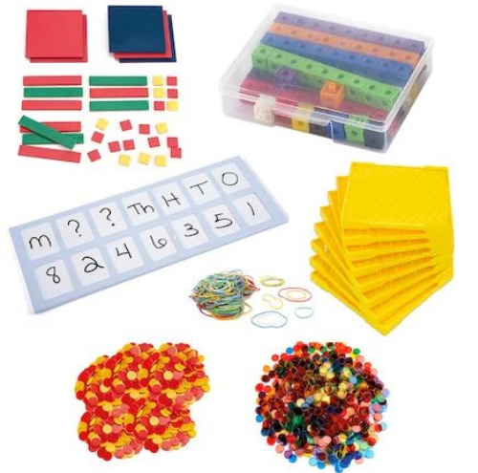
Maths
Children are taught maths in small steps and all children follow the same sequence of learning.
We use concrete and visual resources to ensure a deep understanding of concepts for all children.
Where needed pupils will be in additional support groups to ensure they have grasped concepts that have been taught.

Slide 9
Year 4 Multiplication Check
A government check on the recall of times tables by year 4 pupils.
Takes place in June (dates tbc)
More information will be sent out to parents later in the year.
Vital that children practice their times tables outside of school. Please ensure that they are logging in to TT Rockstars at least 3 times a week.
We will practice in school daily through our 10-minute NumberSense fluency sessions.

Slide 10
Writing
Throughout the year children will be exposed to a variety of genres of writing including:
A range of narratives
Newspaper report
Information report
Persuasive letter
Instructions
Persuasive report
Biography
These are all linked to high quality texts which will be shared on our website curriculum overview each half term. Year 4 pupils need to include a range of features within their writing which we build upon throughout the year.

Slide 11
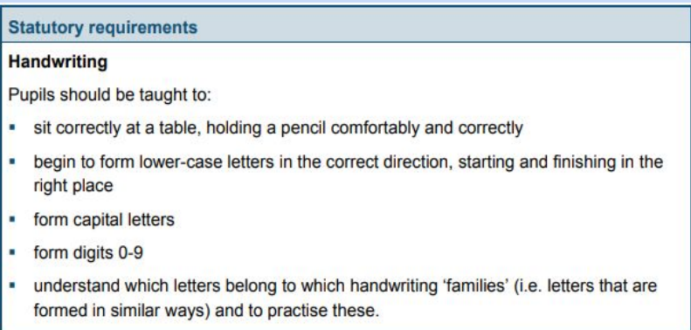
Handwriting – why do we focus on it?
Legible writing that can be produced comfortably at speed and with little conscious effort allows a child to attend to the higher-level aspects of writing composition and content.

Slide 12
Handwriting – what are the expectations?
Year 4 will complete frequent handwriting lessons each week.
Initially looking at individual letter formation, moving to joining within words.
Once children are demonstrating a consistent, legible and accurately formed style of writing they will be rewarded with a pen license.
All year groups have high aspirations for their children’s handwriting.

Slide 13
Spelling
Autumn term – revision of Year 1 & 2 common exception word lists, Year 2 and 3 rules previously learnt.
Continuous reminders of phonics sounds to support with spelling.
Word banks available in all writing.
High expectations of all pupils to use the resources available to them and apply rules that have been learnt.
We will send home certain words if we need additional support with certain words/rules.

Slide 14
Homework
Maths (Times Tables Rock Stars) & Spelling– set on Thursday and due the following Wednesday.
Both will follow our current learning within the classroom to allow children to apply their knowledge independently away from the classroom setting.
Please encourage your children to be independent and complete the work to the best of their ability. Please also help to ensure that it’s handed in on time - thank you for your support.

Slide 15
Reading
All pupils have their ZPD reading ability and these will be assessed at the start of each term.
Children need to be reading at least 5 times a week - please spend time listening to them or asking what they are reading about if they have read independently.
Once a book is complete then a quiz must be done on Accelerated Reader.
We will monitor this frequently to see how much pupils are reading. We will be in contact if we feel your child needs to increase the amount that they are reading.

Slide 16
Communication
It is easier for us to speak at the end of a school day as mornings are used to ensure the pupils are in school and settled. Please just ask if it is something quick that you need to discuss with us.
If communication can be emailed, then please send this via the office and they will forward to the appropriate member of staff. Please allow two working days for a response.
office@wheelock.cheshire.sch.uk
If it is urgent then please contact the office via phone.

Slide 17

Thank you for listening.

