Slide 1


Year 3 Information Evening
10th September 2025

Slide 2

Year 3 Team
Miss Wilkins/Mrs Lewis– class teacher of Moorhens
Mrs Warburton– class teacher of Sandpipers
Miss Wood– support
Mrs Moses– support
Miss Camm– support
Mrs Goode– support
Mrs Capewell- support

Slide 3

Our Vision and Values
Children at Wheelock are taught to believe in themselves.
Children at Wheelock belong to an inclusive community where all are treated fairly.
Being kind is central to everything that we do at Wheelock.
Believe Belong Be kind

Slide 4
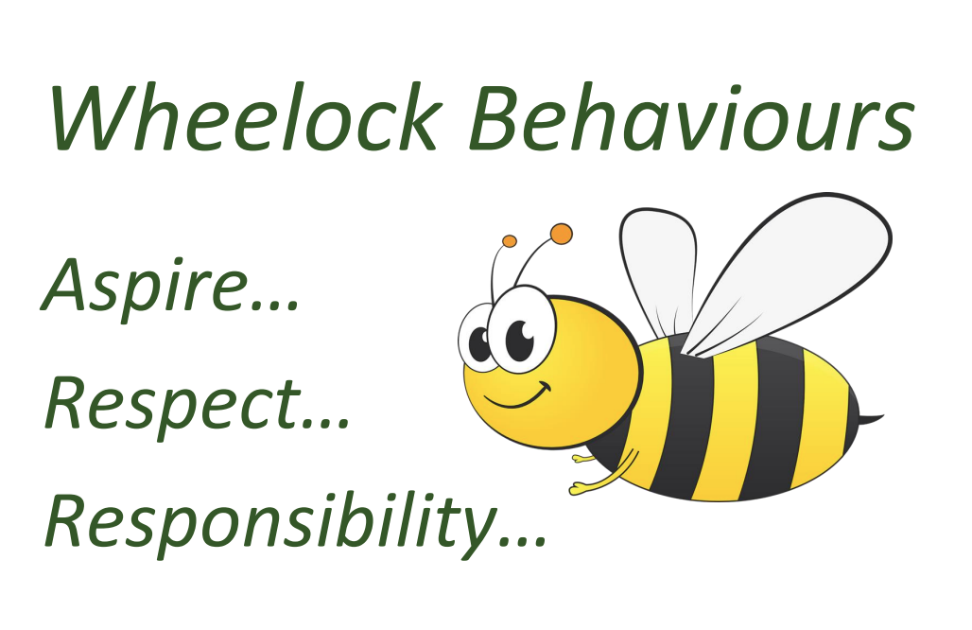
Learning behaviours

Slide 5
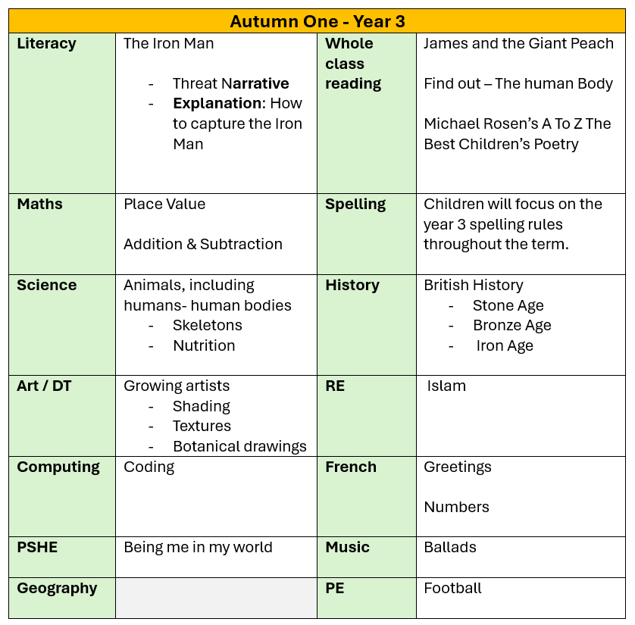
Curriculum coverage

Slide 6
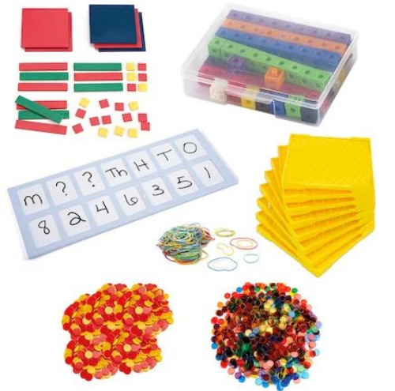
Maths
Children are taught maths in small steps and all children follow the same sequence of learning.
We use concrete and visual resources to ensure a deep understanding of concepts for all children.
Where needed, pupils will be in additional support groups to ensure they have grasped concepts that have been taught.
Follow this link to view our calculation policy and further information around the maths curriculum.

Slide 7



Writing
Throughout the year children will be exposed to a variety of genres of writing including:
A range of narratives
Information leaflet
Descriptive letter
Instructions
Newspaper report
These are all linked to high quality texts which will be shared on our website curriculum overview each half term. Year 3 pupils need to include a range of features within their writing which we build upon throughout the year.

Slide 8
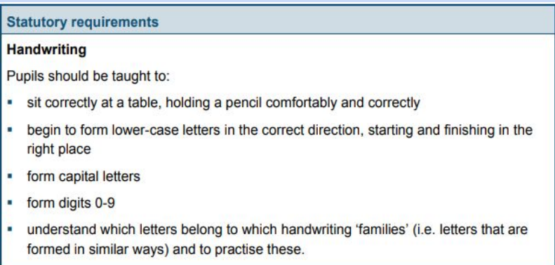
Handwriting – why do we focus on it?
Legible writing that can be produced comfortably at speed and with little conscious effort allows a child to attend to the higher-level aspects of writing composition and content.

Slide 9
Handwriting – what are the expectations?
Year 3 will complete frequent handwriting lessons each week.
Initially looking at individual letter formation, moving to joining within words.
Once children are demonstrating a consistent, legible and accurately formed style of writing they will be rewarded with a pen license.
All year groups have high aspirations for their children’s handwriting.

Slide 10
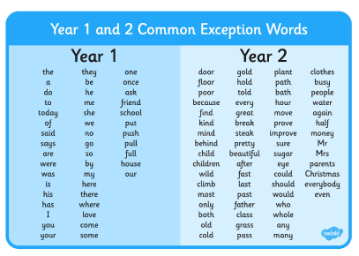
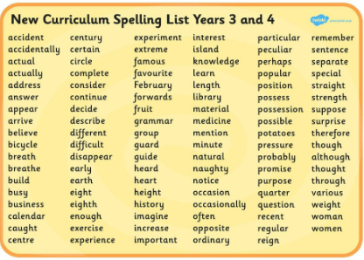
Spelling
Area of improvement across the school.
Autumn term – revision of Year 1 & 2 common exception word lists.
Continuous reminders of phonics sounds to support with spelling.
Daily spelling lessons based on year 3 spelling patterns.
Word banks available in all writing.
High expectations of all pupils to use the resources available to them and apply rules that have been learnt.
Please support your child with learning and securing the common exception words found on our website.

Slide 11

Reading
All pupils who have completed phonics have their ZPD reading ability and these will be assessed at the start of each term.
Children need to be reading at least 5 times a week - please spend time listening to them or asking what they are reading about if they have read independently.
Once a book is complete then a quiz must be done on Accelerated Reader.
We will monitor this frequently to see how much pupils are reading. We will be in contact if we feel your child needs to increase the amount that they are reading.
*Those children who are continuing their phonics learning have group sessions daily.

Slide 12

Homework
TT Rockstars
All pupils have a log in for TT Rockstars. Times tables are a key part to the maths curriculum in Year 3 & 4. As pupils are tested on their recall of times tables in Year 4. We recommend at least 3 minutes a day in order to have an impact on their speed of recall.
Times Tables Rock Stars: Play (ttrockstars.com)
Reading
Although your child will be taught to read at school, you can have a huge impact on their reading journey by continuing their practice at home. Children will bring home a book that is based on their reading ability. We expect children to read at least 5 times a week. Once your child has completed a book, they will need to complete a quiz on Accelerated Reader. We will monitor the amount of words your child has read as well as their understanding of the text frequently. Children will be given stickers once they have completed quizzes and keep these as record of their reading throughout the year. Pupils have the log in and the link is as follows:
Renaissance Learning Login

Slide 13
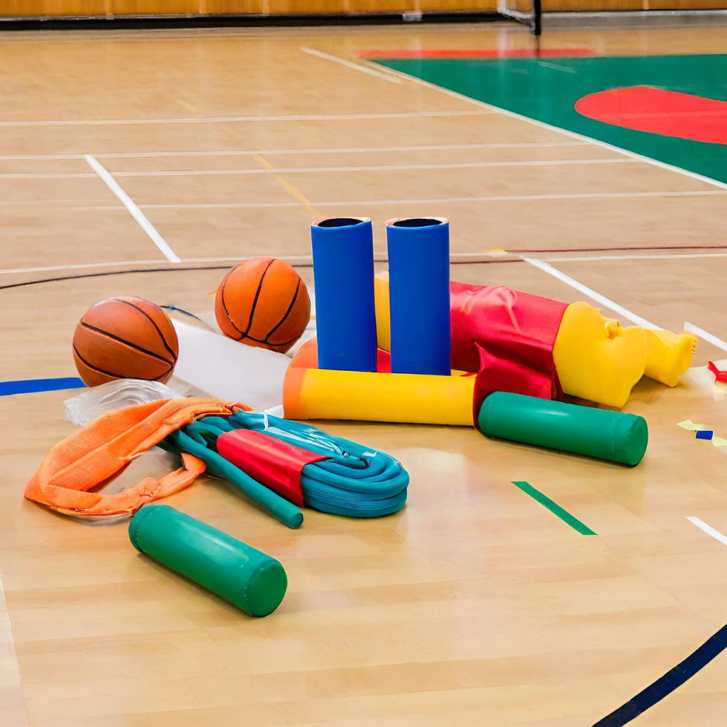
PE- Friday
We ask that all children have an appropriate pair of outdoor shoes in school for extra PE sessions and other outdoor learning. Children will need to come into school wearing different shoes from the ones that they wear for PE. This is to ensure that children are not brining mud through the school when PE has been completed on a wet field.
Kit for PE
White t-shirt/house t-shirt/house hoodie
Black joggers/black leggings/black shorts
Trainers/pumps

Slide 14
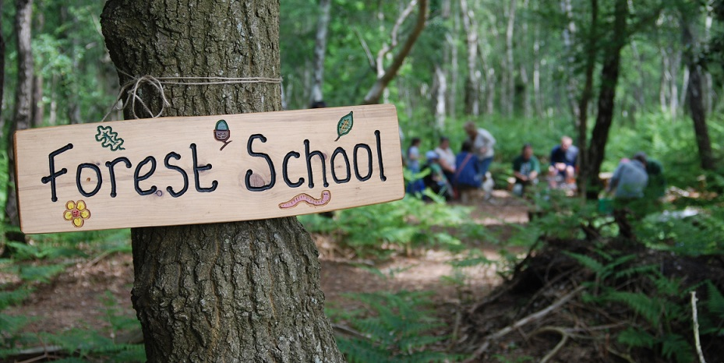
Forest School
Year 3 will access Forest School sessions down in the woodland environment this year.

Slide 15

Swimming
Year 3 will have swimming sessions in June.
Pool on site as it was last year.
Details will be sent nearer the time.

Slide 16
Communication
It is easier for us to speak at the end of a school day as mornings are used to ensure the pupils are in school and settled. Please just ask if it is something quick that you need to discuss with us.
If communication can be emailed, then please send this via the office and they will forward to the appropriate member of staff. Please allow two working days for a response.
office@wheelock.cheshire.sch.uk
If it is urgent then please contact the office via phone.

Slide 17

Thank you for listening.

