Slide 1
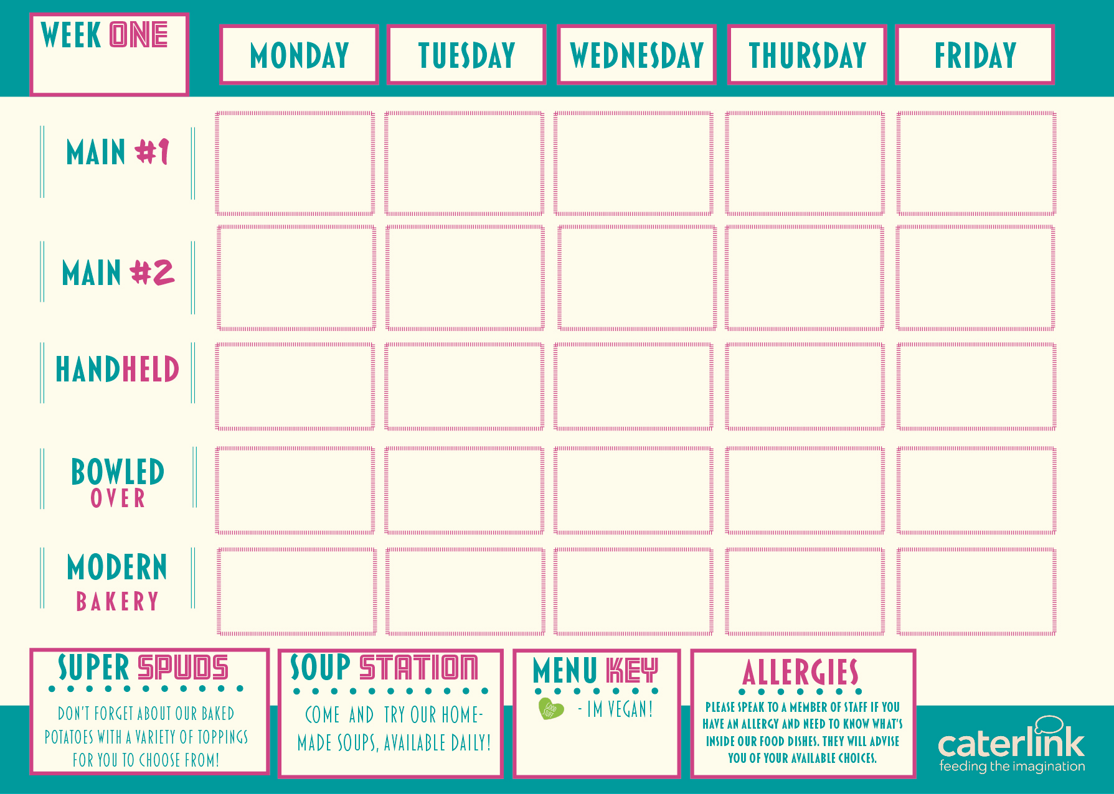
Pork, Beef or Chicken Enchilada (choose one) with Rice
Roast Gammon, Roast Beef or Roast Turkey (choose one), New Potatoes, Seasonal Vegetables & Gravy
Chip Shop Fish or Sausage with Chips, Mushy Peas and Gravy/ Curry Sauce
Crunchy Crouton
Mac & Cheese
Jerk Chicken with Rice and Peas and Pineapple Slaw
Roasted Vegetable
Filo Pastry Tart with New Potatoes & Seasonal Vegetables
Curried Squash, Sweet Potato & Butterbean Stew with Rice and Peas & Pineapple Slaw
Chip Shop Vegan Sausage with Chips, Mushy Peas and Gravy/ Curry Sauce
Bang Bang Cauliflower Mac & Cheese
Quorn Chilli Loaded Wedges
Chicken Wings
Sausage Roll
Chicken Wrap
Bacon & Cheese Flatbread
Veggie Pitta Pizza
Rice Bowl
Pasta Kitchen
Vegetarian
Noodle Street
Loaded Nachos
Pasta Kitchen
Pineapple Upside
Down Cake
Chocolate Crunch Cake
Summer Fruit Crumble with Custard
Warmed Jamaican Ginger Cake with Ice Cream or Custard
Iced Sponge Cake

Slide 2
Sausage and Red Onion Chutney Hot Baguette with Roasted New Potatoes
Vegetable Chow Mein
Chicken Souvlaki with Greek Salads
Chicken Tikka Masala with Rice
Breaded Fish, Chips & Garden Peas
Sweet and Sour Vegetables with Rice
Vegan Sausage and Red Onion Chutney Hot Baguette with Roasted New Potatoes
Cheese and Leek Frittata with Chips and Garden Peas
Feta, Honey and Spinach Parcel with Greek Salads
Sweet Potato, Chickpea & Spinach Curry with Rice
Selection of Paninis
Sausage Roll
Chicken Wrap
Bagel Pizza
Chicken Quesadilla
Rice Bowl
Pasta Kitchen
Noodle Street
Pasta Kitchen
Loaded Nachos
Chocolate Sponge Pudding
Custard Tart with Mixed Berry Compote
Sticky Toffee Apple Crumble and Custard
Jam and Coconut Sponge
Oaty Flapjack

Slide 3
Crunchy Topped Tomato Pasta Bake with Roasted Vegetables
Beef Lasagne with Garlic Bread
and Salad
Spicy Mexican Chicken with Rice and Sides
Chicken Paella with Patatas Bravas and Salads
Fish and Chips with Garden Peas or Baked Beans
Vegetarian Toad in the Hole with Mashed Potatoes & Gravy
Vegan Chilli with Rice and Sides
Vegetable Ragu with Garlic Bread and Spaghetti
Spanish Tortilla with Patatas Bravas and Salads
Vegetarian Burger and Chips with Garden Peas or Baked Beans
Selection of Wraps
Pitta Pizza
Chicken Wrap
Selection of Paninis
Sausage Roll
Rice Bowl
Pasta Kitchen
Rice Bowl
Noodle Street
Pasta Kitchen
Chocolate Orange Cookie
Apple Pie
with Cream
Fruit Muffins
Peach Cake
Chocolate Brownie

