Slide 1
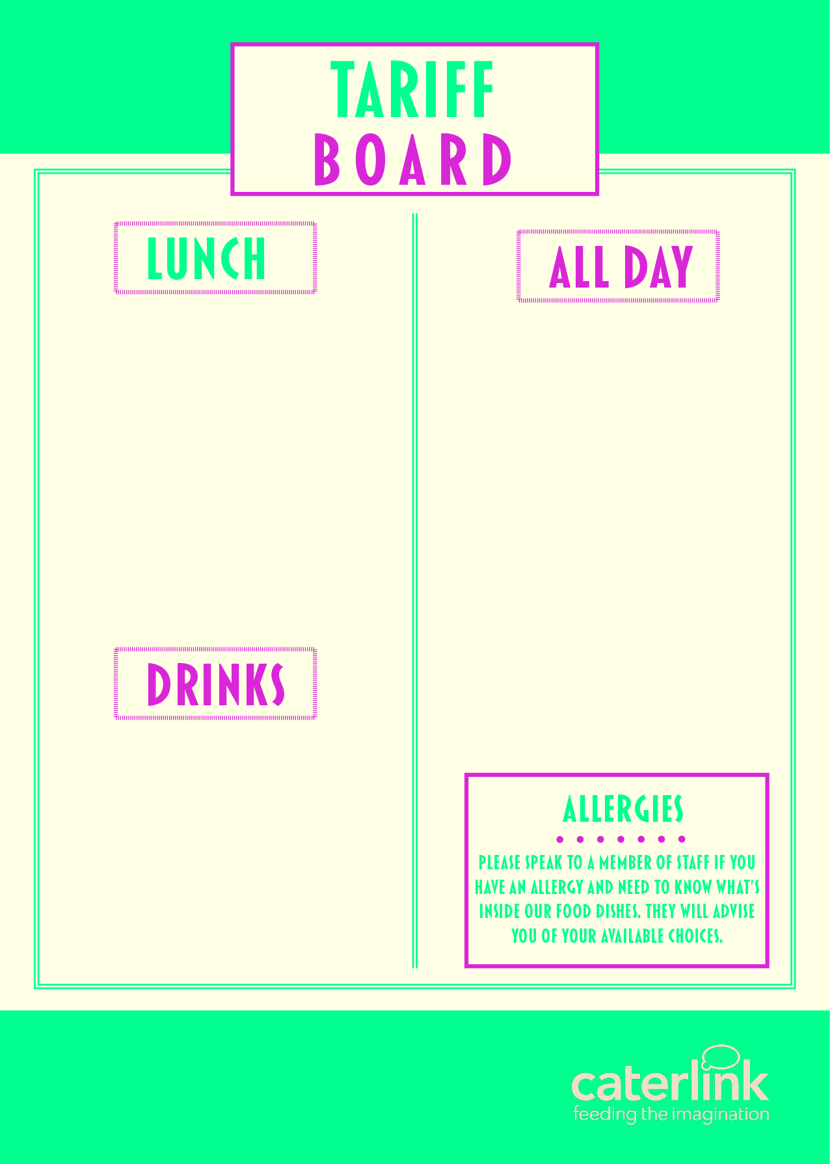
MAIN MEAL DEAL (FSM) (Main Meal & Dessert & Water*) | £2.65
MAIN MEAL | £2.65
JACKET POTATO & 1 FILLING ADDITIONAL FILLING CHICKEN WRAP OF THE DAY | £2.37 £0.50 £2.69
BAGUETTES – FROM SANDWICHES/ROLLS/WRAPS – FROM
HOT PASTA | £2.65
COOKIE | £1.18
HOMEBAKE | £1.29
YOGHURT POTS | £1.10
DRIED FRUIT BAGS | £1.00
PASTA / SALAD POTS - FROM | £1.85
FRUIT POTS - FROM | £1.00
SAUSAGE ROLL | £1.83
PANINIS/BAGELS | £2.69
NACHOS | £1.65
CHICKEN WING/NUGGETS | £2.14
GOUJON BURGER | £2.69
TATERS/WAFFLE FRIES | £1.67
PIZZA | £1.77
BREAKFAST ROLL | £2.37
WATER – 500ml* | £0.85
RADNOR FIZZ – 300ml | £1.17
VIVA MILKSHAKE | £1.29
RADNOR SPLASH – 500ml | £1.10
FRUIT JUICE | £0.90

