Slide 1
Year 6 Parents' Information
Evening
Proud to be part of The White Horse Federation Multi-Academy Trust | www.twhf.org.uk

Slide 2
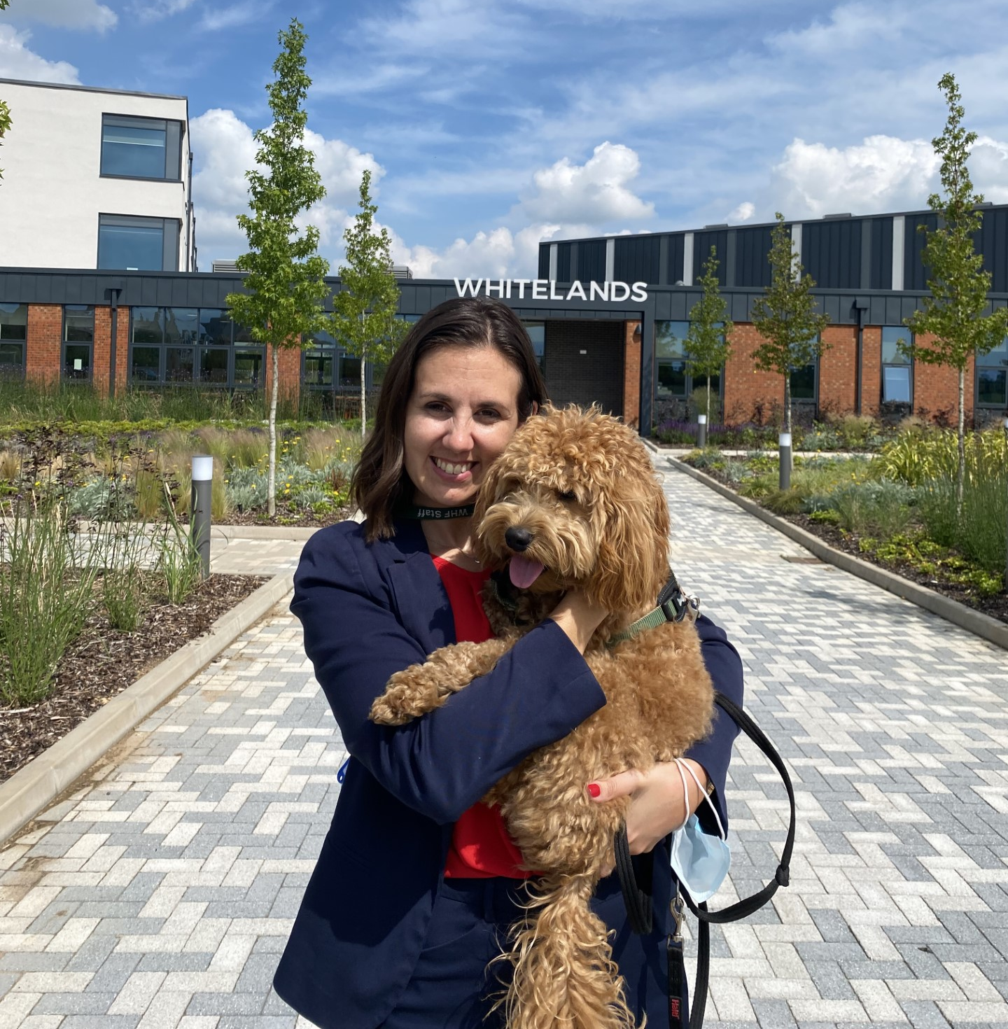
Mrs Edwards
Principal
Notes:
A very warm welcome to Whitelands Academy.
My name is Clair Edwards and I am the princpial of Whitelands Academy.
Having been here from the beginning growing the school from a building site up, I am incredibly committed and passionate into making this school the best in the Nation.
We would like to take this opportunity to welcome you to our school.
This is a hugely exciting time for us as you are the year group who completes our school.

Slide 3
Our mission:
To provide the best possible education in the securest of environments
Academic success
Understand the world
Safe and happy
Notes:
Our mission statement is simple: To provide the best possible education in the securist of environments.
To me this means that we strive for all students to achieve a solid academic footing as standard
In a school where students develop an understanding into the world around them with character that will allow them to excel within the world.
And finally to be safe, healthy and happy.

Slide 4
What is our why?
Student development and learning are at the centre of everything we do.
Regardless of their ability, background or challenges, no students will be left behind.
Whether you cure meat or cure cancer……
To be the best.
Notes:
It does not matter what a child's starting point is or what their background is
All students can and should achieve academically
This is the part that opens as many doors to them in their future as possible
Whatever your child aspires to be, we will guide them to be the very best version of themselves that they can be.
So whether they cure meat or cure cancer - be the very best in that field that you can be.

Slide 5
Welcome to Whitelands
Notes:
Our school is based around 6 core values (Resilience, Respect, Teamwork, Tolerance, Integrity and Ambition)
and these are modelled in everything that we do around the school.
From saying good morning miss as they walk past,
to speaking articulately in full sentences,
to holding the doors open,
to picking up litter
We want students to develop the character that supports them in standing out from the competition and to be successful

Slide 6
What do we believe?
Nothing reduces life chances more than low expectations
Notes:
There are two key points that we believe.
Nothing reduces a child's life chances more than low expectations.
At WLA we sweat the small stuff.
Why - because we want to set your child up to hold the same high expectations that we have for them, for themselves when they are adults.
This can be as simple as posture – Why? Because posture matters when you go for an interview?
This could be speaking in full sentences? Why? Because being able to be seen to be confident and articulate will stand you in good stead to being successful.
Uniform policies – understanding discipline and authority is important for the workplace
Being punctual to your lessons – in life we need to arrive on time to appointments and work

Slide 7
What do we believe?
Nothing reduces a young person's confidence than a lack of belief
Notes:
We also believe in all of our students.
Any child can be whatever they want to be – with the correct attitude, work ethic and professional support.
When I was younger, I was told that I could not apply for Oxford University. So I didn't.
My confidence was reduced.
I then achieved a first class genetics degree and won the Astra Zenica award at Leicester University.
It was through my own determination and resilience that I ended up at Oxford University – which is where I got married and took my children to visit on my 10th wedding anniversary.
At WLA we believe in all students and want them to aspire to whatever interests them. We will support them.

Slide 8
What can you expect?
A challenging academic curriculum
High expectations for students
A warm learning environment
Character development
Notes:
So what can you expect?
A very challenging, academic and traditional curriculum. We believe all students can achieve.
Academic and traditional subjects opens the most number of future doors for students.
We have unapologetically high expectations for our students. We will sweat the small stuff.
Training our students to have the same high expectations for themselves when they are adults.
We will be warm, kind and nurturing to your child.
We will provide them with opportunities that will develop their character so that they stand out from the competition in the world.

Slide 9
Our Leadership Team
Mrs C Edwards – Principal
Miss B Lyall – Vice Principal Pastoral
Mr F Forder - Vice Principal Academic
Mrs S Walkley – Assistant Principal Inclusion
Mr M Cartwright - Associate Assistant Principal Personal Development
Mr C Day - Associate Assistant Principal Raising Attainment

Slide 10
Our website
You will locate this information and our policies through our website.

Slide 11
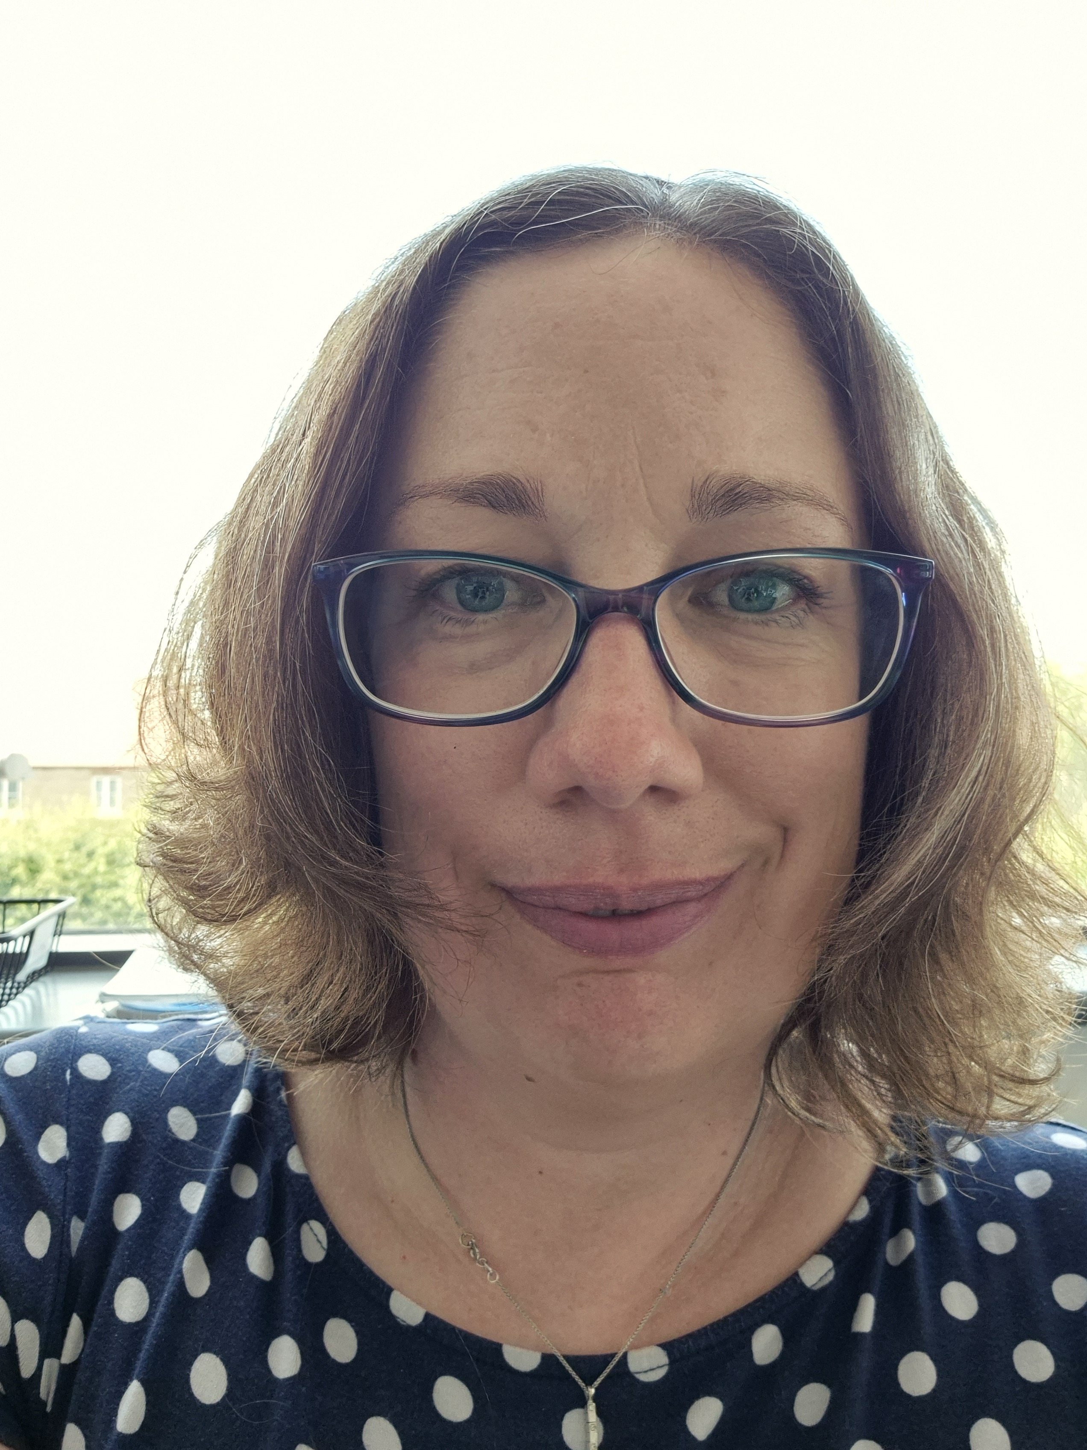
Mrs Starren
Head of Year 7 and transition

Slide 12
Partnership is key!
You do not have to be a subject expert; but if you set high expectations and offer the correct support then you can play a major part in your child's success.
Top tips for parents/carers:
Share our high expectations
Limit mobile phone use
Praise and encourage positive behaviour
If you have a concern, then speak to the relevant person ASAP.
Notes:
Support at home is the most crucial factor behind academic success. At Whitelands we have extremely high expectations on the role of parents as well as pupils.

Slide 14
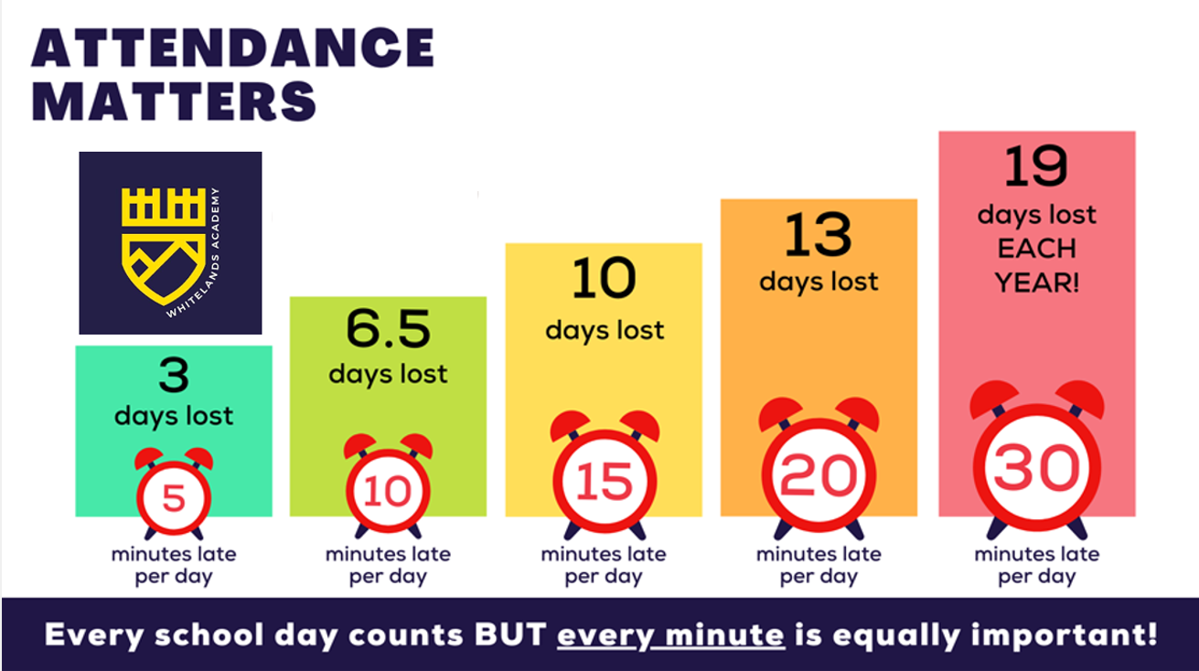

Slide 15
Better Attendance Together
Why is Attendance Important?
Evidence shows that the students with the highest attendance in school gain the best GCSE and A Level results.
Good attendance shows potential employers that they are reliable.
Poor attendance can affect children's ability to make and keep friendships; a vital part of growing up.
Notes:
Students will be expected to complete homework in order to consolidate their understanding. Teachers will try to ensure that homework is accessible to all and tasks are differentiated. Please ensure that as parents you play an active role in providing a suitable environment, access to a PC etc

Slide 16
Need for Structure
Time Management is key.
Supporting your child in managing their work, recreation, social and sleeping times, this is essential.
The school is a mobile phone-free environment, recent surveys indicate that teenagers spend on average 7hrs a day on their mobile phone. This equals 2,548 hours per year!
Notes:
More so now than ever, it is essential that your child has a clear routine to their day. Time Management is key, designate specific times for them to complete their school work. Please limit phone/XBox use and monitor who they are communicating with. Sadly we are dealing more and more with on-line bullying and inappropriate messaging/texts during school, despite having a no-phone policy. What's app age limit is 16- 8 hours sleep is the minimum expectation, lack of sleep will have a detrimental impact on your child’s ability to focus and retain information.
#
Thank you for listening and I look forward to meeting you all face-to-face in September. I will now hand you over to Miss Chelsea Dawe who will run through logistics for the school day, expectations and basic arrangements for the first day of the school term in September. Miss Dawe over to you.

Slide 17
Timings of the day
Arrival at school | 8:15 - 8:25am
Line Up | 8:30am
Tutor Time | 8:40am
Lesson 1 | 9:10am
Lesson 2 | 10:00am
Break Time | 10:50am
Lesson 3 | 11:10am
Lesson 4 | 12:00pm
Lunch time | 12:50pm
Lesson 5 | 13.30pm
Lesson 6 | 2:20pm
Extra-Curricular Clubs | 3:10-4:10pm
Notes:
Thank you Mr Maudsley. For those parents who have a child currently attending Whitelands Academy, the structure of the school day will be changing come September and we will be communicating this to current parents very soon.
The structure of the school day will move to a 6 lesson day and lessons will be 50 minutes long. We ask that students arrive to school promptly by 8:25 and are ready to begin their school day. Every morning students will have a tutor time where they will engage in our Guided Reading programme and 1 day a week students will have an assembly during this time.
After school activities will run for an hour after school.

Slide 18
Equipment
Transparent pencil case
Black/blue pens (more than one)
Green pen
Pencil
Ruler
Rubber
Colouring pencils
Highlighter
Casio scientific calculator
Reading book
Notes:
The equipment listed above is the equipment we expect students to have with them for every school day. This is to promote and develop students responsibility and autonomy.
Whitelands Academy will provide students with a blue knowledge organiser folder. This is to file all of the subject knowledge organiser which can be used in lessons and for home learning.
This is checked and logged in morning tutor time, failure to bring equipment will result in warning and possible sanctions as per the behaviour policy.

Slide 19
Year 7 Pastoral Support Team
Miss Lyall
Vice Principal
Mrs Starren
Head of Year 7
Mrs Walkley
SENCO
Mrs McHattie
Safeguarding Officer
Notes:
Miss Walkley is our SENCO and has already been liaising with primary schools in identifying individual needs of pupils arriving in September.
She is already started the process of developing pupil profile to be created September/October, and has been building a Learning Support team to meet the needs of all. Miss Dennis will arrange a SEN parents review meeting within term 1 of the next academic year. In the meantime please pass on any relevant information regarding your child, which will support us in meeting their needs, if you have not already done so on the entry forms

Slide 20
Uniform Expectations
Trousers should be tailored, mid-grey and ankle length.
Notes:
Having met most of you at the uniform try on evening, you will be aware that we have high expectations of presentation and uniform at Whitelands Academy.
The expectation is that students will attend school wearing the correct uniform and will wear their blazers throughout the school day unless told otherwise by a member of staff.
You can see more information about ordering uniform on our website.
JUMPER AND TROUSERS

Slide 21
Shoes
Please be careful that shops are not advertising trainers as school shoes.
Notes:
Having met most of you at the uniform try on evening, you will be aware that we have high expectations of presentation and uniform at Whitelands Academy.
The expectation is that students will attend school wearing the correct uniform and will wear their blazers throughout the school day unless told otherwise by a member of staff.
You can see more information about ordering uniform on our website.
JUMPER AND TROUSERS

Slide 22
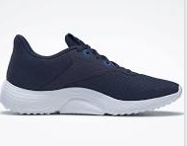
P.E Kit
Please make contact with the reception team about any queries regarding uniform.
Notes:
For PE students will be expected to wear the Whitelands PE kit. Students will need to have gum shield, shin pads and studded boots.
Navy joggers can be purchased from other shops. Trainers cannot have black soles.
For PE students with long hair will be expected to tie it up. Any earrings will need to be removed or covered.

Slide 23
Rewards
Merits - Demerits = House Points
Notes:
The equipment listed above is the equipment we expect students to have with them for every school day. This is to promote and develop students responsibility and autonomy.
Whitelands Academy will provide students with a blue knowledge organiser folder. This is to file all of the subject knowledge organiser which can be used in lessons and for home learning.
This is checked and logged in morning tutor time, failure to bring equipment will result in warning and possible sanctions as per the behaviour policy.

Slide 24
Rewards
Notes:
The equipment listed above is the equipment we expect students to have with them for every school day. This is to promote and develop students responsibility and autonomy.
Whitelands Academy will provide students with a blue knowledge organiser folder. This is to file all of the subject knowledge organiser which can be used in lessons and for home learning.
This is checked and logged in morning tutor time, failure to bring equipment will result in warning and possible sanctions as per the behaviour policy.

Slide 25
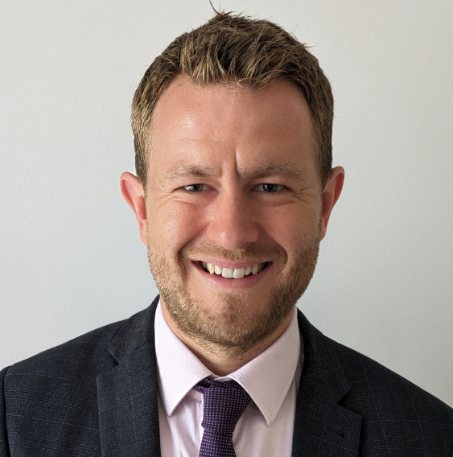
Mr Forder
Vice Principal

Slide 26
Teaching and learning
Notes:
Good evening – it’s lovely to see so many of you here this evening
My name is Freddie Forder, and I’m the Vice Principal Academic, which means I lead on the quality of education here at Whitelands – focusing on what goes on in the classroom.
The last few years have been very exciting to be a teacher because of the advances in educational research about how we learn. Here at Whitelands we take a keen interest in the latest research (you can see our teaching and learning framework on the screen) and use this to inform what your child will learn and how we will teach them in lessons, with a relentless focus on high quality teaching.
As a new school, we’ve had a great opportunity to put together a curriculum which we are proud of and which showcases the high aspirations we have of our students.
In terms of what this looks like, each week your child will have English and Maths lessons 5 times a week, science 4 times a week, Spanish 3 times a week, PE, History and Geography twice a week and DT, art, music, drama, ICT, religious studies and RSHE once a week.

Slide 27
Parent’s/Carer’s role in Home Learning
Support your child with their Home Learning but accept that your input should diminish.
Provide a suitable work-place or encourage them to make use of school facilities before and after school.
If you feel that insufficient or too many Home Learning tasks are being set, contact us so we can resolve this.
Make it clear to your child that you value Home Learning and explain how it can help them to progress.
Encourage, reward and praise them when Home Learning is completed.
Notes:
A question that parents often ask is ‘how can I support my child at home’?
A key way is to support them to complete their homework, which students are expected to complete in order to consolidate their understanding. We are always keeping our homework under review to ensure that it is research based and purposeful. For example, we won’t be setting you unstructured ‘research from the internet tasks’ or pieces of writing that can be copied from chatGTP.
The one strategy which research says makes the most difference and which we want to encourage is reading. Our librarian as well as teachers will be able to support your child to find a suitable book for them to further their knowledge and understanding as well as their love of reading.
As parents, we really value your role in supporting your child to complete their homework and that you play an active role in providing a suitable environment, access to a device and that you discuss your child’s learning with them. Your child will be set home learning each week, and we will go through this process and the details of this with them in September.
I’m really excited to get to know all of you in the coming months, and also really excited about what you can all achieve here.
I’m now going to pass over to Mrs Walkley, our Assistant Principal for Inclusion

Slide 28
Mrs Walkley
Assistant Principal
Notes:
Welcome to Whitelands Academy. My name is Clair Edwards and I am the princpial of Whitelands Academy. Having been here from the beginning growing the school from a building site up, I am incredibly committed and passionate into making this school the best in the Nation.
We would like to take this opportunity to welcome you to our school. This is a hugely exciting time for us as you are the year group who completes our school
We opened here in September 2020 and have been introducing a new cohort of students each year – this will be their first time we have been open with a full school of 600 students with a full year group in all years.
Whitelands is a very special school – our founding year group have played a huge part in shaping the school we are – we have the ability to mold our school to be the place that supports you grow into the adult you are proud to be and your journey starts soon!
Tonight, we will be sharing some information with you to help you child prepare for their Whiteland's journey. We will cover information about the school day, the curriculum, the pastroal care, SEND provision and the co-curricular opportunities available to them.
There will also be an opportunity for you to ask any questions

Slide 29
Inclusion at WLA
Inclusive Environment
Notes:
Inclusive environment – we are an inclusive school and no matter where your starting point, we have the same high expectations for all students.
But, as this diagram shows there is being treated equally and then there is being treated equitably.
In the first diagram you can see everybody being given the same supports – they are being treated equally, however they still all cant see the game. However in the second image you can see the individuals are given different supports to make them have equal access to seeing the game they are being treated equitably.
What we strive for at WLA is that all three students would be able to see the game with the barriers removed and our students equipped with strategies so that this can happen by the time that they leave WLA preparing them for their post-16 journey and adulthood.
How to support our students – high quality teaching, support in the classroom as our teachers are specialists in their field, by removing a student we are removing them from the specialist teacher, however we do provide a range of interventions on a needs based evidence approach, that would have baseline in order ot measure impact and a hub staff that will be getting to know your students quickly and how best to support them.

Slide 30
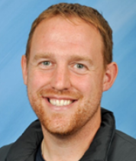
Mr Cartwright
Associate
Assistant Principal for Personal Development
Notes:
Name and role
Delighted to take the lead on an outstanding area of the school. As Mrs Edwards said at the top, we are focused on developing the whole pupil.

Slide 31
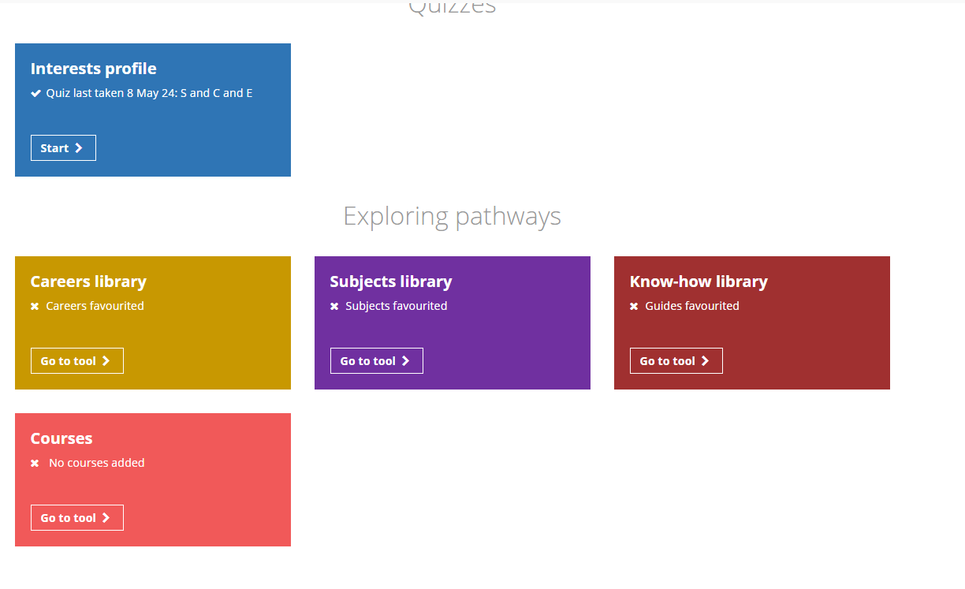
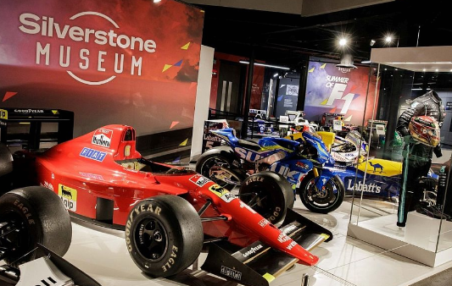
Careers & Personal Development
Notes:
We are really proud of our Personal Development at WLA. Recently graded as Outstanding from Ofsted, our aim to develop this even further.
The purpose of our PD is to develop a child's character to stand out in the competitive world.
We have a rigorous RSHE curriculum, extensive tutor and assembly programme along with a wide plethora of trips and visitors.
Careers is not just a focus in year 10 and 11
Career understanding and the skills needed to stand out develop throughout their journey with us from Year 7.

Slide 32
Extra-Curricular Examples
Notes:
One of the best ways to develop the whole pupil is through involvement of opportunties outside the classroom. These opportunities are perfect for developing the "soft-skills" and pushing outside their comfort zone.
One of the ways we do that here is through our extra-curricular program which is continually developing and evolving as the school grows.
Here are some of the examples of the extra-curricular opportunities that we have offered here at Whitelands. They run on a termly basis and sign up is done through the Arbor app.

Slide 33
Mrs Starren
Head of Year 7 and transition

Slide 34
The cycle of a year 7
Notes:
Here is an example of the PE clubs that will be running in the first term for students to engage with. Other subjects will be offering additional clubs, for example, Chess club, History film club, Green group, Debate club.

Slide 35
Transition Days: 8th & 9th July
Arrive in your school PE kit.
Bring a packed lunch and water bottle with you.
You will meet your tutor group and tutor (unless they are new to the school).
You have a tour around the school and get to know the building.
You will experience the school day and a variety of lessons.
Please arrive at the main entrance between 8:50am and 9:00am in PE Kit.
Please ‘drop off and move off’ – We kindly ask parents to drop students off at the gates and a member of staff will direct them where to go.
Notes:
We are really looking forward to welcoming you on our first day back.
The first day will be year 7 only where we will introduce the students to all staff members and allow them time to become familiar with their surroundings and our expectations.
We ask that you ensure students arrive at 8:25am and you drop them off at the school gates. There will be members of staff on the gate and on the school grounds to welcome and instruct students on where to go.
Please ensure students have a packed lunch.
As a head of year, I would like to thank you for taking the time to attend this evenings presentation, I am really looking forward to working with you and your families over the next academic year. I will now pass you back over to Mr Cush who will say our final goodbyes.

Slide 36
First Day in September
Year 7 Induction
You will receive communication about the first day of school.
Please ‘drop off and move off’ – We kindly ask parents to drop students off at the gates and a member of staff will direct them where to go.
Pupils should arrive in full school uniform (no PE kit required).
Please do not park in the school car park - this is for staff only.
Please bring in a packed lunch for the first day.
Notes:
We are really looking forward to welcoming you on our first day back.
The first day will be year 7 only where we will introduce the students to all staff members and allow them time to become familiar with their surroundings and our expectations.
We ask that you ensure students arrive at 8:25am and you drop them off at the school gates. There will be members of staff on the gate and on the school grounds to welcome and instruct students on where to go.
Please ensure students have a packed lunch.
As a head of year, I would like to thank you for taking the time to attend this evenings presentation, I am really looking forward to working with you and your families over the next academic year. I will now pass you back over to Mr Cush who will say our final goodbyes.

Slide 37
THANK YOU
Proud to be part of The White Horse Federation Multi-Academy Trust | www.twhf.org.uk

