Slide 1
Parent Friday Five
Friday 22nd March
Communication update for parents

Slide 2
Upcoming Dates
Thursday 28th March: End of Term, 12:50pm
Monday 15th April: Term 5 starts at 8:30am
Thursday 24th April: Year 10 mock exams begin
Monday 6th May – school closed, Bank Holiday
14th, 21st, 22nd May – Years 7 & 10 Parents' Evenings

Slide 3
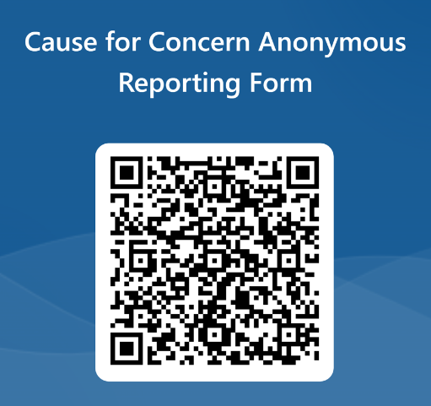
Anonymous Reporting
From time to time, our students experience things that they need to share with trusted adults. This could be a personal problem, an emotional issue, friendship disputes or experiencing bullying type behaviour in person or online.
Frequently, other students can be witnesses to this behaviour but act as a bystander – they are there, they witness it, they don’t speak up at the time or share it with an adult.
At Whitelands, we are a small community and we want to help keep each other safe. To support students (and parents and carers) in reporting incidents, we have an anonymous reporting form. This can be found in toilet cubicles in school and also on the homepage of the school website. If your children share information about incidents at school (or on the way to and from school), please encourage them to use this or report in person.
One day, they might need someone to speak up for them – please help them report and share to support their peers.
Notes:
0

Slide 4
Uniform and Equipment
In preparation for the new school term, please ensure your child has a fully stocked pencil case (please see the equipment mat containing items that they need). Students should have these items in a pencil case – clear exam style for year 10s.
Please also check that you have full and correct uniform including blazer, tie, shirt, trousers/skirt, black socks or tights and black shoes.
We will communicate next week with student specific information.
Notes:
0

Slide 5
Thailand Trip - fundraising
On 18th June, 16 students and 3 staff will be embarking on a trip to Thailand where they will be spending time in a school in Bangkok as well as working with a local Orphanage. In preparation for this trip, the 16 students will be running a number of fundraising events to enable us to make a donation to the orphanage who are looking to extend their building to make space for more children who need a home.
On the last day of this term (28th March), students will be selling ice creams and easter treats for 50p and £1. Students will be able to purchase items from the DT Food room during the Easter Brunch. If you are happy for your child to support this worthy cause, please allow them to bring a small amount of cash in coins to purchase these items. Thank you.
Notes:
0

Slide 6
SEND Focus – SWIFT course for parents
This is an opportunity for parents to take part in a course specifically for parents that have children who are diagnosed neuro-diverse or are suspected to be neuro-diverse.
There are four sessions or ‘modules’ each of which focusses on one of the key areas of difference for children with Autism:
1. Understanding Autism
2. Communication and Interaction
3. Sensory Processing
4. Emotional Wellbeing
The course will be held in person at WLA and run over four consecutive weeks:
Wednesday 12 June 1-2.45pm
Wednesday 19 June 1-2.45pm
Wednesday 26 June 1-2.45pm
Wednesday 3 July 1-2.45pm
If you are interested in joining us, please register your interest by emailing swalkley@whitelandsacademy.org by Thursday 28th March 2024
Notes:
0

