Slide 1



“Love is love” “May our love of God, of each other and of learning make this school a happy, safe place full of faith, hope and high expectations.”
The Royal Law

Slide 2
The Royal Law: Matthew. 5: 21-48.
Show No Favor in Human Status
1My brethren, have not the faith of our Lord Jesus Christ, the Lord of glory, with respect of persons.
2For if there come unto your assembly a man with a gold ring, in fine apparel, and there come in also a poor man in shabby clothing;
3And you have respect to him that wears the fine clothing, and say unto him, Sit here in a good place; and say to the poor, Stand there, or sit here under my footstool:
4Are you not then partial in yourselves, and are become judges of evil thoughts?
5Hearken, my beloved brethren, Has not God chosen the poor of this world rich in faith, and heirs of the kingdom which he has promised to them that love him?
6But you have despised the poor. Do not rich men oppress you, and draw you before the judges?
7Do not they blaspheme that worthy name by which you are called?
8If you fulfill the royal law according to the scripture, You shall love your neighbor as yourself, you do well:

Slide 3
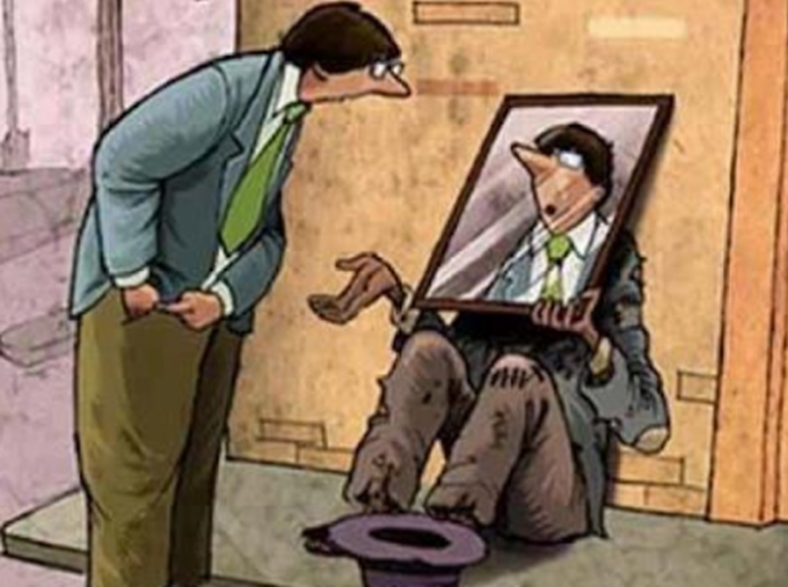
Love your neighbour…discuss

Slide 4



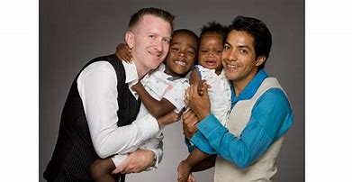
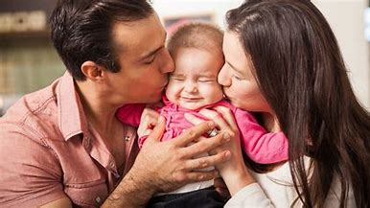
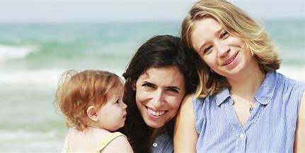
What makes a Family?
Families can be a mixture of anything (parents in particular). Some people have two mothers, some people have two dads others have a mum and dad. Some people even have a mum, mum and a dad/ dad, dad and mum.
Can you think of anymore combinations?

Slide 5


Accept your differences
Being the same as everyone else is boring and so our differences are what make us special and unique. Some of those differences are to do with who you love. It doesn’t matter what gender you love, it doesn’t matter what gender you are, you should always be happy in any relationship you are in. Boys can love boys. Girls can love girls. Girls can love boys. Boys can love girls.

Slide 6

Human rights : your right to chose.

Slide 7


Fuck you callam and faithe and harry

Slide 8
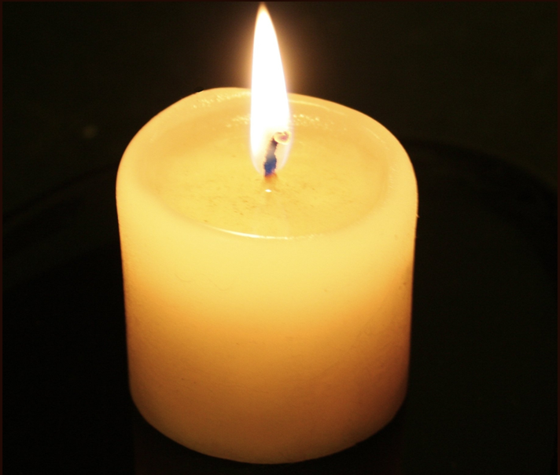


Love is love – Let us pray

