Slide 1

The same, but different
Collective worship
Monday 23rd January 2023
““May our love of God, of each other and of learning make this school a happy, safe place full of faith, hope and high expectations.”

Slide 2
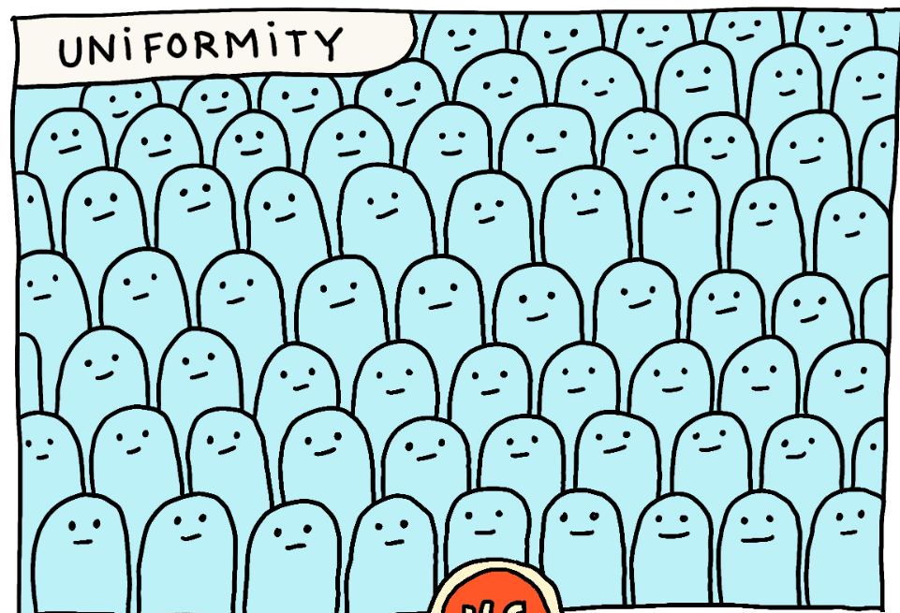
Uniformity
What do you think to this picture?
How does it make you feel?
What do you see?

Slide 3
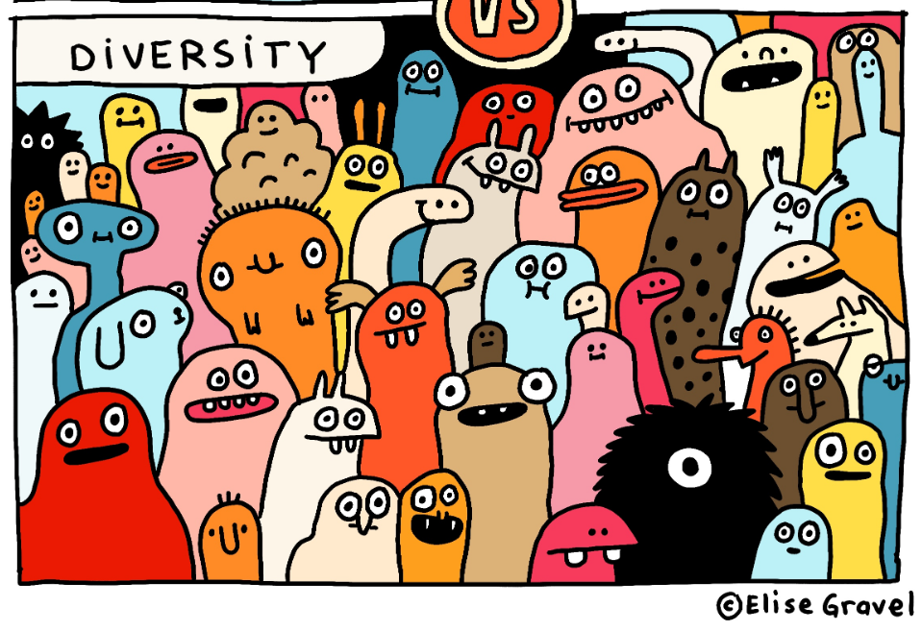
Diversity
What do you think to this picture?
How does it make you feel?
What do you see?

Slide 4
The same, but different quiz
What is the same and what is different about us all here at William de Yaxley CE Academy?
Share back…
close your eyes and think about one thing now that makes you different and special – do you have curly hair? Are you good at tennis? Are you a fast reader?

Slide 5
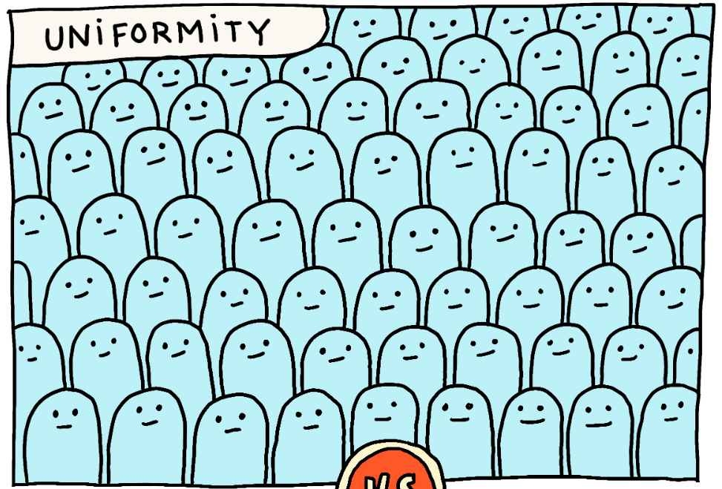
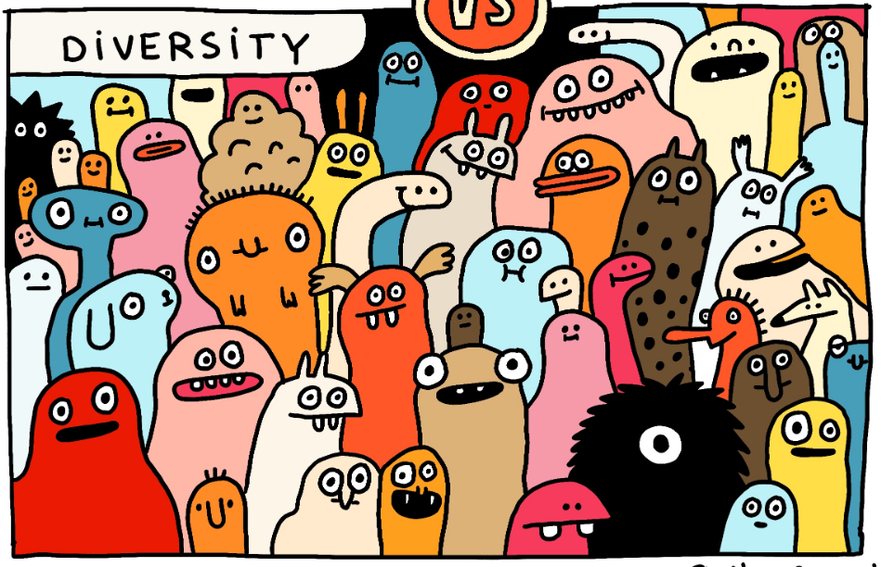
We are all different colours but together…
sometimes we might look completely different, but actually we might have a lot in common.
Point to two completely different characters on the diversity picture – these two characters look entirely different but they might both love cheese, or both think maths is the best lesson ever! Sometimes our differences on the surface hide our similarities underneath.

Slide 6

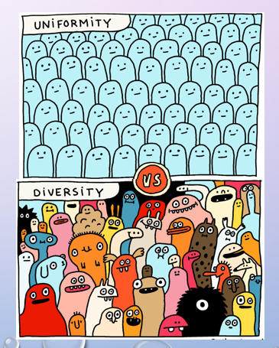
Kindness first!
we don’t all look the same but that’s a good thing
Our differences make us unique and special
• Sometimes our differences are just on the surface
one thing we all have in common is that we all have feelings
we all have mental health.
Mental health is just like our physical health, we have to look after our bodies and our minds to be healthy.
our mental health affects how we think about ourselves

Slide 7
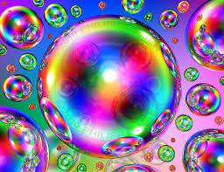
Reflection and prayer.
Colour breathing
sit in a comfortable position. close your eyes if they wish.
imagine your favourite colour, or a colour which helps you to feel calm.
take a breath in and imagine that they are breathing in this colour.
As you breathe out, you are going to imagine blowing a bubble made of this colour. See how big it can get before you need another breath!
our school prayer.

