Slide 1
Year 2 Meet the Teacher

Slide 2
Communication The key to a successful working relationship
FAMILIES (PARENTS & CARERS)
Check the Calendar of Events regularly
Read the newsletter
Check the Year Group Noticeboards for half termly curriculum newsletters
Attend parent teacher consultations
Communicate at the gate at home time with the class teacher
Email – admin@hogarth.hounslow.sch.uk
Website – https://www.williamhogarthschool.co.uk
Twitter - @hogarth_the
School phone - 020 8994 4782
Planners

Slide 3
Home Learning – set every Thursday on Google Classroom. Must click ‘hand in’ by the following Wednesday.
Aims of home learning
To give children an opportunity to practice basic skills linked to learning in school.
To engage all children in learning in a cross curricular manner.
To allow children to shine in all subject areas
To generate pride and excitement about what they are producing
To be more open ended so children have more flexibility over what they are producing and how
Traditional homework is scientifically proven to have very little impact on pupils learning
Research says that home learning which has the most impact on learning is practising basic skills through repetition and giving children ownership over what they are doing.

Slide 4
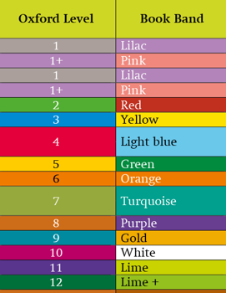
Home Learning
Every
Reading
On Mondays children will receive 2 levelled books for the week and on Tuesdays children can change library books.
Reading should be recorded in pupil planners
Each entry needs:
the date,
the book being read,
how much was read and
any comments about how they got on.
Pupil Planners should be brought in daily to be checked in class.

Slide 5
Home Learning: posted on Google Classroom
SPELLING
10 spelling words will be put on Google Classroom weekly.
Research indicates that the best way for children to learn the spelling of more complex words is to use them in the correct context.
Spelling test will be once a week.
Children have personal log-ins to access vocabulary and spelling activities via the PiXL Vocab App (free download from the App Store, Google Play, Amazon App)
https://vocab.pixl.org.uk/

Slide 6
Home Learning
Multiplication Tables
National Curriculum expectation: all children know a range of multiplication tables and facts (at least up to 12 x 12) by the end of Year 4.
To support this, children will note their Challenge Level weekly in their pupil planners.
The practice children complete at home will help to prepare them for a timed test in class. It will also help them substantially with their written methods and mathematical problem solving, as they will be able to focus on their reasoning rather than calculations that need to be known by heart.

Slide 7
Home Learning
Creative home learning tasks all link directly to the topic being studied in class and will support the children’s learning by giving them opportunities to learn new knowledge around their topic, explore a particular area of interest in more depth or further develop their skills.
A selection of different tasks will be provided and displayed on the Year Group page at the start of each half term. Families and children are encouraged to choose one (or more) of these projects to work on together at home, so that parents and carers can share in and further enrich the learning that is taking place in class.
At the end of each half term, parents will be invited to a Celebration of Learning open afternoon to give families an opportunity to celebrate the topic work their children have been completing in class and to see how this links to the projects they have worked on together at home.
Half Termly Creative Home Learning
Creative home learning is one of the fundamental principles that underpins our Home Learning Policy and an important way for us to build effective home school partnerships. This is because we believe that learning continues beyond the classroom.
Children will be introduced to their new creative topic at the start of each half term.

Slide 8
Home Learning
Home learning that is not being completed
Parents are encouraged to talk to their child’s class teacher if their child is unable or unwilling to complete home learning tasks independently.
We will also offer some after school homework clubs in the school library for parents to support their children in a friendly and hardworking atmosphere.
Class teachers will discuss any concerns about home learning tasks initially with children and then parents in order to find out the reasons behind incomplete tasks.
WHOLE SCHOOL HOME LEARNING
Sometimes, children are asked to contribute to an activity or concert by learning – words to a poem, play or song etc. Learning by heart in these situations helps children develop techniques for learning, contributes to their self-esteem by giving them an opportunity to experience success and participate fully in the activity. It also contributes to the whole school ethos, developing a sense of responsibility for team success. Families and children are encouraged to value this home learning so that it is done alongside any other home learning set by the class teacher.

Slide 9
Home Learning
Holiday Home Learning
We place great value on children having opportunities to spend time with their families, playing, talking and having fun so we will not set homework over school holidays. However, we do expect children to read or be read to every day. Children will also continue to be able to access fun learning activities online or via the Apps.

Slide 10
School Uniform
White short or long-sleeved logo’d polo shirt
Grey logo’d ‘V’ neck cardigan or jumper with double gold stripe
Plain grey trousers, shorts, skirt, pinafore or gingham dress (in summer)
Plain long or short, grey, black or white socks or tights
Sensible black flat shoes or boots (in winter)
Black reversable logo’d school coat or plain black or navy coat (Winter is coming!)
Grey or black scarf, hat and gloves
Grey, black or white kippa or turban
Grey, black, white or yellow hijab
Plain grey, black, white or yellow hair accessories (shoulder length hair tied back)
Black logo’d rucksack or plain black rucksack

Slide 11
PE Kit
White logo’d sports top with house coloured sleeves
Black shorts
Black logo’d hoodie with black tracksuit bottoms
Trainers or plimsolls
Water bottles
Key Stage 1: PE Kits should be in school every day. They will be sent home half-termly.
Key Stage 2: Clean PE Kits should be brought in every Monday.

Slide 12
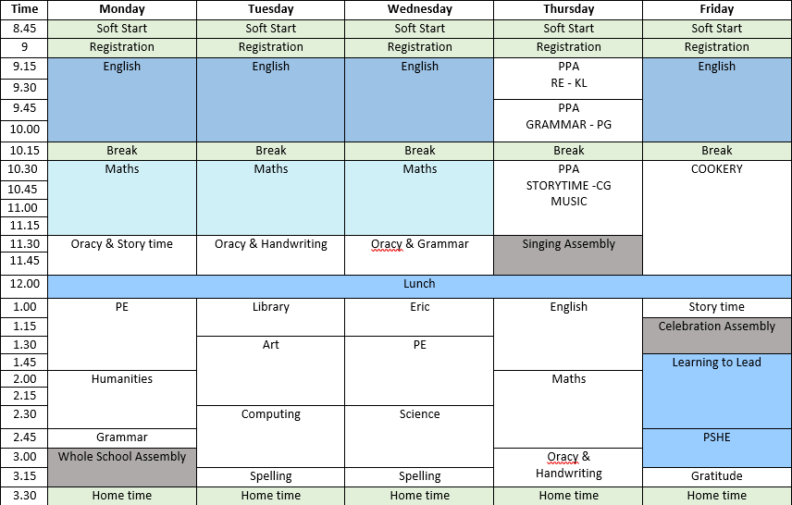

Slide 13
Assemblies
Harvest assembly – 28th September 2022
Year 2 Guy Fawkes assembly – 5th November 2022
Last week before Christmas – KS1 nativity performance

Slide 14
Thank you for coming! Any questions?

