Slide 1
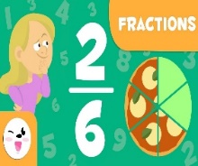
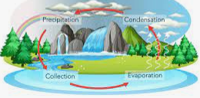
Spring 2 Term Newsletter Monet Class
Class Novel
Harry Potter and the Philosopher’s Stone
English
This term we shall explore the book “The Lost Happy Endings” by Carol Ann Duffy. This book is a fantastic and magical tale about what happens when, one night, a wicked witch steals the happy endings to bedtime stories. We shall use the text to study alternative ending to stories and compile a persuasive letter.
Maths
We begin this half-term with measurement and will swiftly move on to fractions (adding, subtracting, counting in and using mixed numbers). We then move into decimals. The big push for this half-term is focusing on applying the knowledge learnt into worded problems/ reasoning in maths.
Science
We will be closing out our ‘States of Matter’ topic next half-term. We have looked at the various states of matter and we will consolidate this learning by investigating changes of State and the Water cycle. We will then move on to Classification & extinction for the remainder of the term.
P.E.
We will be taking part in tag rugby this half-term. We will break down the key skills and focus on ball control, passing and control while moving. Once we have mastered these, we will apply them into small-sided game situations. We will also continue with our swimming lessons!
PSHE
Year 4 will be focusing on friendship and what makes a good friend. We will use this opportunity to build bonds within the class and work on techniques that could help everyone to be the best possible friend.
Humanities
In Geography, we will be learning about migration this half-term. We will explore what migration is, how it affects people and places, economic migration, what a refugee is and how climate change may affect migration in the future.
Music
The children will continue to receive music lessons from our amazing music teacher including using our recorders and also in music assembly, where they learn singing techniques.
R.E.
This term, we will analyze how Jesus is depicted historically and why perceptions vary. We will learn about his life and different beliefs about him. We will also compare prophecies and events before discussing Easter's significance.
Computing
We will be learning about ‘Repetition of ‘Shapes in computing this half-term. We will be using Logo language through Turtle Academy to programme repeated patterns.

