Slide 1





LADDERS AT HOME
The William Hogarth School
Your school logo here

Slide 2

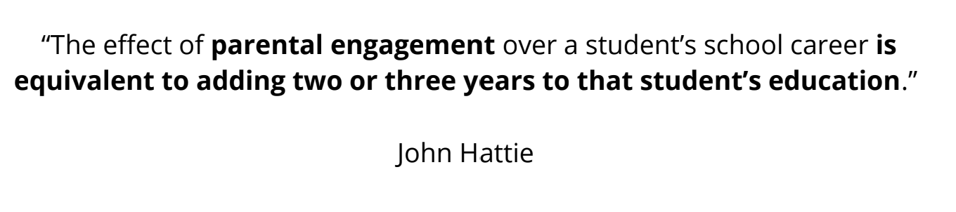
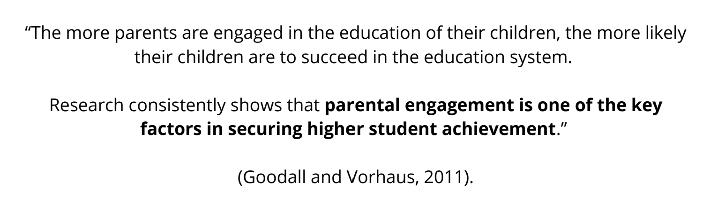
What does the research tell us?

Slide 3
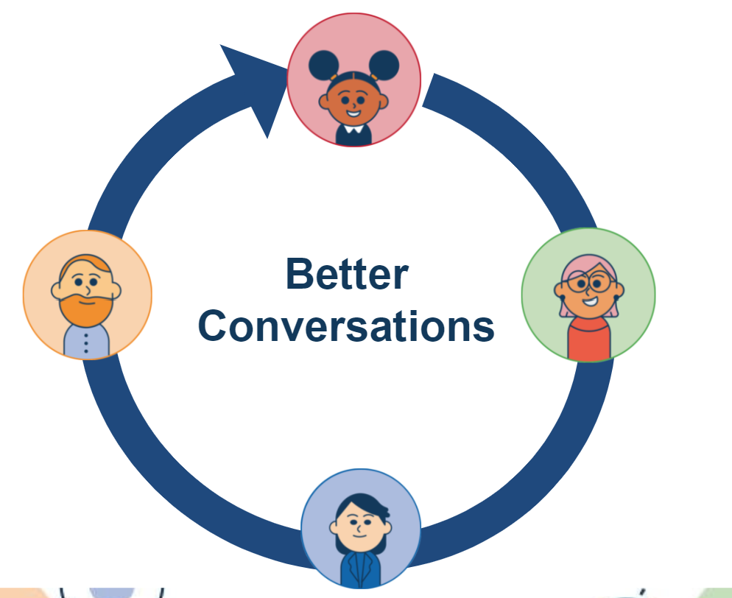
Ladders at Home enables better conversations about learning.
Two-way messaging
All adults working in partnership to know exactly where a child is in their learning and how to support learning in school and at home.
Shared, personalised learning goals
Personalised homework tasks
Bespoke individual student reports
Educational terms unlocked with support articles for parents

Slide 4
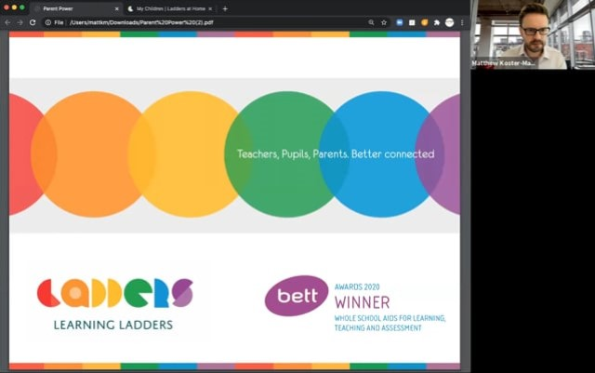
We expect you as parents to engage with Ladders at Home and use it as a way to support your child in their learning.
It is an essential way to start conversations about the learning taking place and enables you to support your child at home and even extend their learning.

Slide 5
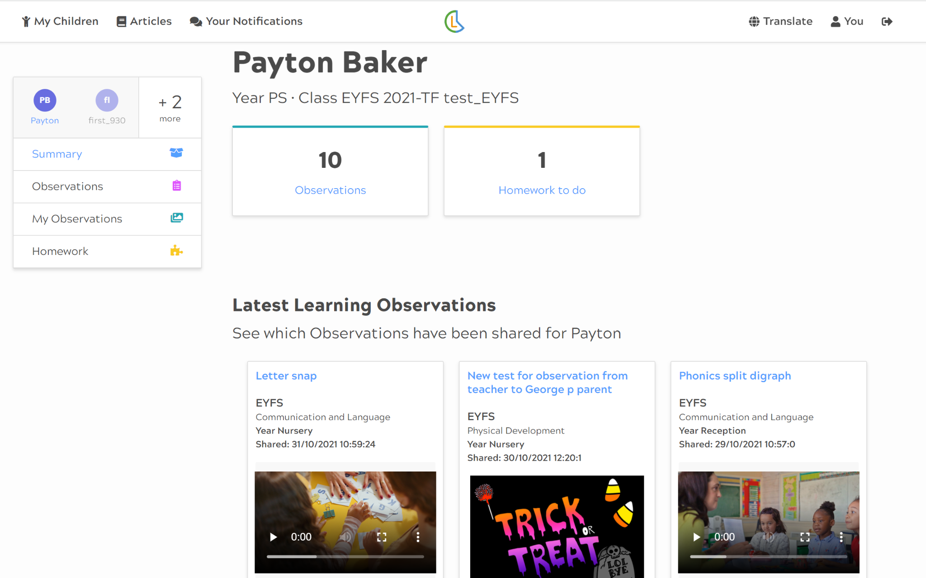
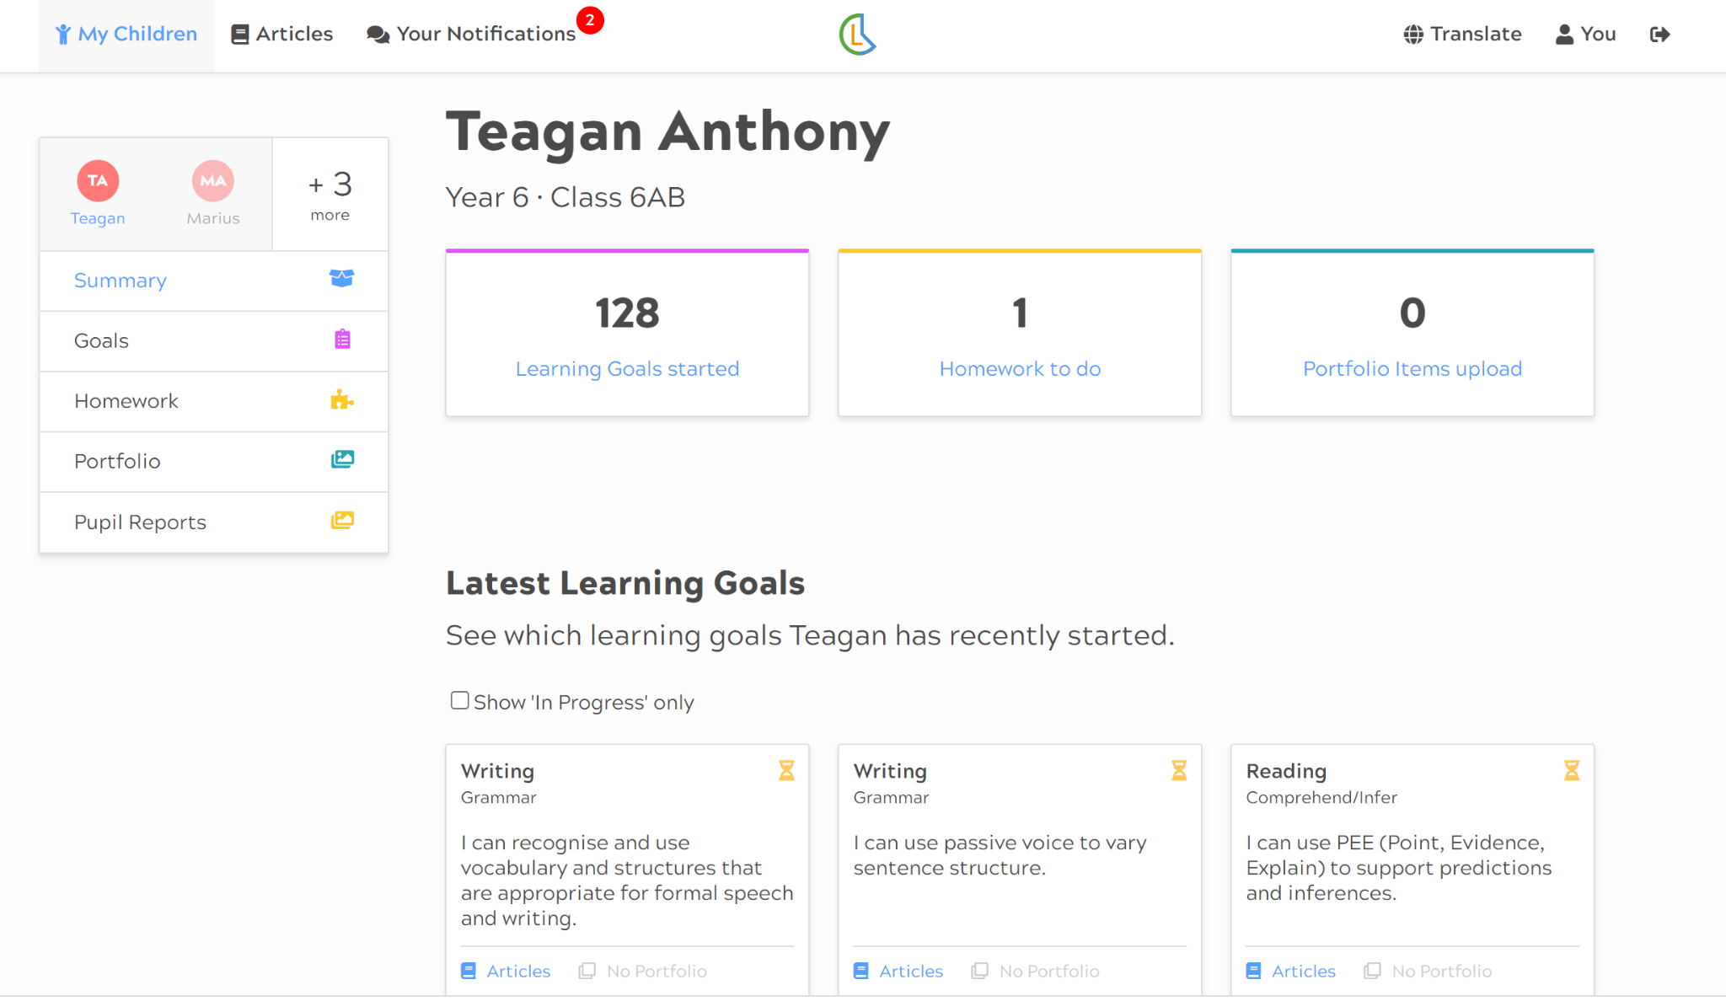
How do we access Ladders at Home?
One login for multiple siblings across school
Phase appropriate information shared for each stage of learning
Accessed via a URL on any device
Separate accounts for any adults involved in learning at home
EYFS View
Primary View

Slide 6
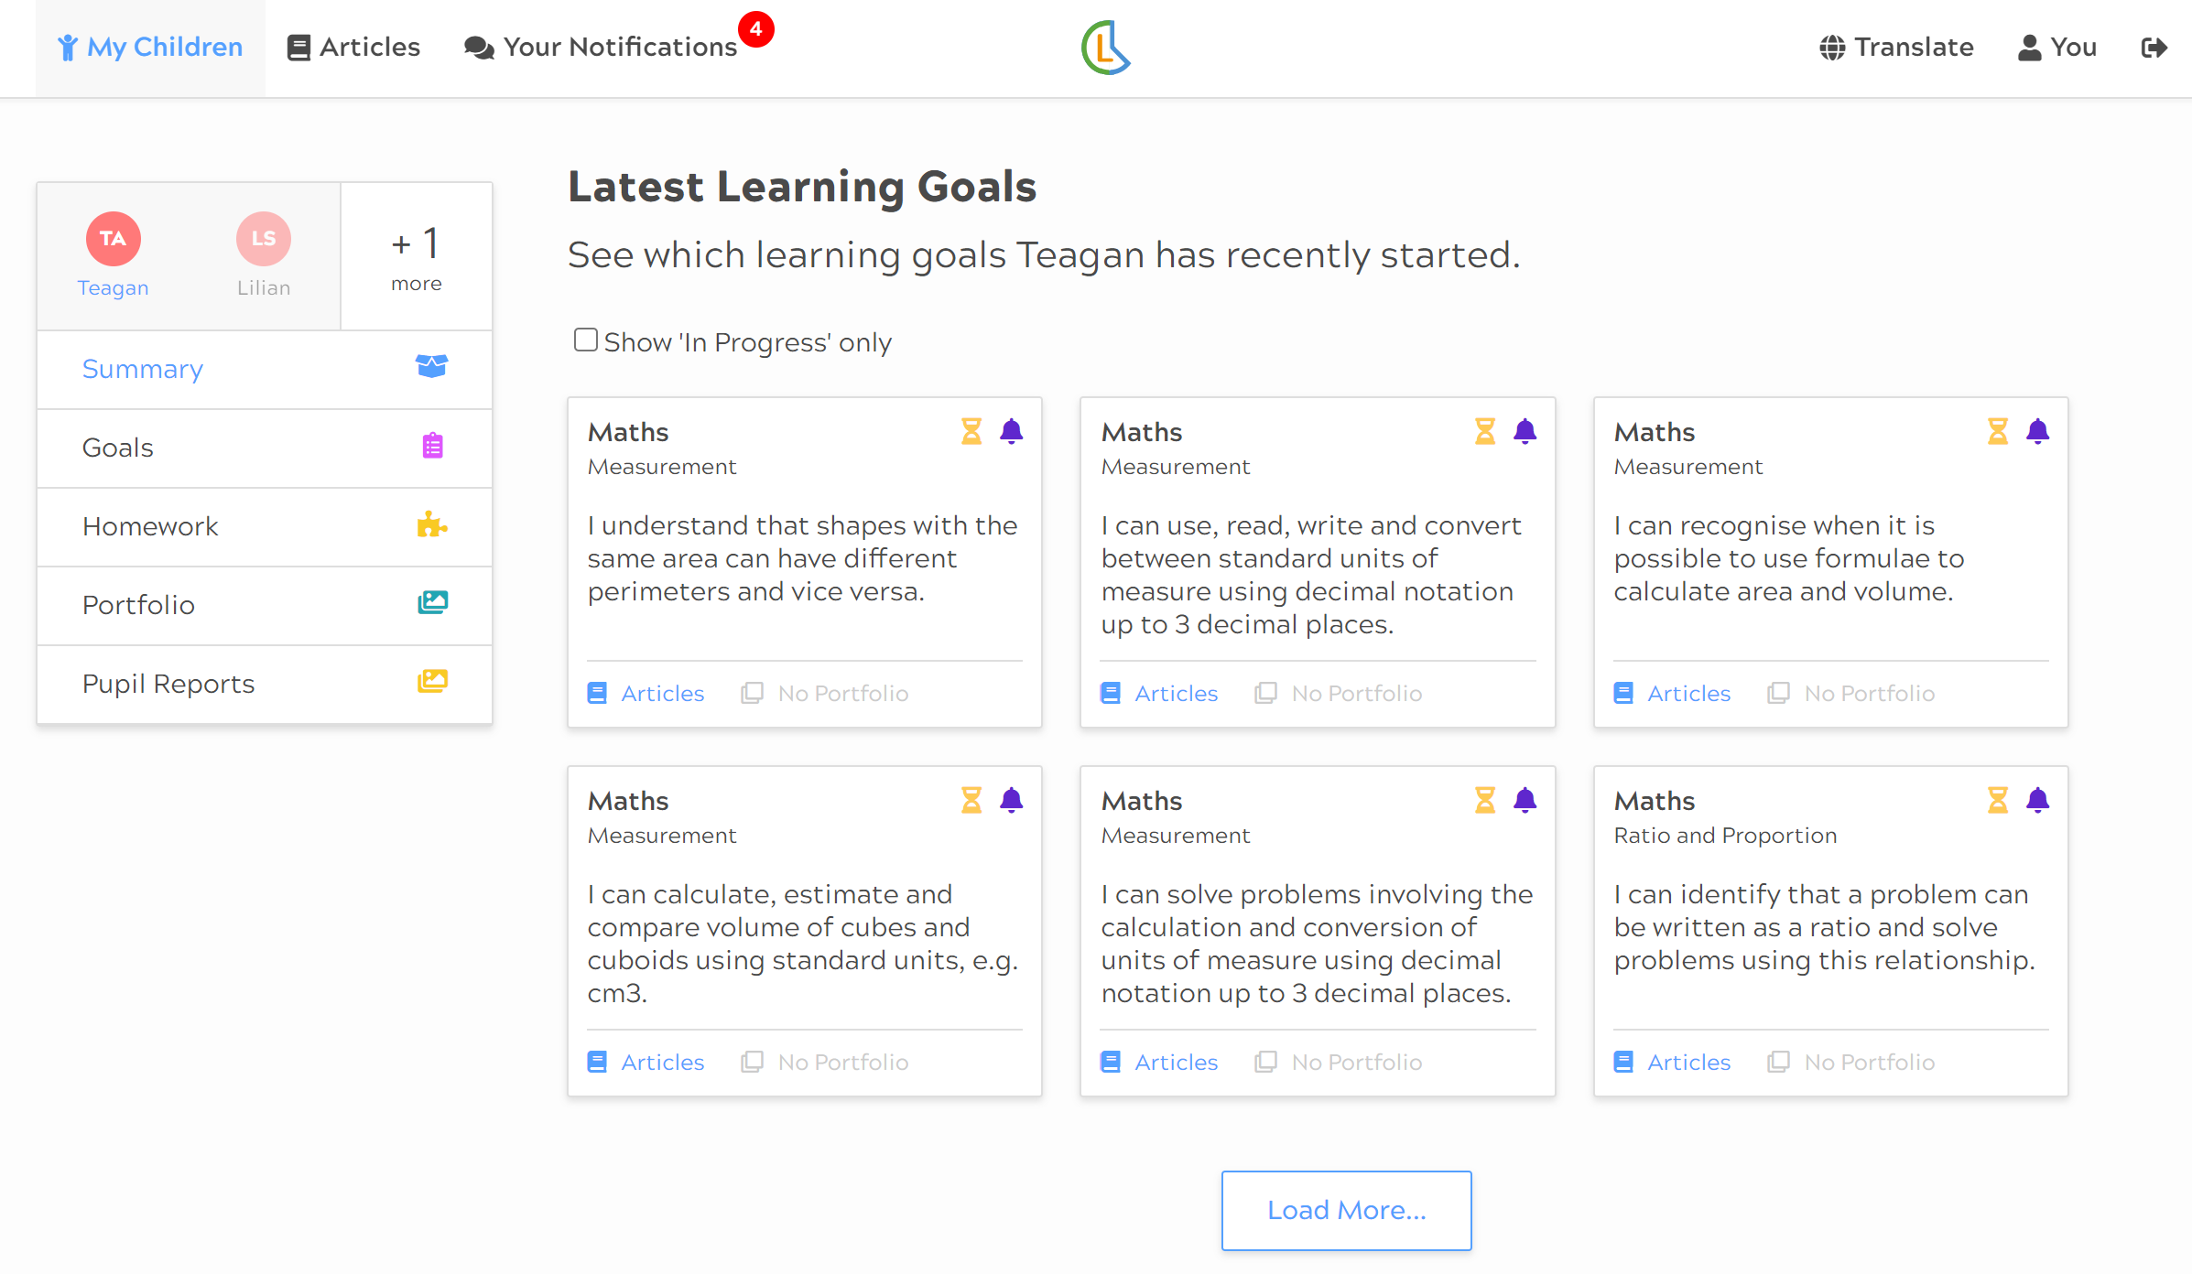
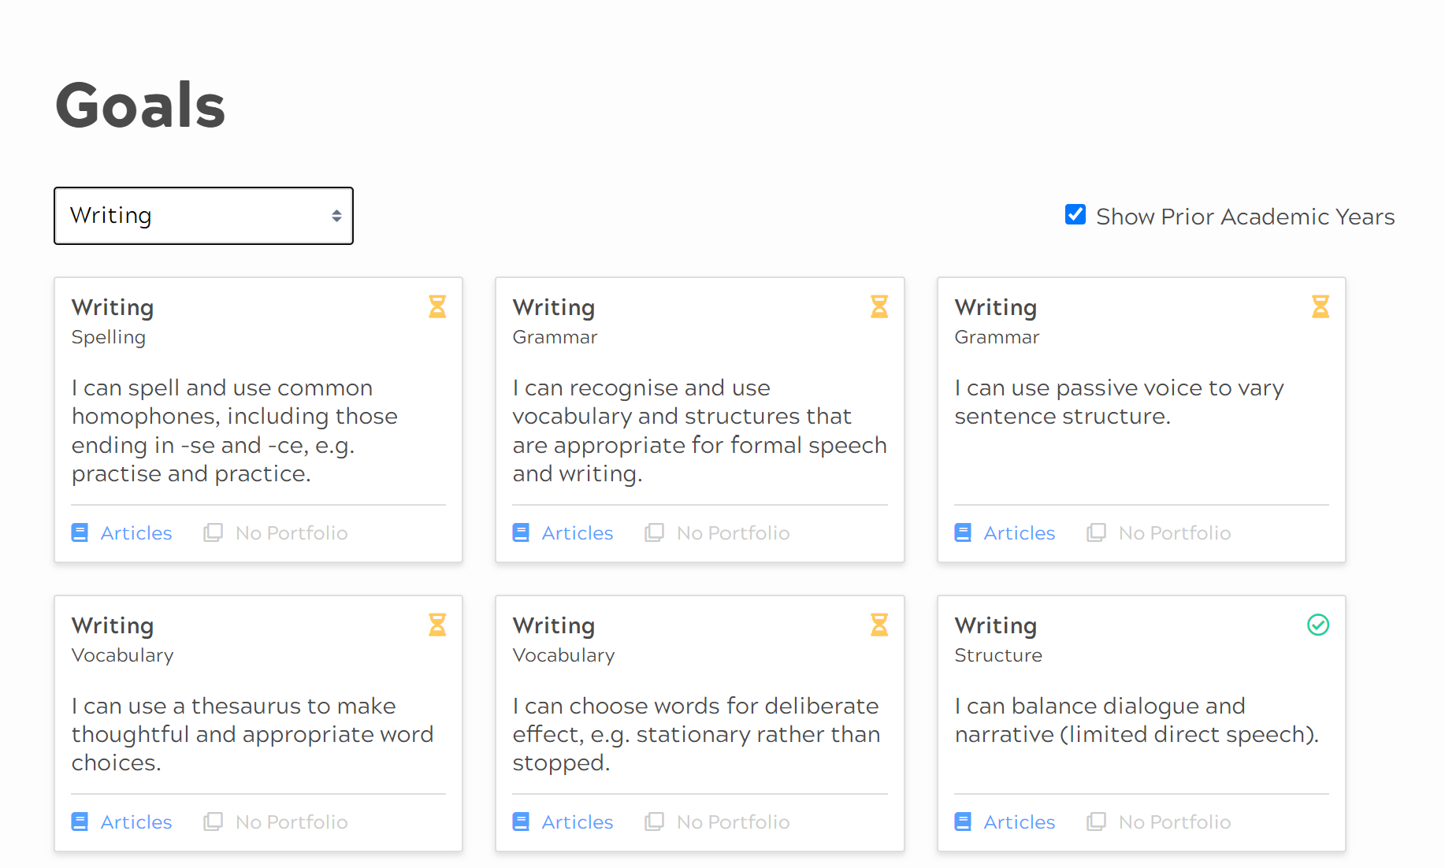
What information is shared with parents? (Primary)
Receive ongoing information about your child’s progress against learning goals taught in school.
View the latest learning goals
View all learning goals by subject
Find out when your child has started a new learning goal
Remain up to date with when your child has completed each learning goal

Slide 7
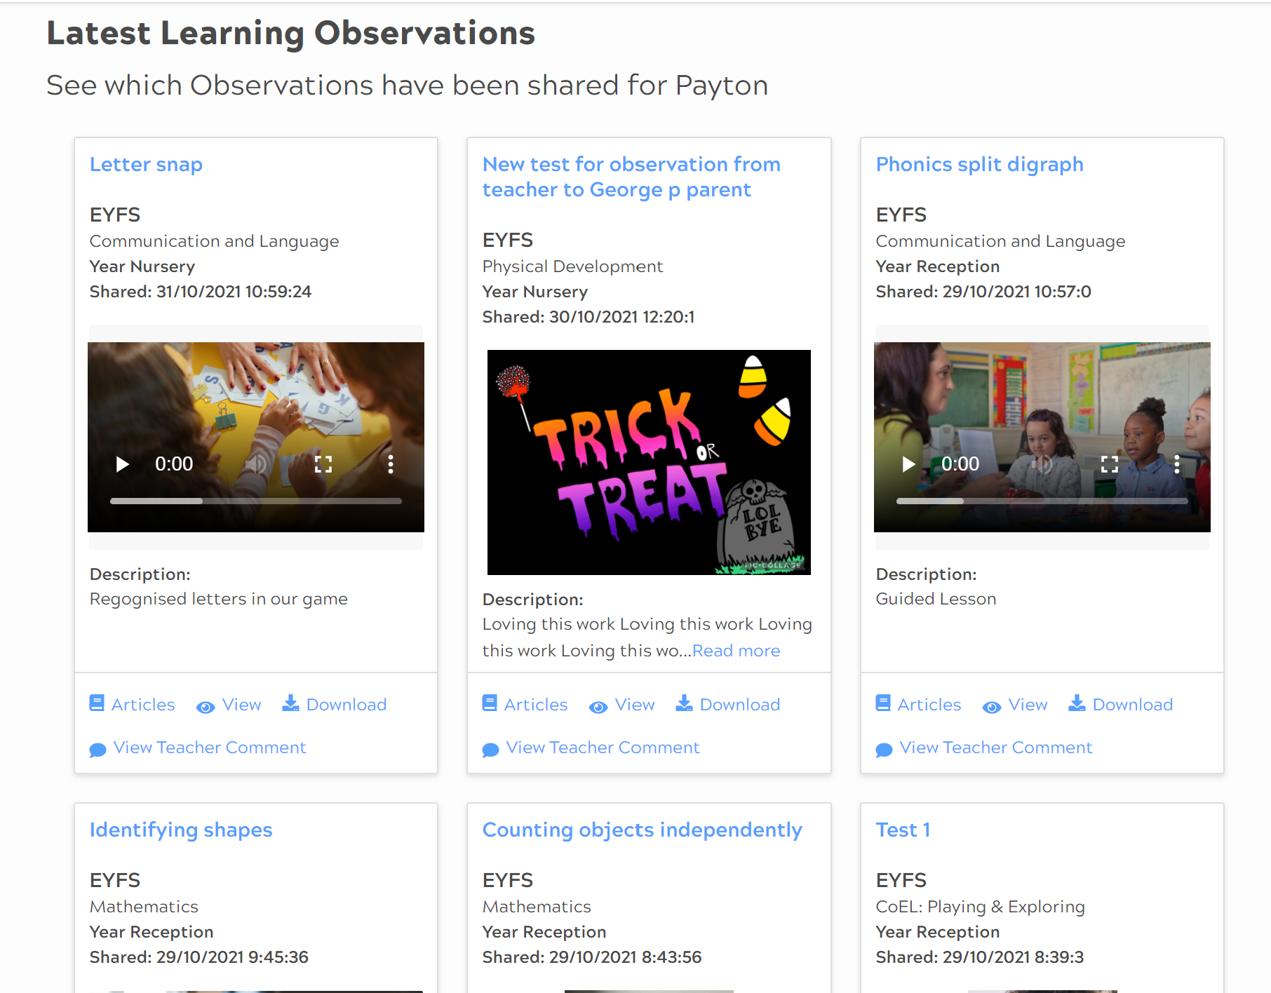
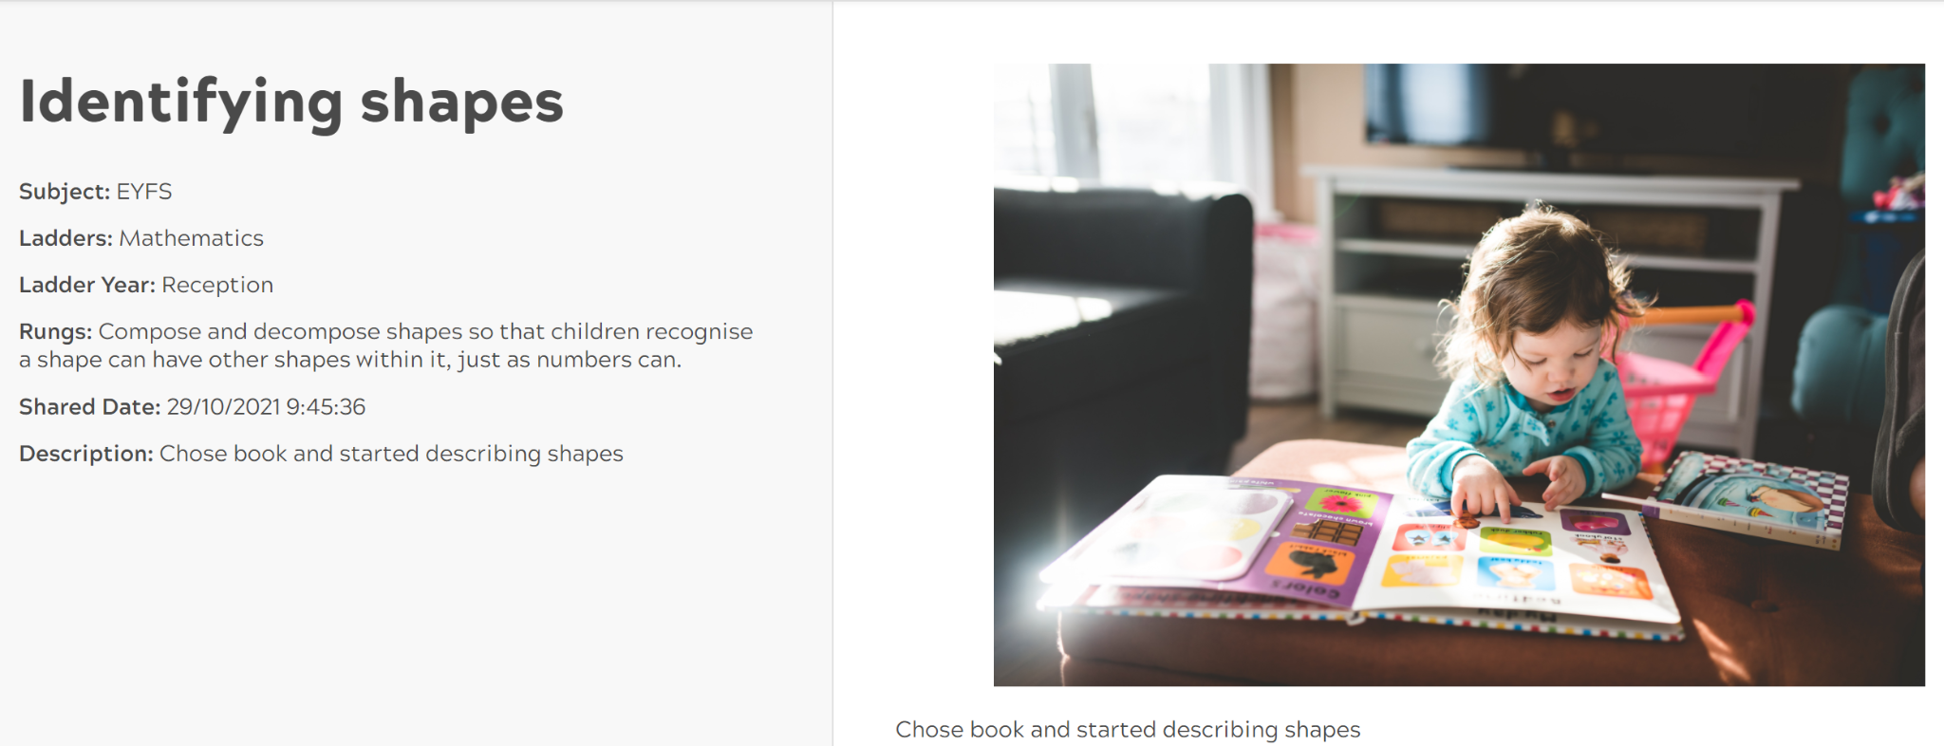
What information is shared with parents?
Observations of your child accessing the enabling environment in school.
We will share observations automatically.
Observations are used in Early Years assessment to record significant moments of learning and build a picture of development over time.

Slide 8
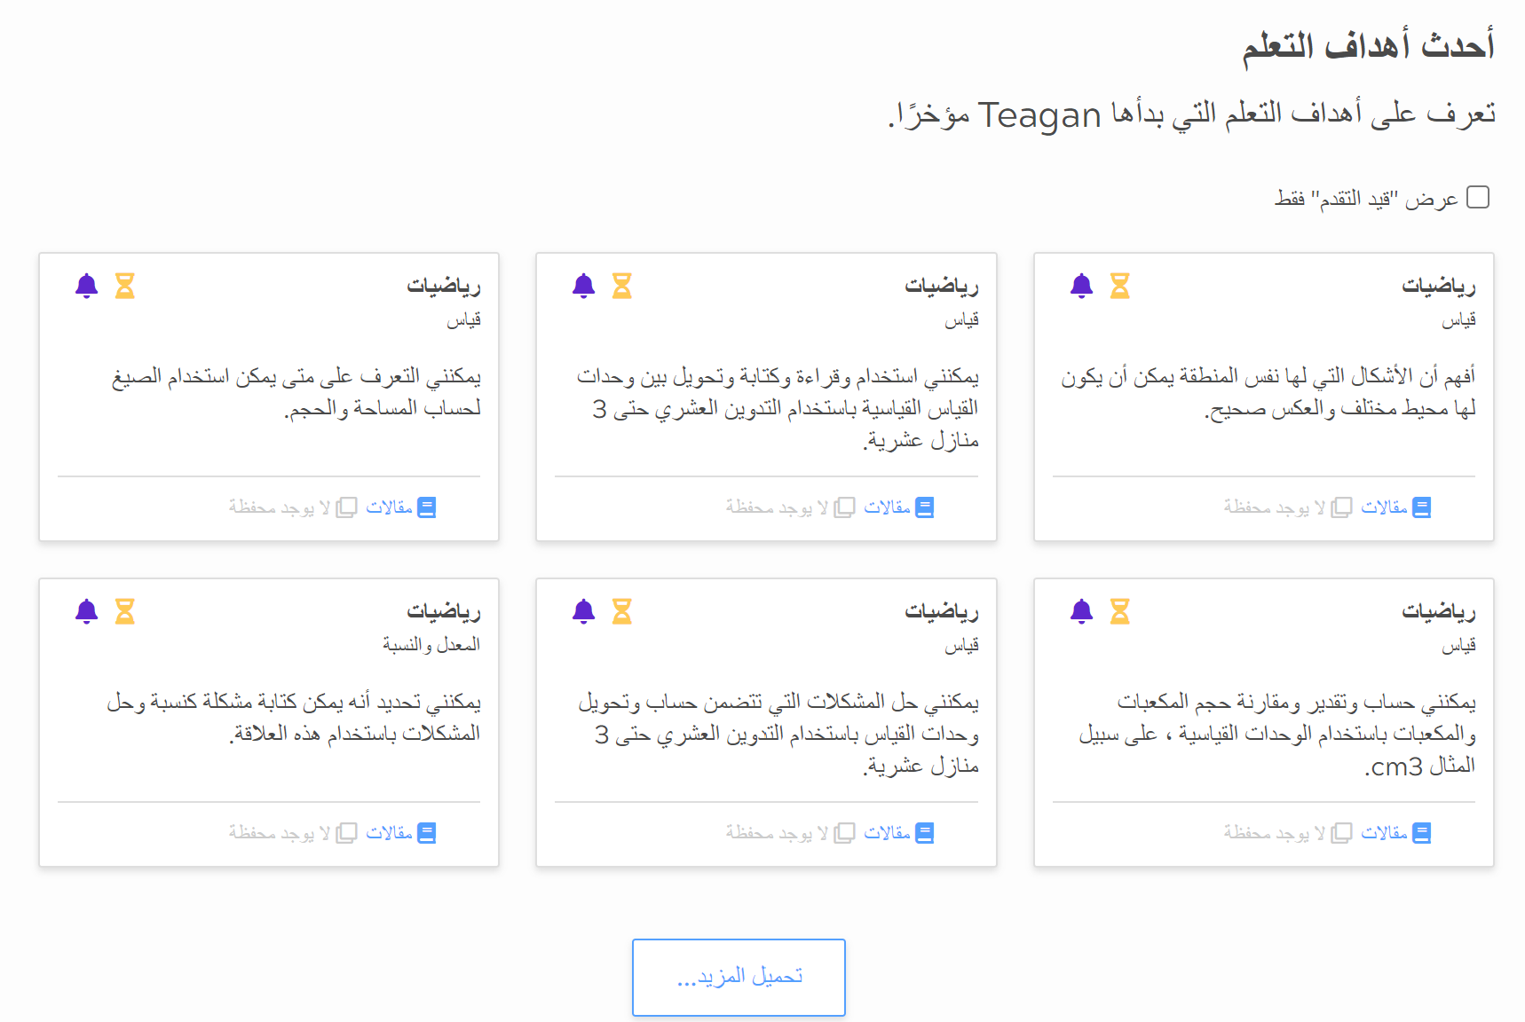
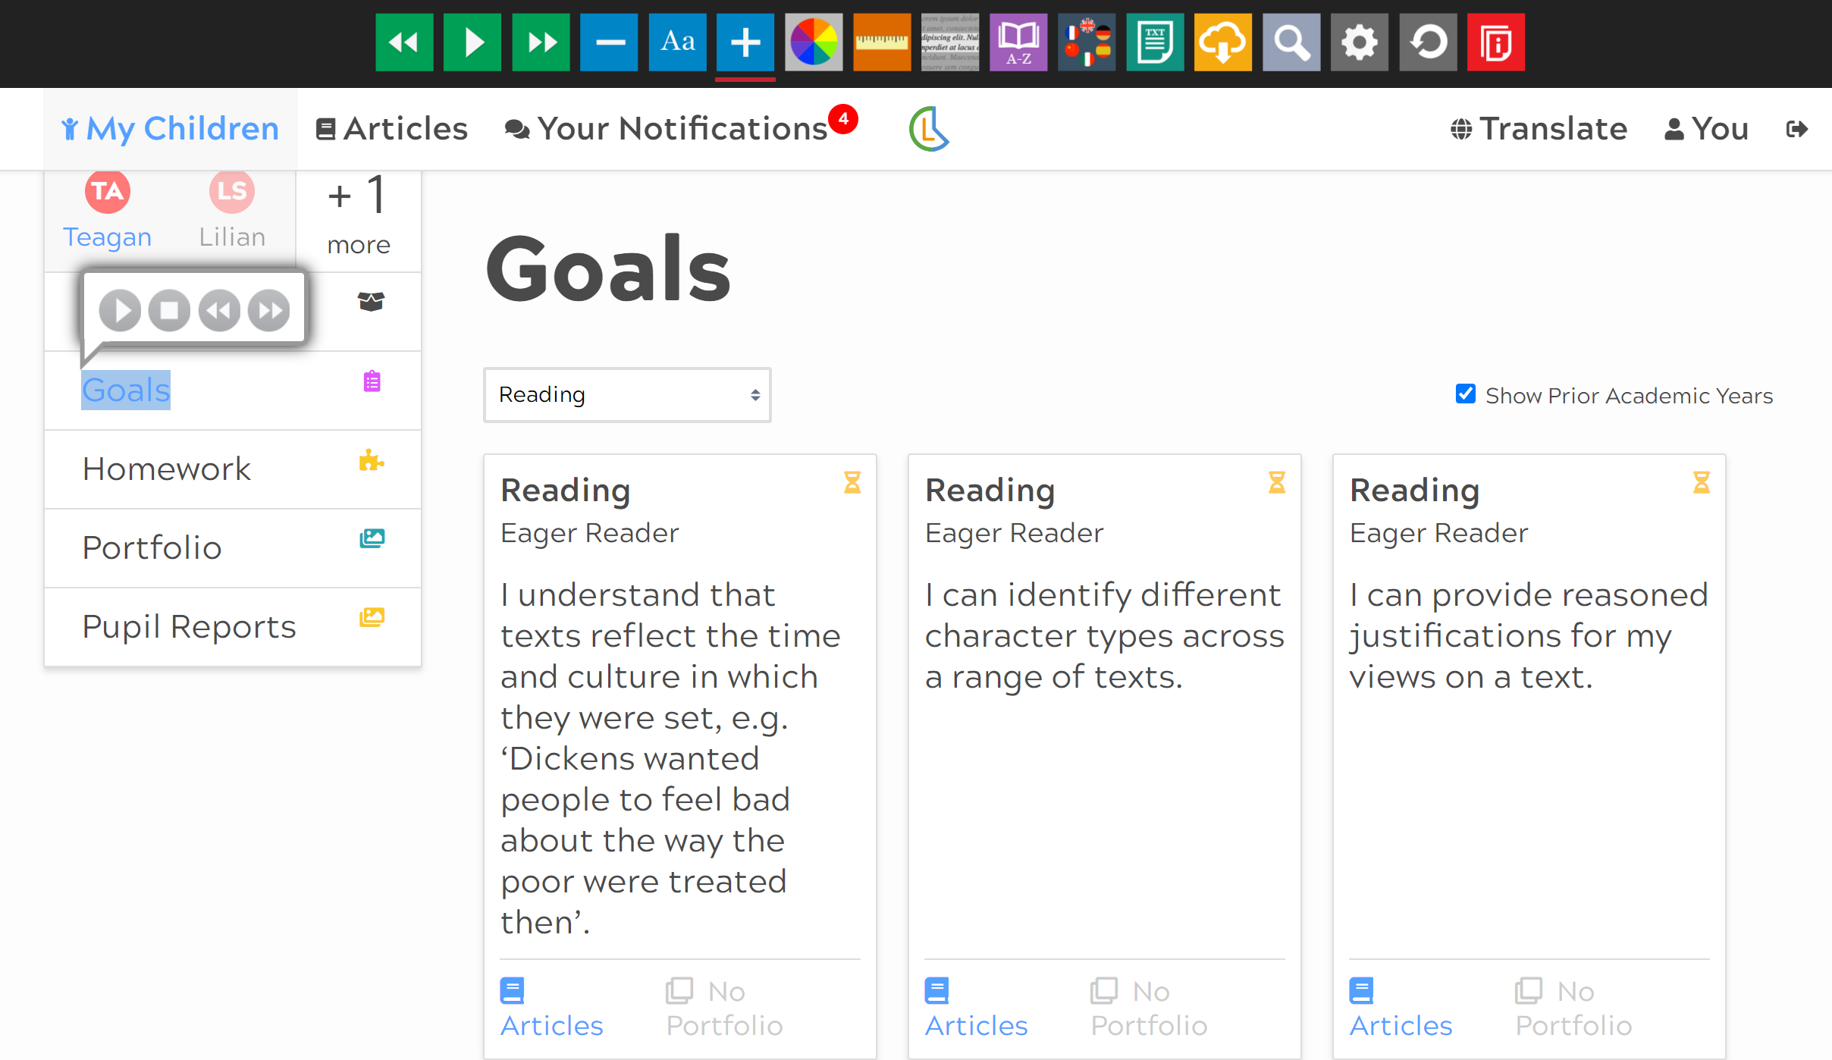
What information is shared with parents?
Information about your child’s learning is now more accessible with translation and accessibility tools
Accessible information on demand, from any device.
Accessibility tools for text size and colour preferences
Translate learning goals into any of 100+ languages

Slide 9
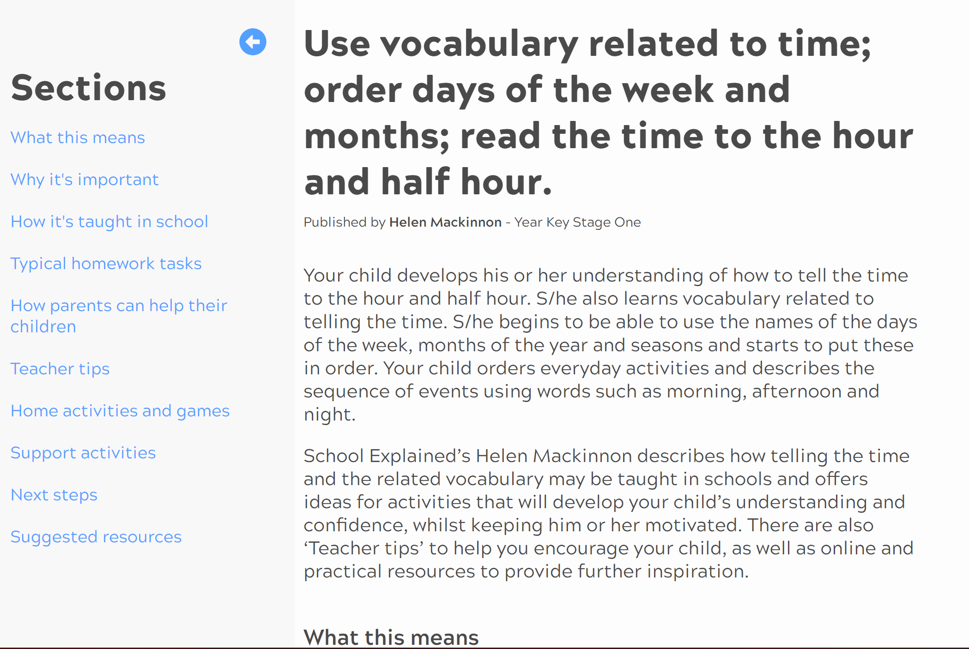
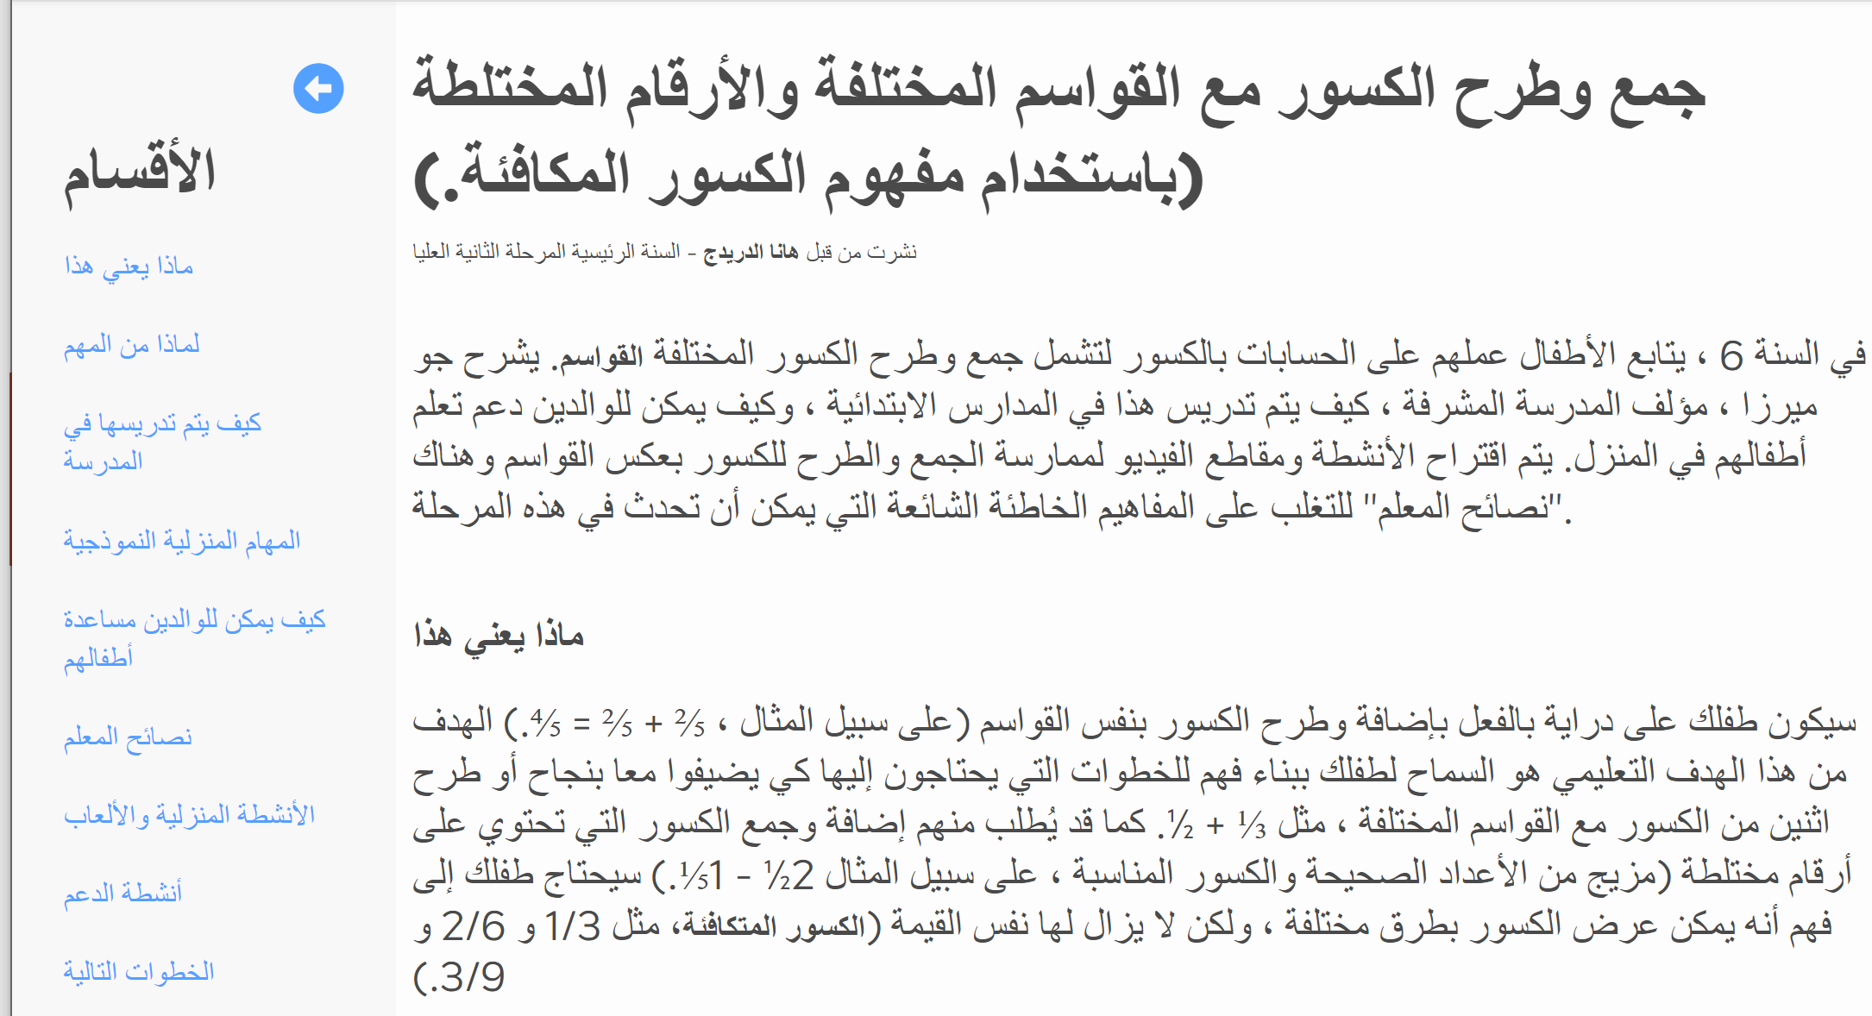
How can I help my child at home?
Ladders at Home provides explanations of exactly how, as a parent you can support learning at home.
Support articles, written by qualified teachers link to the learning goals for Maths. Articles provide explanations of educational terms, how learning is supported in school and activities to take part in at home.
Schools have the option to write and publish their own articles, explaining the specific resources and approaches to learning used in your child’s classroom.
Translatable in over 100 languages

Slide 10
Create conversations about learning
Sharing portfolio evidence, home learning or reports with your child provides opportunities for celebrating learning, shows your interest in their learning and promotes a culture of communicating that continues throughout their school journey.
Top Tips for talking to your child about learning:
Find a quiet time where your child has your full attention
Offer specific praise, focusing on effort over outcome “I can see you are concentrating here!”, “You look like you persevered and didn’t give up!”
Tell me about what you were learning here
Is there anything we can do together to help you?
How did the activity make you feel?
Is there anything else you enjoy doing inside/outside?
Who do you enjoy learning with?
What will you practise tomorrow?

Slide 11
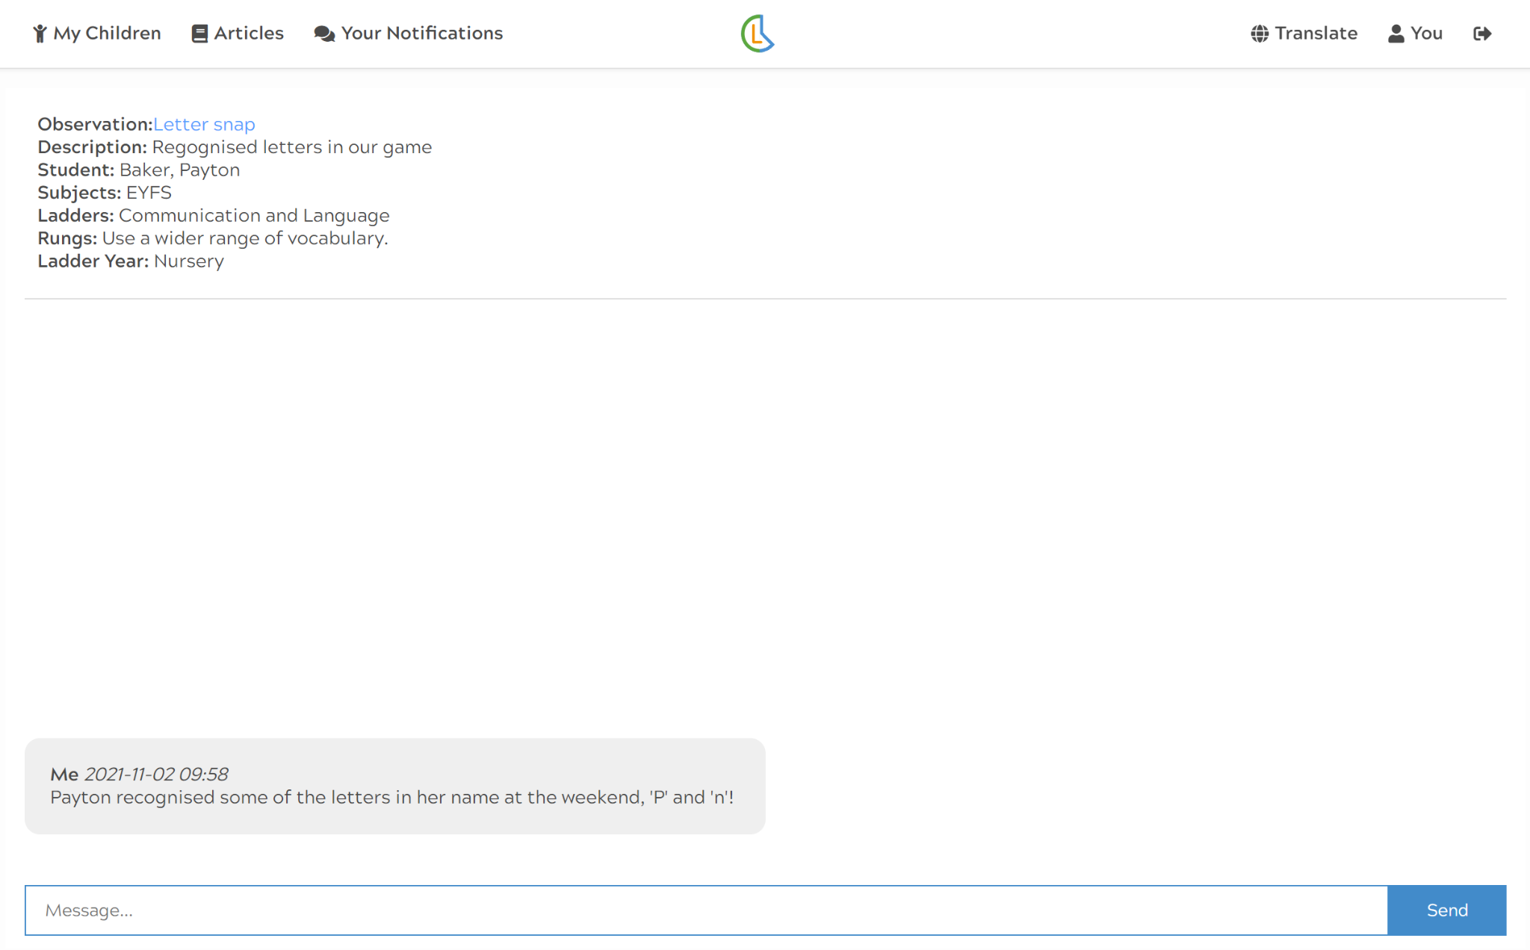
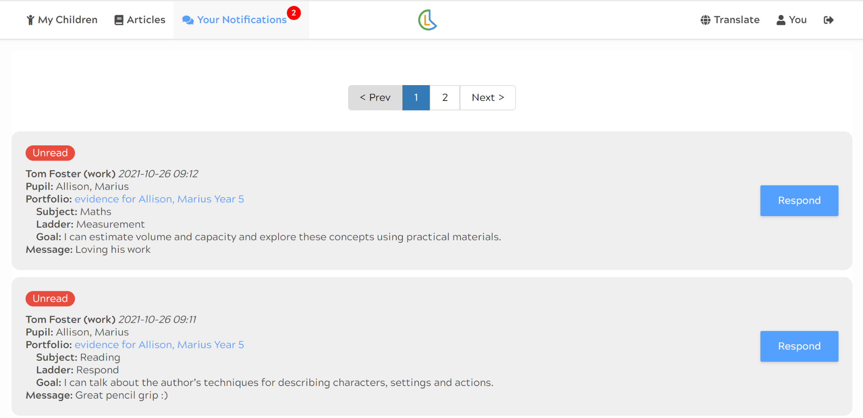
How can I communicate with the teacher?
As parents, you are the experts about your child and we value your reflections and feedback from home.
We encourage you to engage in two-way conversation with us in response to home learning, pupil reports or evidence shared.
Do we need to respond to every portfolio evidence, report or homework?
There is no expectation for parents to respond to every piece of information shared. Two-way communication exists to enable parents to respond to what they have viewed, ask questions or share details of development at home.

Slide 12
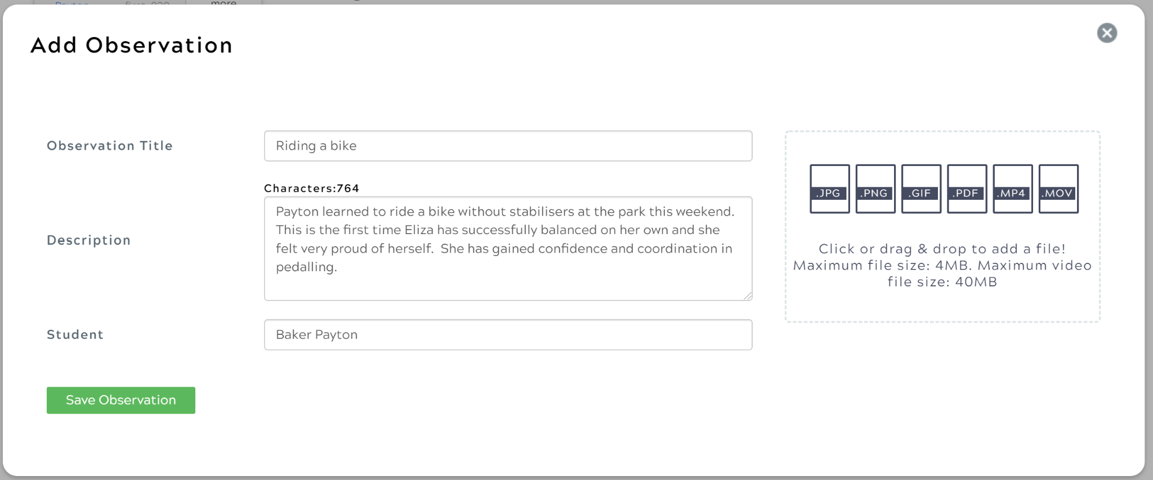
How can we communicate our observations from home?
Useful details to include in your observations:
What was your child doing in the picture/video/audio file?
Who were they doing the activity with?
Where is the observation taking place (seaside, garden, party etc.)
How did it make them feel?
Is this a new development or something they have shown you a number of times?

Slide 13
How is GDPR and Safeguarding managed using an online system?
Observations containing images/video files/audio will only be shared with adults registered to a child
Any safeguarding procedures around consent of photography/video in place in our school will apply to our use of Ladders at Home
School only invites adults with the email addresses provided by the parent to create an account

Slide 14
Improved transition
One consistent communication tool from EYFS to end of Primary.
Uninterrupted communication as your child moves between year groups for maximum progress in learning.
Accelerated Progress
All of the information about exactly what your child is learning and how to help guide learning at home.
Access for multiple adults
All adults involved in a child’s learning at home can have their own login to Ladders at Home- from parents to tutors.

Slide 15
What support will we have in using Ladders at Home?
We will send you an invitation via e-mail to set up your login
We will put a ‘Parents Guide to Ladders at Home’ which provides step by step instructions to using Ladders at Home on the school website
Ongoing support with any issues or questions you may have can be directed to Miss Rees by emailing:
admin@williamhogarth.sch.uk
We can liaise directly with Learning Ladders to resolve any technical issues.

Slide 16
Questions

