Slide 1
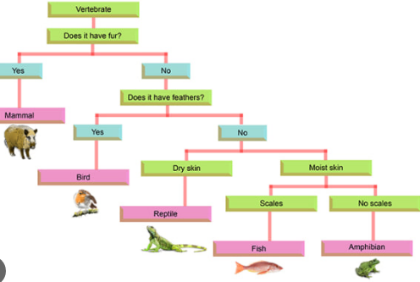
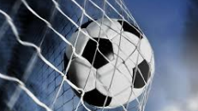
In PE, we will continue to progress with our swimming and we will also be working on our football skills. This will include our touch, passing skills, shooting, as well as working efficiently as a team.

