Slide 1
Home Farm Residential

Slide 2
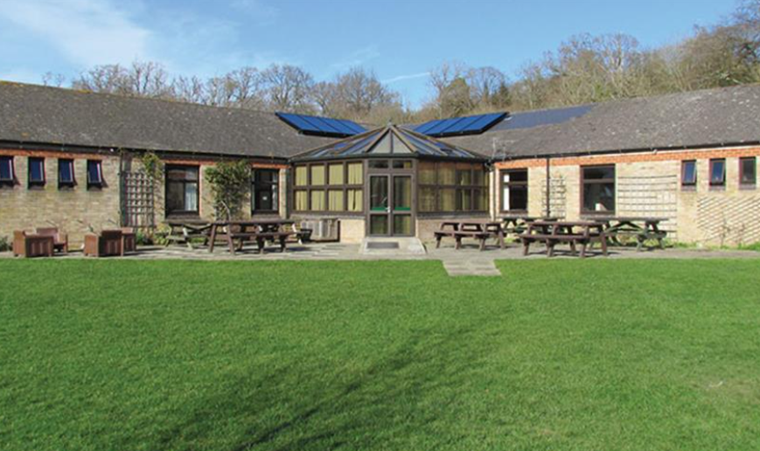
Travel Arrangements
Monday morning
Children to arrive in school at normal time
Coach departs at 1030
Departure point: Dukes Avenue
Friday afternoon
Coach returns
Estimated arrival time 3.30pm
Dukes Avenue

Slide 3
Food & Drink
Example Menu
Breakfast:
Toast
Cereal
Fruit
Croissants
Eggs
Packed Lunch
Supper:
Lasagne
Sweet & Sour
Chicken curry
Bangers & mash
Monday
Breakfast at home
Snack for the coach
Packed lunch from home
Supper at the farm
Friday
Breakfast at the farm
Packed lunch from the farm
Supper at home
Halal & vegetarian options catered for.

Slide 4
Schedule for the week
Monday:
Travel
Lunch & settling in
Touring the farm
Nature garden survey
Tuesday:
Buckler’s Hard (Geography)
Stream study
Pond dipping
Wednesday:
Village study (Geography)
Motor Museum
Thursday:
Shelter building
Orienteering
Friday:
Team building
Travel
Farm Chores: Every day begins and ends with working on the farm
(Cattle & goats, poultry, veg garden)

Slide 5
Contact Arrangements
Sleeping Arrangements
Children organised into rooms of 4 – 6
Boys and girls are separate
Boys and girls have separate bathrooms
Male and female staff sleep in their own rooms
School mobile number will be provided to parents. This should only be used in emergencies. Regular updates and photographs will be posted to Twitter.

Slide 6
KIT LIST
Bedding
Bedding is provided by the centre.
If children prefer, they can bring their own sleeping bags & pillow.
DO NOT BUY A SLEEPING BAG ESPECIALLY FOR THE TRIP!
Cuddly toy
Clothing
Slippers / indoor shoes
Outdoor shoes (good for walking)
Wellie boots
Waterproof coat
Gloves / hat
Activity wear (trousers, shirts / t-shirts, sweatshirt, warm jumper / fleece
Old clothes recommended
Underwear!
(Socks , Pants , Vests)
Nightwear
(PJs etc)
Miscellaneous
Disposable camera
Book Small rucksack for day trips
£10 spending money
Toiletries
Hairbrush
Toothbrush Toothpaste
Shower gel
Towel
No mobile phones
No electronic games

