Slide 1
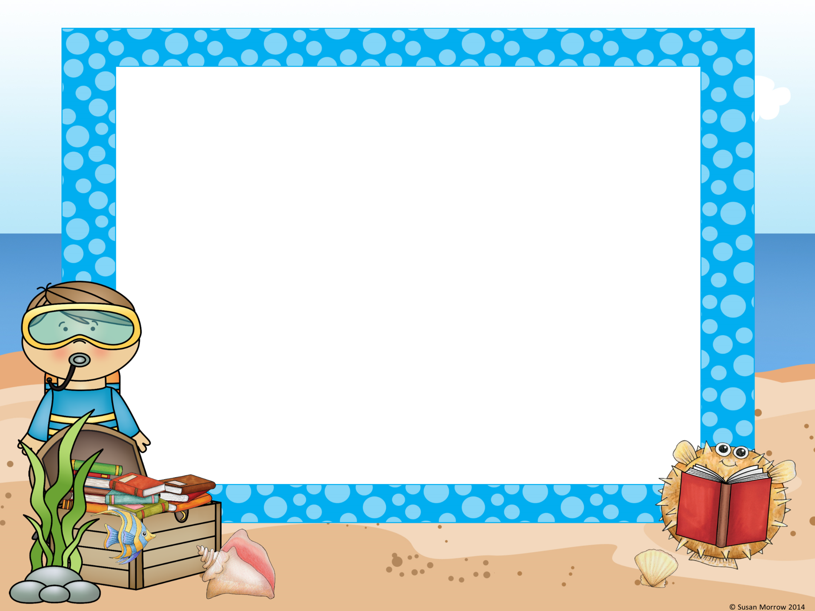
Home Learning
Home Learning is set every Wednesday on Google Classroom (children’s user ids have been sent home in their planners).
Spellings weekly, following spelling patterns and rules
Times Table Challenge
My Maths
Termly
Creative learning in conjunction with topic.

Slide 2
Uniform
White short or long-sleeved logo’d polo shirt
Grey logo’d ‘V’ neck cardigan or jumper with double gold stripe
Plain grey trousers, shorts, skirt, pinafore or gingham dress (in summer)
Plain long or short, grey, black or white socks or tights

Slide 3
Uniform
Sensible black flat shoes or boots (in winter)
Black reversible logo’d school coat or plain black or navy coat (Winter is coming!)
Grey or black scarf, hat and gloves
Grey, black or white kippa or turban
Grey, black, white or yellow hijab
Plain grey, black, white or yellow hair accessories (shoulder length hair tied back)
Black logo’d rucksack or plain black rucksack

Slide 4
P.E. Kit
White logo’d sports top with house coloured sleeves
Black shorts
Black logo’d hoodie with black tracksuit bottoms
Trainers or plimsolls
Key Stage 2: Clean PE Kits should be brought in every Monday.

Slide 5
The Library
Visits to the Library will be once weekly.
To ensure that children can change their books, please make sure children have their books in their bags at the ready.

Slide 6
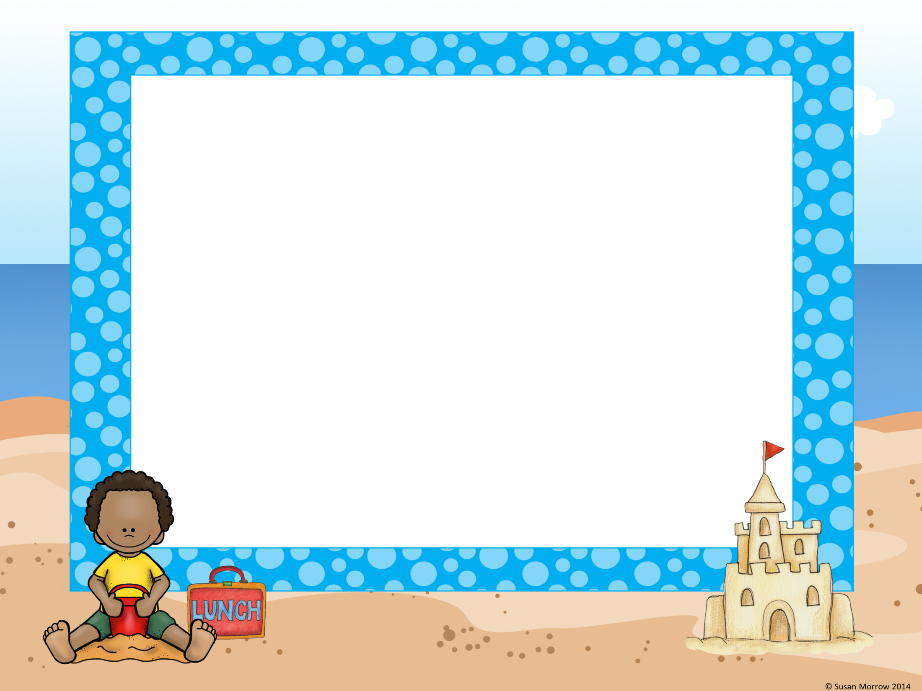
Lunches
School Lunch – Preferably paid online (Parent Pay
Option 1
Option 2 (Vegetarian)
Halal Option
Purchased milk and healthy Snack for break

Slide 7
First Aid
If a child is sick you will need to notify the office, preferably before 8:30am.
If your child takes medication, this can be left in the office where it will be administered by a first aider.
A list of allergies is kept in the register and in the class first aid box. An epi-pen is kept in the office.
If your child is in school, they are expected to participate in all lessons - including PE.

Slide 8
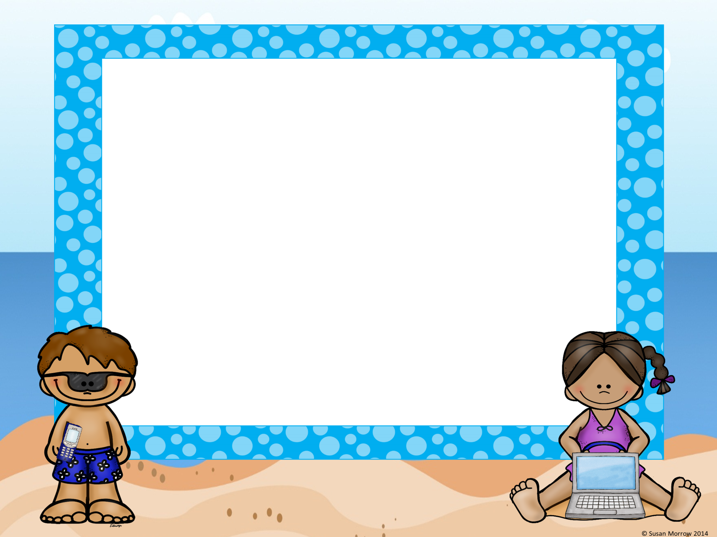
Communication
Newsletter
Email – admin@Hogarth.hounslow.sch.uk
Website – https://www.williamhogarthschool.co.uk
Twitter - @hogarth_the
School phone - 020 8994 4782
Homelearning planner
Parent conferences

Slide 9
Questions?

