Slide 1
2019 /2020 Performance Progress and Outcomes
Impact of COVID-19
2020 was a very different year in education
Countrywide, children in Years 2 and 6 did not sit SATs (end of Key Stage Assessments)
Year 1 Phonics Screening Check was deferred until Autumn 2020
Many children across the country missed the opportunity to celebrate their outcomes and show the progress made as a result of all their hard work in previous years
At The William Hogarth School
During the week of 9th March – just before partial closure – our Year 2 and Year 6 children sat the 2019 National SATs papers in:
Reading
Maths and
Spelling and Grammar
Writing was teacher assessed
Data from these assessments was intended to inform future teaching and learning
The fantastic results achieved by the children in these Mock SATs shows their readiness for the national tests had they gone ahead in May.

Slide 2
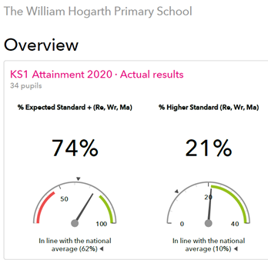
Key Stage 1 Outcomes
Subject | Percentage
% Expected Standard+ Reading | 79%
% Higher Standard Reading | 38%
% Expected Standard+ Writing | 79%
% Higher Standard Writing | 21%
% Expected Standard+ Maths | 82%
% Higher Standard Maths | 35%
Based on assessments taken week beginning 9th March 2020

Slide 3
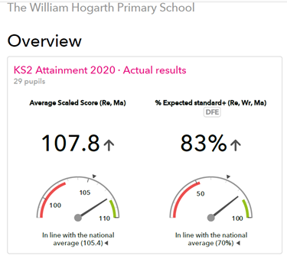
Key Stage 2 Outcomes
Subject | Percentage
% expected higher standard (R,W,M) | 14%
% Expected Standard+ Reading | 83%
% Higher Standard Reading | 21%
% Expected Standard+ Writing | 83%
% Higher Standard Writing | 14%
% Expected Standard+ Maths | 90%
% Higher Standard Maths | 45%
Based on assessments taken week beginning 9th March 2020

Slide 4
EYFS Outcomes
The Early Learning Goals (ELG) are assessed at the end of Reception.
These results were submitted to the Local authority in March 2020.

Slide 5
Phonics Outcomes
The Phonics Screening Check is taken by children at the end of Year 1.
The 2019/2020 assessments were deferred until October 2020.
100% of the children who attended the William Hogarth School in Year 1 passed the Phonics Screening Check in October.

