Slide 1
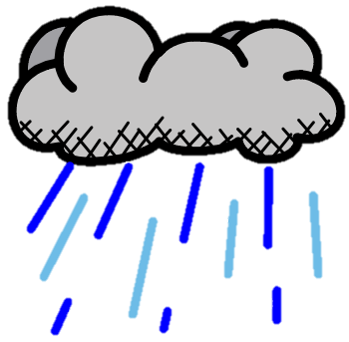
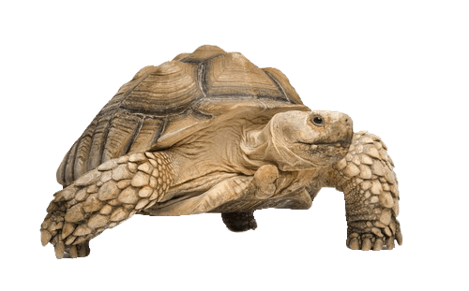
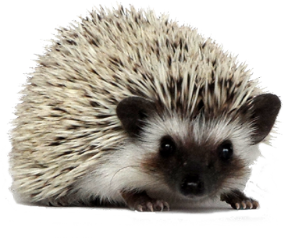
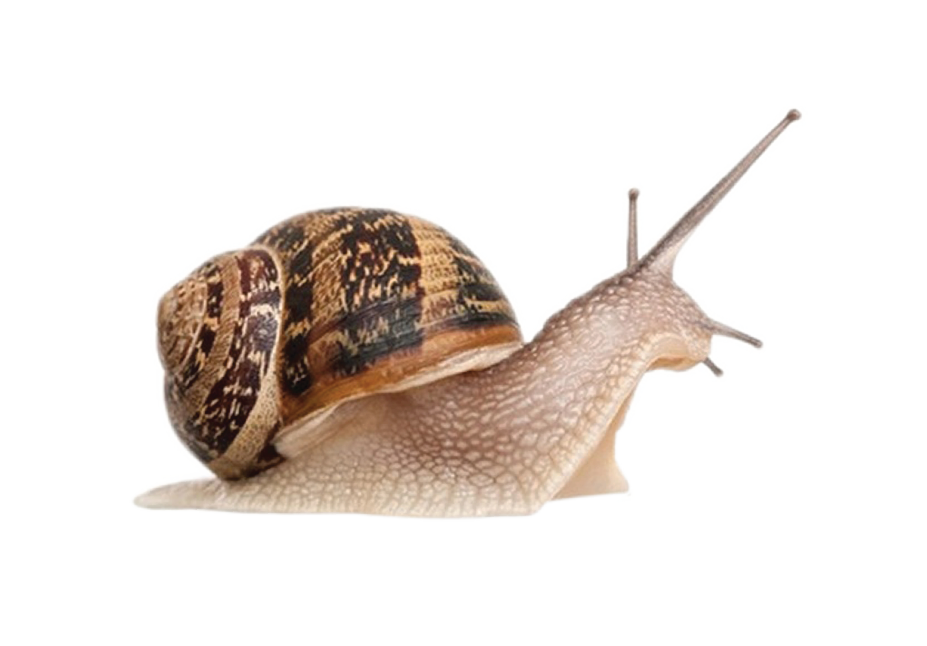
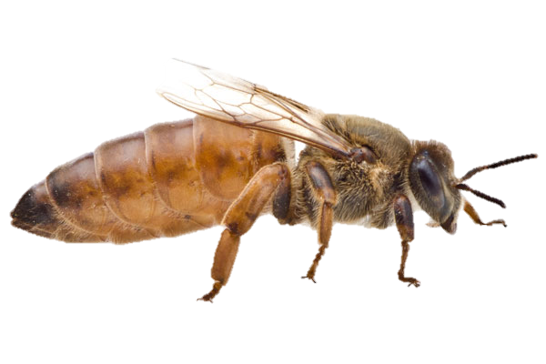
Seasons and The Weather ¦ Year 2 ¦ Summer 1
SEASONS
WEATHER
Rainy Water falling from clouds.
Cloudy Some clouds in the sky.
Snowy Snow falls from cold clouds.
Sunny The sun is shining brightly in the sky.
Stormy Thunder, lightning, wind and rain.
Foggy Clouds we can see.
KEY TERMS
Hibernation
Animals sleep in the winter to survive the cold weather. hedgehog snail tortoise bat bee
Weather Forecast
Shows the weather today and in the future.
SPRING March April May
trees grow leaves weather becomes warmer days become longer baby animals born
SUMMER June July August
trees have full green leaves weather is usually warm days are bright and long
AUTUMN September October November
leaves become brown and fall weather becomes more rainy and cold days become shorter animals prepare to hibernate
WINTER December January February
no leaves on trees weather is cold and there can be snow days are dark and short animals hibernate

