Slide 1


Purple Day as part of
Mental Health Awareness Week
Denise Woodhouse

Slide 2
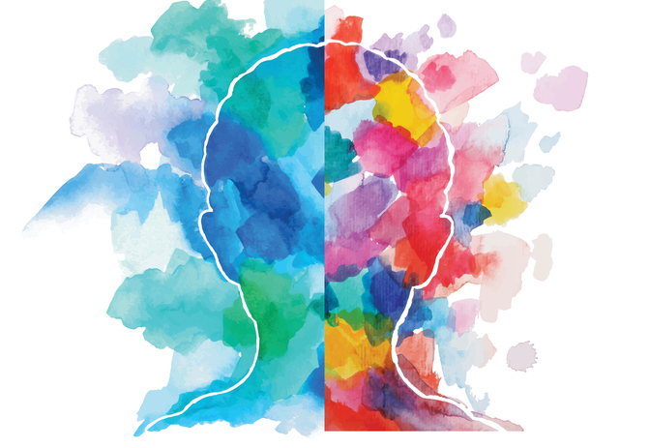


Purple Day
22 May 2020

Slide 3






Mental Health Awareness Week
18-22 May 2020
We are going to focus our attention on how we can be more mentally well. Sleep is the unsung hero for Mental Health. Good quality sleep will help you to have better:
concentration
creativity
memory
mood
wellbeing
All of these will then help you to
work well
Notes:
Sleep is an essential part of feeling well and feeling happy, but almost everyone experiences problems sleeping at some time in their life. Sleep disruption is common, especially during times when you may feel emotionally overwhelmed. Anxiety, relentless replaying of the day's events, and heightened emotions may significantly interfere with your sleep.
Bringing sleep patterns under control is important – you need your rest. However, it often takes some time to get problematic sleep under control and rarely can this be done overnight. The most common cause of insomnia is a change in your daily routine or stress. For example, travelling, exams, work stress, change in work hours, disruption caused by eating, exercise, or leisure, relationship conflicts, etc, may all cause problems.
Paying attention to good sleep hygiene is the most important thing you can do to maintain good sleep.
Do ✓ Keep a regular sleep routine – wake up at the same time each day, weekends included. ✓ Get regular exercise each day, preferably in the morning (there is good evidence regular exercise improves restful sleep). ✓ Get regular exposure to outdoor or bright lights, especially in the early afternoon. ✓ Keep the temperature in your bedroom comfortable. ✓ Keep the bedroom dark enough to facilitate sleep. ✓ Keep the bedroom quiet – try thicker curtains, sleeping at the back of your house or even earplugs to avoid being woken by noise. ✓ Only use your bedroom for sleep, sex, and getting dressed.

Slide 4
First things first…
Do you accept the challenge to become your own…
Sleep hero ?

Slide 5
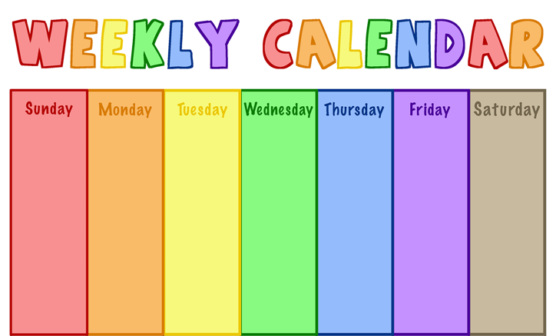
Purple Day
There are activities to learn about sleep and to help you look at what you do now and if you can make any changes improve your sleep. If you can sleep better, your memory and mood, your concentration and creativity and your wellbeing and work will improve too.
On Friday it will be Purple Day, so join other children from your school and the other schools in the Trust to celebrate by having a Sleep Heroes Pyjama Day.

Slide 6
Activities
Key Stage 2 - Concentration, creativity and memory
Better brains with more sleep
Activity 1 - Sleep Patrol diary to track and monitor your sleep
Activity 2 - True or false quiz to learn about Sleep Myths
Activity 3 - Catnaps – learn about the animal world
Activity 4 - Sleep Olympics (including competition to design a beanbag)
Preschool, Reception and Key Stage 1 - Memory and concentration games
Mood and wellbeing activity
Everyone!
Mindfulness
Creative, mood and wellbeing
Good night cube craft
Here is a project to make and use to help you calm you before bed. There is a template to make a paper cube which you can use to ask each other questions before bed.

Slide 7
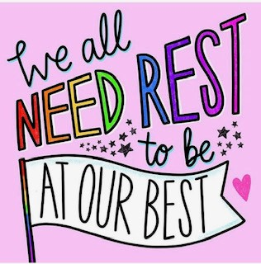
Sleep is very important to being physically well, mentally well and feeling happy, but almost everyone has problems sleeping at some time in their life. Finding it hard to sleep is common, especially when you may feel like you have a lot on your mind. It is sometimes hard to switch off from the thoughts in your head or maybe you have strange dreams which stop you getting a good night’s sleep.

Slide 8
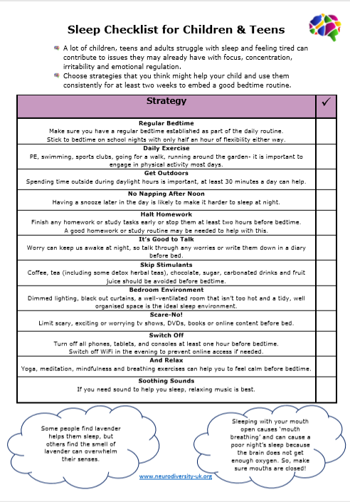
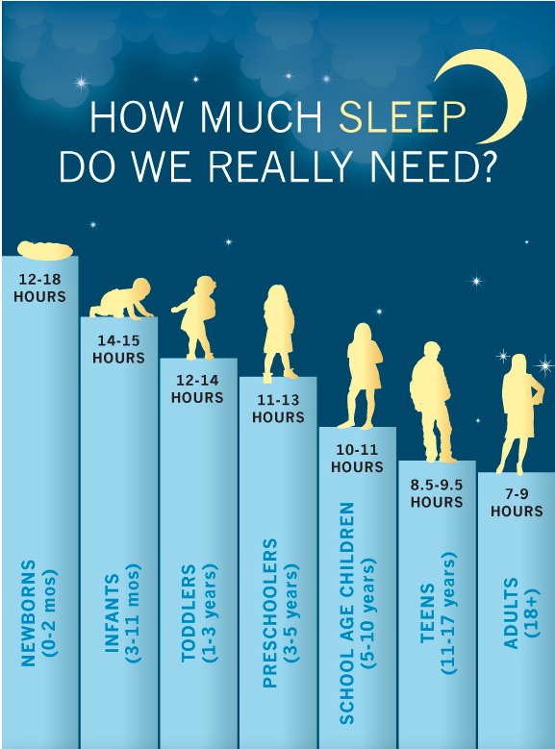

Slide 9
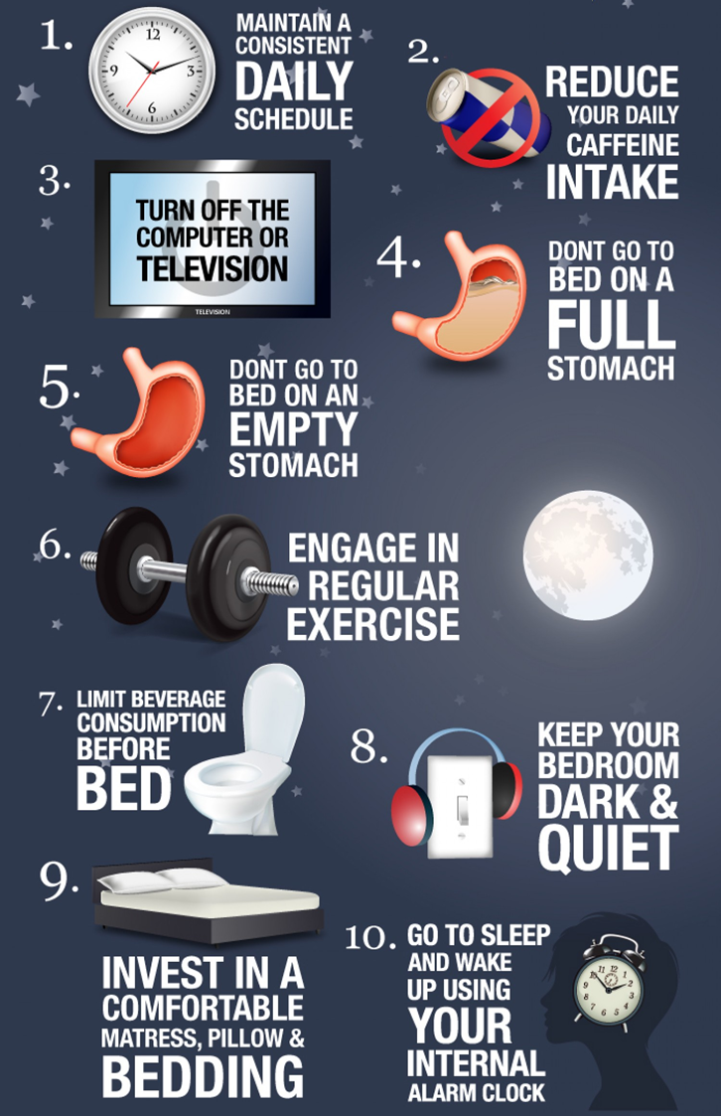
Sleep tight: tips for a good night
Avoid sugary snacks and caffeine (in cola, chocolate), particularly at supper time. Good alternatives are bananas, porridge or wholemeal bread.
Think about the bedroom environment: is it calm and will it help you to sleep?
Have a consistent routine that you follow every evening in the hour before bedtime – device free zone.
No screen activity in the hour before bed; no TVs, computers, phones or tablets.
Having a bath or shower before bed can be relaxing. If you do this 30 minutes before bedtime your body temperature rises and then drop again to feel sleepy.
Activities to help the brain wind down before bed including sharing a story or reading your own book.
Have a set wake-up time, even at the weekend to help your body clock work best.

Slide 10
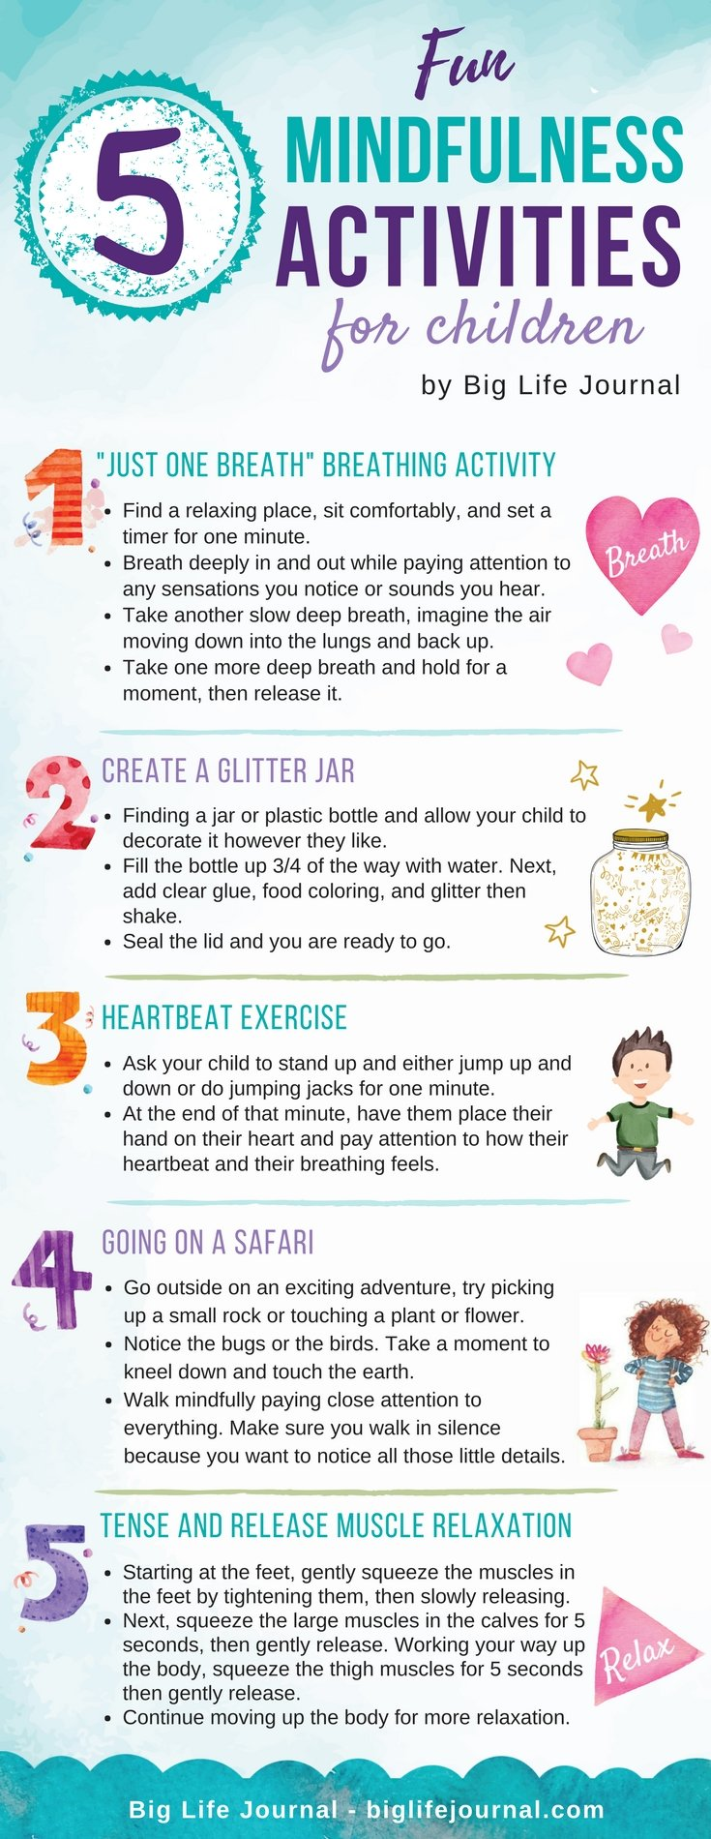
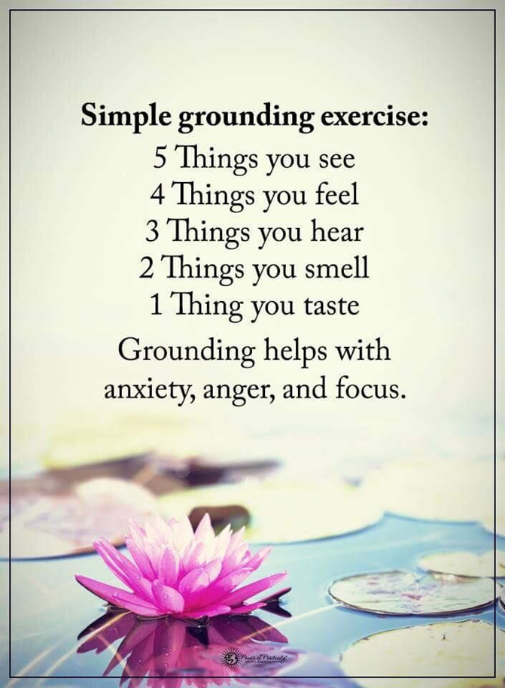
What Is Mindfulness?
Mindfulness is about focusing on the present moment by tuning into our thoughts, feelings, bodily sensations and what's around us. It's all about being aware of what's happening here and now, slowing down and calming your mind.
Mindfulness activities can be practiced anytime and anywhere. They are useful to help calm your thoughts before bed or when things become a little overwhelming and you need to feel safe and secure. This grounding exercise is very useful to get your thoughts back into the present.

Slide 11
Can you get your grown ups to be sleep heroes too?
Here are some slides for them…

Slide 12
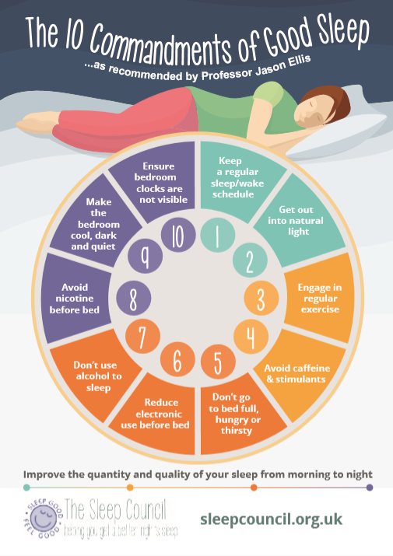
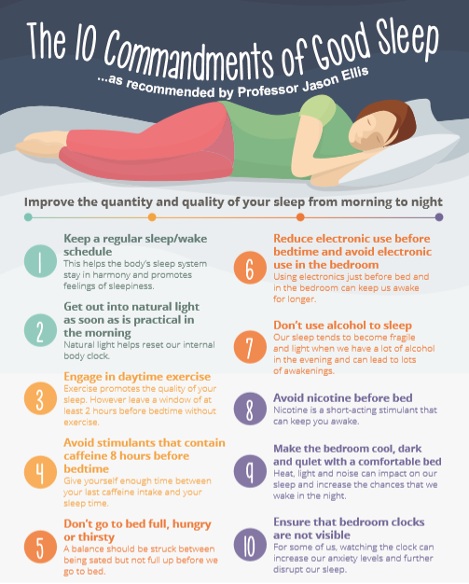

Slide 13
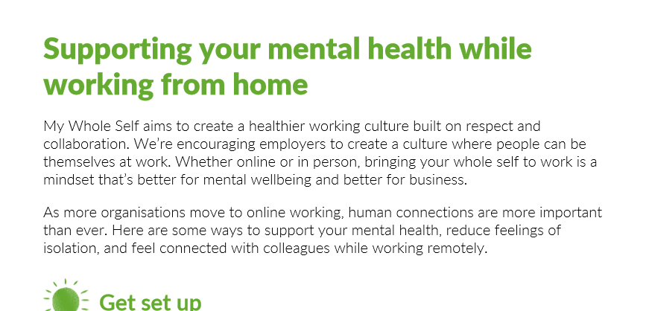
https://mhfaengland.org/remote-working-resources/everyone/
https://youtu.be/es8l7JAyYMk
Notes:
https://mhfaengland.org/remote-working-resources/everyone/
Document available as a PDF (will send) and a short video https://youtu.be/es8l7JAyYMk

Slide 14

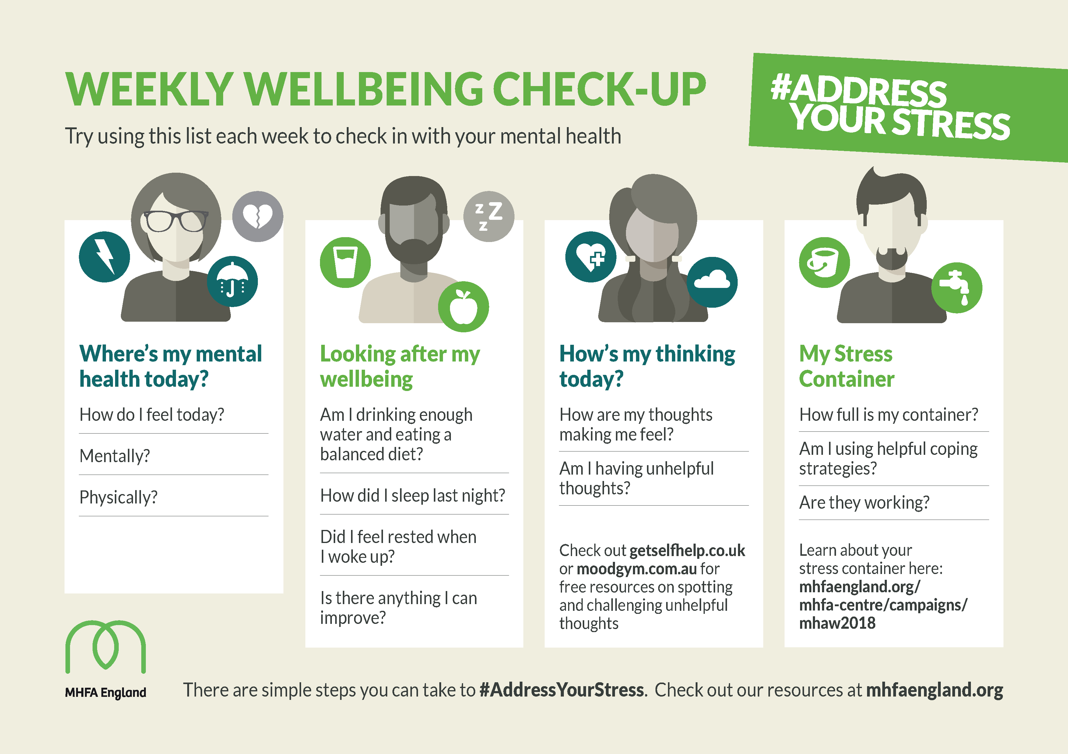
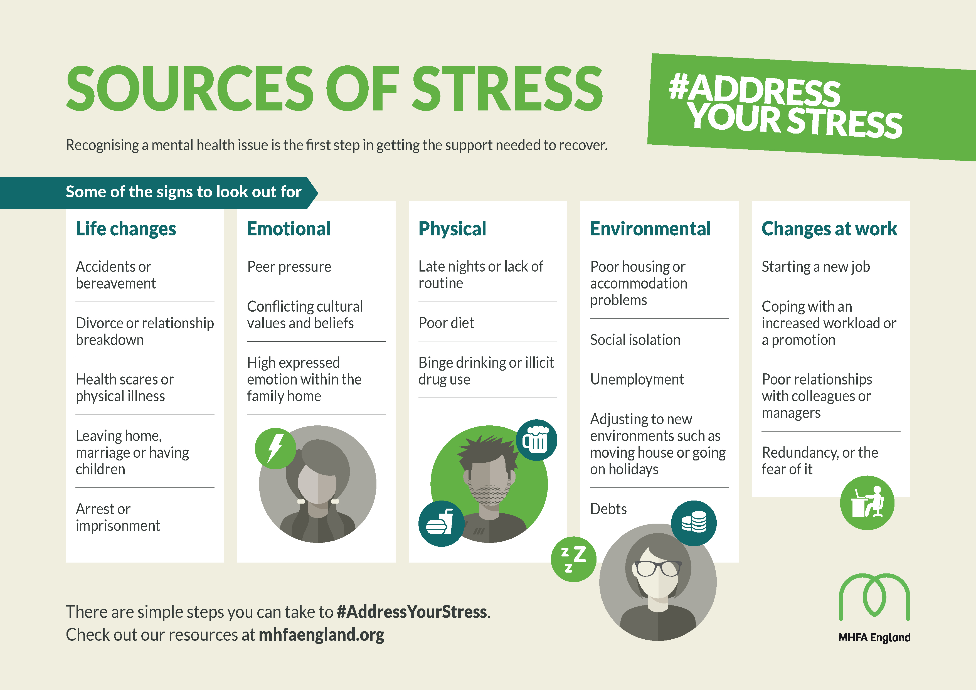
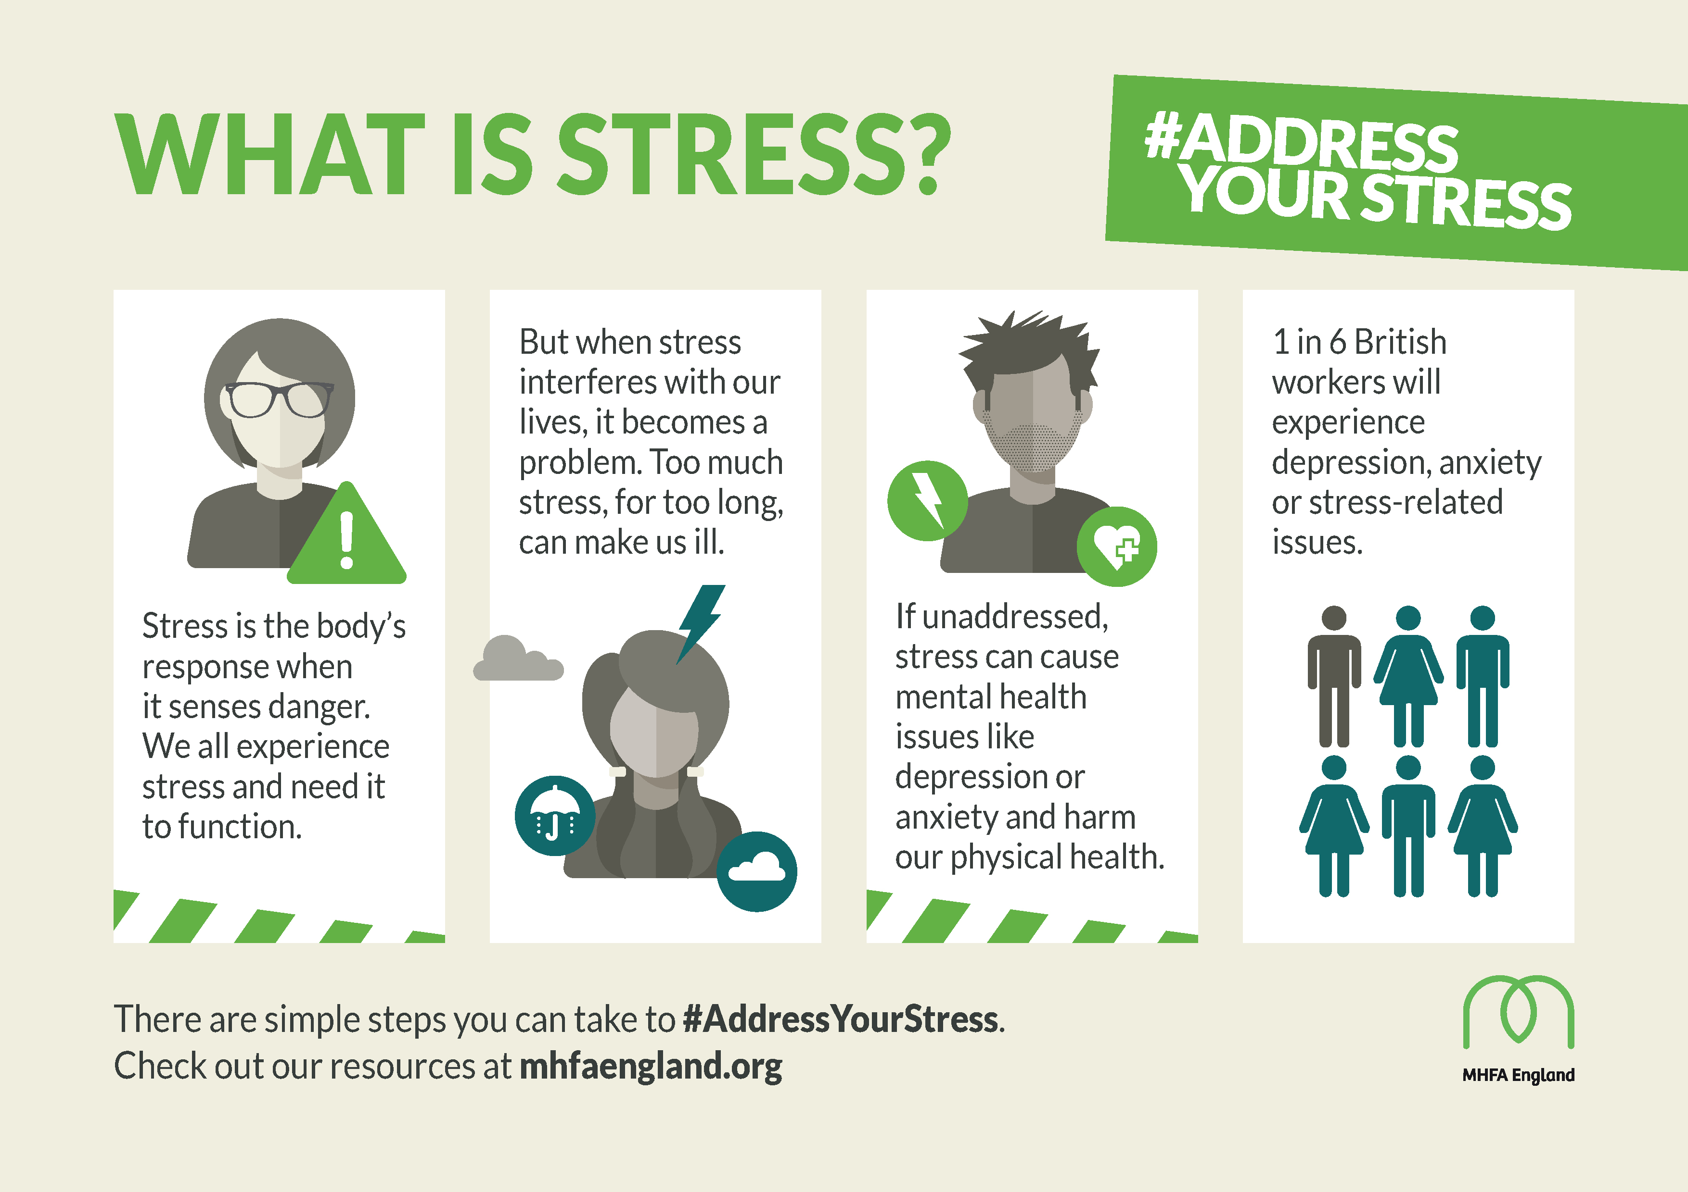

Slide 15
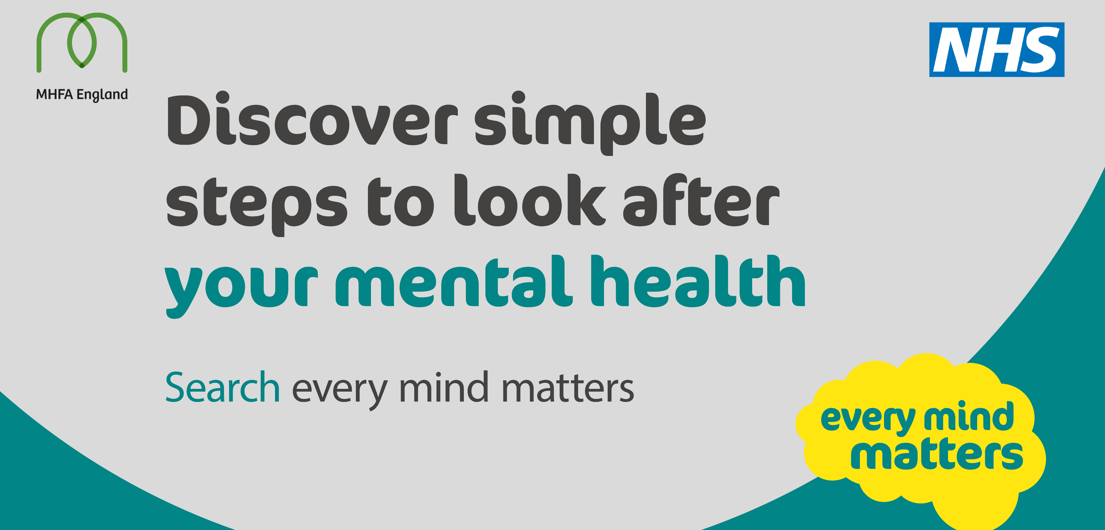
Notes:
Every mind matters slide deck to be sent out to you with this powerpoint. https://mhfaengland.org/every-mind-matters/

Slide 16

Looking after your mental health
Having good mental health helps us relax more, achieve more and enjoy our lives more. We have expert advice and practical tips to help you look after your mental health and wellbeing.
Coronavirus and wellbeing
10 tips to help if you're worried about coronavirus
Looking after children and young people
7 simple ideas to tackle working from home
Mental wellbeing while staying at home
https://www.nhs.uk/oneyou/every-mind-matters/
Notes:
Each bullet point is a link to a resource

Slide 17
Helpful resources
Public Health England - Guidance for the public on the mental health and wellbeing aspects of coronavirus (COVID-19)
Government advice on how to look after your mental health and wellbeing during the coronavirus (COVID-19) outbreak.
City Mental Health Alliance - Supporting colleagues
Resources to help organisations support their colleagues, including how to manage remote teams in challenging times.
Every Mind Matters - Coronavirus and wellbeing
Includes ten tips to help if you are worried about coronavirus, and advice on maintaining your wellbeing while staying at home.
Mental Health At Work - Coronavirus and isolation: supporting yourself and your colleagues
Mental Health At Work has grouped together resources to support one another’s mental health through the outbreak and through working remotely.
Mental Health Foundation - Looking after your mental health during the coronavirus outbreak
Some tips to help you, your friends and your family to look after your mental health, including how to avoid rumour and speculation which can fuel anxiety.
Mind - Coronavirus and your wellbeing
Information including practical advice for staying at home, taking care of your mental wellbeing, and finding support for benefits or housing.
Rethink Mental Illness - Covid-19 and mental illness
Online hub of practical support and information for people living with, or supporting people with mental illness.
Samaritans - If you're worried about your mental health during the coronavirus outbreak
Support and guidance for anyone worried about their mental health.

Slide 18
