Slide 1


Welcome to Year 4
Rio (miss Davenport) & Mexico City (Mrs Lawrie)
2026- 2027

Slide 2
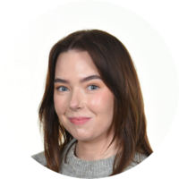
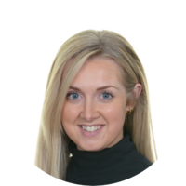
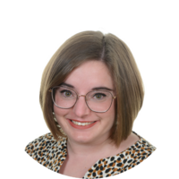
Meet the Team
Class teachers: Miss Davenport & Mrs Lawrie
Class support staff: Miss Valente
Notes:
KN
2

Slide 3
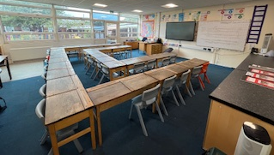
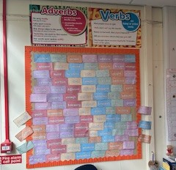
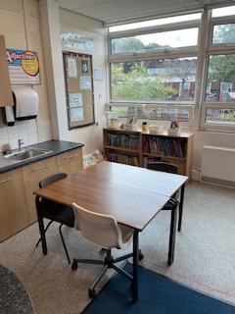
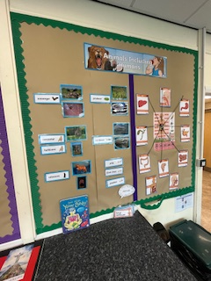
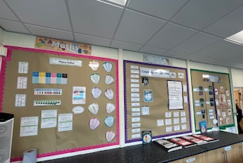
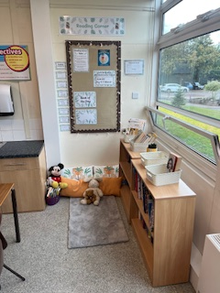
Rio

Slide 4
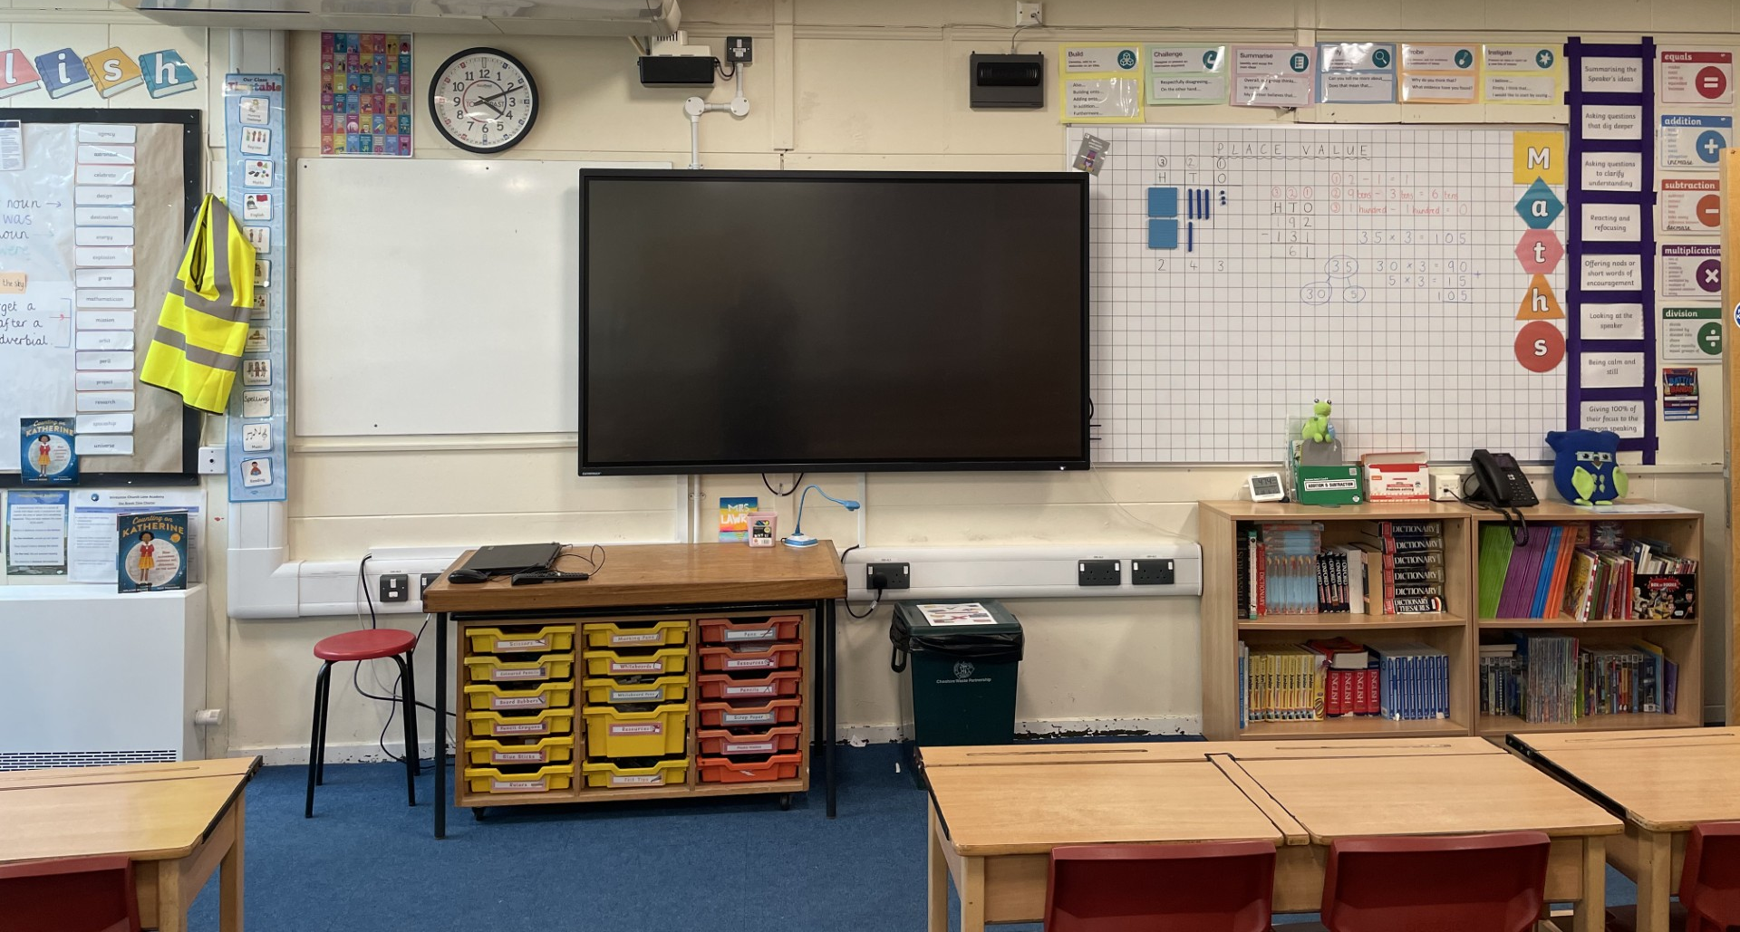
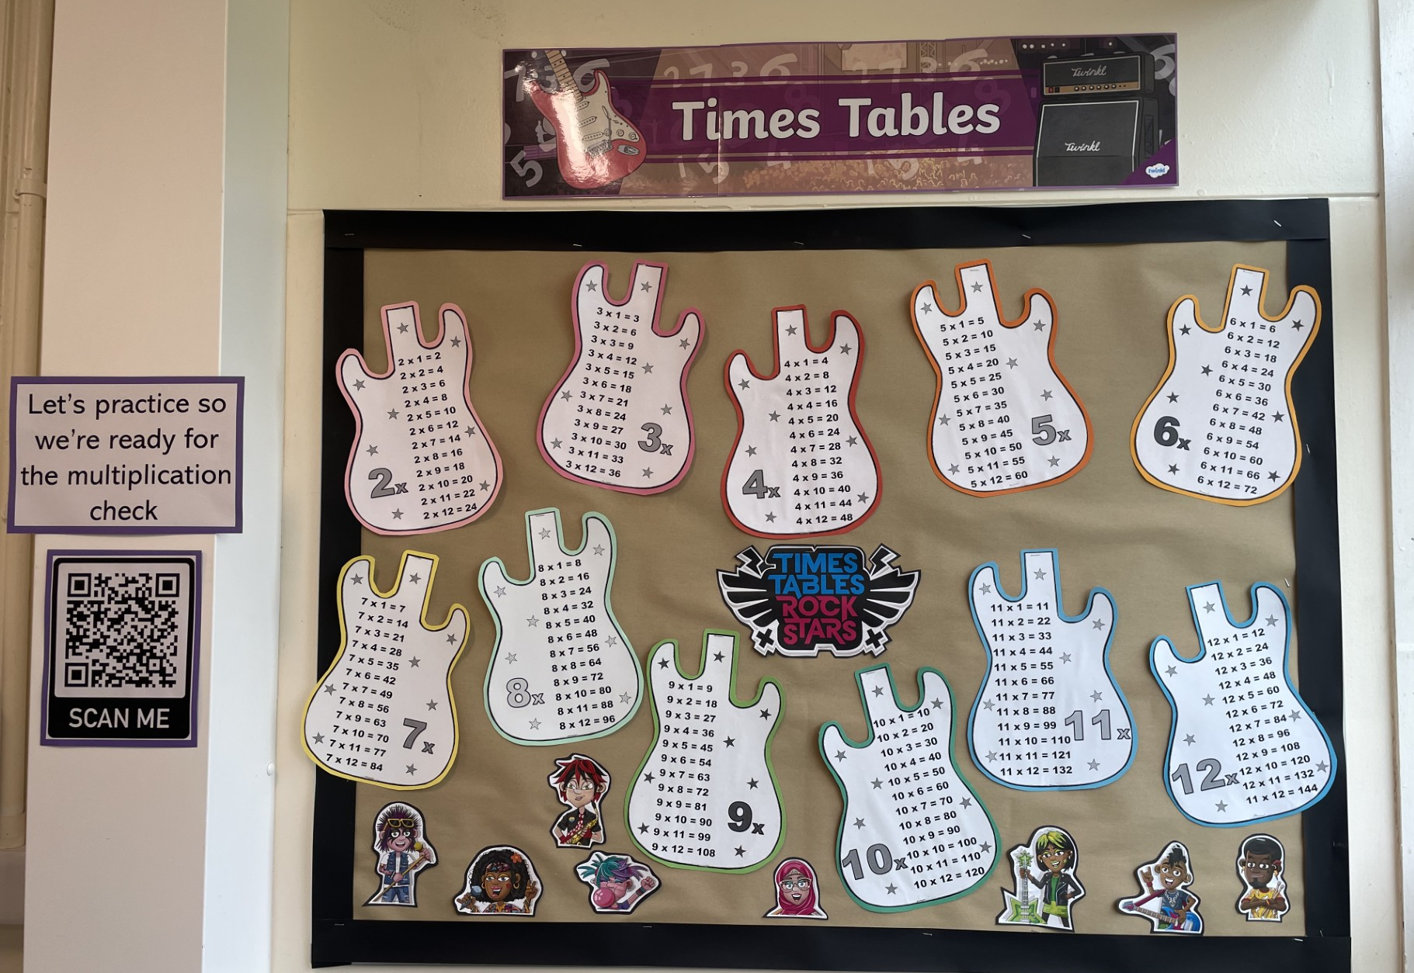
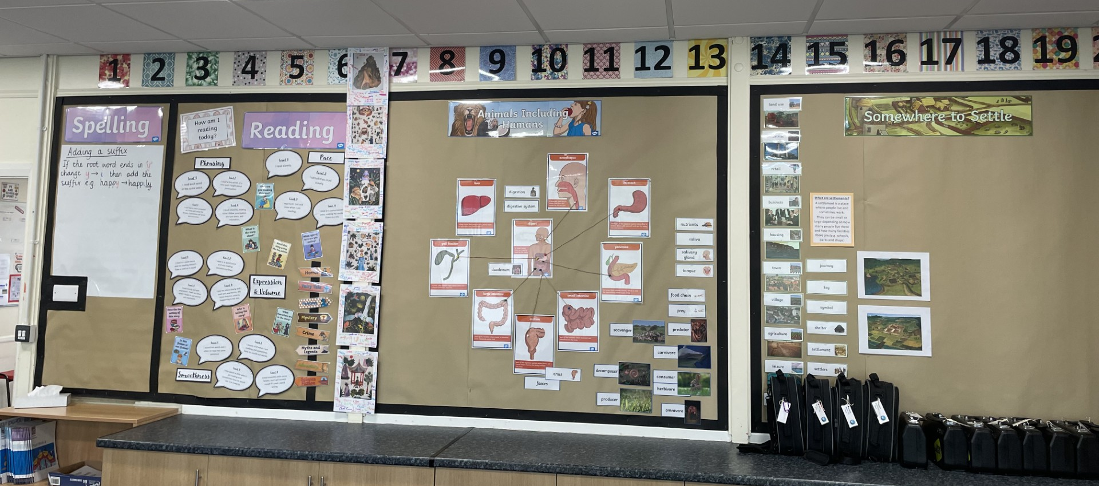
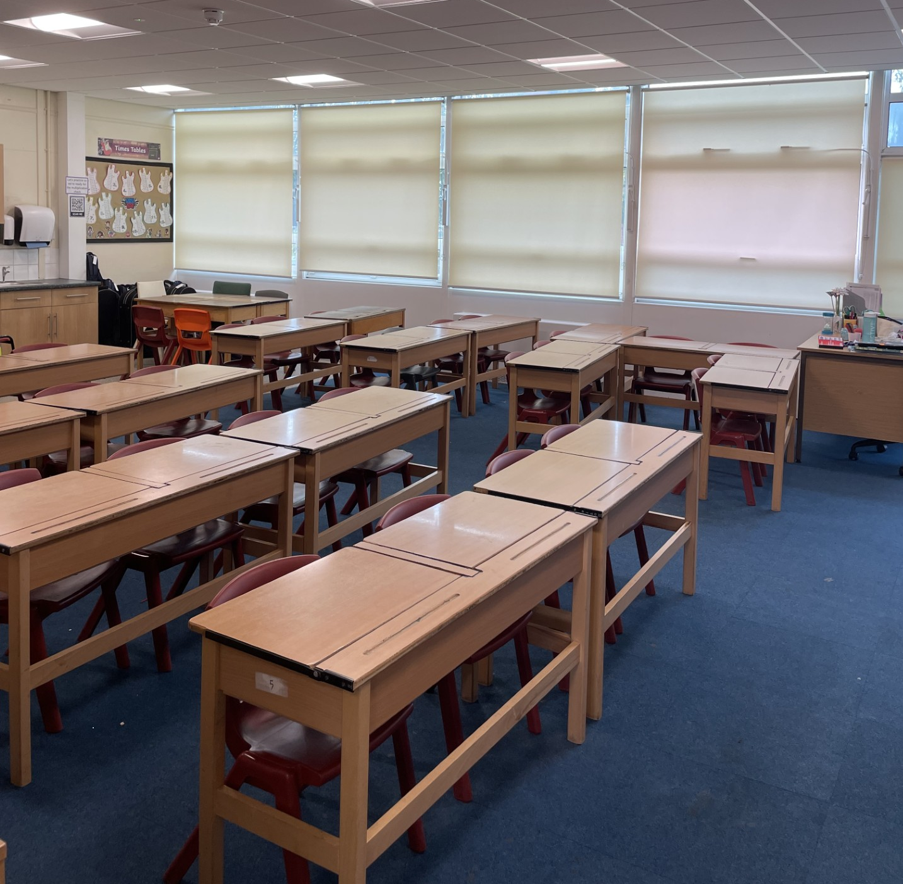
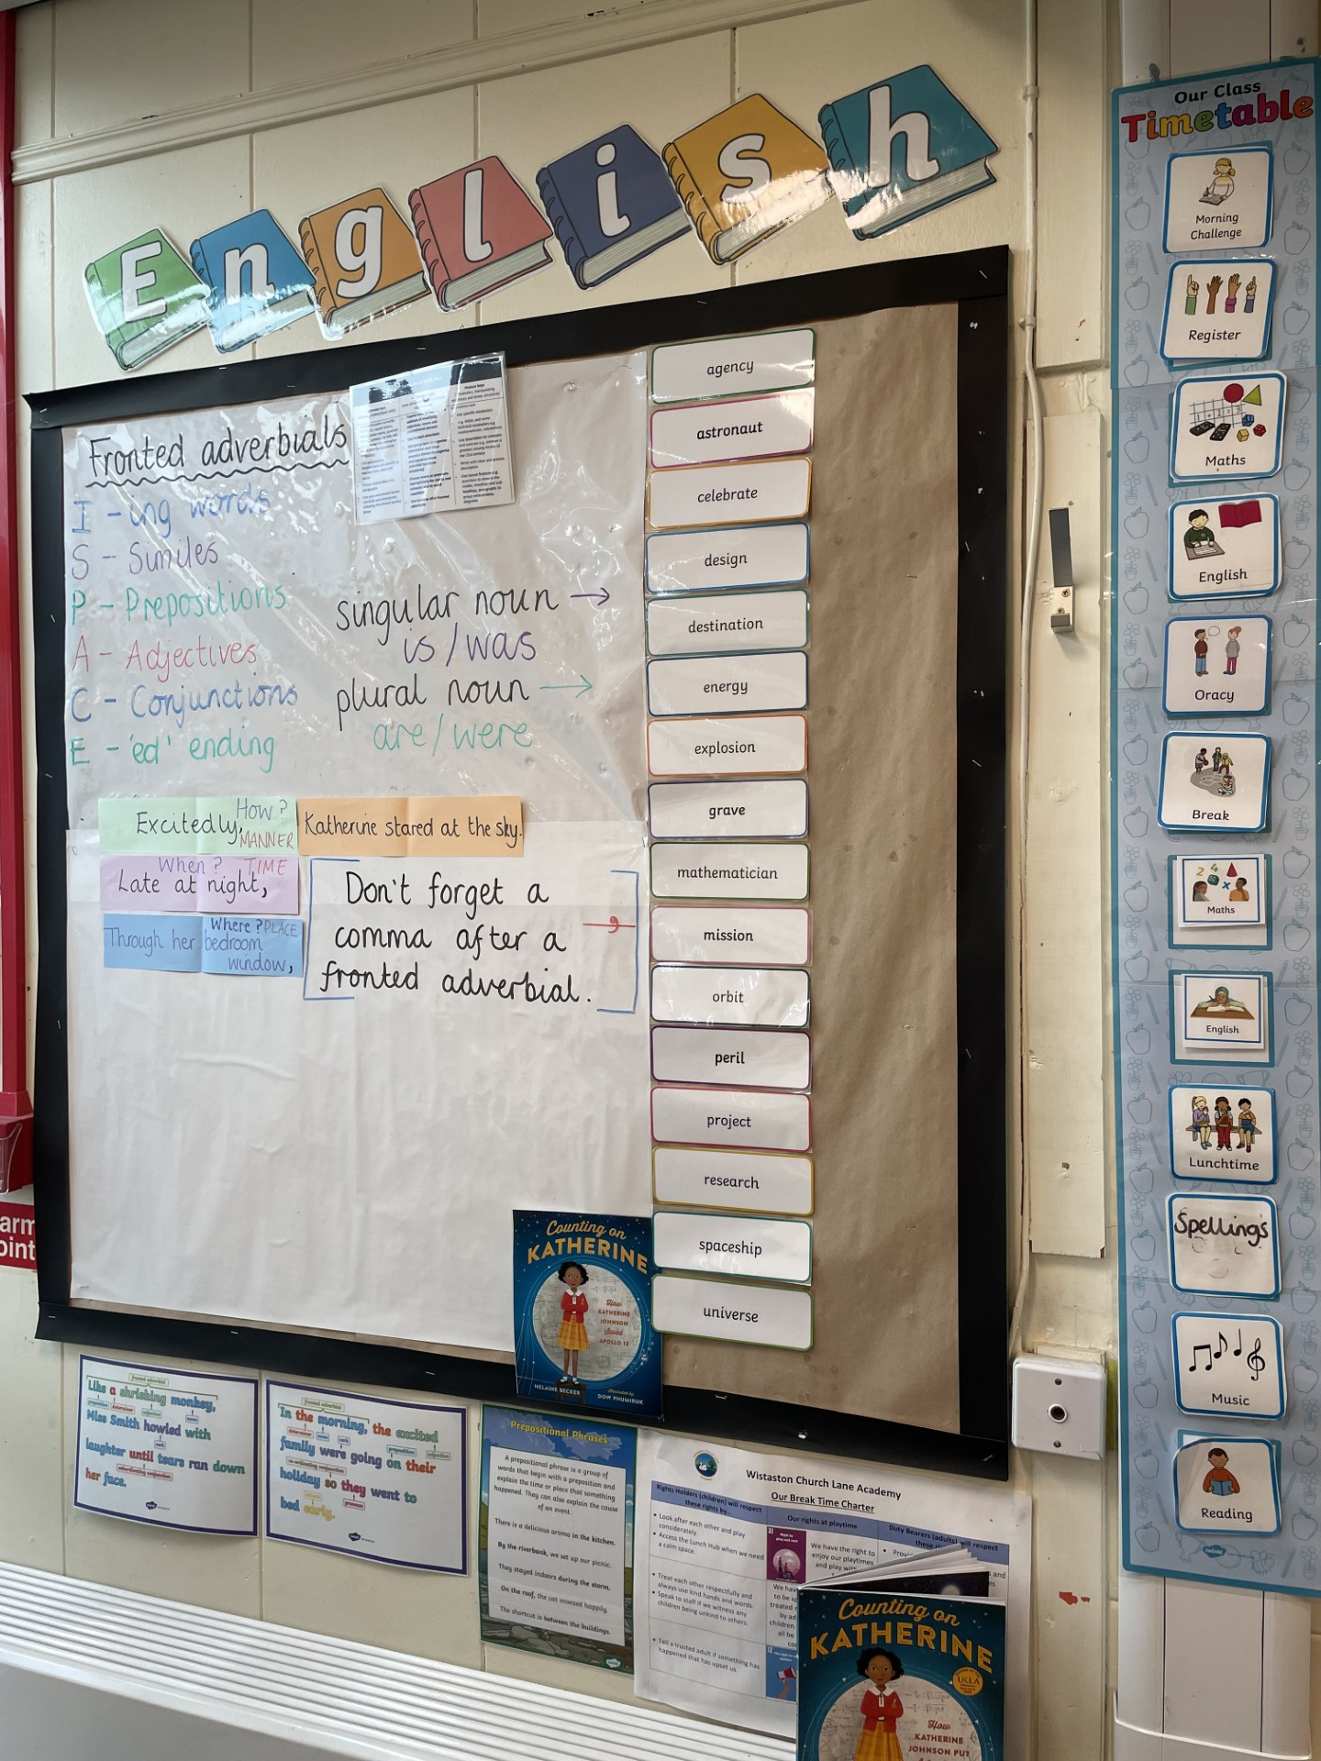
Mexico City

Slide 5
Procedures for Contacting Staff
First point of call: for quick messages please use your child’s planner. This is the most effective way of getting a message to your child’s class teacher.
Important messages: if you wish to speak confidentially to a member of staff over a concern relating to your child, please email the school office. All enquiries will be passed on to the appropriate member of staff and you will be contacted within two days to discuss the issue or arrange a meeting if necessary.
Notes:
KN
5

Slide 6
Communication
School Website: The website will be updated with: events, dates, clubs, curriculum, forms and class information.
Newsletter: Newsletters will be updated every week with information of the children’s learning and important dates
Text Messages: These are sent as reminders and to inform you of important information.
Parents Evenings: Take place in the Autumn and Spring term (Dates posted on the online calendar PLEASE NOTE Extra Curricular Clubs do NOT run on these evenings to allow all staff to sufficiently prepare).
Reports: Report at end of Summer term.
Notes:
KN
6

Slide 7
Our Golden Rules
Notes:
KN
7

Slide 8
High Expectations
Behaviour – Be Ready, Be Respectful, Be Safe
Punctuality – coming to school on time. Be a HERO!
Attendance – making sure you are here every day, if not this should be communicated with the school office.
Uniform – Neatness and Presentation (PE kit and School uniform)
Notes:
KN
8

Slide 9
High Expectations
Be a HERO!
Here
Everyday
Ready
On time
Notes:
KN
9

Slide 10
Homework
Homework is made up of the following elements:
Reading: Please record reading on Pageticker.
Spelling: 10 words from the Pathways to Spell spelling scheme. Spelling test is every Thursday.
Times tables: TTRS – 15mins a week.
Notes:
KN
10

Slide 11
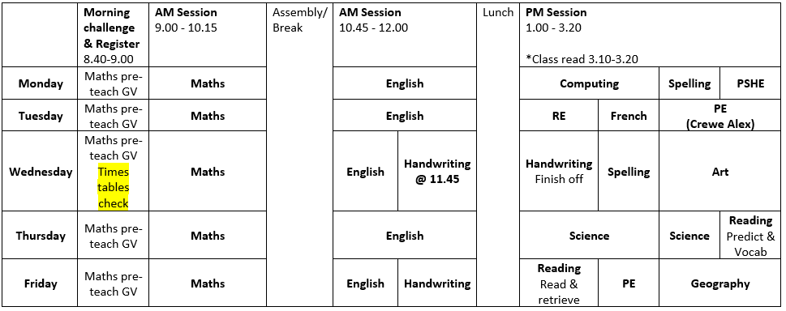
Our Week
Notes:
EJ
11

Slide 12
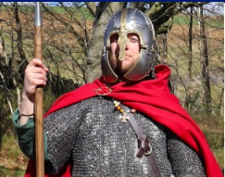
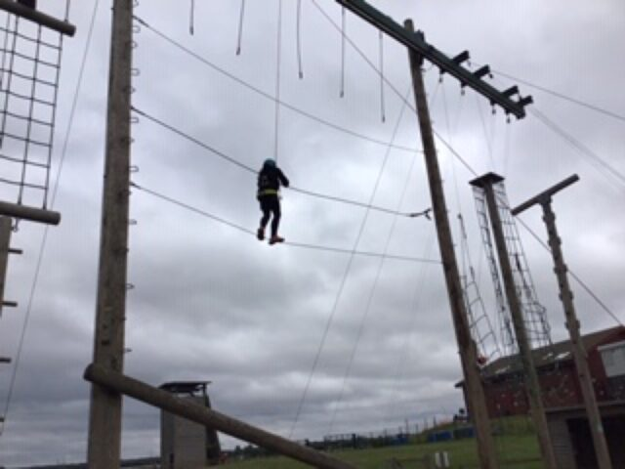
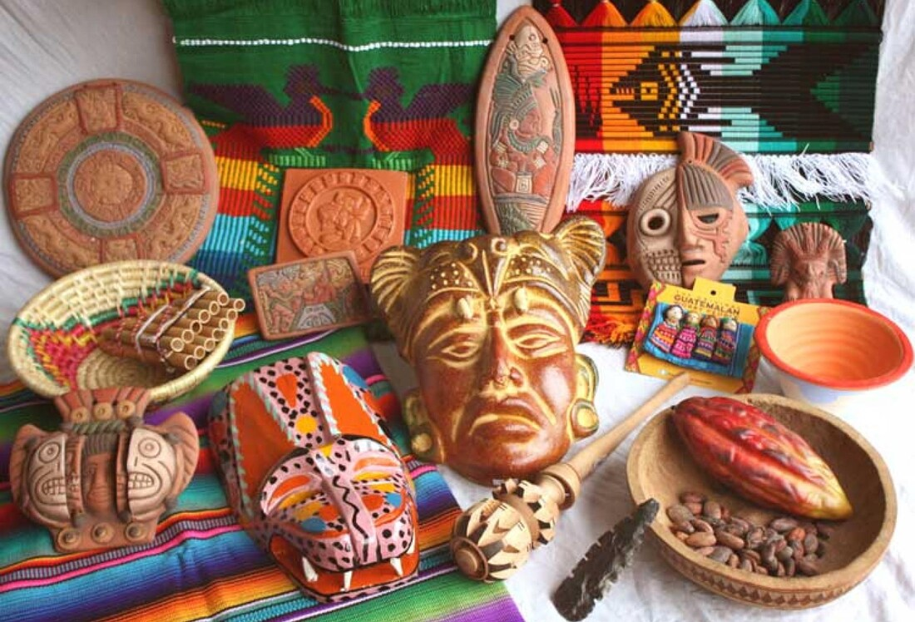

Visits and Visitors
13th-15th January Whitemoor Lakes Residential
March/April (date TBC) Dewa Centre, Chester
24th March Year 4 Bikeability (in school)
May 2025 (date TBC) Mayan Workshop (in school)
Notes:
KN
12

Slide 13

We look forward to the following year ahead! Thank you for all your continued support. Your children are making exceptional progress and we are extremely proud of them.
Notes:
EJ
13

