Slide 1


Welcome to Cygnets
Paris – Mrs Rimmer
2026- 2027

Slide 2
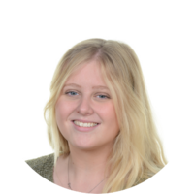
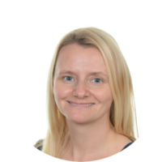

Meet the Team
Class teacher: Mrs Rimmer
Class support staff: Mrs Plant (am), Ms Boschi , Mrs Ladley(pm)
Notes:
KN
2

Slide 3
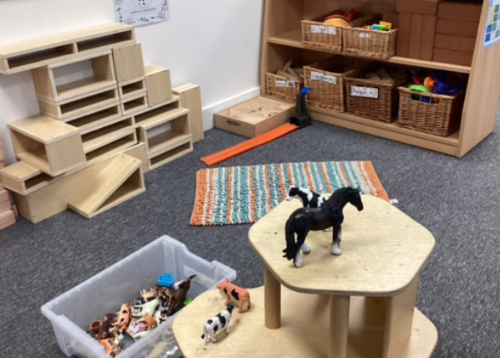
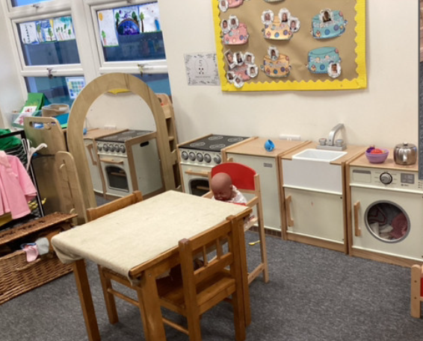
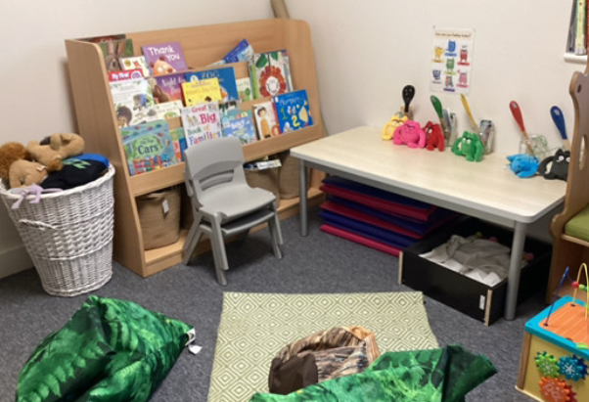
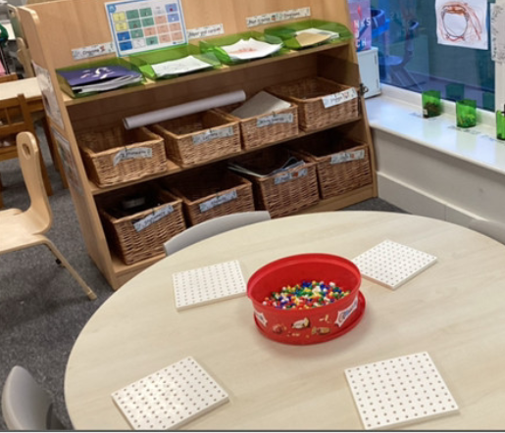
Cygnets nursery

Slide 4
Procedures for Contacting Staff
First point of call: Please speak to Mrs Rimmer or staff during drop off and pick up times.
Important messages: if you wish to speak confidentially to Mrs Rimmer over a concern relating to your child, please email the school office. All enquiries will be passed on to the appropriate member of staff and you will be contacted within two days to discuss the issue or arrange a meeting if necessary.
Notes:
KN
4

Slide 5
Communication
School Website: The website will be updated with: events, dates, clubs, curriculum, forms and class information.
Newsletter: Newsletters will be updated every week with information of the children’s learning and important dates
Text Messages: These are sent as reminders and to inform you of important information.
Parents Evenings: Take place in the Autumn and Spring term
Reports: Report at end of Summer term.
Notes:
KN
5

Slide 6
Our Golden Rules
Notes:
KN
6

Slide 7
What to bring
Nursery starts at 8:45am each day. Please make sure your child brings:
A named water bottle
A coat
Spare clothes in a named bag and welly boots to keep in school for muddy play
Lunch bag /If child requires school lunch please order or Arbor or tell the staff the lunch choice during drop off
If you are running late please note you need to sign in at the office first then come to nursery
Notes:
KN
7

Slide 8
Tapestry
Please ask for activation link in the office and fill the permission forms.
We post adventures weekly , some will be group posts , some individual.
Please contribute on too as we use tapestry and children’s experiences with families in activities
Notes:
KN
8

Slide 9
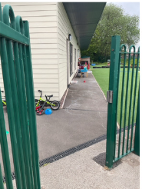
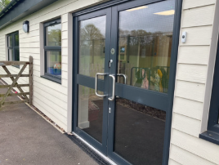
Pick up times
Full day sessions – 3.15pm from the garden door
Morning session- 11.45am from garden door
Monday session – 12.45pm from double doors
Notes:
KN
9

Slide 10
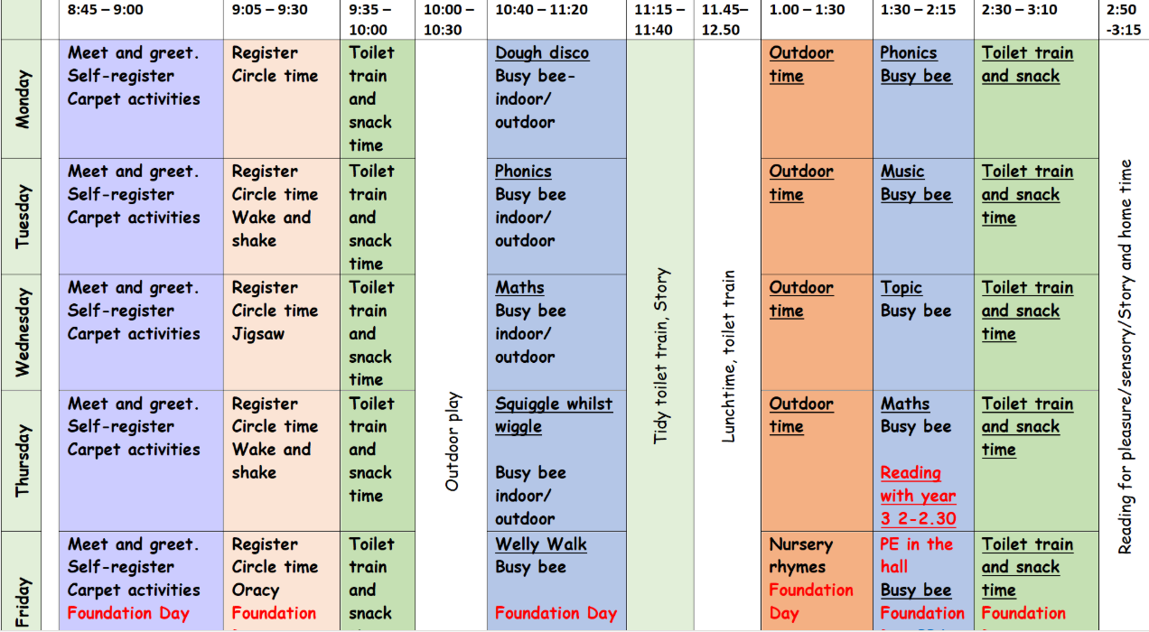
Our Week
Notes:
EJ
10

Slide 11
During the week
Physical activities are on Friday – please wear jogging bottoms and trainers – full pe kit is not required
PPA- Mrs Rimmer planning time is on Friday afternoon- Mr Farrell will be teaching then.
Welly walks are on Friday - please provide welly boots and coat
Notes:
KN
11

Slide 12
We are delighted to welcome you to our Nursery and look forward to meeting all of the children.
We can't wait to meet you all and begin a fun-filled year together!
Notes:
EJ
12

