Slide 1
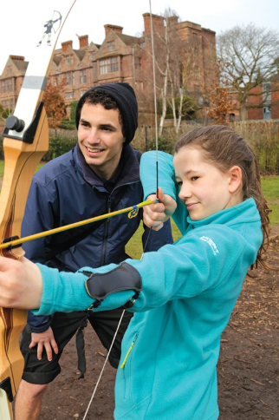
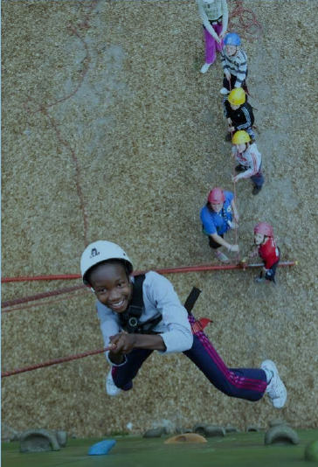
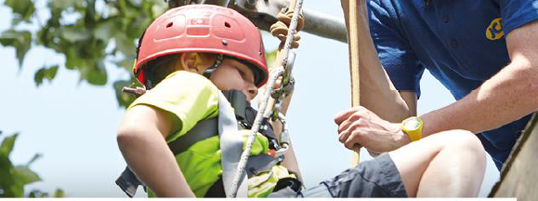
YEAR 6 PARENT/CARER

Slide 2
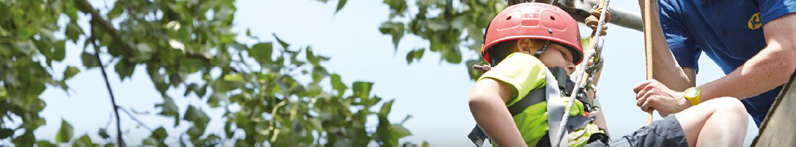
Our Year 6 residential this year is to Condover Hall, which is located in the village of Condover, 4 miles south of Shrewsbury.
Dates: 24th March – 26th March
We will leave school on the 24th March. Children should come in at normal time on this day, in non-uniform. We will be leaving school at 12:30 so children can have packed lunch or school lunch as usual.
We will return on the 26th at 3.20pm (traffic dependent).

Slide 3
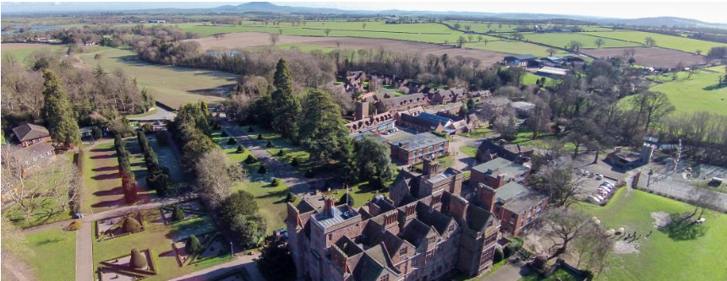
Condover Hall is JCA Adventure’s flagship activity centre centred around an Elizabethan Manor house in the middle of a conservation area.
https://www.jca-adventure.co.uk/wp-content/uploads/condover-hall-drone-video.mp4

Slide 4
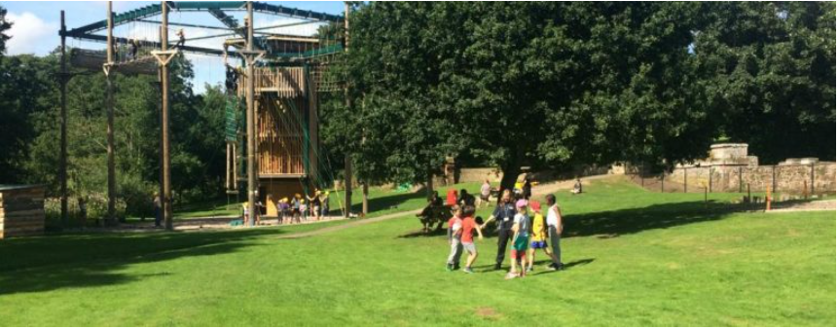
During our time there the children will participate in a combination of outdoor and indoor activities which will be confirmed nearer to our departure date.
Examples of some of the 41 activities available that they could participate include:
Robotics workshop
Outdoor survival
Lazer conquest
Buggy building

Slide 5
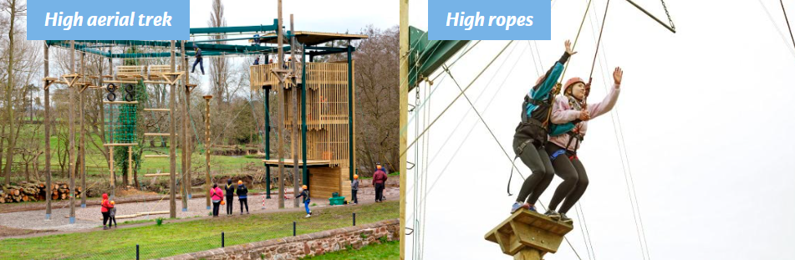

All activities will be led by JCA fully trained and qualified instructors, supported by school staff.
Children will be placed in groups (between 10 and 12) and will have a dedicated instructor for the entire duration of our trip, unless a specially qualified instructor is required.
This allows instructors to get to know the strengths, weaknesses and personality of each child, supporting children in getting the most out of their time on the residential.

Slide 6
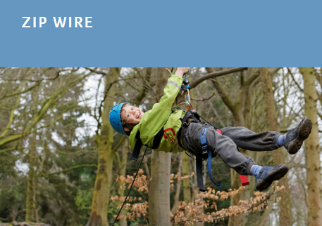

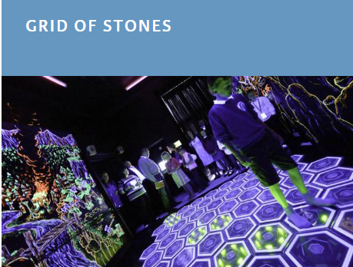
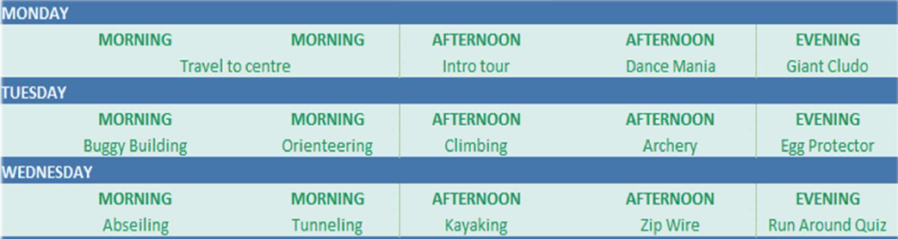
This is an example of a typical timetable at the centre.

Slide 7
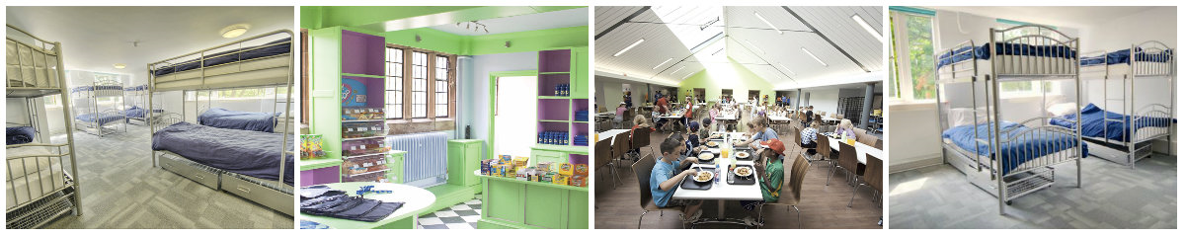
Our accommodation will be in a dedicated wing, in dormitory style rooms (up to a maximum of 6 children).
Bedding is provided by the centre.
All personal items must be named and packed in suitcase/bag that the child can carry to their accommodation by themselves.
A kit list will be sent out nearer the departure date once the activities have been confirmed. NO ELECTRONICS (INCLUDING PHONES) OR JEWELLERY PLEASE.

Slide 8
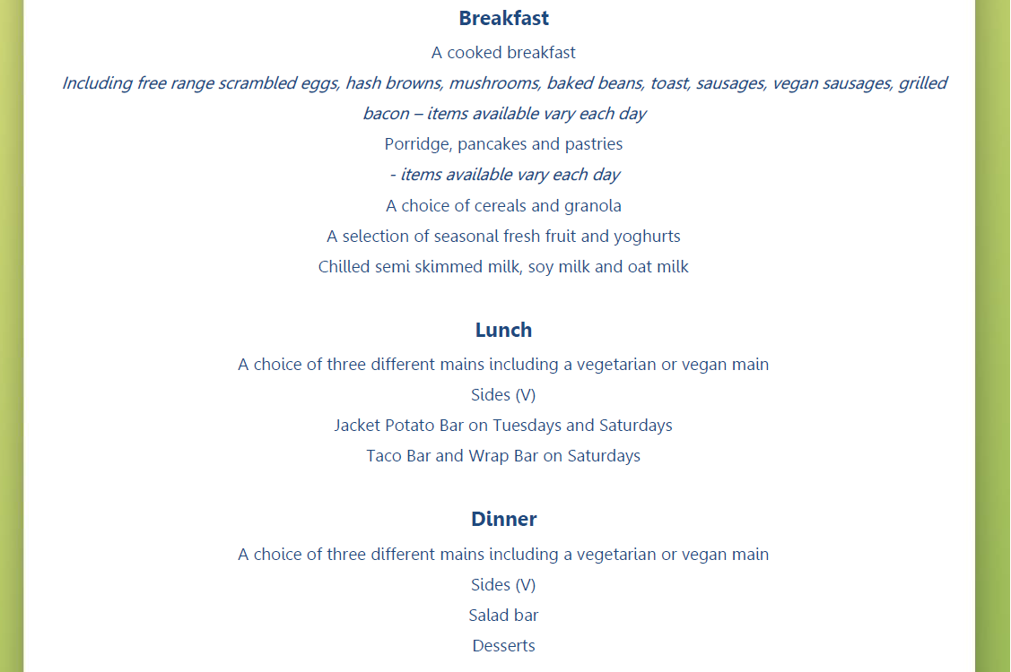
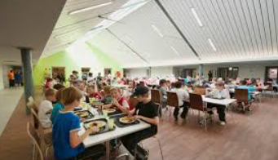
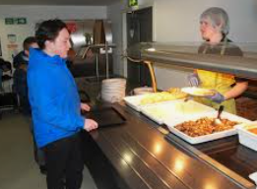
Here is a sample menu:

Slide 9
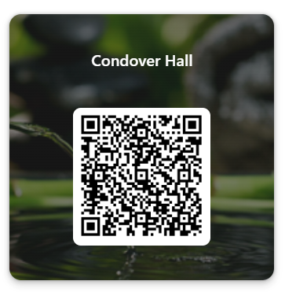
If you have any further questions, please scan the QR Code and we will respond as soon as possible.
Year 6 staff are visiting Condover Hall at the end of January and so we will confirm with JCA Adventure any questions we are unable to answer at this time.
In the meantime, if you would like any more information, please check out Condover Hall’s website.
https://www.jca-adventure.co.uk/activity-centres/condover-hall/

