Slide 1
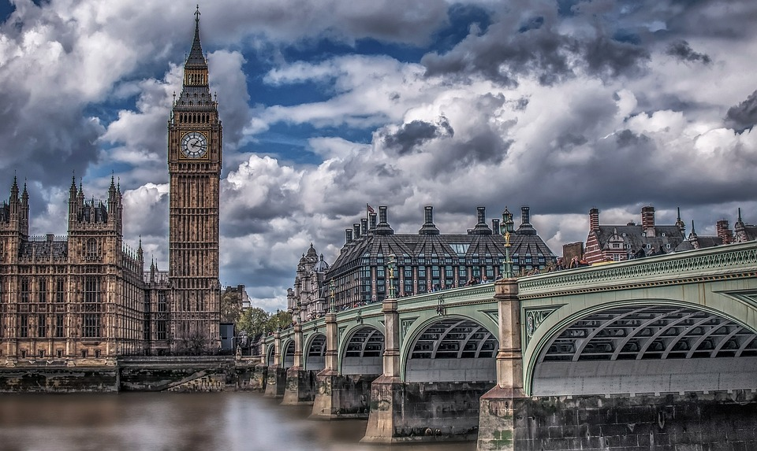
Year 6 Residential - London 2025

Slide 2
Key Info
Leave on Wednesday 15th October
Return on Friday 17th October
Staff attending
Mrs Watson – Designated Safeguarding Lead
Mrs Dunbobbin – First aider
Miss Smith
Mrs Young – First aider
Mr Farrall – First aider
Mr Hastings

Slide 3
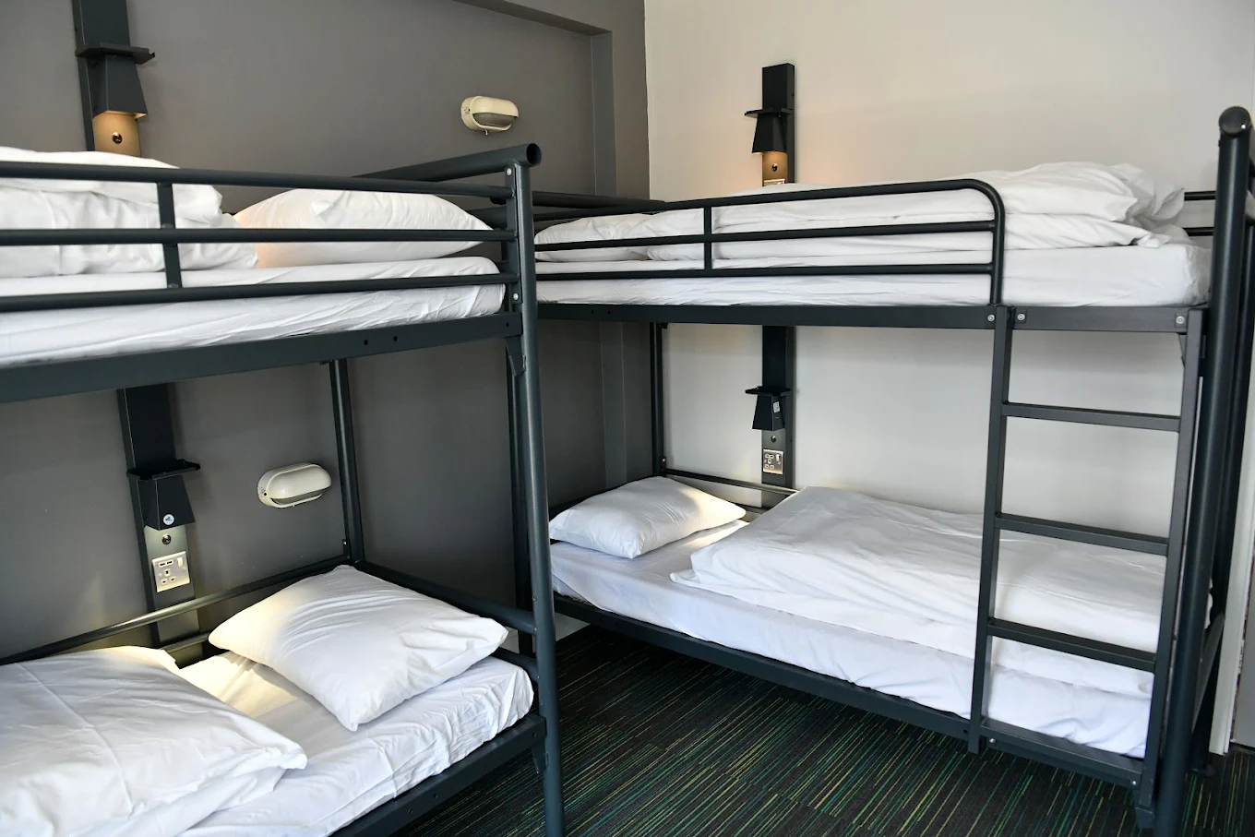
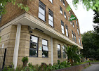
Key Info: Accommodation
YHA London Thameside
Familiar with having school groups of this age
Electronic keyed doors for access to each floor and room
Teacher’s rooms will be interspersed with
children’s rooms and all children will know
which room to go to in an emergency.

Slide 4
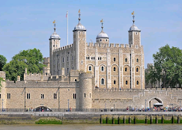
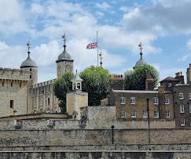
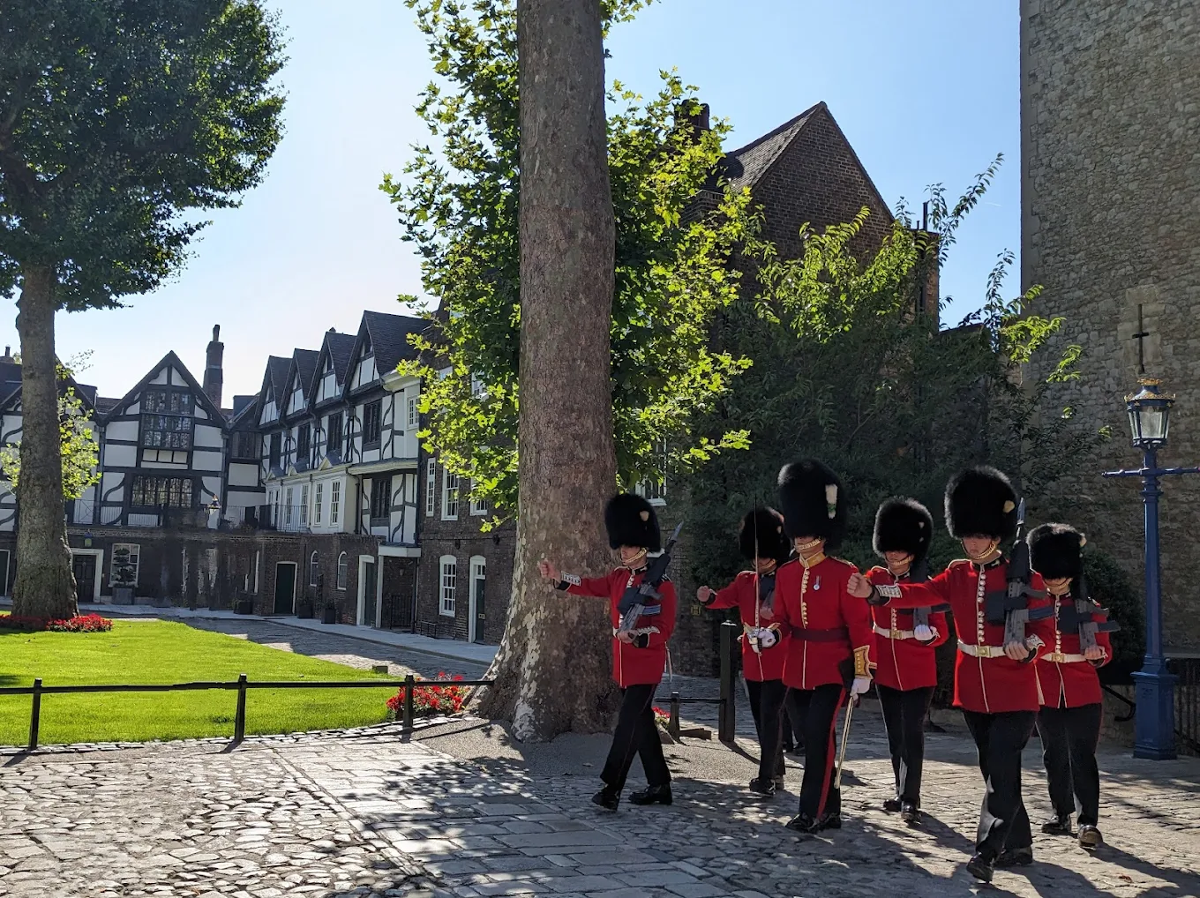
Day 1
Be in school for 8:15am for prompt 8.30am departure
Packed lunch will be eaten when we arrive at Tower of London
Explore Tower of London and take in the history
Coach pick up and head to the youth hostel
Children will need to make their own beds – please practise!
Evening meal at the hostel
Guided walking tour in the evening
This Photo by Unknown Author is licensed under CC BY-SA

Slide 5
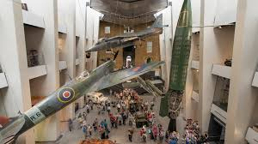
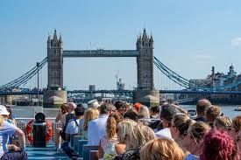
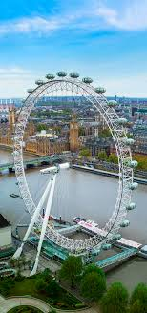
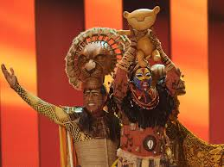
Day 2
Breakfast at Youth Hostel
Coach drop off at Imperial War Museum
Packed lunch provided by hostel
Walk to River cruise
Enjoy a circular river cruise
London Eye
Coach return to the hostel for evening meal
Lion King
Coach journey back to the hostel
This Photo by Unknown Author is licensed under CC BY-SA

Slide 6
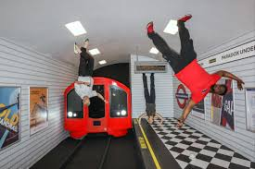

Day 3
Breakfast at Youth Hostel
Visit to The Paradox Museum
Lunch provided by the Youth hostel
Coach journey back to school
Arrive back at 5pm – collection behind barrier in car park

Slide 7
Further details
Meals will be provided except for a packed lunch on the first day. Please could you send a packed lunch in a disposable bag.
Children will need to bring a rucksack with their lunch in, a waterproof coat and a refillable water bottle.
All items need to be NAMED (including clothes)
Children to pack their own case with clothes for 3 days (suitable for the weather) and will require comfortable shoes
This needs to be packed in a small suitcase/holdall that they are able to carry independently. Please being your own towels as they not provided.
NO ELECTRONICS/MOBILE MOBILES/AIRTAGS.
All medication to be handed to Mrs Young on the day of departure in a sealed container with appropriate medical forms. She will collect these at the year door on arrival.
Minimal spending money is required - £20 maximum.

