Slide 1
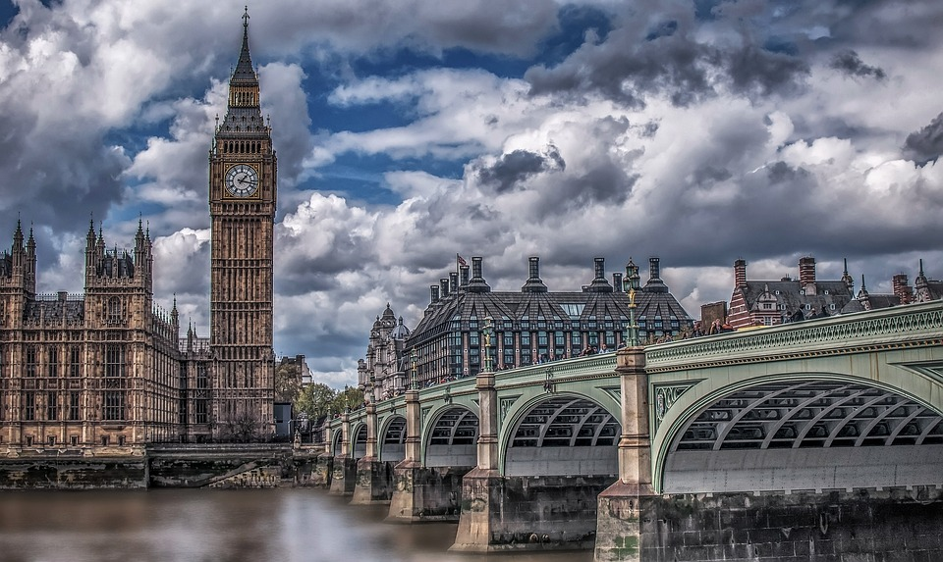
Year 6 Residential - London 2026

Slide 2
Key Info
Leave on Wednesday 30th September
Return on Friday 2nd October
Staff attending
Mrs Watson – Designated Safeguarding Lead
Mrs Dunbobbin – Trip lead/EVC/first aider
Miss Willington – Safeguarding team
Miss Blackledge - First aider
Mr Farrall – First aider
1 other (TBC)

Slide 3
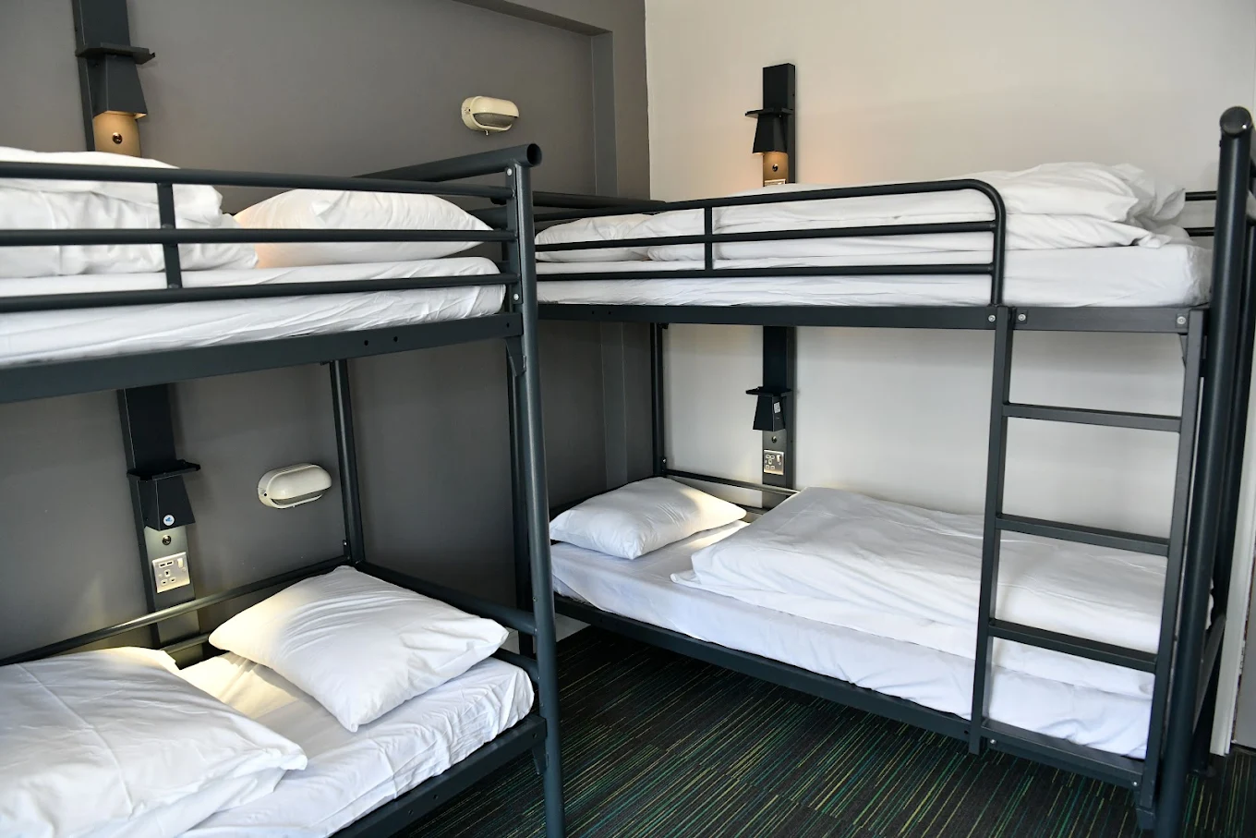

Key Info: Accommodation
YHA London Thameside
Familiar with having school groups of this age
Electronic keyed doors for access to each floor and room
Dormitory-style room with bunk beds and ensuite.
Number of beds per room ranges from 2 to 8.
Teacher’s rooms will be interspersed with
children’s rooms and all children will know
which room to go to in an emergency.

Slide 4
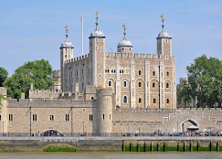
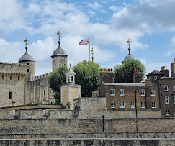
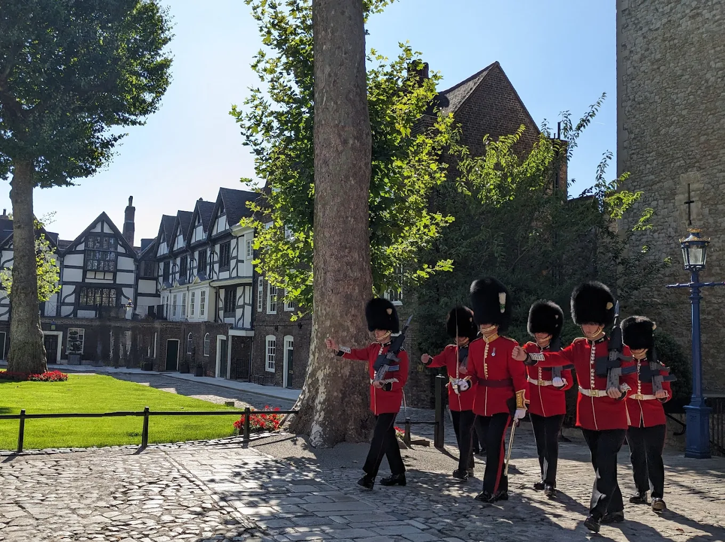
Day 1
Be in school for 8:15 am for a prompt 8.30 am departure
Packed lunch will be eaten when we arrive at Tower of London
Explore Tower of London and take in the history
Opportunity to visit gift shop, so pack any spending money in rucksack
Coach pick-up and head to the youth hostel
Children will need to make their own beds – please practise!
Evening meal at the hostel
Guided walking tour in the evening
This Photo by Unknown Author is licensed under CC BY-SA

Slide 5
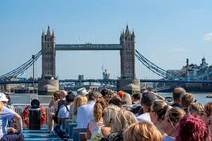
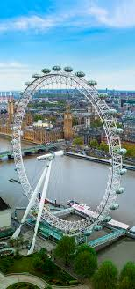
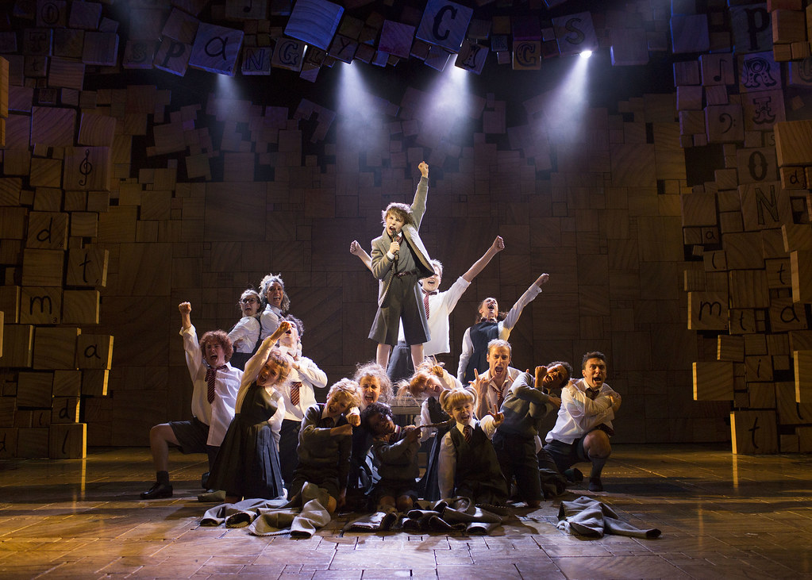
Day 2
Breakfast at Youth Hostel
Coach to Science Museum (Wonderlab and Wonder Show)
Packed lunch provided by hostel
Walk to River cruise (weather dependent)
Enjoy a circular river cruise
London Eye
Coach to Pizza Express
Walk to Cambridge Theatre to see Matilda
Matilda
Coach journey back to the hostel
This Photo by Unknown Author is licensed under CC BY-SA

Slide 6
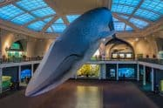

Day 3
Breakfast at Youth Hostel
Coach to Natural History Museum
Lunch provided by the Youth hostel
Coach journey back to school
Arrive back at 4.30 pm – collection behind barrier in car park

Slide 7
Further details
Meals will be provided except for a packed lunch on the first day. Please could you send a packed lunch in a disposable bag
Children will need to bring a rucksack with their lunch in, a waterproof coat, a refillable water bottle and a purse/wallet with spending money (optional)
All items need to be NAMED (including clothes)
Children to pack their own case with clothes/toiliteries for 3 days (suitable for the weather) and will require comfortable shoes
This needs to be packed in a small suitcase/holdall that they are able to carry independently. They need to bring their own towel, as one is not provided.
NO ELECTRONICS/MOBILE PHONES/AIRTAGS
All medication to be handed to Mr Farrall or Miss Blackledge on the day of departure in a sealed container with appropriate medical forms. They will collect these at the year 6 door on arrival. Forms will be handed out the week before, so discuss with your child which form(s) they need – prescribed or non-prescribed.
Minimal spending money - £20 maximum. This is optional
Text updates will be sent during the trip (signal dependent)

Slide 8
Any questions?

