Slide 1


Welcome to Year 3
Seoul (mrs Horan) & tokyo (Miss hillard)
2026 - 2027

Slide 2
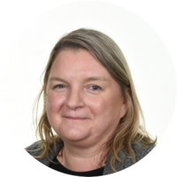
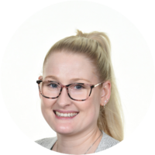
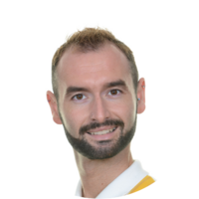
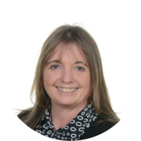
Meet the Team
Class teachers: Mrs. Horan & Miss Hillard
Class support staff: Mr Farrall and Mrs Simpson
Notes:
KN
2

Slide 3
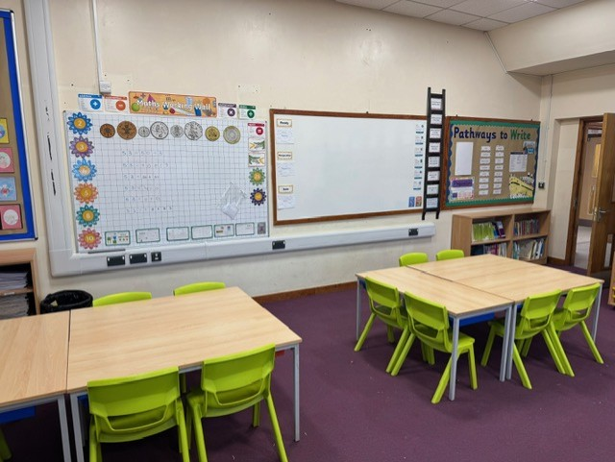
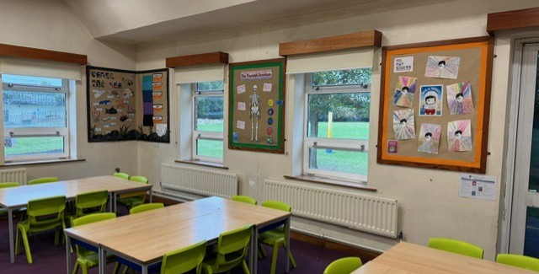
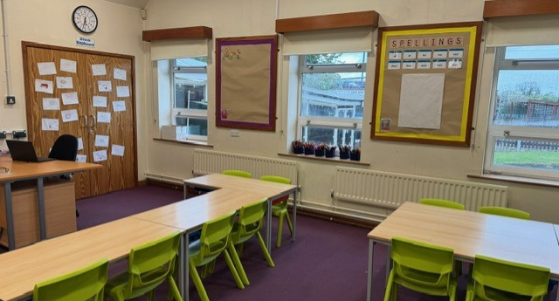
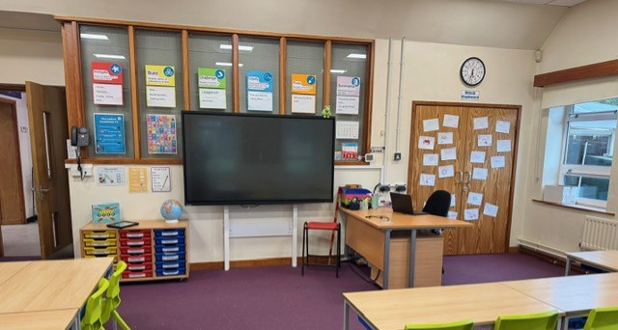
THE LEARNING ENVIRONMENT - Seoul

Slide 4
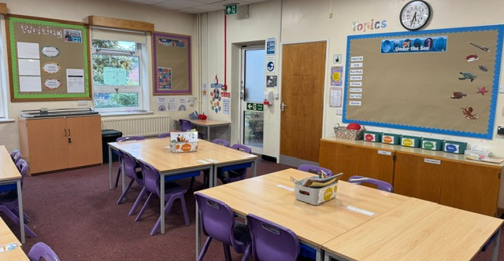
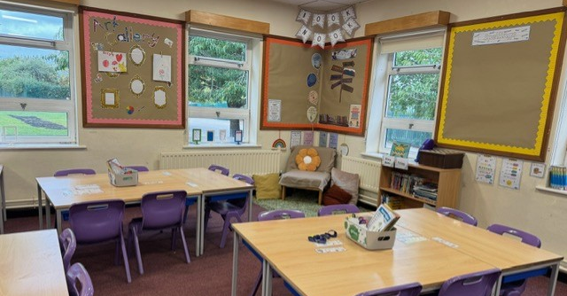
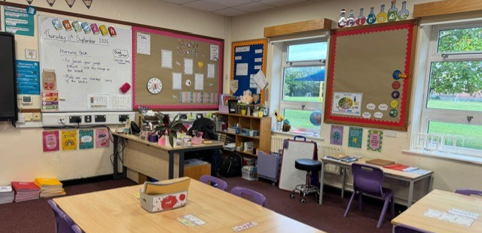
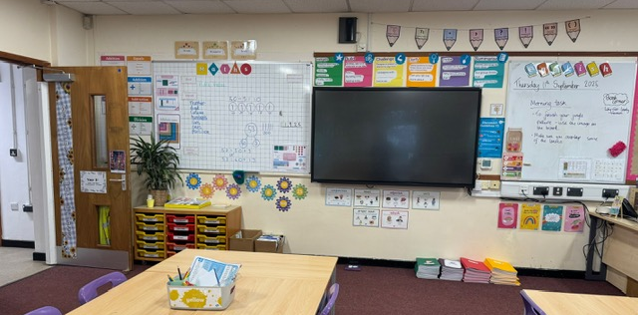
THE LEARNING ENVIRONMENT - tokyo

Slide 5
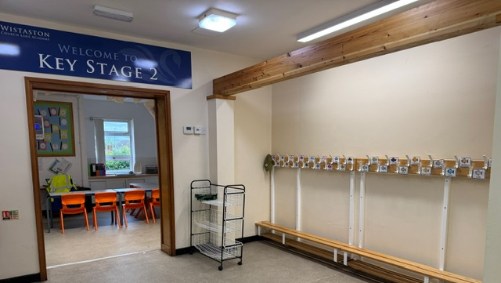
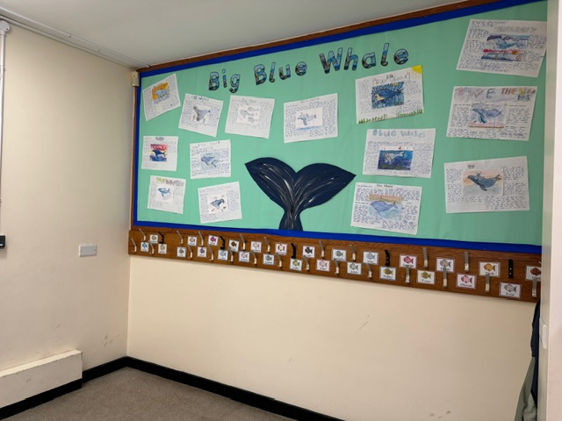
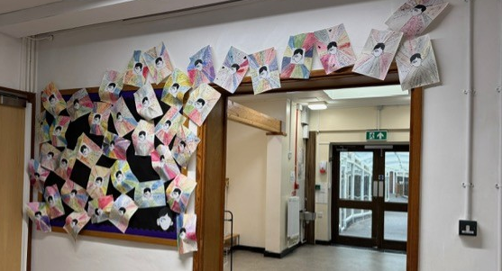
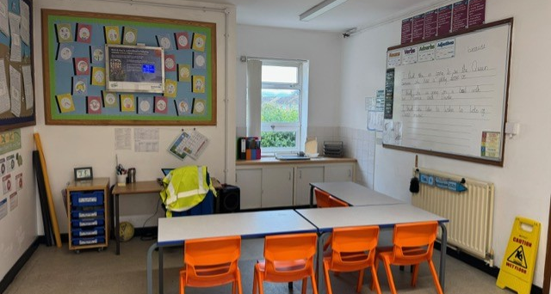
THE LEARNING ENVIRONMENT – shared area

Slide 6
Procedures for Contacting Staff
First point of call: For quick, non-urgent messages, please pass these on to staff on the door in the morning, but preferably all messages should be emailed to the office. You can also come and speak to us at the end of the day to pass on any messages or ask us a question.
Important messages: If you wish to speak directly to a member of staff, please email the school office. All enquiries will be passed on to the appropriate member of staff who will contact you ASAP and can arrange a meeting or call if necessary.
Notes:
KN
6

Slide 7
Communication
Learning Posters: These will be emailed out each week to let you know what we are learning about, any important messages and the weekly spelling list.
School Website: The website will be updated with: events, dates, clubs, curriculum, forms and class information.
Newsletter: Newsletters will be updated every week with information of the children’s learning and important dates and will be emailed out by the office team.
Text Messages: These are sent as reminders and to inform you of important information.
Parents Evenings: These take place in the Autumn and Spring terms. (Extra Curricular Clubs will NOT run on these evenings to allow all staff to sufficiently prepare).
Reports: Report will be sent out at the end of Summer term.
Notes:
KN
7

Slide 8
Our Golden Rules
Notes:
KN
8

Slide 9
High Expectations
Behaviour – Be Ready, Be Respectful, Be Safe
Punctuality – Please aim to arrive at school ready and on time. (Be a HERO!)
Attendance – Attending school regularly is important, but if for some reason your child is absent, please inform the school office.
Uniform – Neatness and presentation (PE kit and school uniform).
Notes:
KN
9

Slide 10
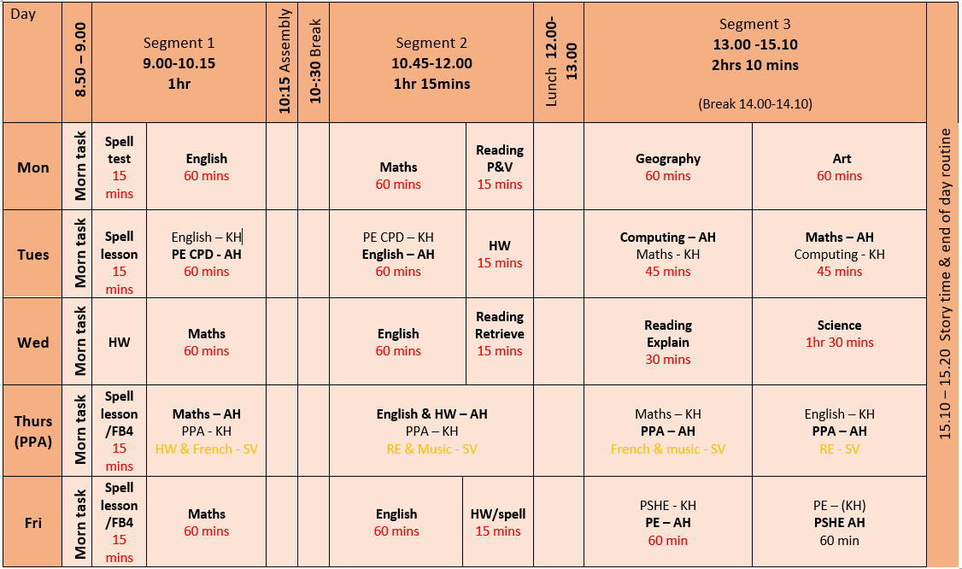
Our Week
Notes:
EJ
10

Slide 11
Visits and Visitors
Sea Life Centre (under the sea) – November (date to be confirmed)
Burwardsley Forest (Stone-age day) – March (date to be confirmed)
Egyptian visitor – Summer Term 2027 (date to be confirmed)
Other local visits/visitors
Notes:
KN
11

Slide 12
Homework
Homework is made up of the following elements:
Reading: Recording on Pageticker at least 3 times per week from a parent/guardian. Reading records will be checked regularly.
Spelling: These will be sent out each week on the learning poster and should be practised in preparation for our test on Mondays.
Times tables: TTRS – 15 mins a week.
Notes:
KN
12

Slide 13

We are really looking forward to the year ahead. Thank you for your continued support. Your children are making exceptional progress and we are extremely proud of them.
Notes:
EJ
13

