Slide 1


Welcome to Year 5
Los Angeles (Miss Harvey) and Atlanta (Miss Smith)
Mrs Dyde and Mrs Machin will be working across both classes.
2026 - 2027

Slide 2
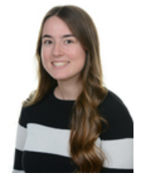
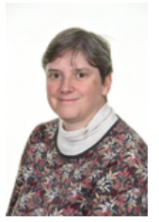
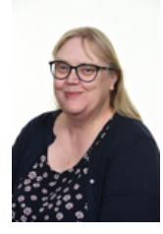
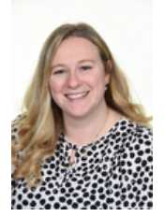
Staff
Los Angeles – Miss Harvey
Atlanta – Miss Smith
The teaching assistants working across Year 5 are Mrs Machin and Mrs Dyde.
Notes:
in

Slide 3
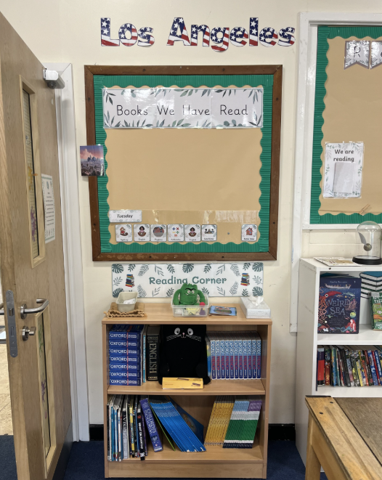
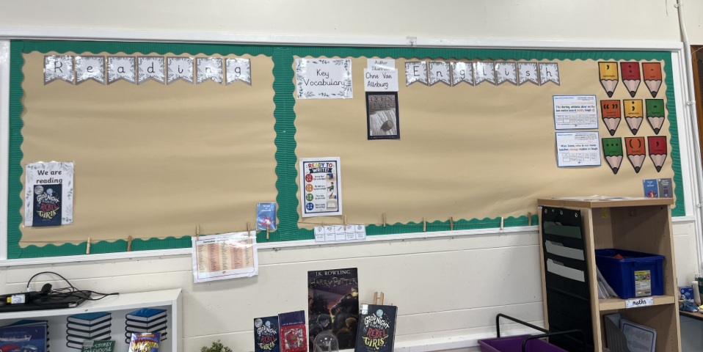
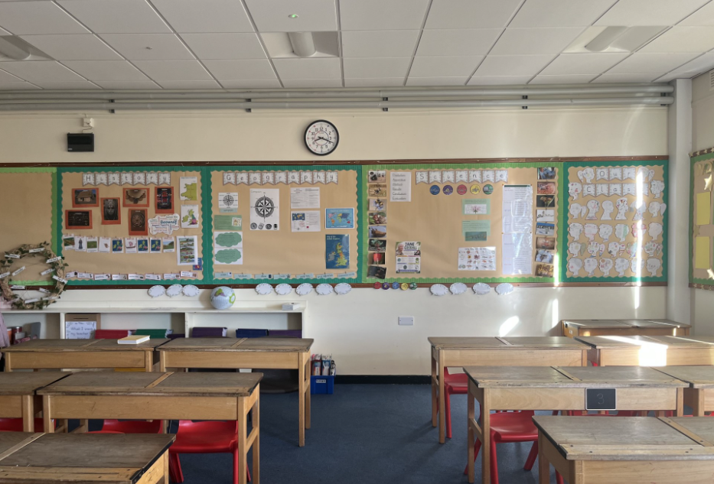
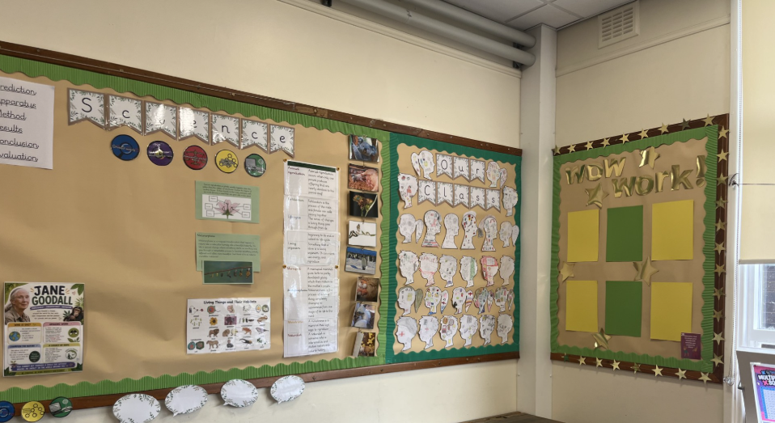
Los Angeles
Notes:
in

Slide 4
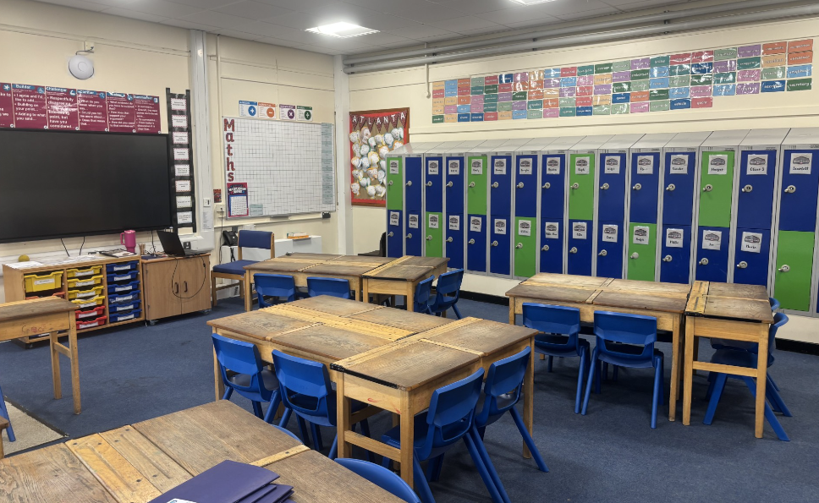
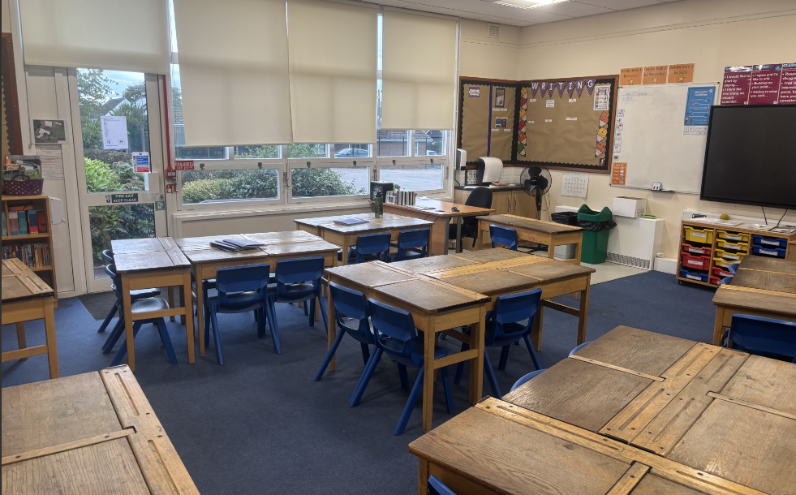
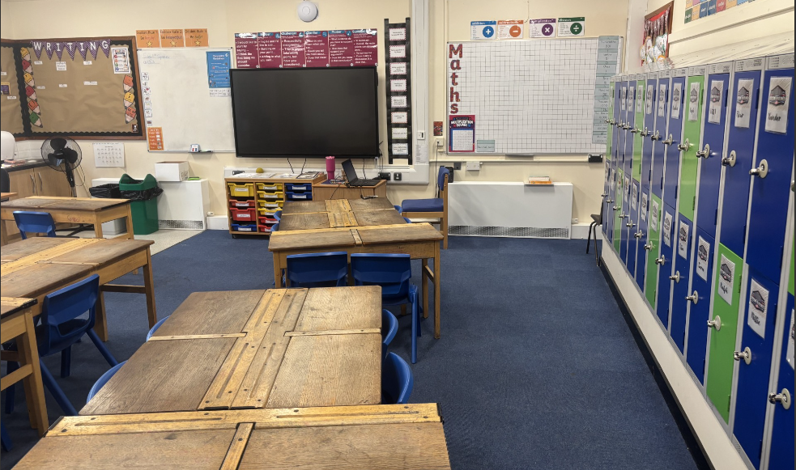
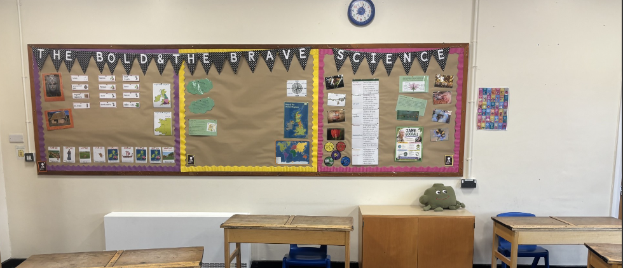
Atlanta
Notes:
in

Slide 5
Procedures for Contacting Staff
First point of call: for quick messages please email the school office, this is the most effective way of getting a message to your child’s class teacher.
Important messages: if you wish to speak confidentially to a member of staff over a concern relating to your child, please email the school office. All enquiries will be passed on to the appropriate member of staff and you will be contacted within two days to discuss the issue or arrange a meeting if necessary.
Notes:
KN
5

Slide 6
Communication
School Website: The website will be updated with: events, dates, clubs, curriculum, forms and class information.
Newsletter: Newsletters will be updated every week with information of the children’s learning and important dates
Text Messages: These are sent as reminders and to inform you of important information.
Parents Evenings: Take place in the Autumn and Spring term (Dates posted on the online calendar PLEASE NOTE Extra Curricular Clubs do NOT run on these evenings to allow all staff to sufficiently prepare).
Reports: Report at end of Summer term.
Notes:
KN
6

Slide 7
Our Golden Rules
Notes:
KN
7

Slide 8
High Expectations
Be a HERO!
Here
Everyday
Ready
On time
Notes:
KN
8

Slide 9
Homework
Homework is made up of the following elements:
Reading: Record reading on Pageticker 3 times a week. Books will be changed as required.
Spelling: 10 words from the Pathways to Spell spelling scheme. Spelling test is every Friday.
Times tables: TTRS – 15 active mins a week.
Notes:
KN
9

Slide 10
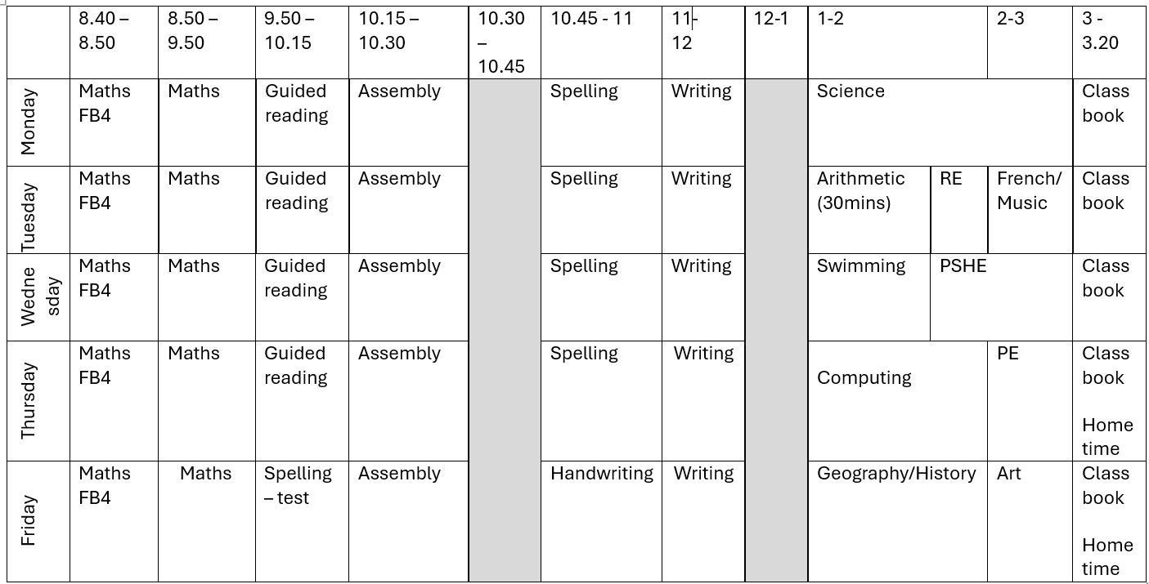
A Typical Week
Notes:
EJ
10

Slide 11
Visits and Visitors
Tatton Park – Tatton Park – Anglo Saxon Day.
Bikeability – 8th and 9th February
Primary College – WC 5th July - exact date tbc.
Notes:
KN
11

Slide 12
Mobile Phones/ Walking Home
Some children may bring a mobile phone into school if they are walking home, but parents/carers will need to give consent for Y5. If you have any issues, please speak to the school office.
Children are unable to leave the school grounds or bring a phone in without these updated forms.
All phones need to be switched off on arrival outside the school gates and handed into the class teacher during the day. Phones are handed back out at the end of the day and should not be switched on until your child leaves the school grounds.
Notes:
in

Slide 13

We look forward to the following year ahead! Thank you for all your continued support. Your children are making exceptional progress and we are extremely proud of them.
Notes:
EJ
13

